Slide 1

Javascript

Slide 2
Agenda
What is JavaScript?
JavaScript Console
Datatypes in JavaScript
Variables
Operators
Conditional Statements
Loops
Functions
Types of Functions
Scope of Variables
Built In Functions- Strings/Arrays
Date/Math/Random Libraries

Slide 3
What is Javascript?
JavaScript is a text-based programming language used both on the client-side and server-side that allows you to make web pages interactive.

Slide 4
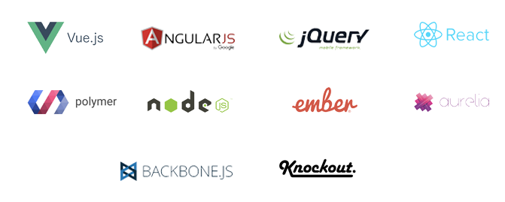
Javascript Frameworks

Slide 5
JavaScript Console
The console is an object which provides access to the browser debugging console.
The console object provides us with several different methods, like :
log()
error()
warn()
clear()
time() and timeEnd()
table()
count()
group() and groupEnd()
custom console logs

Slide 6
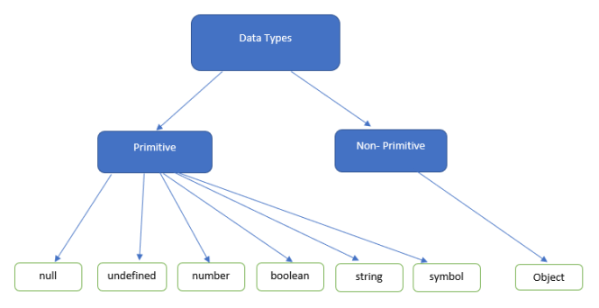
Datatypes in Javascript

Slide 7
Variables
Variables are used to store information to be retrieved and manipulated in the program.
A variable is a value that can change depending upon conditions or on the information passed to the program.

Slide 8
Variables Naming Conventions
Do not use JavaScript language Keywords such as class, if, do etc
Do not start with a digit 0,1,2,..9
Do not use special characters (%, &, *) except underscore and dollar.
Start with an alphabet/Underscore/dollar and followed by an alphabet or digits or underscore.
Can use uppercase or lowercase alphabets. However JavaScript is case sensitive.

Slide 9
Operators
JavaScript includes following categories of operators.
Arithmetic Operators
Comparison Operators
Logical Operators
Assignment Operators
Conditional Operators
Ternary Operator

Slide 10
Arithmetic Operators
Arithmetic operators are used to perform arithmetic on numbers:
Operator | Description
+ | Addition
- | Subtraction
* | Multiplication
** | Exponentiation
/ | Division
% | Modulus
++ | Increment
-- | Decrement

Slide 11
Comparison Operators
JavaScript provides comparison operators that compare two operands and return a boolean value true or false.
Operator | Description
=== | Compare with type.
!= | Not Equals to
> | Greater than
>= | Greater than or Equals to
< | Less than
<= | Less than or Equals to

Slide 12
Logical Operators
The logical operators are used to combine two or more conditions.
Operator | Description
&& | AND operator
|| | OR operator
! | NOT operator

Slide 13
Assignment Operators
JavaScript provides the assignment operators to assign values to variables with less key strokes.
Operator | Description
= | Assignment
+= | Add and Assign
-= | Subtract and Assign
*= | Multiply and Assign
/= | Divide and Assign
%= | Modulus and Assign

Slide 14
Ternary Operators
Ternary Operator assigns a value to a variable based on some condition. This is the short form of the if else condition.
var a = 10, b = 5;
var c = a > b? a : b; // value of c would be 10

Slide 15
Conditional Statements
In JavaScript we have the following conditional statements:
Use if to specify a block of code to be executed, if a specified condition is true
Use else to specify a block of code to be executed, if the same condition is false
Use else if to specify a new condition to test, if the first condition is false
Use switch to specify many alternative blocks of code to be executed

Slide 16
Loops
JavaScript supports different kinds of loops:
for - loops through a block of code a number of times
for/in - loops through the properties of an object
for/of - loops through the values of an iterable object
while - loops through a block of code while a specified condition is true
do/while - also loops through a block of code while a specified condition is true

Slide 17
Functions
A function allows you to define a block of code, give it a name and then execute it as many times as you want.
There are two types of functions:
Named Functions
Anonymous Functions

Slide 18
Scope of Variables
Local Scope
Global Scope
Block Scope

Slide 19
Built In Functions
String Functions
Array Functions

