Slide 1
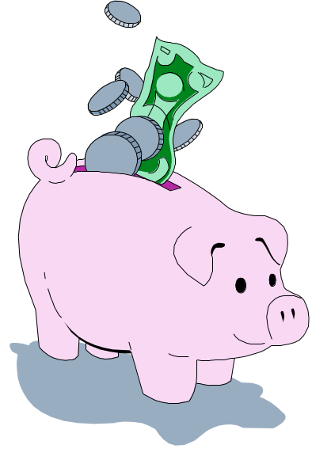
Off-Campus Living
*Most students choose to live in the dormitories. But, in some instances, living off-campus in a shared apartment could be cheaper.

Slide 2
Cooperative Housing
*Many colleges offer private, cooperative housing. At the University of California, living in a university co-op costs about half of what it costs to living in campus dorms.

Slide 3

Set a daily budget.
*Figure out how much money you will have for the month then divide that by the number of days in that month. That’s how much money you can spend a day.

Slide 4
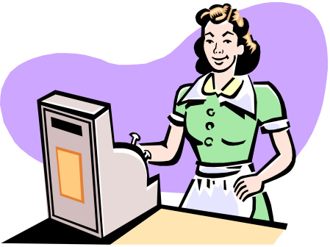
Get a job where you earn tips.
The best paying (legal) jobs while you are in school are those where you get an hourly wage plus tips. If you make more money manage it, and don’t spend it all.

Slide 5

Avoid fines and fees
These are easy to get, but tough to pay. Pay bills on time, return things on time, don’t park where your not supposed to, make sure you put enough money in the meter, etc.

Slide 6
Score free rent.
*Rent is one of your biggest expenses each month. If you can, live at home as long as possible. Believe me, when you have to find and furnish your own apartment, you’ll really appreciate all those years of free rent when you were growing up.

Slide 7
Never Pay retail
*There are coupons and discounts for everything from plane tickets to textbooks to pizza. Seek them out and use them. The Internet is loaded with deals. A little surfing can save you bunches.

Slide 8
Don’t pay for two meals eat one.
*This is what happens when you have meal plan at the cafeteria that allows you a specific number of meals each week and instead of using them up, you go out to eat. The food may taste better at the local restaurant than the school cafeteria, but it’s costing you twice what you actually paid for it.

Slide 9
Percentage points count
*Credit cards are a great way to start establishing a credit history, but make sure you get one with low interest rates, and don’t spend what you wont be able to pay back.

Slide 10
Become money conscious
*Be careful with what your buying. Read magazines at the library instead of buying one. Buy cheaper items because they work just the same.

Slide 11
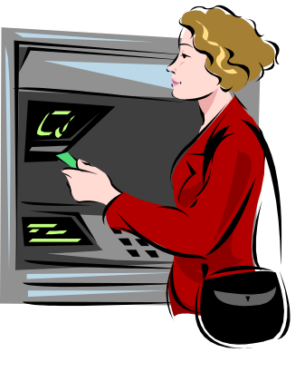
Stay away from the ATM machines
*Try not to go to the ATM machine. Take enough money out to live on. If you keep going back, your bank account will keep getting lower.

