Slide 1
Clearance Monitoring Web-Based System
WEB
+
MOBILE
with Attendance Integration
A role-based digital platform for student clearance, requirement tracking, event attendance validation, and review workflows.
Core Message
The system combines digital clearance processing, attendance validation, and staff review into one centralized platform.
Presentation prepared from the implemented web app, mobile app, and Supabase backend design.
Notes:
Introduce the platform as a combined web and mobile system. Emphasize that clearance processing, attendance validation, and staff review all share the same backend and rule set.

Slide 2
Slide 2 of 10
Problem and Objectives
Why the system was built
Project Goal
Traditional clearance is paper-based, slow, and difficult to track.
Centralize submission, review, attendance validation, announcements, and status tracking in one secure system.
Students lack real-time visibility into missing, completed, and returned requirements.
Offices and organizations need a consistent review, approval, and escalation workflow.
Attendance-linked requirements should be validated automatically instead of manually checked.
All major workflow decisions are enforced by the backend rather than relying only on client-side checks.
Notes:
Frame the problem first, then explain the system objective. The audience should understand why this became a multi-role platform instead of just a simple document uploader.

Slide 3
System Overview
Core platform composition
Supported Roles
Web app for students, staff heads, and administrators
Students, Offices, Departments, Clubs, CSG, CSPSG, CSG-LGU, CSP Division, and Admin
Flutter mobile app for event attendance scanning and recording
Supabase backend for authentication, storage, database, and realtime updates
Database-side business rules for submission validation, status history, and revalidation
All major workflow decisions are enforced by the backend rather than relying only on client-side checks.
Notes:
Explain that the web app is the main operational console while the mobile app specializes in attendance-based workflows. Mention that multiple organizations share one backend model.

Slide 4
Architecture
Clients, backend services, and database-enforced business rules
Auth
Next.js Web App
Users
Students, Staff, Admin
Supabase Backend
PostgreSQL
Flutter Attendance App
Storage
Business Rules
RPCs, Triggers, RLS
Realtime
The database layer is responsible for validation, history, access control, and workflow consistency.
Notes:
Walk from users to clients, then to the Supabase backend services. Clarify that the database is not just storage: it also contains RPCs, triggers, and row-level security.

Slide 5
Technology Stack
Implemented stack
Web: Next.js, React, TypeScript, Tailwind CSS
Mobile: Flutter, Dart, supabase_flutter, mobile_scanner
Backend: Supabase Auth, PostgreSQL, Storage, Realtime
Architecture Fit
Supporting features: QR or ID attendance, file uploads, Excel import, password reset by email
The stack supports real-time status updates, secure auth, file storage, and cross-platform attendance operations.
All major workflow decisions are enforced by the backend rather than relying only on client-side checks.
Notes:
Keep this slide practical. The purpose is to show that the stack is modern, cross-platform, and aligned with the actual implementation in the repositories.

Slide 6
Database Design
Core data model
profiles stores identity, roles, and organization membership
requirements defines source-specific clearance rules
Workflow Focus
clearance_requests and clearance_items track per-student progress
The schema is centered on clearance items, requirement submissions, events, and attendance records.
requirement_submissions stores uploaded proof, confirmations, or scan fulfillment
events and attendance_records power attendance-based requirements
clearance_item_history and announcements support auditability and communication
All major workflow decisions are enforced by the backend rather than relying only on client-side checks.
Notes:
This is the data model slide. Focus on how the entities connect to the workflow instead of listing every column.

Slide 7
Security and Access Control
Security model
Security Principle
Authentication is handled by Supabase Auth.
The frontend cannot directly force approval or submission state. The database remains the final authority.
Authorization is role-based for student, staff, and admin users.
Row-Level Security limits data access by role and ownership.
Security Principle
Server-side RPCs validate clearance submission before status changes.
Business rules stay on the backend so the client cannot directly force sensitive status transitions.
Triggers and revalidation logic reset invalid submissions when requirements or event rules change.
All major workflow decisions are enforced by the backend rather than relying only on client-side checks.
Notes:
Emphasize trust boundaries here. Students can interact from the UI, but completion and status changes are still enforced by backend rules.

Slide 8
Use Case Diagram
Main actors and system interactions
Student
Submit requirements
Key use cases
- View requirements and status
- Upload files or confirm requirements
- Submit for review
- Approve, reject, or place on hold
- Manage announcements and events
- Monitor system activity
Staff Head
Review submissions
Clearance Monitoring
System
Attendance Scanner
Record attendance
Administrator
Manage users
Different roles share one platform, but each role is limited to its own responsibilities and data scope.
Notes:
Explain the actors and the main interactions with the system. The goal is to show the platform supports different operational responsibilities, not only student submission.

Slide 9
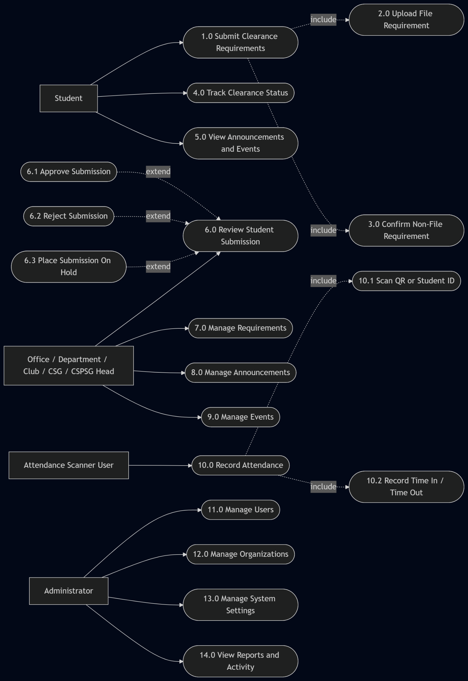
Notes:
Explain the actors and the main interactions with the system. The goal is to show the platform supports different operational responsibilities, not only student submission.

Slide 10
Sequence Diagram: Clearance Submission
Validation path for student submission
Student
Web App
RPC/API
Database
Open source page
Load requirements
Query records
Sync submissions
Check completeness
Return success or error
Notes:
Describe the student submission path from opening the page up to the database validation of completeness. Highlight that incomplete requirements are rejected before the item can become submitted.

Slide 11
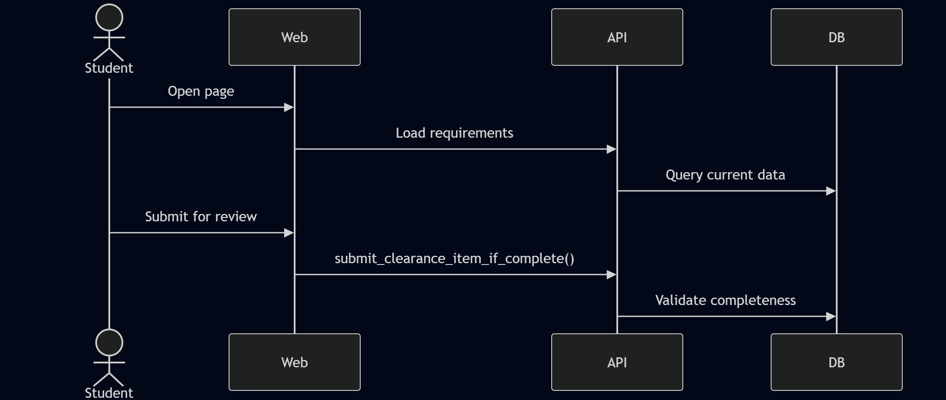
Sequence Diagram: Clearance Submission
Validation path for student submission
Notes:
Describe the student submission path from opening the page up to the database validation of completeness. Highlight that incomplete requirements are rejected before the item can become submitted.

Slide 12
Sequence Diagram: Attendance Scan and Revalidation
Attendance fulfillment and later rule revalidation
Staff
Mobile App
Backend
Database
Open event screen
Record scan
Save attendance
Fulfill linked requirement
Revalidate if rules change
Return attendance result
Notes:
Show the mobile attendance flow and explain how requirement fulfillment can happen from attendance. End by mentioning that later rule changes can trigger revalidation and move items back to on hold.

Slide 13
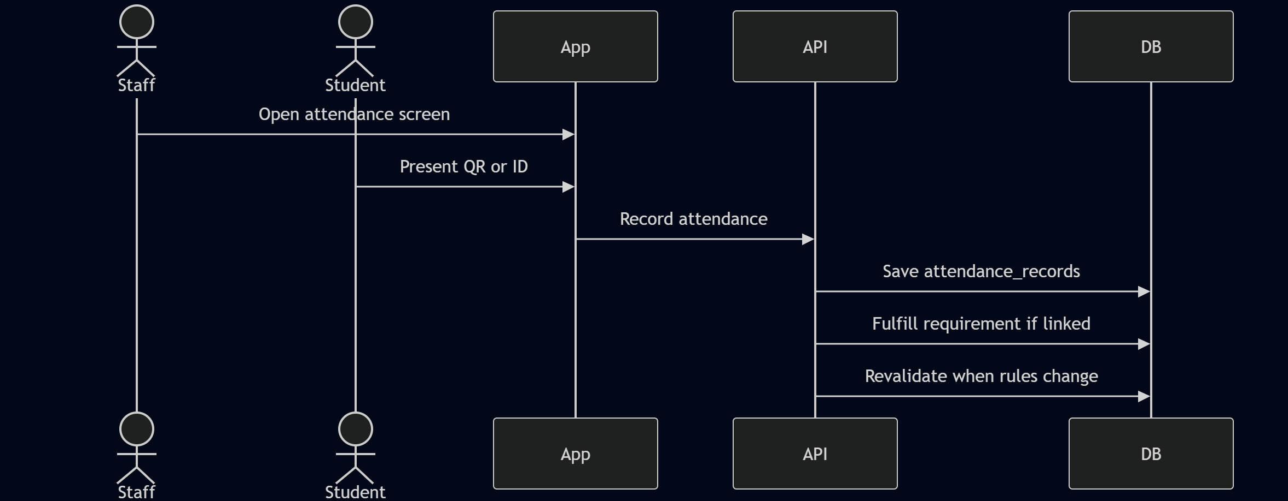
Sequence Diagram: Attendance Scan and Revalidation
Attendance fulfillment and later rule revalidation
Notes:
Show the mobile attendance flow and explain how requirement fulfillment can happen from attendance. End by mentioning that later rule changes can trigger revalidation and move items back to on hold.

