Slide 1
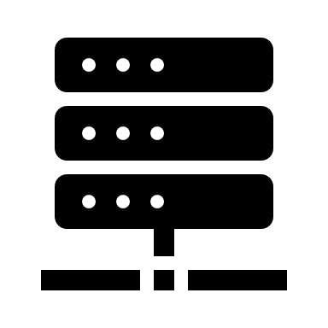
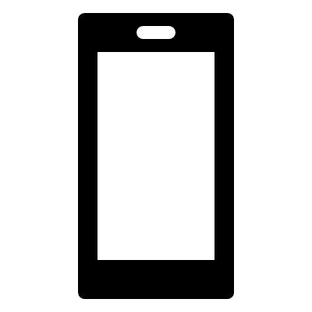

Blockchain node
Blockchain node
Blockchain node
Blockchain network
Blockchain node (Device Manager)
Blockchain node (Device Manager)
IoT Devices
IoT Devices

