Slide 1
Appian AI Application Challenge
TEAM CAMPUSCONNECTORS
PINTA RAM M
SPOORTHI M S
VIGNESH P
VIDHYA GANESH A
UNIVERSITY : REVA UNIVERSITY
BRANCH : CSE 5th SEM
Github Link
https://github.com/PintaRam/APPIAN_SOFTWARE-PLATFORM.git

Slide 2
CONTENTS
PROBLEM STATEMENT
INTRODUCTION TO CAMPUSCONNECT
OBJECTIVES
FEATURES
SYSTEM ARCHITECTURE
TECHNOLOGY STACK
CONCLUSION

Slide 3
PROBLEM STATEMENT
This global university seeks to prepare students for life in a global environment. This means giving students modern tools to manage their educational journey. USF IT wanted to transform and fully-mobilize the student experience. The number of applications that IT was supporting was growing and the ability to maintain those applications was eliminating the ability to deliver new capabilities. USF IT was already using Agile principles to manage projects, but needed a low-code, AI driven platform that could accelerate delivery.

Slide 4
INTRODUCTION
Our solution is an application or software designed to assist students comprehensively. It encompasses various functionalities, including an AI-powered feature enabling students to choose courses aligned with their preferences, especially when faced with uncertainty in their selections. Additionally, an AI tutor is available to address students’ inquiries when university professors are not available. Furthermore, an automated management system allocates courses to students based on flexible timings, facilitating their participation in non-curricular activities conveniently.
This software serves to enhance the overall student experience by providing personalized guidance in course selection, immediate doubt resolution through an AI tutor, and optimized course scheduling to accommodate non-academic pursuits

Slide 5
OBJECTIVES
Enhance Course Selection Experience
Enable students to make informed decisions by providing AI-powered recommendations for course selection based on their academic strengths and interests.
Improve Accessibility to Academic Support
Facilitate continuous learning by offering an AI tutor, a chatbot named BullBot that addresses students’ doubts and queries, ensuring access to assistance even during off-hours when university professors may be unavailable.
Optimize Course Allocation and Scheduling
Implement an automated management system to efficiently allocate courses to students, considering flexible timings. This objective aims to enhance scheduling convenience, allowing students to balance academic and non-curricular activities effectively.

Slide 6
Increase Student Engagement and Satisfaction
Focus on providing a user-friendly interface and personalized features to increase student engagement with the software. The objective is to enhance overall satisfaction by delivering a seamless and tailored experience.
Facilitate Data-Driven Decision-Making
Implement analytics and reporting features within the software to provide administrators and faculty with valuable insights into student preferences, performance, and engagement. This objective aims to support data-driven decision-making for continuous improvement and adaptation of the software.
Reduced Errors and Rework
AI systems can minimize errors in various processes, reducing the need for rework and associated costs.This is particularly important in industries where errors can have significant financial consequences.

Slide 7
Continuous Feedback Loop
Establishing a continuous feedback loop for continuous improvement. Collect feedback from students, teachers, and administrators on the effectiveness of AI-driven features. Use this feedback to refine algorithms, update content, and enhance the overall platform.
Collaborative Learning Environments
Fostering collaboration and communication among students and educators.Integrating AI-driven collaboration tools that facilitate group projects, discussion forums, and peer-to-peer learning. Provide intelligent feedback and recommendations for collaborative activities.
Automated Grading and Feedback
AI algorithms for automating the grading of assignments and providing instant feedback.Allows educators to focus more on teaching and less on manual grading.

Slide 8
FEATURES
AI Performance Analysis
Implement AI algorithms to analyze individual student performance, providing valuable insights for educators to tailor support and interventions.
Personalized Learning Paths
Offer personalized learning paths based on AI-driven assessments, addressing specific areas of improvement for each student and optimizing the learning experience.
Multilingual Support
Enable users to access the system in their preferred language, fostering inclusivity and ease of use for a diverse student population.

Slide 9
Gamification Elements
Integrate gamification elements to enhance engagement, motivation, and participation, making the learning process more enjoyable and interactive.
Collaborative Learning Tools
Provide integrated tools for collaborative learning, allowing students to work together on projects at early stages, fostering teamwork and interactive learning experiences.
E-Library Management System
Introduce an e-library management system, granting students easy access to a wide range of books and journals from any location, promoting convenient and flexible learning resources.

Slide 10
Language Translation and Accessibility
AI-driven language translation features to break down language barriers.
Accessibility features such as text-to-speech and speech-to-text for diverse learner needs
Automated Grading and Feedback
AI algorithms for automating the grading of assignments and providing instant feedback. Allows educators to focus more on teaching and less on manual grading.

Slide 11
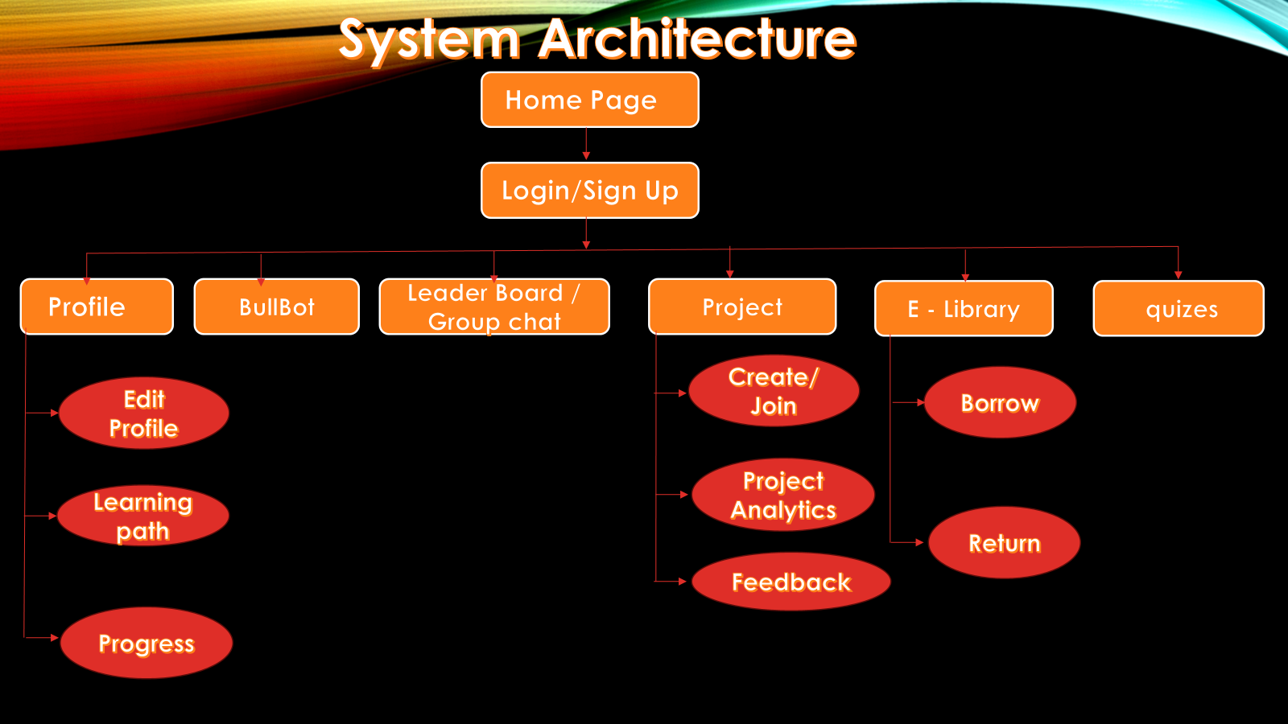

Slide 12
TECHNOLOGY STACK
ANDROID STUDIO
JAVA
XML
FIGMA
JDBC
REST API
GPT API
TESTING FRAMEWORK
AMAZON WEB SERVICES / MICROSOFT AZURE

Slide 13
CONCLUSION
To conclude, the proposed Student Management Software is a comprehensive solution poised to revolutionize the educational experience with features like multilingual support, AI-driven performance analysis, personalized learning paths, gamification elements, collaborative learning tools, and an E-Library Management System, the software aims to address diverse student needs. The system architecture, strategically designed with distinct layers, ensures scalability, security, and seamless integration of advanced technologies. This software not only streamlines administrative processes but also prioritizes student success and engagement. As we move forward with implementation, our commitment to refinement based on user feedback remains steadfast, promising a dynamic and innovative platform that contributes to the evolution of modern education.

