Slide 1

Arquitecturas de Alto Desempenho
Assignment 2 – | Sorting Sequences of Values
 | GPU Threading and Memory Mapping
Grupo 1, Lab 3
Lucas Pinto
Carlos Vidal
DETI, Arquitecturas de Alto Desempenho, Janeiro 2022
<number>-8

Slide 2
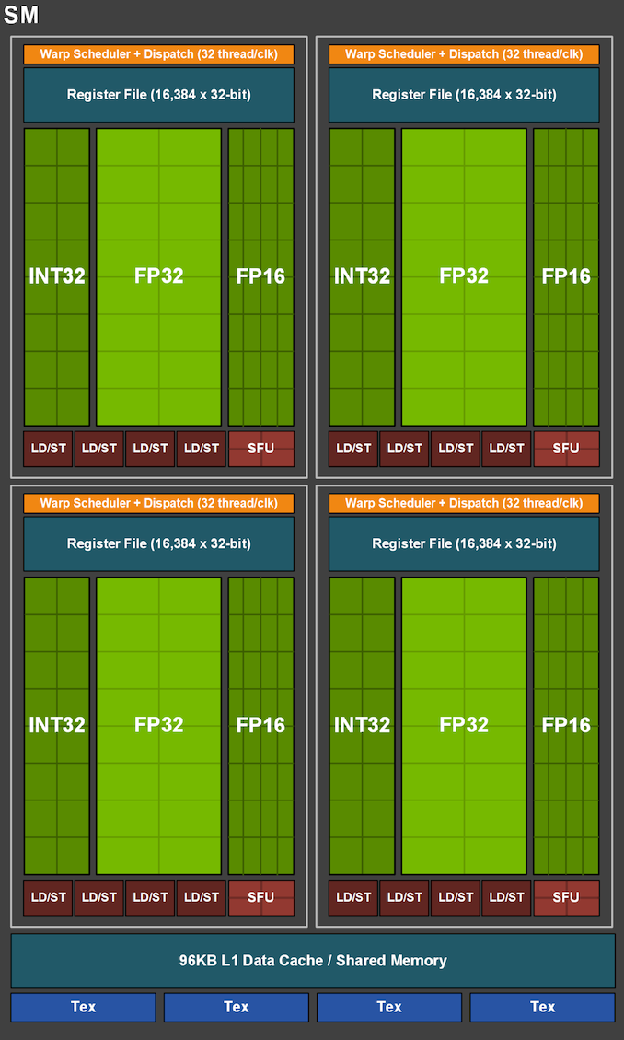
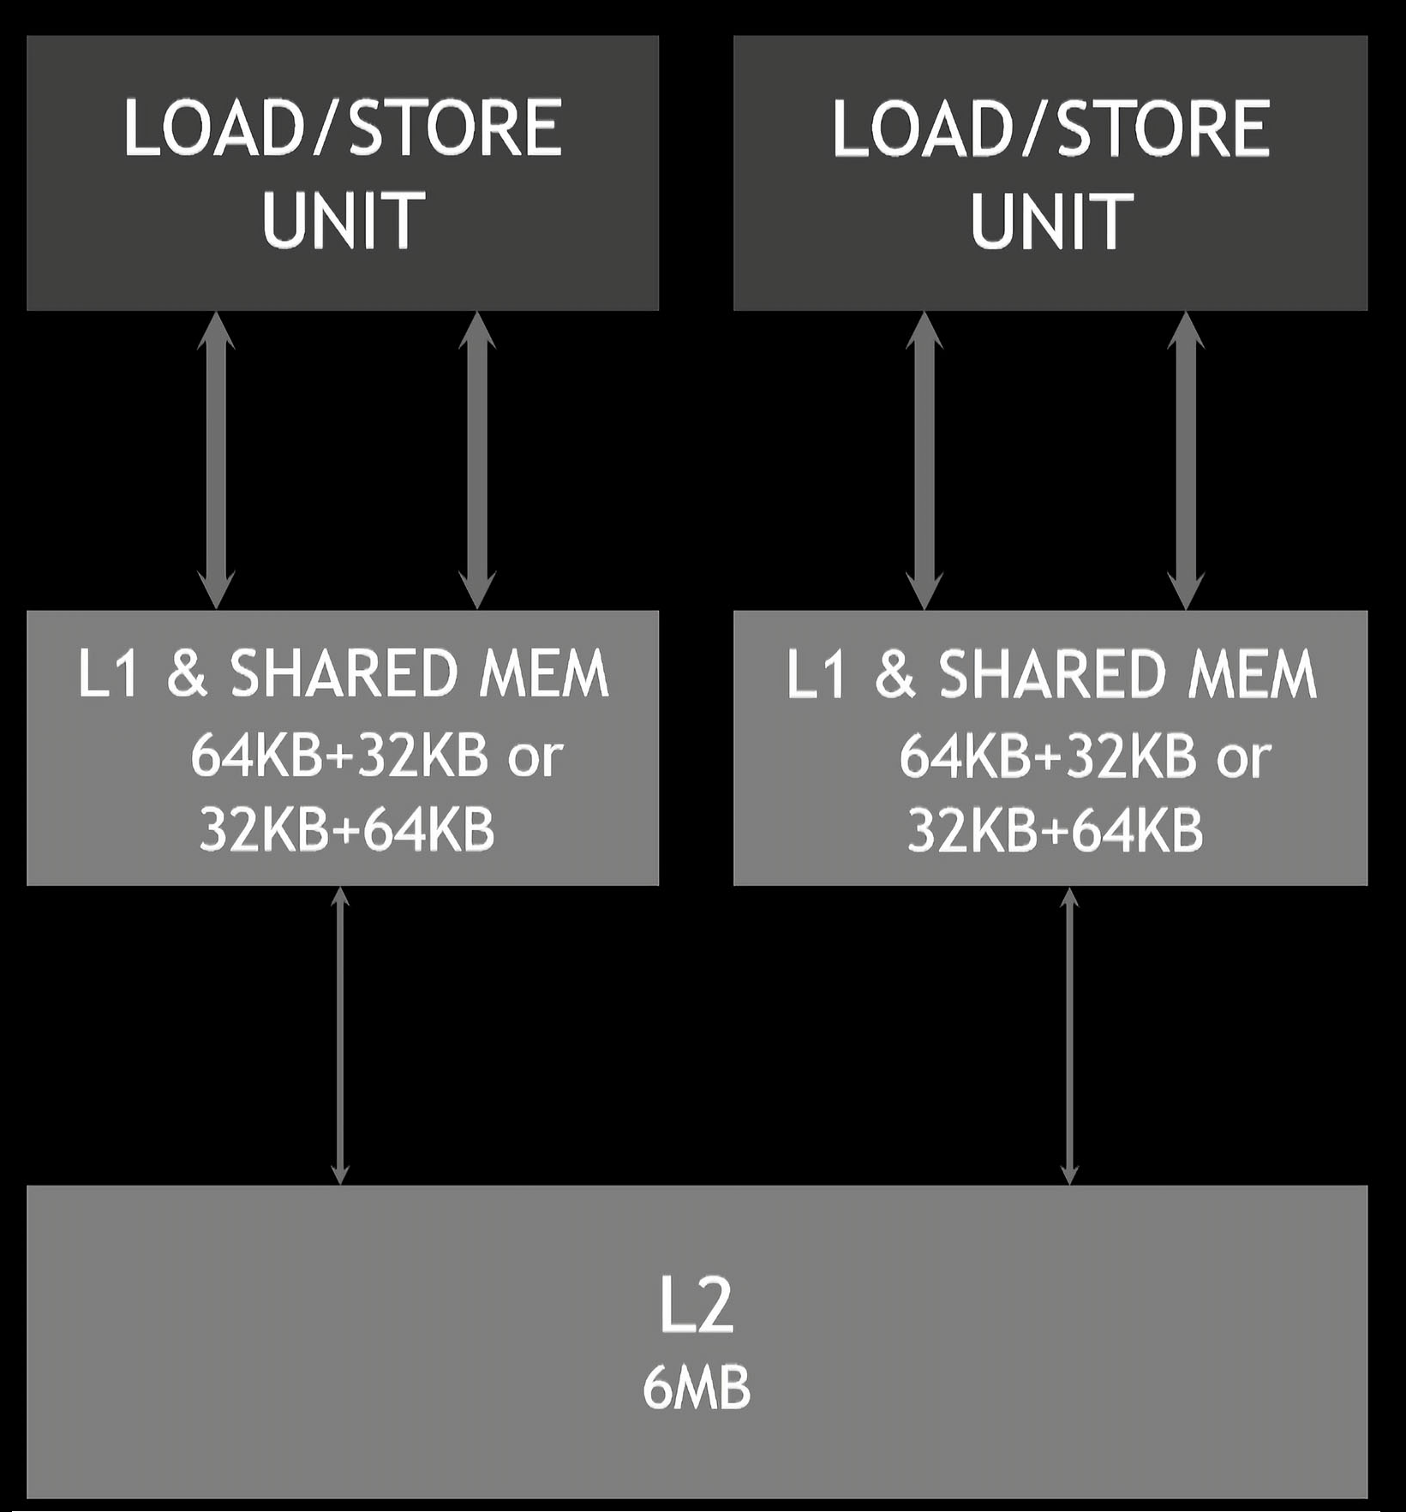
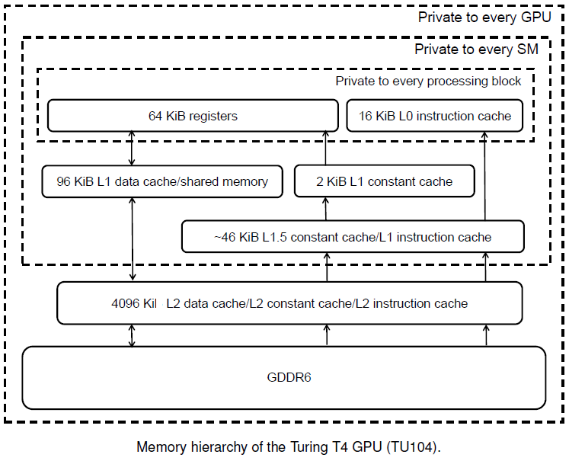
The aim of the assignment is to sort sequences of values on two versions of the bubble sort algorithm on a CPU and a GPU.
For analising the mapping between each running thread and the memory region it accesses we studied the GPU arquitecture and organization.
/usr/local/cuda-12.0/samples/1_Utilities/deviceQuery$ ./deviceQuery
GeForce GTX 1660 Ti Main Specification
GPU Engine Specs: | Architecture | Turing TU116-400-A1 Chip
 | Compute Capability | 7.5
 | Transistor Count | 6.6x10^9
 | SM Count | 24
 | NVIDIA CUDA® Cores | 1536
 |  | (24) Multiprocessors, ( 64) CUDA Cores/MP
 | Boost Clock (GHz) | 1770
 | Base Clock (GHz) | 1500
Memory Specs: | Tex L1 Cache | 32 KB per SM
 | L1 Cache | 64 KB per SM
 | L2 Cache | 1536 KB
 | Standard Memory Config | 5945 MBytes (6233391104 bytes) GDDR6
 | Memory Interface Width | 192-bit
 | Total amount of shared memory per Block | 49152 bytes
 | Total number of registers available per Block | 65536
 | Maximum number of resident blocks per SM | 16
 | Maximum number of resident warps per SM | 32
 | Maximum number of threads per Block | 1024
 | Maximum number of resident threads per SM | 1024
 | Max dimension size of a thread block (x,y,z) | (1024, 1024, 64)
 | Max dimension size of a grid size (x,y,z) | (2147483647, 65535, 65535)
 | Maximum memory pitch | 2147483647 bytes
NVIDIA Device: GeForce GTX 1660 Ti
STREAMING MULTIPROCESSOR (SM) ARCHITECTURE
1.5MB
DETI, Arquitecturas de Alto Desempenho, Janeiro 2022
<number>-8

Slide 3
The Bubble Sort Algorithm
On one version, the elements are seen as forming the rows of a matrix, each row corresponding to a different sequence to be sorted.
In the second, the elements are seen as forming the columns of a matrix, each column corresponding to a different sequence to be sorted.
TreadID and launch configuration, running both versions with various blockDimX and blockDimY configurations, from 2⁰ to 2¹⁰, comparing the average time execution, using the best Block performance to test various Grid X and Y configurations.
#ifndef ARRAY_LENGTH
# define ARRAY_LENGTH (1 << 10) //(2^10=1024)
#endif
#ifndef N_ARRAYS
# define N_ARRAYS (1 << 10) //(2^10=1024)
#endif
data_size = (size_t) N_ARRAYS * (size_t) ARRAY_LENGTH * sizeof (unsigned int);
blockDimX = 1 << 0;
blockDimY = 1 << 0;
blockDimZ = 1 << 0;
gridDimX = 1 << 10; //(2^10=1024)
gridDimY = 1 << 0;
gridDimZ = 1 << 0;
x = (unsigned int) threadIdx.x + (unsigned int) blockDim.x * (unsigned int) blockIdx.x;
y = (unsigned int) threadIdx.y + (unsigned int) blockDim.y * (unsigned int) blockIdx.y;
idx = (unsigned int) blockDim.x * (unsigned int) gridDim.x * y + x;
Data_size = 2¹⁰ * 2¹⁰ * 2² bytes = 2²² bytes = 4 194 304 bytes <=>
2²² * 2³ bits = 2²⁵ bits = 33 554 432 bits
Row Sorting algorithm
Column Sorting algorithm
data += length * idx; // adjust pointer to the array to be ordered
for (i = 0; i < length - 1; i++)
{ noSwap = true;
for (j = length - 1; j > i; j--)
if (data[j] < data[j-1])
{ tmp = data[j];
data[j] = data[j-1];
data[j-1] = tmp;
noSwap = false;
}
if (noSwap) break;
}
data += idx; // adjust pointer to the array to be ordered
for (i = 0; i < length - 1; i++)
{ noSwap = true;
for (j = length - 1; j > i; j--)
if (data[j*N_ARRAYS] < data[(j-1)*N_ARRAYS])
{ tmp = data[j*N_ARRAYS];
data[j*N_ARRAYS] = data[(j-1)*N_ARRAYS];
data[(j-1)*N_ARRAYS] = tmp;
noSwap = false;
}
if (noSwap) break;
}
DETI, Arquitecturas de Alto Desempenho, Janeiro 2022
<number>-8

Slide 4
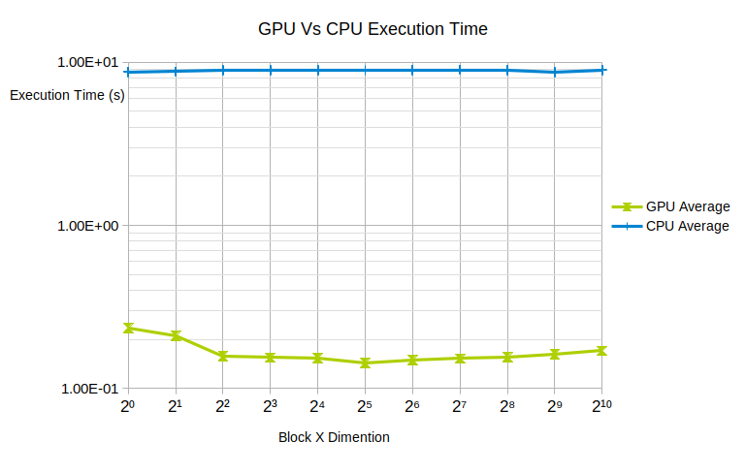
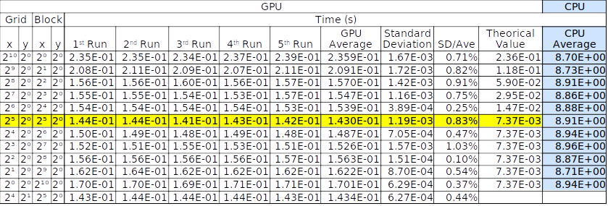
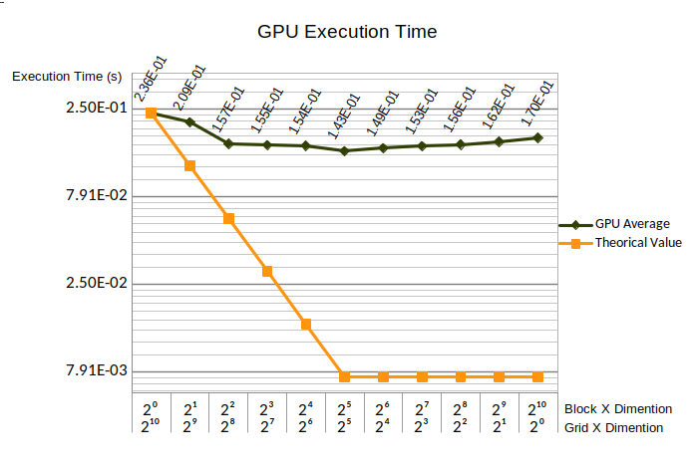
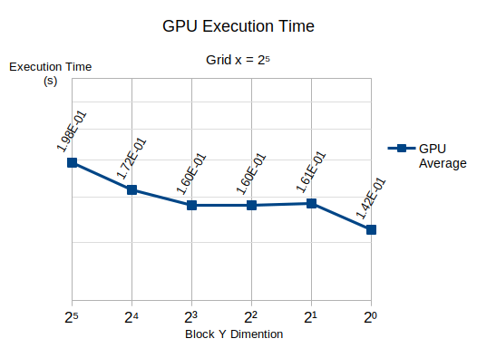
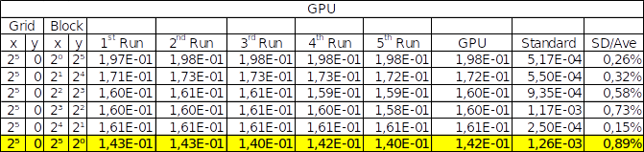
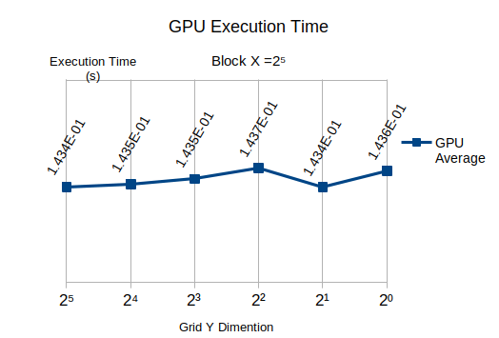
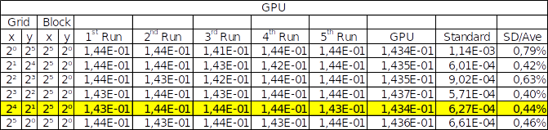
Time Execution Results for The Row Sorting
The average relative speedup execution time for the CPU and the best GPU configuration is = CPU time/GPU time = 62,30 <=> 6.230%
DETI, Arquitecturas de Alto Desempenho, Janeiro 2022
<number>-8

Slide 5
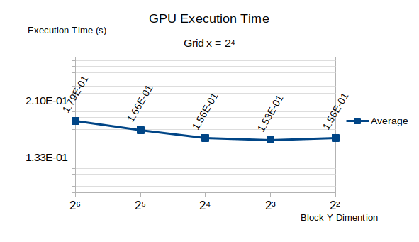
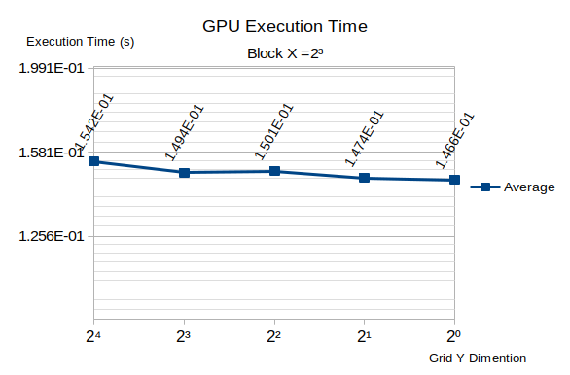
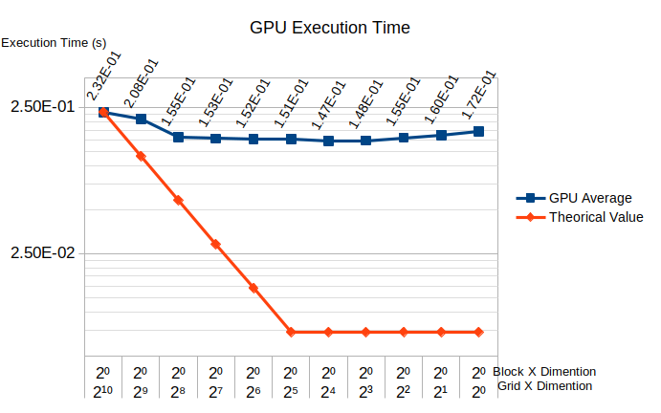
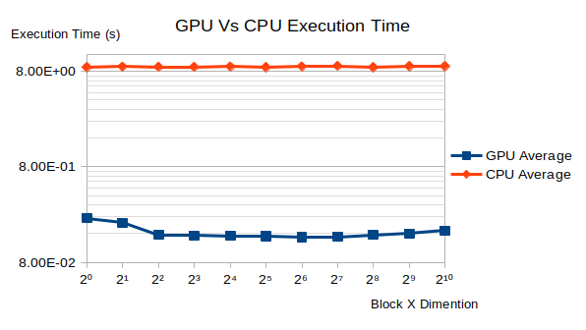
Time Execution Results for The Column Sorting
Conclusion
DETI, Arquitecturas de Alto Desempenho, Janeiro 2022
<number>-8

Slide 6
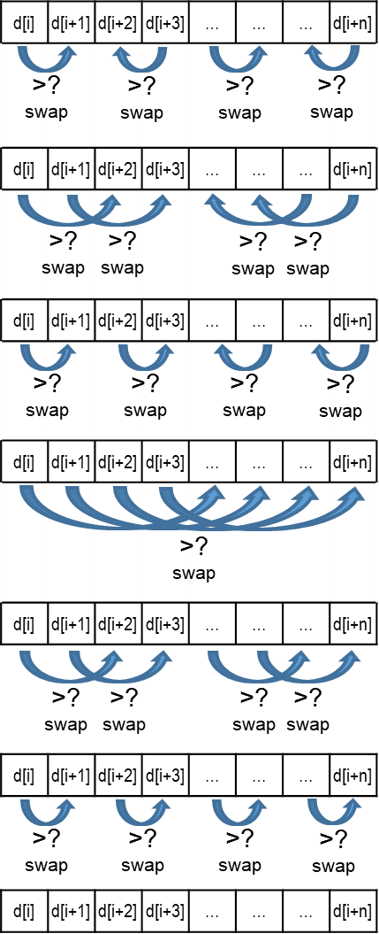
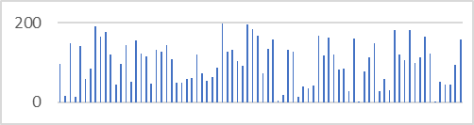
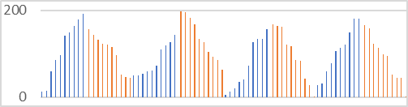
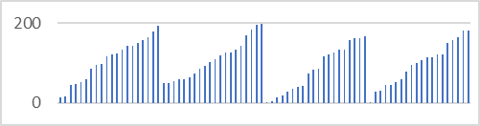
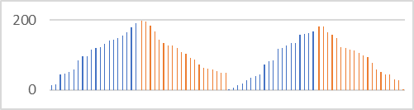
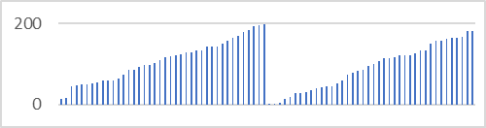
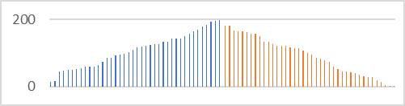
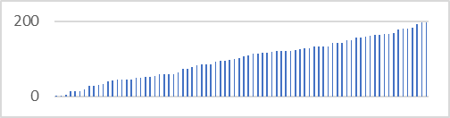
Bitonic Sort Algorithm
Sub-list
Sub-list
Sub-list
Sub-list
Stage 1
Stage 2
Sub-list
Sub-list
Stage 3
Full List
Sorted List
DETI, Arquitecturas de Alto Desempenho, Janeiro 2022
<number>-8

Slide 7
For a N x N matrix, the number of the initial sub-list would be
Each (sub)list sorting is comprised of 3 stages
Being the number of elements to be ordered “m”, the number of independent threads for Stage 1 would be m/2, having only one pass.
For Stage 2, the number of independent threads would also be m/2, but this fase needs 2 passes.
For Stage 3, the number of independent threads would once more be m/2, with 3 passes nedded.
Total space complexity = O(n.log²n). For n=1024x1024 ⬄ 1024²x(log1024²) ² ⬄ 1024²x(2log1024) ² = 38,008x10⁶ comparisons.
Total time complexity is O(log²n). For n=1024² ⬄ (log1024²)² = (2log1024)² = 3,625x10¹
The time complexity of the buble sort is for the worst case is O(n²), runed in sequencial, wich is worst than the basic bitonic sort.
Current graphics processors do not support scatter operations i.e., the fragment processor cannot write to arbitrary memory locations. This restriction avoids a write-after-a-read hazard between multiple fragment processors accessing the same memory location. Therefore, most sorting algorithms such as Quicksort cannot be efﬁciently implemented on GPUs. On the other hand, sorting network algorithms are a class of algorithms that map well to the GPUs.
https://www.researchgate.net/publication/228359315_A_cache-efficient_sorting_algorithm_for_database_and_data_mining_computations_using_graphics_processors

Slide 8
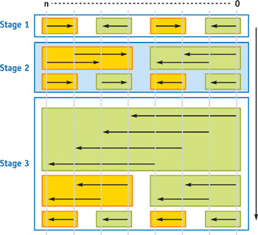
d[i] | d[i+1] | d[i+2] | d[i+3] | … | … | … | d[i+n]
d[i] | d[i+1] | d[i+2] | d[i+3] | … | … | … | d[i+n]
d[i] | d[i+1] | d[i+2] | d[i+3] | … | … | … | d[i+n]
d[i] | d[i+1] | d[i+2] | d[i+3] | … | … | … | d[i+n]
d[i] | d[i+1] | d[i+2] | d[i+3] | … | … | … | d[i+n]
d[i] | d[i+1] | d[i+2] | d[i+3] | … | … | … | d[i+n]
d[i] | d[i+1] | d[i+2] | d[i+3] | … | … | … | d[i+n]
Stage 1
>?
swap
>?
swap
>?
swap
>?
swap
>?
swap
>?
swap
>?
swap
>?
swap
Stage 2
>?
swap
>?
swap
>?
swap
>?
swap
>?
swap
for (unsigned int i = 0; i < arrSize ; i++) {
unsigned int idx=treadIdx.x;
unsigned int arrSize = (size_t) N_ARRAYS * (size_t) ARRAY_LENGTH;
unsigned int j, tmp;
data += idx*2; // adjust pointer to the array to be ordered
if(i%2==0)
{
j=2*idx;
if (data[j]>data[j] ) // swapping
{
tmp = data[j];
data[j]=data[j+1];
data[j+1]=tmp;
noSwap = false;
} if (noSwap) break;
}
else
{
j=2*idx+1;
if (j<arrSize-1)
{
if (data[j]>data[j] ) // swapping
{
tmp = data[j];
data[j]=data[j+1];
data[j+1]=tmp;
noSwap = false;
}
}
}
Stage 3
>?
swap
>?
swap
>?
swap
>?
swap
>?
swap
>?
swap
>?
swap
>?
swap
https://developer.nvidia.com/gpugems/gpugems2/part-vi-simulation-and-numerical-algorithms/chapter-46-improved-gpu-sorting
DETI, Arquitecturas de Alto Desempenho, Janeiro 2022
<number>-8

