Slide 1

Arquitecturas de Alto Desempenho
Assignment 2 – | Sorting Sequences of Values
 | GPU Threading and Memory Mapping
Grupo 1, Lab 3
Lucas Pinto
Carlos Vidal
DETI, Arquitecturas de Alto Desempenho, Janeiro 2022
1-7

Slide 2
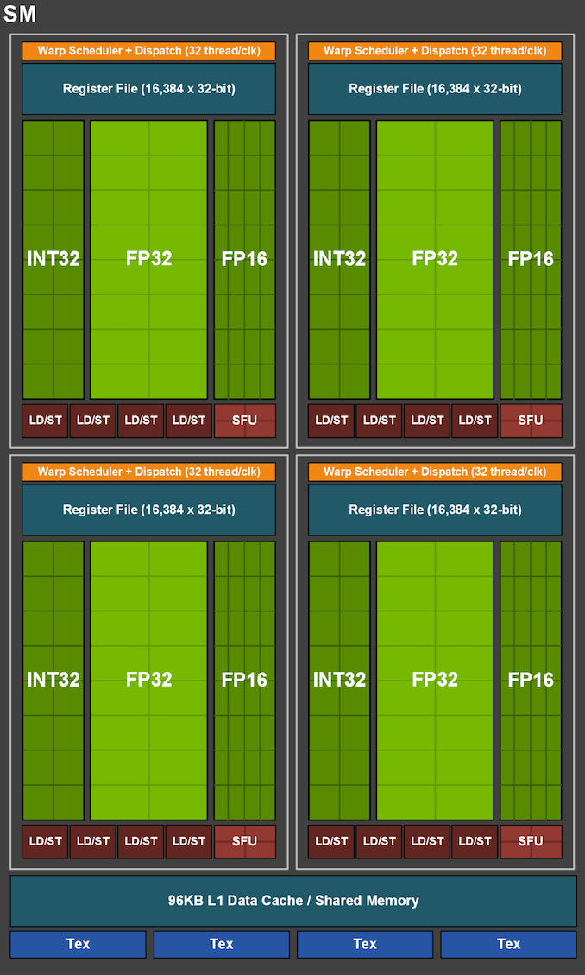
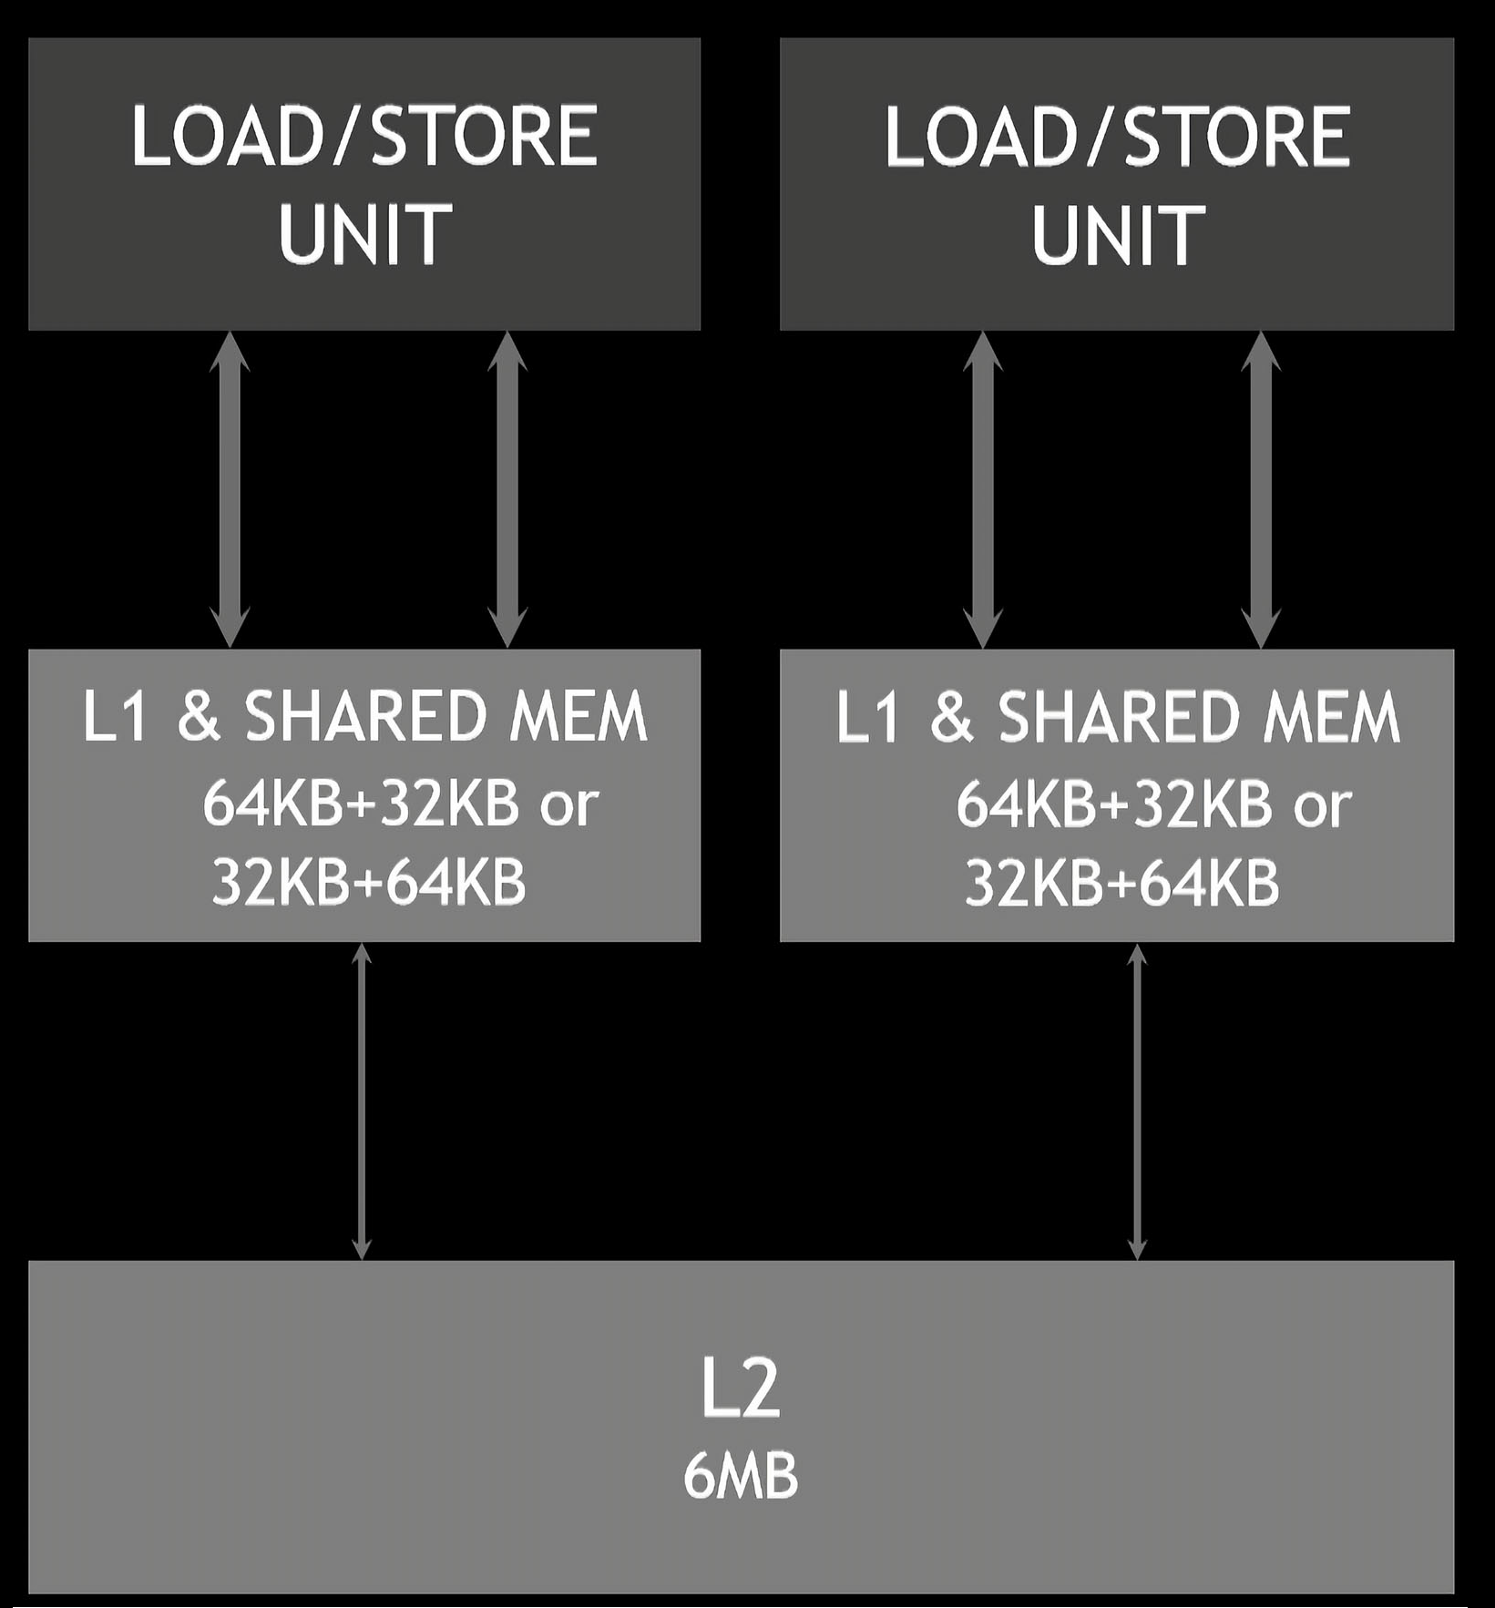
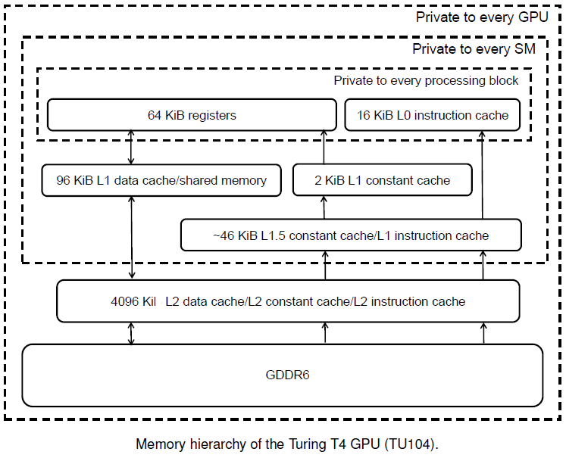
NVIDIA Device: GeForce GTX 1660 Ti
/usr/local/cuda-12.0/samples/1_Utilities/deviceQuery$ ./deviceQuery
STREAMING MULTIPROCESSOR (SM) ARCHITECTURE
GeForce GTX 1660 Ti Main Specification
GPU Engine Specs: | Architecture | Turing TU116-400-A1 Chip
 | Compute Capability | 7.5
 | Transistor Count | 6.6x10^9
 | SM Count | 24
 | NVIDIA CUDA® Cores | 1536
 |  | (24) Multiprocessors, ( 64) CUDA Cores/MP
 | Boost Clock (GHz) | 1770
 | Base Clock (GHz) | 1500
Memory Specs: | Tex L1 Cache | 32 KB per SM
 | L1 Cache | 64 KB per SM
 | L2 Cache | 1536 KB
 | Standard Memory Config | 5945 MBytes (6233391104 bytes) GDDR6
 | Memory Interface Width | 192-bit
 | Total amount of shared memory per Block | 49152 bytes
 | Total number of registers available per Block | 65536
 | Maximum number of resident blocks per SM | 16
 | Maximum number of resident warps per SM | 32
 | Maximum number of threads per Block | 1024
 | Maximum number of resident threads per SM | 1024
 | Max dimension size of a thread block (x,y,z) | (1024, 1024, 64)
 | Max dimension size of a grid size (x,y,z) | (2147483647, 65535, 65535)
 | Maximum memory pitch | 2147483647 bytes
1.5MB
DETI, Arquitecturas de Alto Desempenho, Janeiro 2022
2-7

Slide 3
TreadID
#ifndef ARRAY_LENGTH
# define ARRAY_LENGTH (1 << 10) //(2^10=1024)
#endif
#ifndef N_ARRAYS
# define N_ARRAYS (1 << 10) //(2^10=1024)
#endif
data_size = (size_t) N_ARRAYS * (size_t) ARRAY_LENGTH * sizeof (unsigned int);
blockDimX = 1 << 0;
blockDimY = 1 << 0;
blockDimZ = 1 << 0;
gridDimX = 1 << 10; //(2^10=1024)
gridDimY = 1 << 0;
gridDimZ = 1 << 0;
x = (unsigned int) threadIdx.x + (unsigned int) blockDim.x * (unsigned int) blockIdx.x;
y = (unsigned int) threadIdx.y + (unsigned int) blockDim.y * (unsigned int) blockIdx.y;
idx = (unsigned int) blockDim.x * (unsigned int) gridDim.x * y + x;
Data_size = 2¹⁰ * 2¹⁰ * 2² bytes = 2²² bytes = 4 194 304 bytes <=>
2²² * 2³ bits = 2²⁵ bits = 33 554 432 bits
Row Sorting algorithm
Column Sorting algorithm
data += length * idx; // adjust pointer to the array to be ordered
for (i = 0; i < length - 1; i++)
{ noSwap = true;
for (j = length - 1; j > i; j--)
if (data[j] < data[j-1])
{ tmp = data[j];
data[j] = data[j-1];
data[j-1] = tmp;
noSwap = false;
}
if (noSwap) break;
}
data += idx; // adjust pointer to the array to be ordered
for (i = 0; i < length - 1; i++)
{ noSwap = true;
for (j = length - 1; j > i; j--)
if (data[j*N_ARRAYS] < data[(j-1)*N_ARRAYS])
{ tmp = data[j*N_ARRAYS];
data[j*N_ARRAYS] = data[(j-1)*N_ARRAYS];
data[(j-1)*N_ARRAYS] = tmp;
noSwap = false;
}
if (noSwap) break;
}
DETI, Arquitecturas de Alto Desempenho, Janeiro 2022
3-7

Slide 4
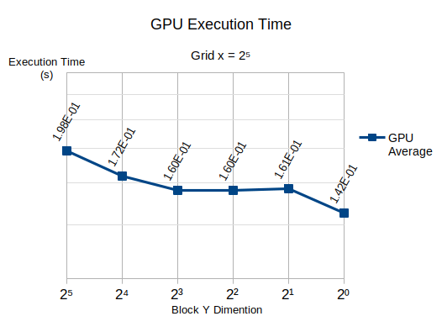
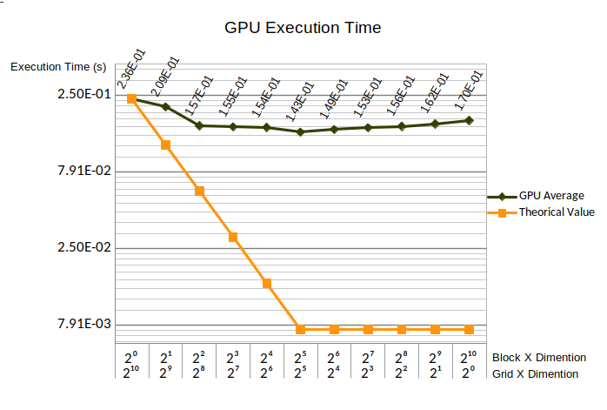
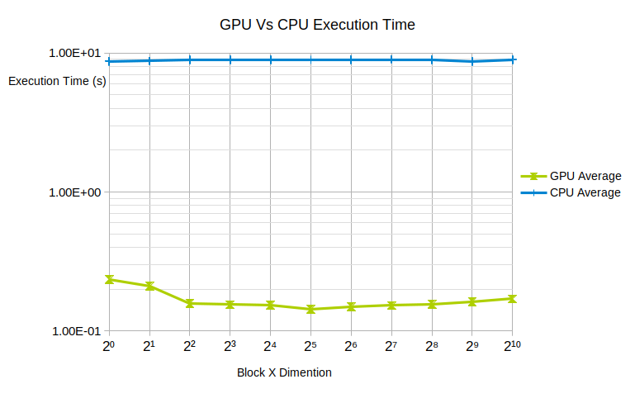
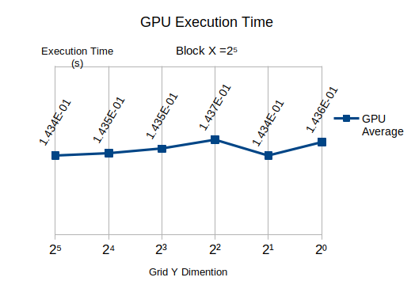
DETI, Arquitecturas de Alto Desempenho, Janeiro 2022
4-7

Slide 5
for (unsigned int i = 0; i < arrSize ; i++) {
unsigned int idx=treadIdx.x;
unsigned int arrSize = (size_t) N_ARRAYS * (size_t) ARRAY_LENGTH;
unsigned int j, tmp;
data += idx*2; // adjust pointer to the array to be ordered
if(i%2==0)
{
j=2*idx;
if (data[j]>data[j] ) // swapping
{
tmp = data[j];
data[j]=data[j+1];
data[j+1]=tmp;
noSwap = false;
} if (noSwap) break;
}
else
{
j=2*idx+1;
if (j<arrSize-1)
{
if (data[j]>data[j] ) // swapping
{
tmp = data[j];
data[j]=data[j+1];
data[j+1]=tmp;
noSwap = false;
}
}
}
DETI, Arquitecturas de Alto Desempenho, Janeiro 2022
5-7

Slide 6
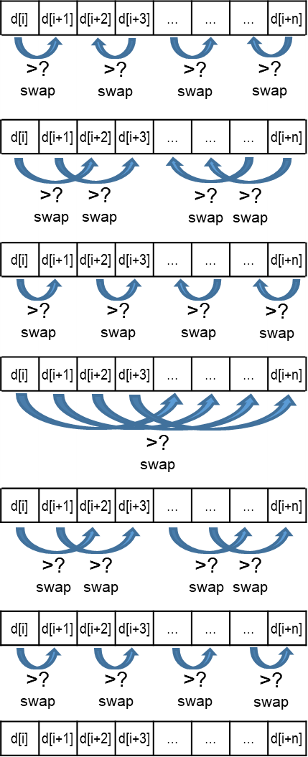
DETI, Arquitecturas de Alto Desempenho, Janeiro 2022
6-7

Slide 7
d[i] | d[i+1] | d[i+2] | d[i+3] | … | … | … | d[i+n]
d[i] | d[i+1] | d[i+2] | d[i+3] | … | … | … | d[i+n]
d[i] | d[i+1] | d[i+2] | d[i+3] | … | … | … | d[i+n]
d[i] | d[i+1] | d[i+2] | d[i+3] | … | … | … | d[i+n]
d[i] | d[i+1] | d[i+2] | d[i+3] | … | … | … | d[i+n]
d[i] | d[i+1] | d[i+2] | d[i+3] | … | … | … | d[i+n]
d[i] | d[i+1] | d[i+2] | d[i+3] | … | … | … | d[i+n]
>?
swap
>?
swap
>?
swap
>?
swap
>?
swap
>?
swap
>?
swap
>?
swap
>?
swap
>?
swap
>?
swap
>?
swap
>?
swap
>?
swap
>?
swap
>?
swap
>?
swap
>?
swap
>?
swap
>?
swap
>?
swap
DETI, Arquitecturas de Alto Desempenho, Janeiro 2022
7-7

