Slide 1
CS 332 : Natural Language Translator
Nicholas DiPinto
Robert Velarde

Slide 2
JavaScript History
Brandon Eich 1995
Gained popularity in 2005
Jesse James Garret
Movement started to use JavaScript as a scripting language
Primarily used in the background of web applications

Slide 3
C++ History
Bjarne Stroustrup, 1979
Built on top of C for speed and portabiliity
C With Classes
First Language manual 1985

Slide 4
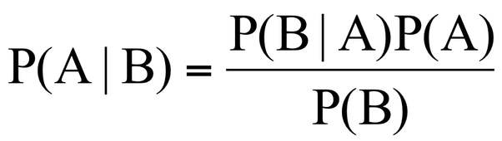

PROJECT BACKGROUND
Language Translator
Statistical Models
Baye’s Theorem
Bi-Gram Probability
Corpuses
https://qph.ec.quoracdn.net/main-qimg-003a7aaa0935215238a082f0412fb564
https://umbrella.cisco.com/blog/blog/2014/10/16/detecting-pinyin-domains/

Slide 5
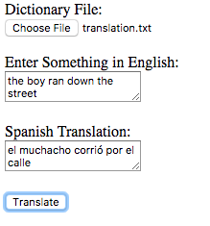
Metrics
File IO
Reading in Dictionary
String manipulation
Formatting Strings
Translating Individual Words
Floating Point Arithmetic
Calculating Translation Accuracy
JavaScript Program

Slide 6
Objective Metrics: Speed
 | Execution Time (milliseconds)
Iteration # | String Manipulation |  | File IO |  | Floating Point Math
 | C++ | JavaScript | C++ | JavaScript | C++ | JavaScript
1 | 0.008 | 0.2949 | 0.62 | 0.0117 | 0.5444 | 1.6518
2 | 0.006 | 0.0581 | 0.329 | 0.1408 | 0.577 | 0.2329
3 | 0.005 | 0.0529 | 0.309 | 0.0949 | 0.546 | 0.202
4 | 0.006 | 0.0610 | 0.329 | 0.0400 | 0.52 | 0.1801
5 | 0.007 | 0.0632 | 0.528 | 0.0432 | 0.517 | 0.2368
6 | 0.006 | 0.0561 | 0.315 | 0.0419 | 0.528 | 0.1860
7 | 0.005 | 0.0449 | 0.333 | 0.0397 | 0.203 | 0.2041
8 | 0.007 | 0.1479 | 0.047 | 0.3501 | 0.464 | 3.7209
9 | 0.008 | 0.0378 | 0.314 | 0.0310 | 0.512 | 0.2880
10 | 0.005 | 0.0439 | 0.315 | 0.05102 | 0.2 | 0.1701
Total Average | 0.006 | 0.0860 | 0.3439 | 0.084432 | 0.46114 | 0.70727

Slide 7
Objective Metrics: Costs
JavaScript
Safety
Debugging
Browser Configurations
C++
Doesn’t support garbage collection
Lack of security

Slide 8
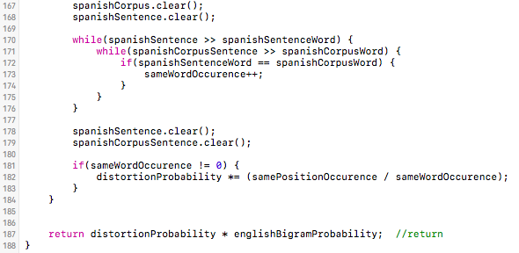
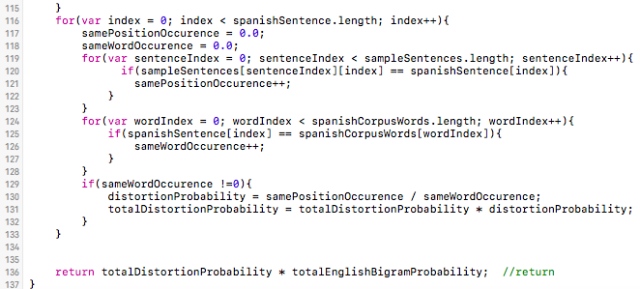
Objective Metrics: Lines of Code
C++ Code
JavaScript Code

Slide 9
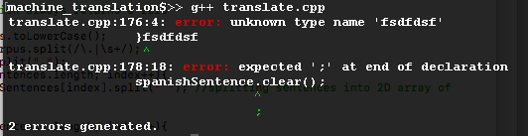
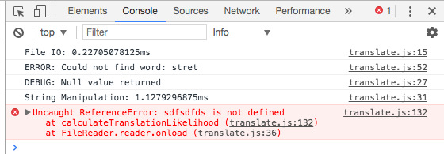
Subjective Metrics
Readability
Ease of debugging
Extensibility
Number of Libraries
C++ Debugging
JavaScript Debugging Console

Slide 10
Analysis
JavaScript is superior in:
Simple functions
Application-specific support
Code Size
C++ is superior in:
Debugging
Speed

Slide 11
Questions
Contact:
Nicholas DiPinto
dipinton@my.erau.edu
Robert Velarde
velarder@my.erau.edu

