Slide 1

Dimensions and Dark Matter May 17, 2012
5/2/2012

Slide 2
New purifications
All from metagenomic targets
New targets purified and in crystallization trials
VCID5939, 5956, 5972, 5973, 5980, 5989 submitted for crystallization on April 27 (5939, 5971, 5973, 5980) and April 30 (5956)
5 trays each
Requested fermentations of VCID5990, 5991, 6010, 6016, 6700, 6702
Fermentations to harvest today (5/17)
Purifications scheduled for next week
5/2/2012

Slide 3
Structures Tally
Target | PDB | res | PDB | Res
Phage Pdf | 3UWA (apo) | 1.95Å | 3UWB (+ actinonin) | 1.70Å
Se PDF | 4DR8 (apo) | 1.55Å | 4DR9 (+ actinonin) | 1.90Å
Thioredoxin | 3VFI | 1.75Å | - | -
Capsid | 4DMI | 1.50Å | 4E27 (+Iodide) | 2.4Å
5/2/2012

Slide 4
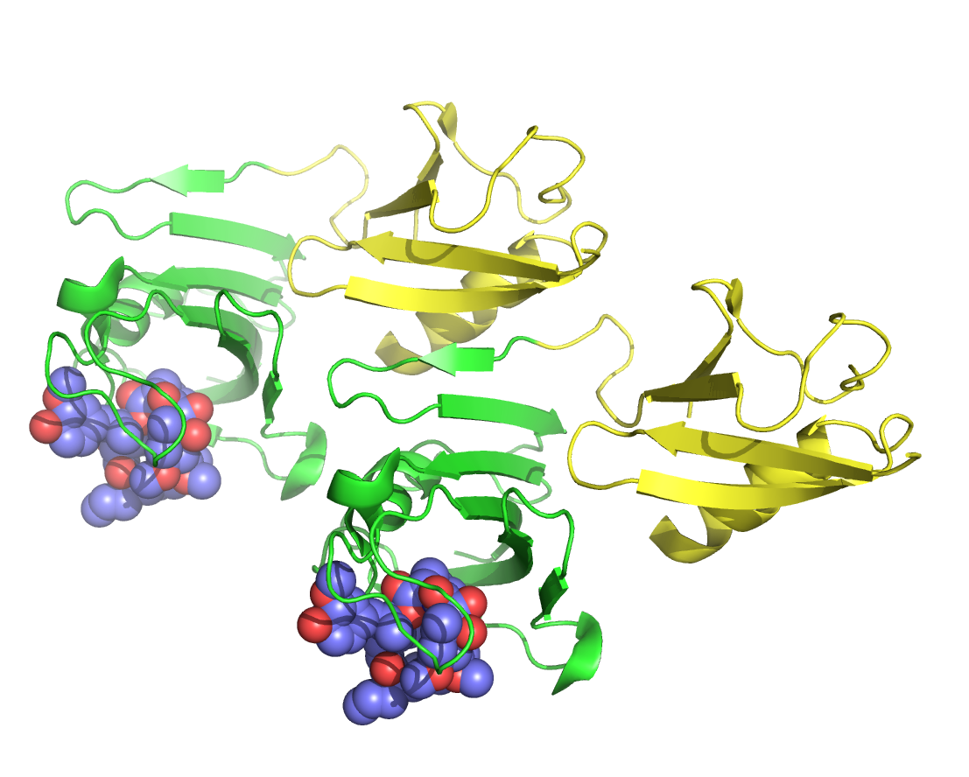
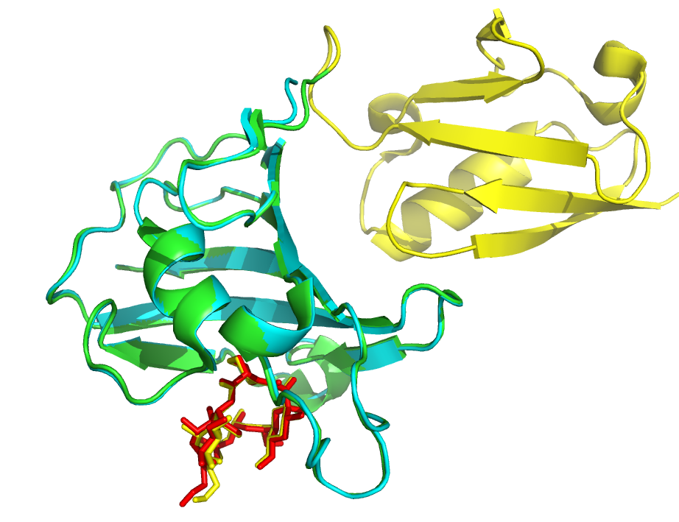
Salvage Pathways
Nearly through with all clones with little success in crystallization from CAR9/STAR7
How can improve numbers?
NIAID grant used protein concentration effectively to salvage
Revisit and boost or dilute protein
Yields for some were low such that concentrations were 5-10 mg/ml
Smt-tag-on crystallization worked well in one case
Yellow-green – Tag-on
Blue – Tag-off
Ligand binding identical
Different Space Groups

Slide 5
Summary
48 genes in first set (VCID5513-5628)
7 from Microcystis phage
7 from Synechococcus phage
34 proteins from various phages
20 purified and in crystallization trials
96 metagenomic samples (VCID5920-6019 & 6700-6716)
33 soluble
22 purified and in crystallization trials
11 not yet attempted
Papers
Pdf paper is in Merry Youle’s hands
She has sent me questions for clarification
ANN paper sent to Victor last week
Thioredoxin paper
I’m giving a Webinar on “Seawater Phage Metaproteomics or: Dark Matter, It’s Not Just for Astronomers Anymore” next month so I may hit up Forest for some slides or background info
5/2/2012

