Slide 1

Dimensions and Dark Matter May 2, 2012
5/2/2012

Slide 2
New purifications
All from metagenomic targets
New targets purified and in crystallization trials
VCID5939, 5956, 5972, 5973, 5980, 5989 submitted for crystallization on April 27 (5939, 5971, 5973, 5980) and April 30 (5956)
5 trays each
Requested fermentations of VCID5990, 5991, 6010, 6016, 6700, 6702
5/2/2012

Slide 3
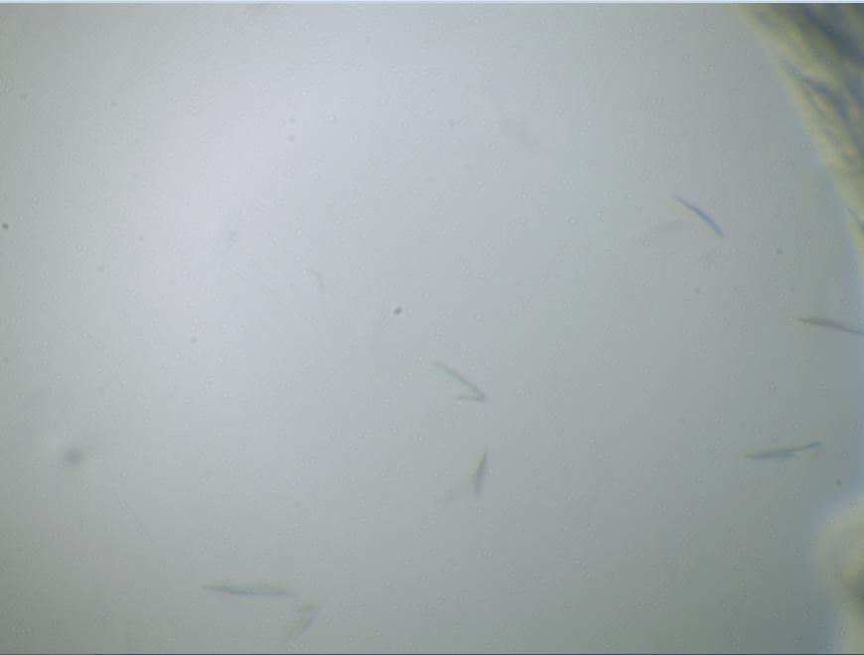
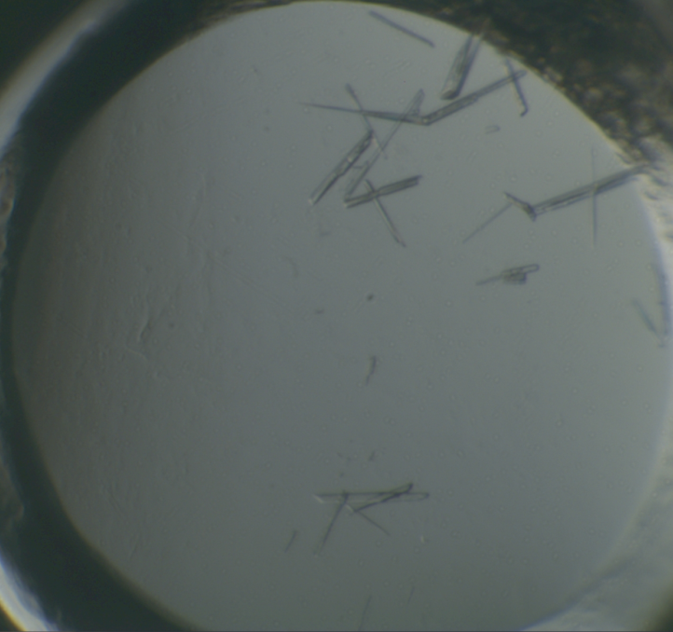
Crystals
VCID5965
Small, thin, triangular plates
Hampton CSHT_A5:
0.2M Na₃Citrate
0.1M HEPES, pH 7.5
30% v/v (+/-)-2-Methyl-2,4-pentanediol
No Diffraction ☹
VCID5971
Needles/prisms
Wizard 3/4_F3:
50% PEG400
0.1M NaAcetate, pH 4.5
0.2 M LiSO₄
Salt ☹

Slide 4
Structures Tally
Target | PDB | res | PDB | Res
Phage Pdf | 3UWA (apo) | 1.95Å | 3UWB (+ actinonin) | 1.70Å
Se PDF | 4DR8 (apo) | 1.55Å | 4DR9 (+ actinonin) | 1.90Å
Thioredoxin | 3VFI | 1.75Å | - | -
Capsid | 4DMI | 1.50Å | 4E27 (+Iodide) | 2.4Å
5/2/2012

Slide 5
Summary
48 genes in first set (VCID5513-5628)
7 from Microcystis phage
7 from Synechococcus phage
34 proteins from various phages
20 purified and in crystallization trials
96 metagenomic samples (VCID5920-6019 & 6700-6716)
33 soluble
22 purified and in crystallization trials
11 not yet attempted
Papers
Pdf paper sent to Alex to look over and comment on
ANN paper next in line for me
Thioredoxin?
5/2/2012

