Slide 1
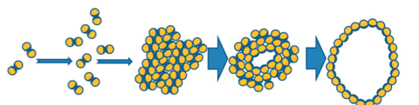
Mike’s Update 5-3-2012:
Review:
Holins are virus proteins which control the length of the infectious cycle.
They accumulate in the host membrane, and at a genetically determined time, form holes so that endolysins in the cytoplasm lyse the cell.

Slide 2
Mike’s Update 5-3-2012:
70 new ANNs were trained at different stringencies (different levels of sensitivity and specificity). They are able to predict Holins and Non-Holins at 85% accuracy
The Holin nets predicted almost 18,000 hypothetical phage proteins
Unlike MCP and Tail ANN predictions, the first 1,000 Holin-ANN predictions resonate as Holin-hits across all ANN stringency groups

Slide 3
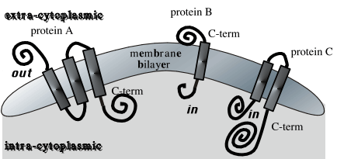
Mike’s Update 5-3-2012:
By using TMHMM (transmembrane prediction software), the alleged number of predicted TM-helices, number of AAs in the helices, and the probability that the N-terminus of the protein is in the cytoplasm will be compared among Holins and Non-holins, and used as features during ANN training.

Slide 4
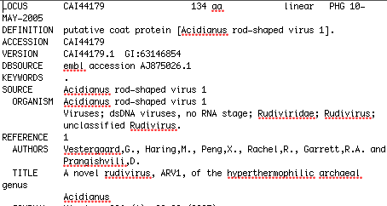
In Other News:
The paper we re-submitted to PLoS was sent back to us (again) with critiques
One reviewer is skeptical about the validity of the annotations of some of the sequences used in ANN training and testing

Slide 5
In Other News:
I am going to verify a set of Archaeal structural protein annotations by:
PsyBLASTing them,
Running them against a Conserved Domain Database,
Checking their annotations (if existent) in the ACLAME database
Manual Curation

