Slide 1
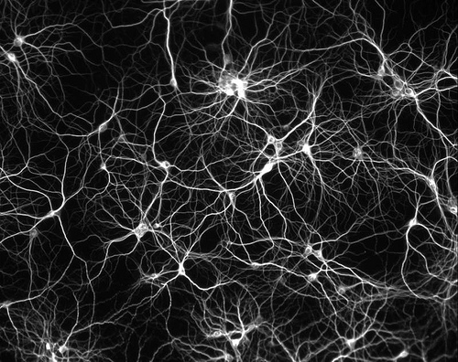

DDM ANN and Metaproteomics Update
Victor Seguritan
April 5, 2012

Slide 2
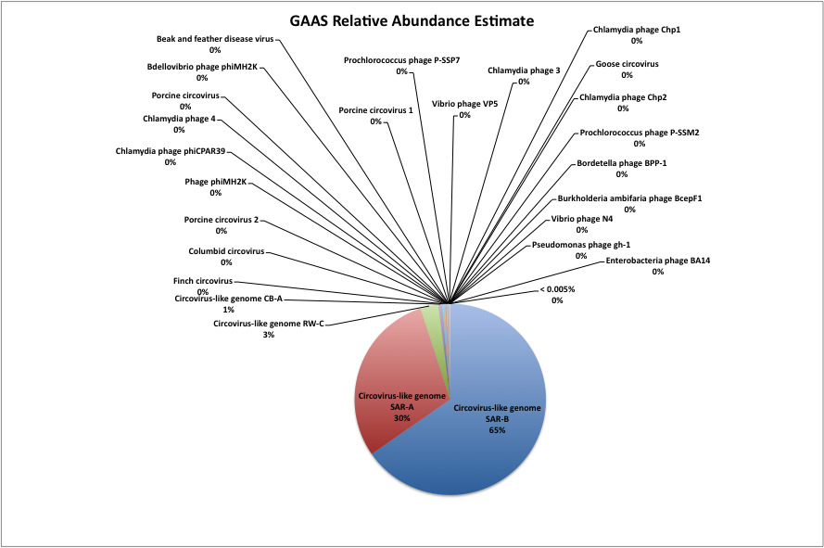
CAR9

Slide 3
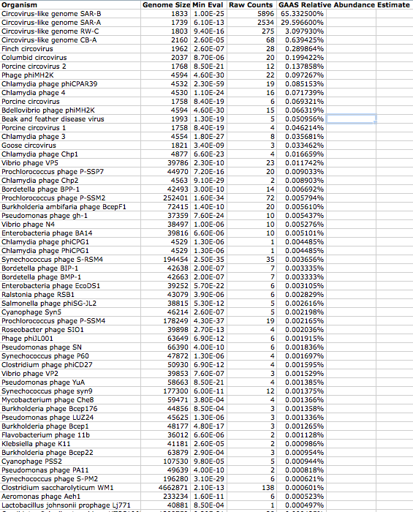
CAR9
MORE GAAS Data (Raw)

Slide 4
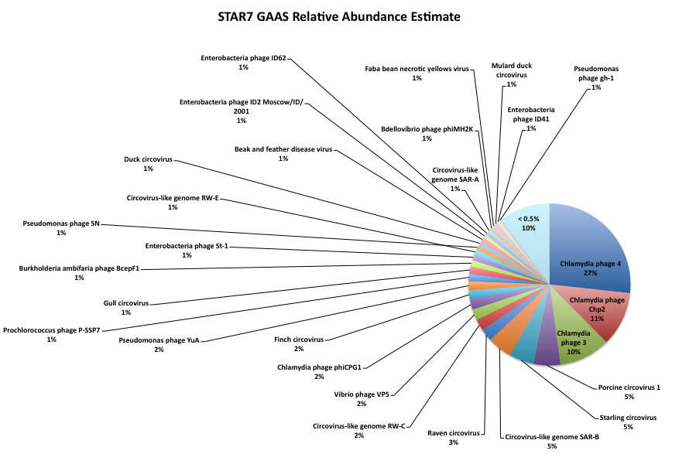

Slide 5
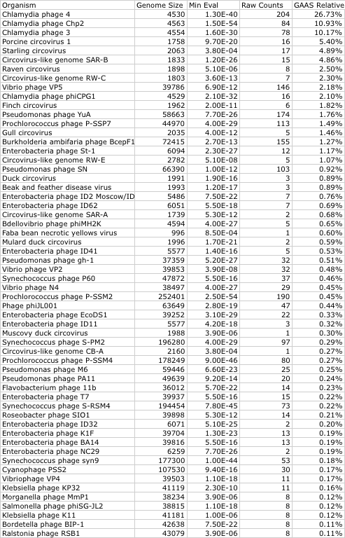
STAR7
MORE GAAS Data (Raw)

Slide 6
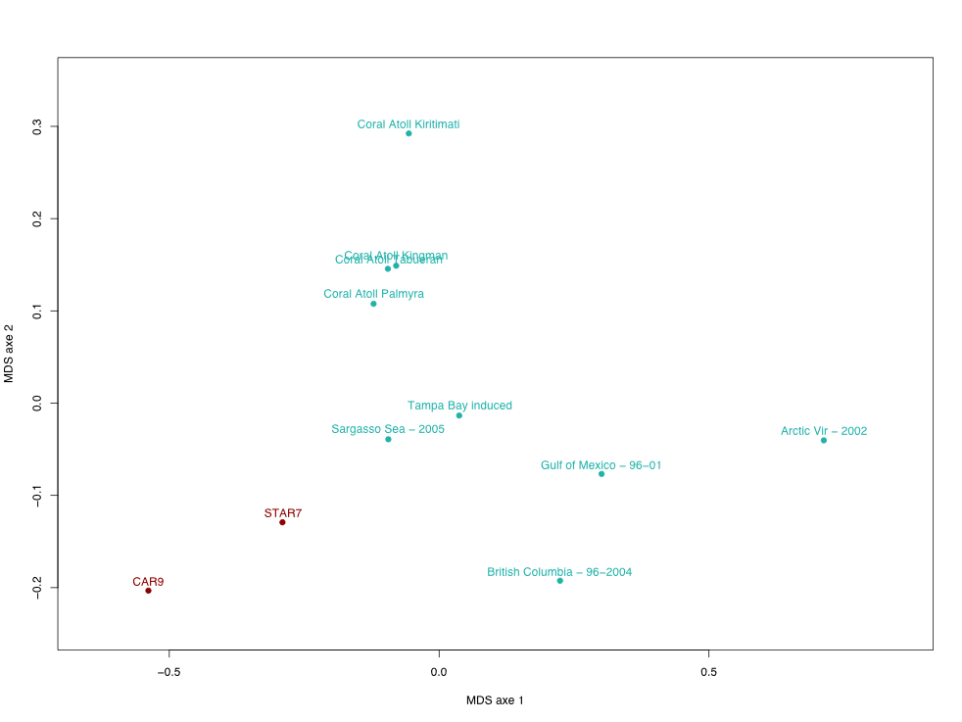
METAVIR BLAST MDS (Multidimensional Scaling)

Slide 7
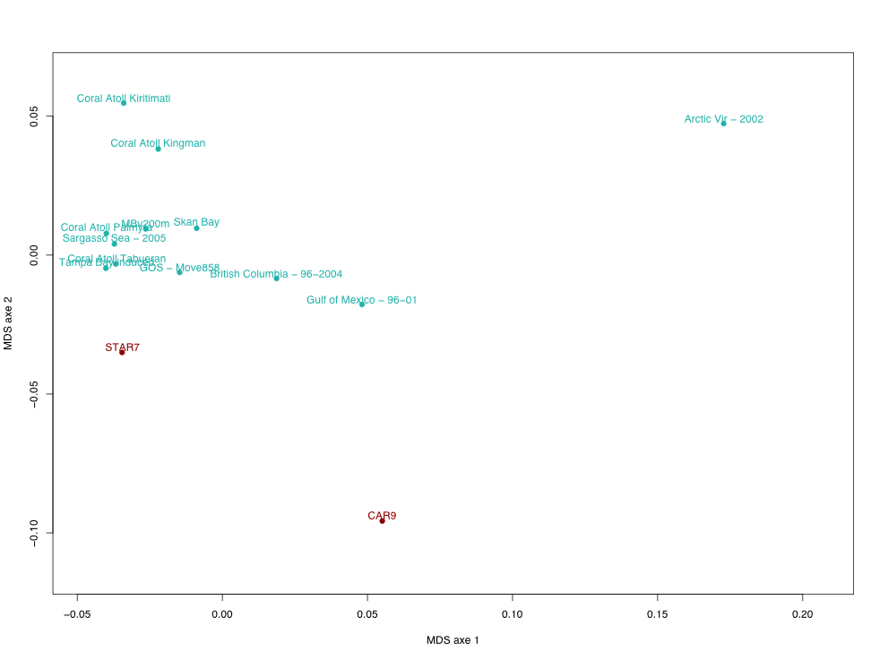
METAVIR Di-Nucleotide MDS

Slide 8
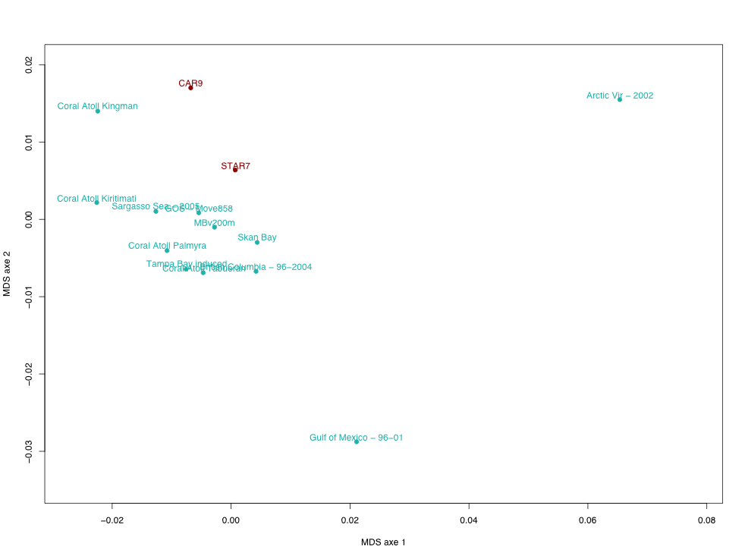
METAVIR Tri-Nucleotide MDS

Slide 9
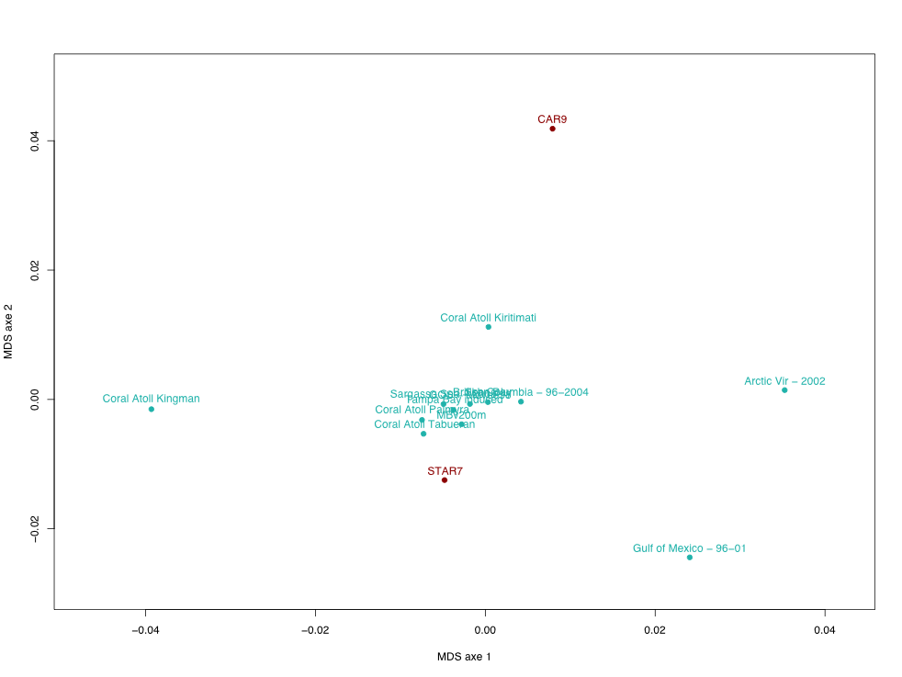
METAVIR Tetra-Nucleotide MDS

Slide 10
To Do
Submit ANN paper.
Finish iVIREONs web interface, Background and Download (Mike A.) pages http://vds.sdsu.edu/ivireons
Re-calculate MOWSE scores and analyze CAR9 and STAR7.
Finish writing metaproteomics paper.

