Slide 1
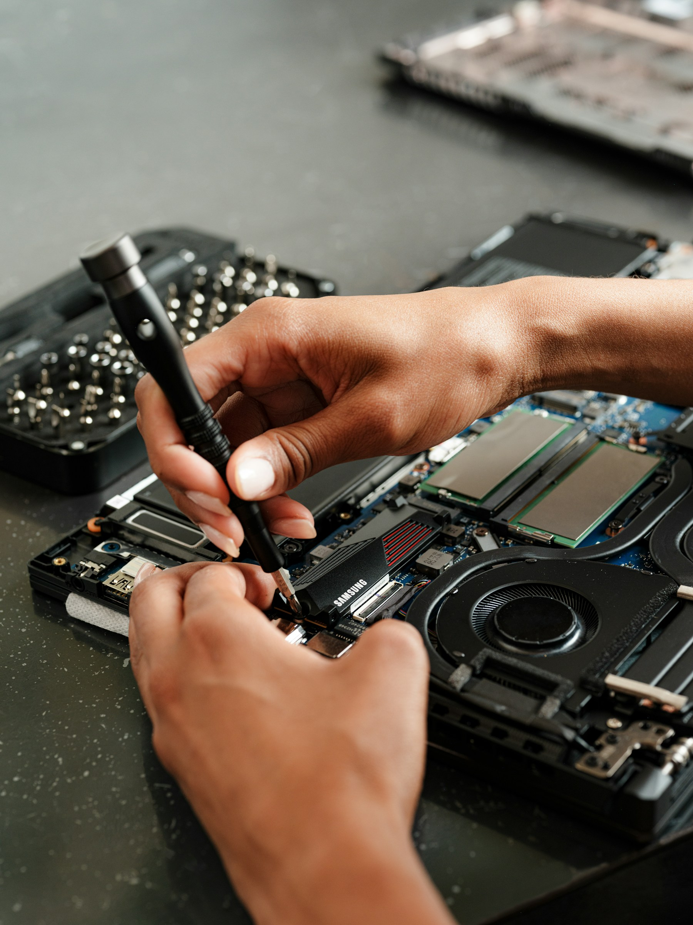
CRSM
Computer Repair
Appointment and
Service Management
System
Project overview
November 2026
Notes:
Project title and current application entry point: README.md; src/Main.java; src/crsm/fx/FxApplication.java. Cover image: src/crsm/assets/repair-workbench.jpg (supplied project asset). This overview describes source code and prepared SQL; it does not certify a live deployment.

Slide 2
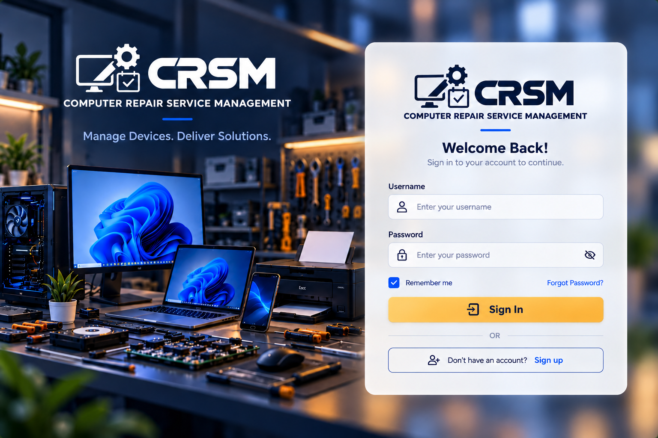
Project purpose
Keep each repair connected
to the right customer, device
and payment record.
The system brings appointment intake, technical work, estimate decisions and payment tracking into one desktop application.
Supplied sign-in design reference
CRSM | 02
Notes:
Sources: README.md; src/crsm/fx/WorkspaceController.java; src/crsm/CustomerWorkflowService.java. Problems here describe the workflow the project is designed to address, not measured findings from a real repair business. Design image: docs/design/SIGN IN.png; not a current application screenshot.

Slide 3
Three account roles
Customer
Technician
Admin
Registers devices, requests repairs, tracks progress, reviews estimates and views receipts.
Handles assigned work, confirms the final cost, records received payments and confirms pickup.
Manages records and accounts, assigns technicians, reviews reports and handles refunds.
All roles have Profile access. Role and activation controls remain with Admin.
CRSM | 03
Notes:
Sources: src/crsm/fx/WorkspaceController.java role/navigation branches; src/crsm/UserSession.java; docs/profile_and_photo_access_migration.sql; docs/availability_and_payment_migration.sql. Technician accounts use the STAFF role. Admin assigns technicians; assigned technicians and Admin may record shop payments and confirm pickup.

Slide 4
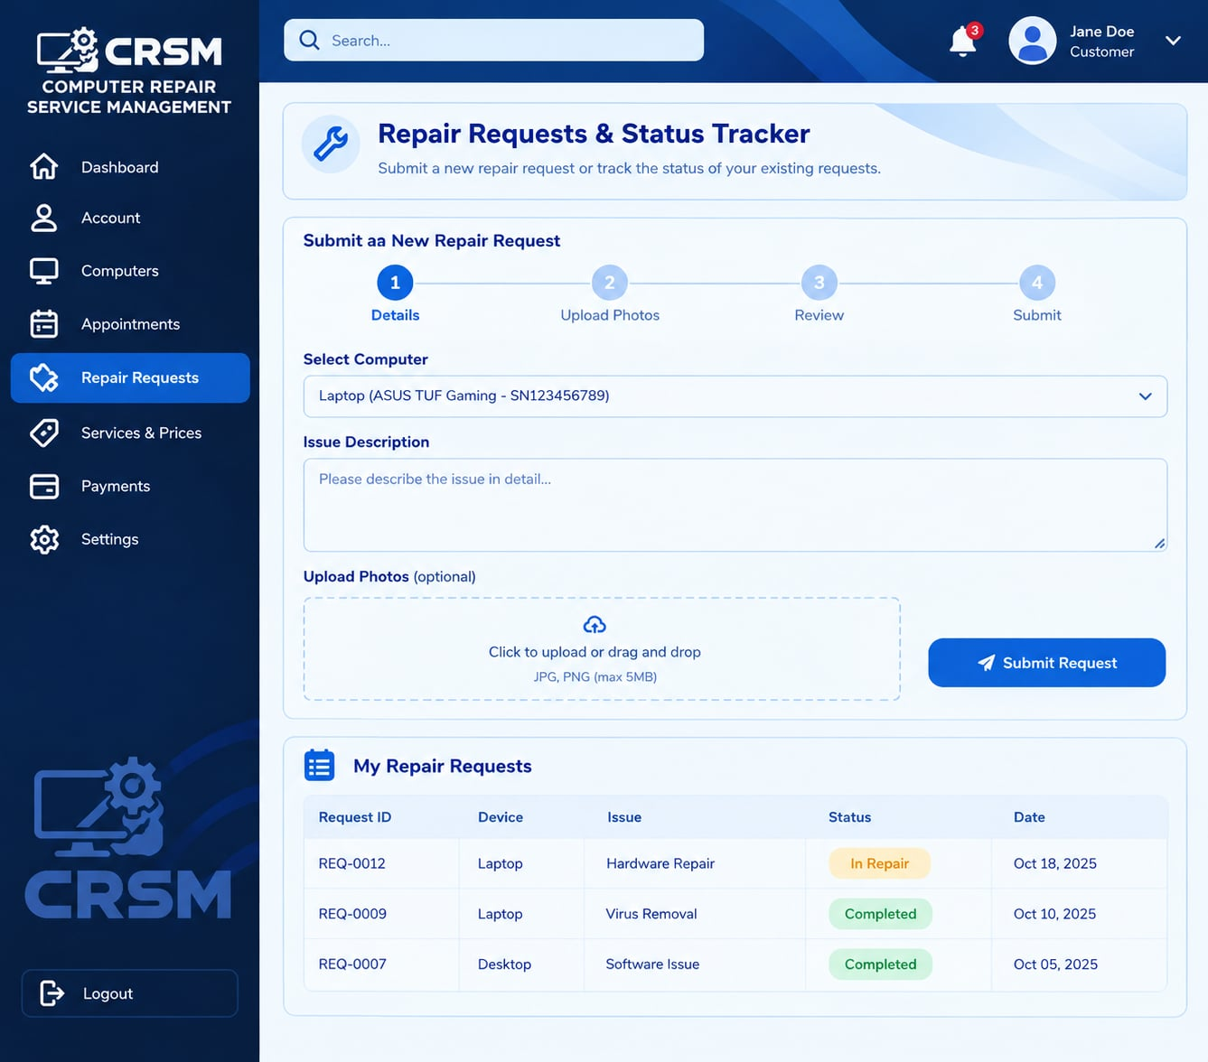
Customer repair intake
Device and problem
Record the device details, reported issue and requested service.
Appointment and photos
Book a drop-off and attach up to three readable PNG/JPEG photos, each up to 2 MB.
Design reference; current upload limit is 2 MB per photo
CRSM | 04
Notes:
Sources: src/crsm/fx/WorkspaceController.java customerRequest(), customerComputers(), customerAppointments(), myRepairs(); src/crsm/SupabaseStorageService.java validateImage(). Image: docs/design/user/3.jpg. This is a supplied design reference: its 5 MB label differs from the current Java upload limit of 2 MB per PNG/JPEG and up to three files.

Slide 5
Repair lifecycle
01
Request and assignment
Customer submits the repair; Admin assigns an eligible technician.
02
Diagnosis and estimate
Technician diagnoses the issue; Customer approves or declines the estimate.
03
Technical work
Repair work and parts are recorded; the final bill is confirmed.
04
Payment and pickup
Received payments produce receipts; a settled repair can be collected.
CRSM | 05
Notes:
Sources: docs/customer_workflow_migration.sql estimate and work RPCs; docs/availability_and_payment_migration.sql assignment, finish, payment, pickup RPCs. The sequence summarizes the main successful path, not every permitted transition. Customer estimate decline returns the request for follow-up; parts/testing can add intermediate steps.

Slide 6
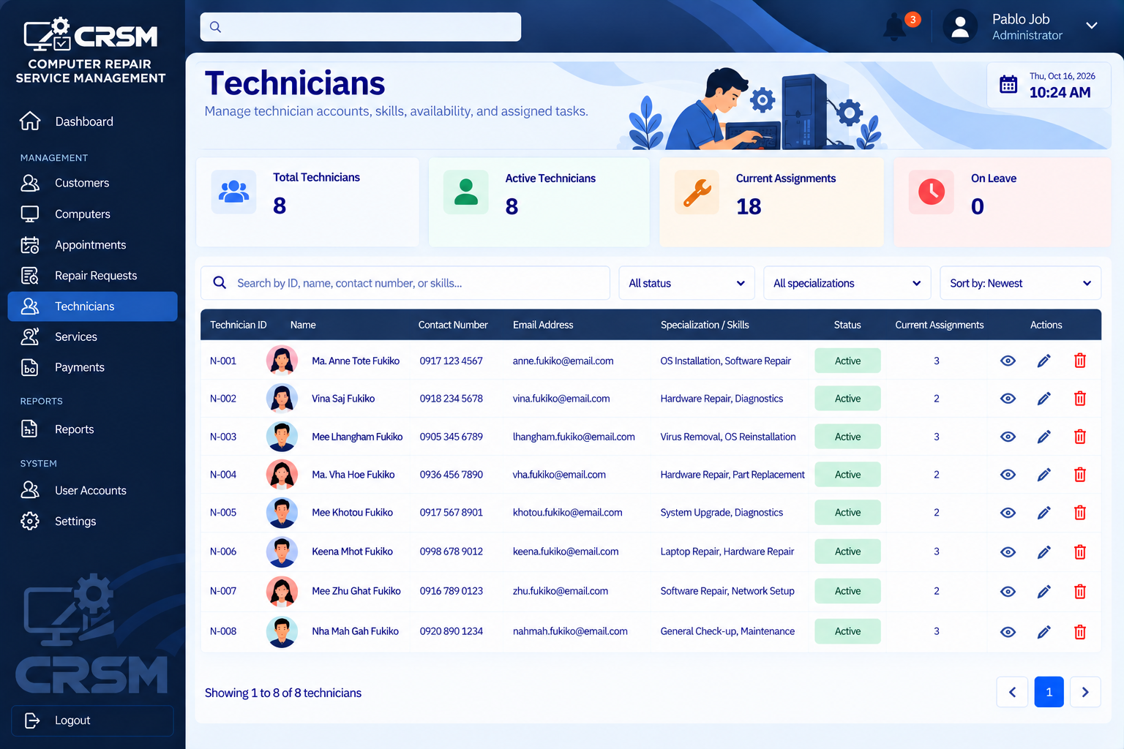
Technician availability
Availability combines duty
status and technical workload.
One active technical repair per technician.
Busy, Unavailable and Off Duty block new assignments.
Finished technical work frees the slot before payment or pickup.
Design reference; names and counts are illustrative
CRSM | 06
Notes:
Source: docs/availability_and_payment_migration.sql crsm_technical_status(), guard_crsm_technician_capacity(), list_crsm_technician_availability(). Finishing technical work releases capacity while Awaiting Payment or Ready for Pickup do not consume a technical slot. Existing multiple assignments are not deleted by the migration. Image: docs/design/technician.png is a design reference with illustrative values, not current capacity rules or live counts.

Slide 7
Shop payments and digital receipts
PHP 500 final bill
PHP 200 received
PHP 300 still due
Each received payment gets a receipt.
Customers can view and save it as text.
Pickup requires the balance to be settled.
Illustrative example | Demo QR does not process real payments
CRSM | 07
Notes:
Sources: docs/availability_and_payment_migration.sql record_crsm_payment(), confirm_crsm_pickup(); src/crsm/PaymentReceipt.java; src/crsm/fx/PaymentDialogs.java. The PHP 500 bill and PHP 200 payment shown here are an illustrative arithmetic example, not business performance data. A later PHP 300 payment settles that example. Customers pay at the shop; assigned Technician or Admin records received funds. Refunds remain Admin-only. The QR is a non-scannable demo visual and transfers no money.

Slide 8
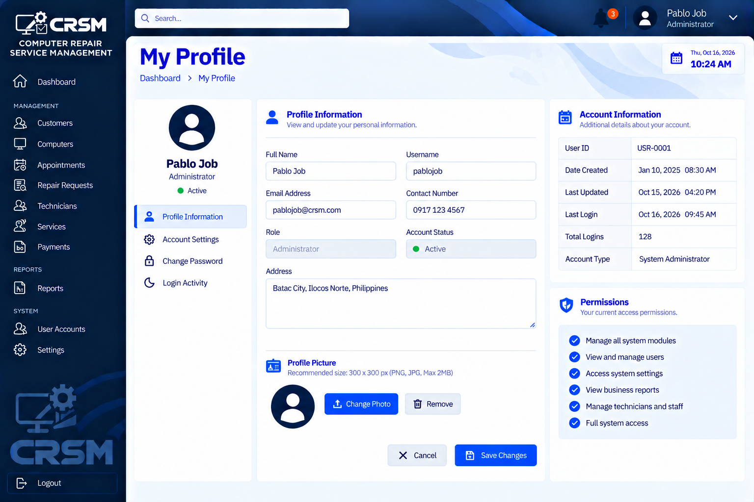
Profiles and attached photos
Account information
Edit name, username and contact details. Change passwords through the authentication service.
Damage-photo viewer
Open stored thumbnails, preview photos and navigate between images. Loading failures can be retried.
Supplied profile design reference
CRSM | 08
Notes:
Sources: src/crsm/fx/RepairPhotoViewer.java; src/crsm/SupabaseAuthService.java; docs/profile_and_photo_access_migration.sql; src/crsm/fx/WorkspaceController.java profile(). Repair-photo permissions cover owning Customer, assigned Technician and active Admin. Profile save updates supported identity/contact fields and preserves account links. Email is read only in the current JavaFX screen. Image: docs/design/profile info.png is a supplied design reference, not an exact screenshot of all supported current fields.

Slide 9
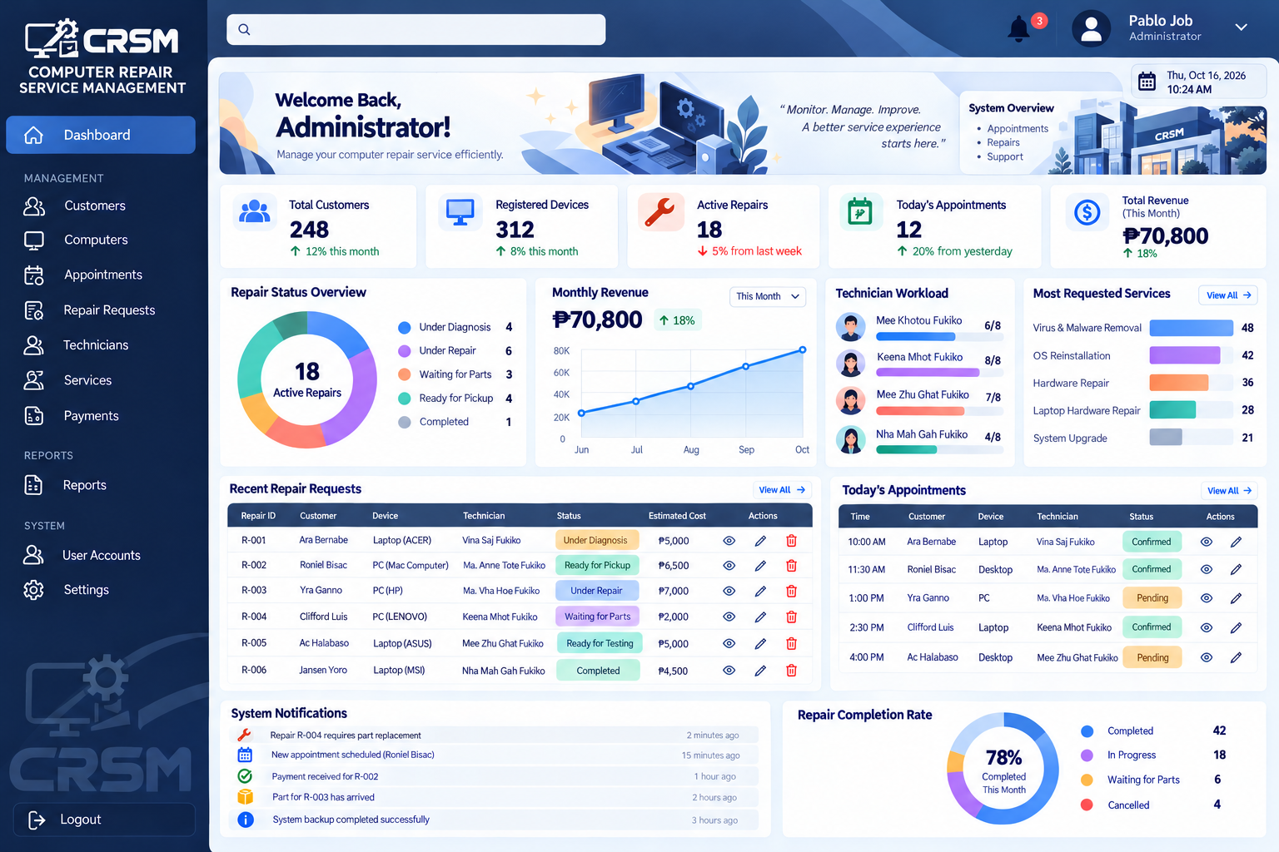
Dashboard charts and statistics
Repair status
Net payment trends
Current balances
Customer: owned repairs
Technician: assigned repairs
Admin: shop overview
Design reference; values illustrative and extra modules may differ
CRSM | 09
Notes:
Sources: src/crsm/fx/WorkspaceController.java dashboard(); docs/dashboard_statistics_migration.sql. Current native JavaFX charts: repair-status pie chart and six-month net-payment bar chart. Metrics are scoped to owner/assignment/Admin. Payments subtract refunds and group by the original payment month. Image: docs/design/dashboard.png is a design reference. All visible values in that image are illustrative; its extra modules do not imply implementation.

Slide 10
Application architecture
Presentation
JavaFX controllers, FXML layouts and CSS. The downloaded Figma project supplies visual references.
Application services
Authentication, workflow RPCs, private image storage, receipt formatting and supplier links.
Persistence
Supabase Auth / Storage / PostgreSQL, plus existing JDBC repository paths.
CRSM | 10
Notes:
Sources: src/Main.java; src/crsm/fx/FxApplication.java; src/crsm/fx/WorkspaceController.java; src/crsm/SupabaseClient.java; src/crsm/SupabaseAuthService.java; src/crsm/SupabaseStorageService.java; src/crsm/CustomerWorkflowService.java; src/crsm/RepairRepository.java. Legacy Swing classes remain. JDBC still uses a configured shared database credential; it does not inherit the signed-in Supabase JWT identity.

Slide 11
Core database records
Entity | Primary responsibility | Main relationship
Customers | Contact and ownership | Owns computers
Computers | Device identifiers and details | Belongs to a customer
Appointments | Drop-off schedule | Links customer and computer
Repair requests | Issue, status and costs | Links device, technician and service
Technicians | Skills, duty and account link | Assigned to repairs
Repair services | Service descriptions and fees | Referenced by repairs and part prices
Payments | Received amount and receipt | Belongs to a repair request
Profiles, history, estimates, refunds and catalog tables extend these records
CRSM | 11
Notes:
Sources: docs/supabase_fresh_setup.sql; docs/customer_workflow_migration.sql; docs/repair_request_pricing_migration.sql. This editable table summarizes the seven core business entities; additional tables hold profiles, history, estimates, refunds, catalog and settings. It is not a full ERD.

Slide 12
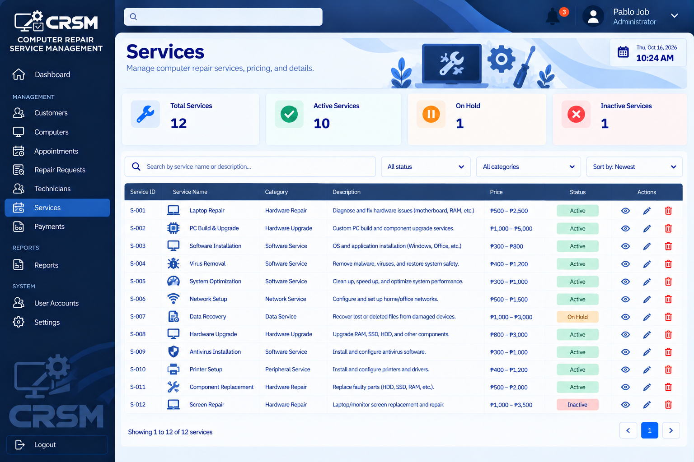
Parts prices and supplier browsing
Search compatible parts
by brand, model and specification.
Shop part prices are stored separately from labor.
Check on Shopee opens the selected part search in the user's browser.
Current product photos and prices are viewed on Shopee.
Service-catalog design reference
CRSM | 12
Notes:
Sources: src/crsm/fx/WorkspaceController.java partPrices(); src/crsm/SupplierLinks.java; src/crsm/fx/FxApplication.java openLink(); docs/repair_request_pricing_migration.sql. Parts prices are stored shop prices, not scraped live supplier data. Shopee opens in the external browser on explicit user click. The application does not import supplier photos/prices or purchase parts. Image: docs/design/services.png is a design reference for service browsing, not a screenshot of the new parts browser.

Slide 13
Security boundaries
Account and repair access
Active-account checks, Customer ownership and Technician assignment protect guarded workflow and photo operations.
Restricted management
Admin controls account role/status and refunds. Payment recording is limited to the assigned Technician or Admin.
Deployment concern
Legacy JDBC uses a shared database credential. Migrate or isolate those paths before distributing the app to untrusted users.
CRSM | 13
Notes:
Sources: docs/profile_and_photo_access_migration.sql; docs/availability_and_payment_migration.sql; docs/dashboard_statistics_migration.sql; src/crsm/RepairRepository.java; docs/workflow_implementation_notes.md. These are source-level controls requiring deployed migrations. The remaining shared-credential JDBC path is a material deployment limitation, and role-based UI visibility alone is not database authorization.

Slide 14
Verification and deployment status
Automated local checks
Service contracts, validation, payment roles, attachment requests, receipt totals, statistics requests and supplier-link encoding.
Database and sign-in checks
Apply ordered migrations, then verify persistence, role restrictions, concurrent assignment/payment and private storage access.
Local checks passed; live database and signed-in UI behavior still require verification.
CRSM | 14
Notes:
Sources: build-javafx.ps1; test-workflows.ps1; tests/WorkflowChecks.java; tests/AccountPhotoChecks.java; tests/workflow_regression.sql; docs/javafx-feature-checklist.md. Local service tests were rerun successfully for this inspection. The suites use a localhost HTTP server and do not validate deployed SQL. No app launch or sign-in was performed. Migration application and database regression execution remain unverified.

Slide 15
Suggested demonstration
1 Submit a repair as Customer
2 Assign and complete technical work
3 Record a partial payment, then settle the bill
4 View the receipt and confirm pickup
5 Review charts and open Shopee search
Prepare linked test accounts and apply the required migrations before the demonstration.
CRSM | 15
Notes:
Sources: docs/javafx-feature-checklist.md; src/crsm/fx/WorkspaceController.java; src/crsm/fx/PaymentDialogs.java; src/crsm/SupplierLinks.java. Prepare linked test accounts and deployed migrations first. Do not use real customer records or real funds for a classroom demonstration. The presentation uses design reference images rather than captured runtime screens.

