Slide 1

Caching in hibernate
Presented by Pioneer Coders

Slide 2
Explanation…
Caching is a facility provided by ORM frameworks which help users to get fast running web application, while help framework itself to reduce number of queries made to database in a single transaction. Hibernate achieves the second goal by implementing first level cache.
Fist level cache in hibernate is enabled by default and you do not need to do anything to get this functionality working. In fact, you can not disable it even forcefully
Its easy to understand the first level cache if we understand the fact that it is associated with Session object. As we know session object is created on demand from session factory and it is lost, once the session is closed.

Slide 3
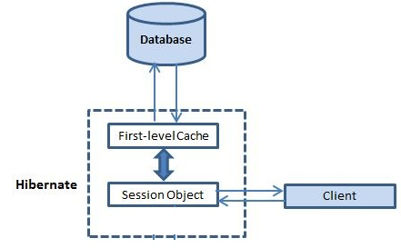
Similarly, first level cache associated with session object is available only till session object is live. It is available to session object only and is not accessible to any other session object in any other part of application.

Slide 4
What is Entity and Value Objects…
First level cache is associated with “session” object and other session objects in application can not see it.
The scope of cache objects is of session. Once session is closed, cached objects are gone forever.
When we query an entity first time, it is retrieved from database and stored in first level cache associated with hibernate session.
If we query same object again with same session object, it will be loaded from cache and no sql query will be executed.
The loaded entity can be removed from session using evict() method. The next loading of this entity will again make a database call if it has been removed using evict() method.

Slide 5
Second level cache: This is apart from first level cache which is available to be used globally in session factory scope.
Above statement means, second level cache is created in session factory scope and is available to be used in all sessions which are created using that particular session factory. It also means that once session factory is closed, all cache associated with it die and cache manager also closed down.
Further, It also means that if you have two instances of session factory (normally no application does that), you will have two cache managers in your application and while accessing cache stored in physical store, you might get unpredictable results like cache-miss.

Slide 6
How second level cache works
Whenever hibernate session try to load an entity, the very first place it look for cached copy of entity in first level cache (associated with particular hibernate session).
If cached copy of entity is present in first level cache, it is returned as result of load method.
If there is no cached entity in first level cache, then second level cache is looked up for cached entity.
If second level cache has cached entity, it is returned as result of load method. But, before returning the entity, it is stored in first level cache also so that next invocation to load method for

Slide 7
You have to add two properties in hibernate.cfg file
To implement second level cache, we need to define cache.provider_class property in the configuration file.
<property name="cache.provider_class">org.hibernate.cache.EhCacheProvider</property>
<property name="hibernate.cache.use_second_level_cache">
true</property>

