Slide 1
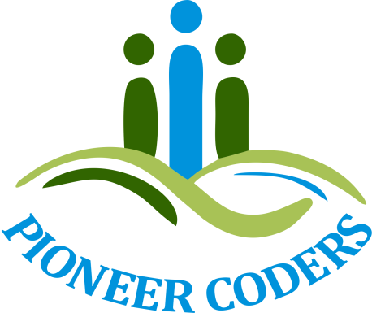
ORM
Presented by Pioneer Coders

Slide 2
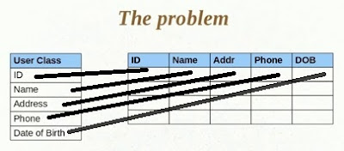
What is ORM?
ORM:
Means Objects to Relational Mapping i.e Java Persistence Objects are mapped to Relational databases by using ORM tools.
ORM stands for Object-Relational Mapping (ORM) is a programming technique for converting data between relational databases and object oriented programming languages such as Java, C# etc. An ORM system has following advantages over plain JDBC
Why We Have to Use ORM Tools?
Notes:
Tip: Add your own speaker notes here.

Slide 3
Problem with mapping with orm?
Here there is one problem to object save in to relational database each entity of the object save individually to the database table in the associated columns. It is more times taken and complex in case of lots of user objects to be save into the database table. When Inserting into database:
Object's Property ID set to ID column Object's Property Name set to Name Column
Object's Property Address set to Address Column
Object's Property phone set to phone Column

Slide 4
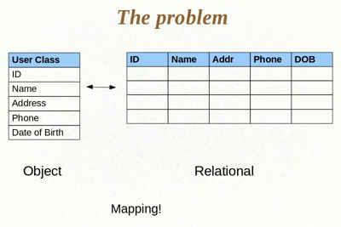
Explanation
When Fetching Result Set from Database Table.
Column ID's Value set to Object's ID Property
Column Name's Value set to Object's Name Property
Column Address's Value set to Object's Address Property
Column Phone's Value set to Object's Phone Property .

Slide 5
ORM frameworks:
There are several persistent frameworks and ORM options in Java. A persistent framework is an ORM service that stores and retrieves objects into a relational database.
Enterprise JavaBeans Entity Beans
Java Data Objects
Spring DAO
Hibernate

Slide 6
Advantages of ORM
Lets business code access objects rather than DB tables.
Hides details of SQL queries from OO logic.
Based on JDBC 'under the hood‘
No need to deal with the database implementation.
Entities based on business concepts rather than database structure.
Transaction management and automatic key generation.
Fast development of application.

