Slide 1

Introduction to JDBC
Presented by Pioneer Coders

Slide 2
Jdbc introduction:
Java Database Connectivity(JDBC) is an Application Programming Interface(API) used to connect Java application with Database. JDBC is used to interact with various type of Database such as Oracle, MS Access, My SQL and SQL Server. JDBC can also be defined as the platform-independent interface between a relational database and Java programming. It allows java program to execute SQL statement and retrieve result from database.

Slide 3
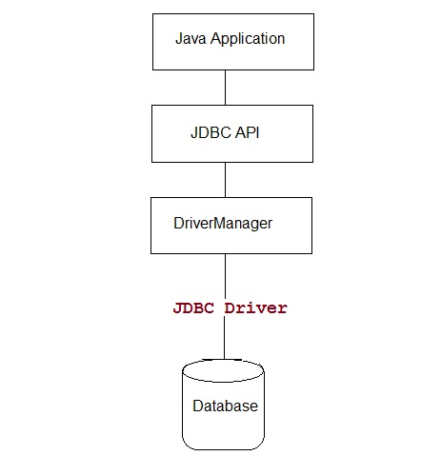
Jdbc introduction:

Slide 4
Jdbc sample code:
public void connectToAndQueryDatabase(String username, String password) {
Connection con = DriverManager.getConnection( "jdbc:myDriver:myDatabase", username, password);
Statement stmt = con.createStatement();
ResultSet rs = stmt.executeQuery("SELECT a, b, c FROM Table1");
while (rs.next()) {
int x = rs.getInt("a");
String s = rs.getString("b“);

Slide 5
Jdbc sample code
float f = rs.getFloat("c");
}
}
JDBC Driver is required to process SQL requests and generate result. The following are the different types of driver available in JDBC.
Type-1 Driver or JDBC-ODBC bridge
Type-2 Driver or Native API Partly Java Driver
Type-3 Driver or Network Protocol Driver
Type-4 Driver or Thin Driver

Slide 6
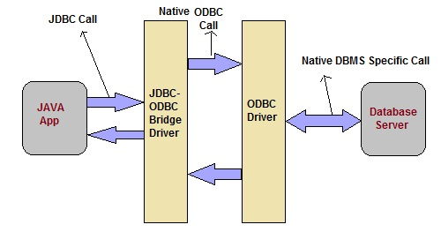
Type-1 Driver act as a bridge between JDBC and other database connectivity mechanism(ODBC). This driver converts JDBC calls into ODBC calls and redirects the request to the ODBC driver.

Slide 7
Advantages of jdbc-odbc bridge
Advantage
Easy to use
Allow easy connectivity to all database supported by the ODBC Driver.
Disadvantage
Slow execution time
Dependent on ODBC Driver.
Uses Java Native Interface(JNI) to make ODBC call.

Slide 8
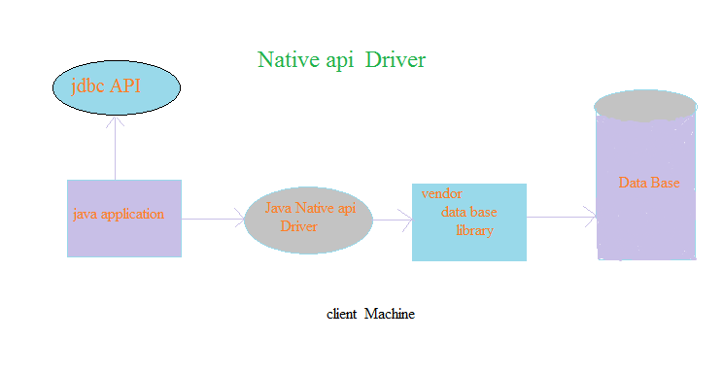
This type of driver make use of Java Native Interface(JNI) call on database
specific native client API. These native client API are usually written in C and C++.

Slide 9
Native api Driver:
Advantage
faster as compared to Type-1 Driver
Contains additional features.
Disadvantage
Requires native library
Increased cost of Application

Slide 10
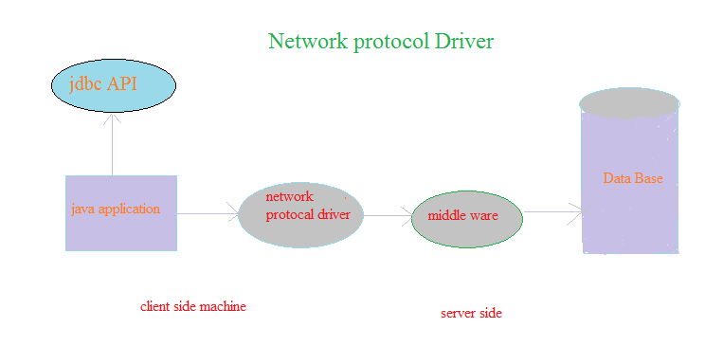
Network protocol Driver
The Network Protocol driver uses middleware (application server) that converts JDBC calls directly or indirectly into the vendor-specific database protocol. It is fully written in java.

Slide 11
Network protocol
Advantage
Does not require any native library to be installed.
Database Independency.
Provide facility to switch over from one database to another database.
Disadvantage
Slow due to increase number of network call.

Slide 12
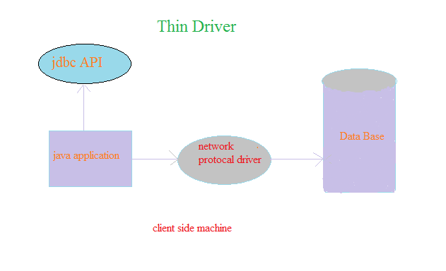
Thin Driver
The thin driver converts JDBC calls directly into the vendor-specific database protocol. That is why it is known as thin driver. It is fully written in Java language.

Slide 13
Thin Driver:
Advantage:
Better performance than all other drivers.
No software is required at client side or server side.
Disadvantage:
Drivers depends on the Database.

