Slide 1

Introduction to RDBMS
Presented by Pioneer Coders

Slide 2
RDBMS introduction:
RDBMS stands for Relational Database Management System. RDBMS is the basis for SQL, and for all modern database systems like MS SQL Server, IBM DB2, Oracle, MySQL, and Microsoft Access.
A relational DBMS is special system software that is used to manage the organization, storage, access, security and integrity of data. This specialized software allows application systems to focus on the user interface, data validation and screen navigation. When there is a need to add, modify, delete or display data, the application system simply makes a "call" to the RDBMS.

Slide 3
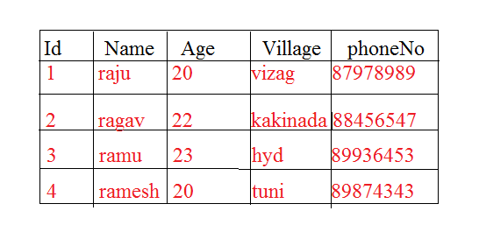
What is table:
In Relational database, a table is a collection of data elements organised in terms of rows and columns. A table is also considered as convenient representation of relations.

Slide 4
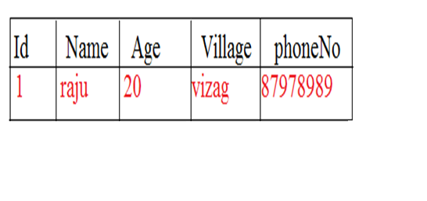
What is record:
A single entry in a table is called a Record or Row. A Record in a table represents set of related data. For example, the above PersionInfo table has 4 records. Following is an example of single record.

Slide 5
What is field and column:
A table consists of several records(row), each record can be broken into several smaller entities known asFields. The above PersionInfo table consist of four fields, ID, Name, Age,Salary
and PhoneNo.
In Relational table, a column is a set of value of a particular type. The term Attribute is also used to represent a column. For example, in PersionalInfo table, Name is a column that represent names of persion.

Slide 6
What is NULL value ?
A NULL value in a table is a value in a field that appears to be blank, which means a field with a NULL value is a field with no value.
It is very important to understand that a NULL value is different than a zero value or a field that contains spaces. A field with a NULL value is one that has been left blank during record creation.
Sql constraints:
Constraints are the rules enforced on data columns on table. These are used to limit the type of data that can go into a table. This ensures the accuracy and reliability of the data in the database.

Slide 7
Sql constraints:
Constraints could be column level or table level. Column level constraints are applied only to one column where as table level constraints are applied to the whole table.
Following are commonly used constraints available in SQL:
NOT NULL Constraint:
Ensures that a column cannot have NULL value.
DEFAULT Constraint:
Provides a default value for a column when none is specified.
UNIQUE Constraint:
Ensures that all values in a column are different.

Slide 8
Sql constraints:
PRIMARY Key: Uniquely identified each rows/records in a database table.
FOREIGN Key: Uniquely identified a rows/records in any another database table.
CHECK Constraint: The CHECK constraint ensures that all values in a column satisfy certain conditions.
INDEX:Use to create and retrieve data from the database very quickly.

Slide 9
Data Integrity:
The following categories of the data integrity exist with each RDBMS:
Entity Integrity:
There are no duplicate rows in a table.
Domain Integrity:
Enforces valid entries for a given column by restricting the type, the format, or the range of values.
Referential integrity:
Rows cannot be deleted, which are used by other records.
User-Defined Integrity: Enforces some specific business rules that do not fall into entity, domain or referential integrity.

Slide 10
Normalization:
Normalization is a process of organizing the data in database to avoid data redundancy, insertion anomaly, update anomaly & deletion anomaly. Let’s discuss about anomalies first then we will discuss normal forms with examples.
If a database design is not perfect, it may contain anomalies, which are like a bad dream for any database administrator. Managing a database with anomalies is next to impossible.
Update anomalies
If data items are scattered and are not linked to each other properly, then it could lead to strange situations.

Slide 11
Anomalies explanation:
For example, when we try to update one data item having its copies scattered over several places, a few instances get updated properly while a few others are left with old values. Such instances leave the database in an inconsistent state.
Deletion anomalies
We tried to delete a record, but parts of it was left undeleted because of unawareness, the data is also saved somewhere else.
Insert anomalies
We tried to insert data in a record that does not exist at all.

Slide 12
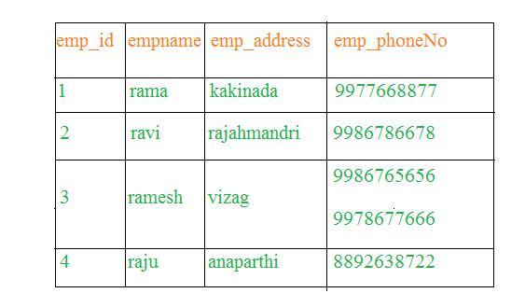
First Normal form:
As per the rule of first normal form, an attribute (column) of a table cannot hold multiple values. It should hold only atomic values.
Example: Suppose a company wants to store the names and contact details of its employees. It creates a table that looks like this:

Slide 13
First normalization:
One employee (ramesh) is having two mobile numbers so the company stored them in the same field as you can see in the table above.
This table is not in 1NF as the rule says “each attribute of a table must have atomic (single) values”, the emp_mobile values for employee (ramesh) violates that rule.
To make the table complies with 1NF we should have the data like this.

Slide 14
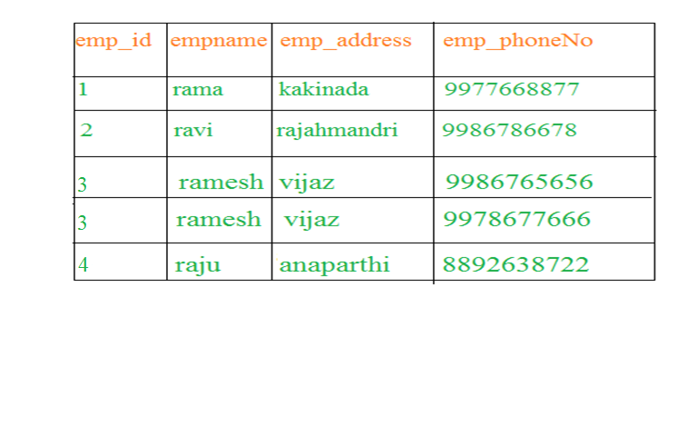
First Normal form:
Using the First Normal Form, data redundancy increases, as there will be many columns with same data in multiple rows but each row as a whole will be unique

Slide 15
Second Normal form:
In example of First Normal Form there are two rows for ramesh, to include multiple phoneNos that he has opted for. While this is searchable, and follows First normal form, it is an inefficient use of space. Also in the above Table in First Normal Form, while the candidate key is {emp_id, emp_name}, phoneNo of Student only depends on emp_id column, which is incorrect as per Second Normal Form. To achieve second normal form, it would be helpful to split out the subjects into an independent table, and match them up using the student names as foreign keys.

Slide 16
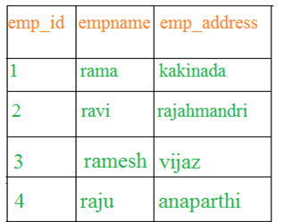
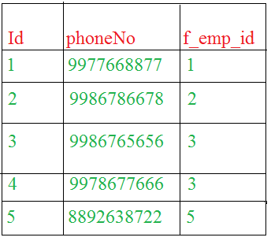
Second Normal form:
In Student Table the candidate key will be emp_id column, because all other column i.e empname,emp_address is dependent on it.

Slide 17
Second Normal form:
In employee Table the candidate key will {emp_id,emp_phoneNo} column. Now, both the above tables qualifies for Second Normal Form and will never suffer from Update Anomalies. Although there are a few complex cases in which table in Second Normal Form suffers Update Anomalies, and to handle those scenarios Third Normal Form is there.

