Slide 1

Basic SQL Queries
Presented by Pioneer Coders

Slide 2
What is SQL :
SQL gives unique learning on Structured Query Language and it helps to make practice on SQL commands which provides immediate results. SQL is a language of database, it includes database creation, deletion, fetching rows and modifying rows etc.
SQL is an ANSI (American National Standards Institute) standard but there are many different versions of the SQL language.
SQL is a database computer language designed for the retrieval and management of data in relational database. SQL stands for Structured Query Language.

Slide 3
What is SQL
SQL is the standard language for Relation Database System. All relational database management systems like MySQL, MS Access, Oracle, Sybase, Informix, postgres and SQL Server use SQL as standard database language.
Also, they are using different dialects, such as:
MS SQL Server using T-SQL,
Oracle using PL/SQL

Slide 4
Why sql:
Allows users to access data in relational database management systems.
Allows users to describe the data.
Allows users to define the data in database and manipulate that data.
Allows users to create and drop databases and tables.
Allows users to create view, stored procedure, functions in a database.
Allows users to set permissions on tables, procedures, and views

Slide 5
Sql process:
When you are executing an SQL command for any RDBMS, the system determines the best way to carry out your request and SQL engine figures out how to interpret the task.
There are various components included in the process. These components are Query Dispatcher, Optimization Engines, Classic Query Engine and SQL Query Engine, etc. Classic query engine handles all non-SQL queries but SQL query engine won't handle logical files.

Slide 6
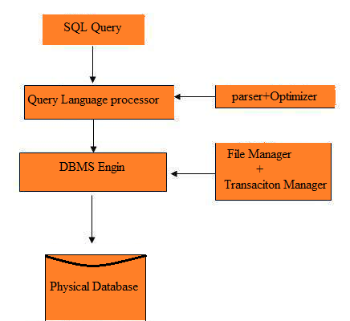
Sql Process:

Slide 7
Sql Commands:
The standard SQL commands to interact with relational databases are CREATE, SELECT, INSERT, UPDATE, DELETE and DROP. These commands can be classified into groups based on their nature:
DDL - Data Definition Language:
CREATE : Creates a new table, a view of a table, or other object in database
ALTER : Modifies an existing database object, such as a table.
DROP : Deletes an entire table, a view of a table or other object in the database.

Slide 8
Example of DDL commands:
The SQL CREATE DATABASE statement is used to create new SQL database.
Syntax is…
CREATE DATABASE DatabaseName;
If you want to create new database <sampleDB>, then CREATE DATABASE statement would be as follows:
CREATE DATABASE sampleDB;
Snytax for show the available databases:
SHOW DATABASES;

Slide 9
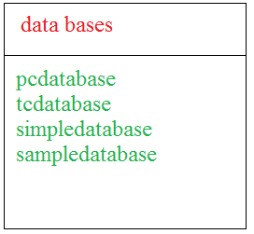
Examples of DDL Commands:
Show database;
Synatax for drop database is :
DROP DATABASE DatabaseName;

Slide 10
Syntax for creating table:
CREATE TABLE table_name( column1 datatype, column2 datatype, column3 datatype, ..... columnN datatype, PRIMARY KEY( one or more columns ) );
CREATE TABLE PERSONS(
ID INT NOT NULL,
NAME VARCHAR (20) NOT NULL,
AGE INT NOT NULL,
ADDRESS CHAR (25) ,
SALARY DECIMAL (18, 2),
PRIMARY KEY (ID) );

Slide 11
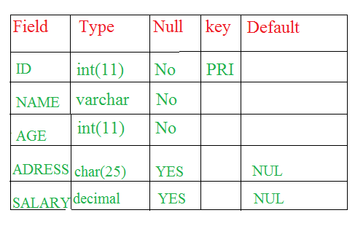
DESC command is for verify your table has been created or not
Successfully
Syntax is :
DESC PERSONS;

Slide 12
Syntax is :
DROP TABLE table_name;
DROP TABLE PERSONS;
Now, if you would try DESC command, then you would get error as follows.
DESC PERSONS; ERROR 1146 (42S02): Table SAMPLE.PERSIONS' doesn't exist

Slide 13
DML –Data Manipulation language
SELECT : Retrieves certain records from one or more tables
INSERT : Creates a record.
UPDATE : Modifies records
DELETE : Deletes records.
DCL –Data Control Language:
GRANT : Gives a privilege to user
REVOKE: Takes back privileges granted from user

Slide 14
Examples of DML Opertions:
There are two basic syntaxes of INSERT INTO statement as follows:
They are
INSERT INTO TABLE_NAME (column1, column2, column3,...columnN)] VALUES (value1, value2, value3,...valueN);
INSERT INTO TABLE_NAME VALUES (value1,value2,value3,...valueN);
Example:
INSERT INTO PERSIONS(ID,NAME,AGE,ADDRESS,SALARY) VALUES (1, 'Ramesh', 30, kakinada', 2000.00 );

Slide 15
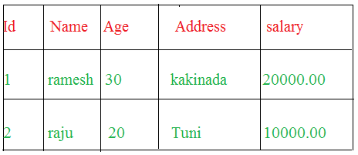
Example with 2nd syntax:
INSERT INTO CUSTOMERS VALUES (2, ‘raju', 20, ‘Tuni', 10000.00 );
Above statements would produce the following records in PERSIONS table:

Slide 16
Example on select query:
Syntax is:
SELECT column1, column2, columnN FROM table_name;
Here, column1, column2...are the fields of a table whose values you want to fetch. If you want to fetch all the fields available in table, then you can use the following syntax:
SELECT * FROM table_name;
SELECT * FROM PERSIONS;

Slide 17
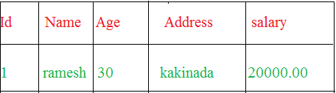
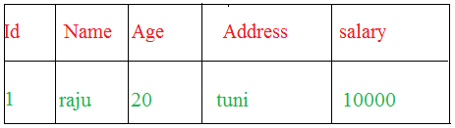
Select with where clause:
SELECT ID, NAME, SALARY FROM PERSIONS WHERE SALARY = 20000;
SELECT ID, NAME, SALARY FROM PERSIONS WHERE NAME = ‘raju’;

Slide 18
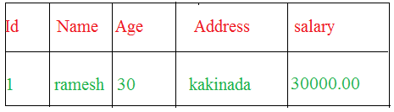
Example of update query:
Syntax is:
UPDATE table_name SET column1 = value1, column2 = value2...., columnN = valueN WHERE [condition];
UPDATE PERSIONS SET SALARY= 30000 WHERE ID=1;
Syntax for delete query is:
DELETE FROM table_name WHERE [condition];
DELETE FROM PERSIONS WHERE ID = 2;

Slide 19
Exmaple of DCL Commands:
To allow session creation for user:
grant create session to username;
To allow the user to create table:
grant create table to username;
To allow user to drop any table:
grant create table to username;
Take back permission from user:
revoke create table from username

