Slide 1

ImplicitObjects
Presented by Pioneer Coders

Slide 2
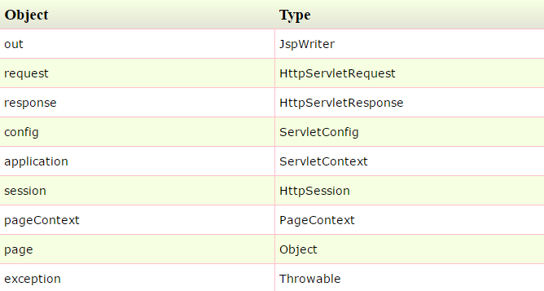
Jsp implicit Objects
There are 9 jsp implicit objects. These objects are created by the web container that are available to all the jsp pages. The available implicit objects are out, request, config, session, application etc.

Slide 3
Explanation of out implicit object:
Jsp out implicit object:
For writing any data to the buffer, JSP provides an implicit object named out. It is the object of JspWriter. In case of servlet you need to write like this
PrintWriter out=response.getWriter();
But in JSP, you don't need to write this code.

Slide 4
Jsp request implicit object
The JSP request is an implicit object of type HttpServletRequest i.e. created for each jsp request by the web container. It can be used to get request information such as parameter, header information, remote address, server name, server port, content type, character encoding etc.It can also be used to set, get and remove attributes from the jsp request scope.
example code is :
<%
String name=request.getParameter("uname");
out.print("welcome "+name);
%>

Slide 5
Jsp response implicit object
In JSP, response is an implicit object of type HttpServletResponse. The instance of HttpServletResponse is created by the web container for each jsp request.
It can be used to add or manipulate response such as redirect response to another resource, send error etc.
Example code is:
<%
response.sendRedirect("http://www.google.com");
%>

Slide 6
Config Implicit Object
In JSP, config is an implicit object of type ServletConfig. This object can be used to get initialization parameter for a particular JSP page. The config object is created by the web container for each jsp page.
Generally, it is used to get initialization parameter from the web.xml file.
<%
out.print("Welcome "+request.getParameter("uname"));
String driver=config.getInitParameter("dname");
out.print("driver name is="+driver);
%>

Slide 7
Jsp Application implicit Object
In JSP, application is an implicit object of type ServletContext.
The instance of ServletContext is created only once by the web container when application or project is deployed on the server.
This object can be used to get initialization parameter from configuaration file (web.xml). It can also be used to get, set or remove attribute from the application scope.
<% out.print("Welcome "+request.getParameter("uname"));
String driver=application.getInitParameter("dname");
out.print("driver name is="+driver);
%>

Slide 8
Session implicit Object
In JSP, session is an implicit object of type HttpSession.The Java developer can use this object to set,get or remove attribute or to get session information.
<%
String name=(String)session.getAttribute("user");
out.print("Hello "+name);
%>
There are the implicit objects which will be regularly used in jsp.

