Slide 1

RequestDispatcher
Presented by Pioneer Coders

Slide 2
About RequestDispatcher
The RequestDispatcher interface provides the facility of dispatching the request to another resource it may be html, servlet or jsp. This interface can also be used to include the content of another resource also. It is one of the way of servlet collaboration
There are two important methods there in RequestDispatcher interface.
Notes:
Tip: Add your own speaker notes here.

Slide 3
Methods of RequestDispatcher
Void forward(ServletRequest request, ServletResponse response):
forwards a request from a servlet to another resource (servlet, JSP file, or HTML file) on the server
Void include(ServletRequest request, ServletResponse response)
includes the content of a resource (servlet, JSP page, HTML file) in the response

Slide 4
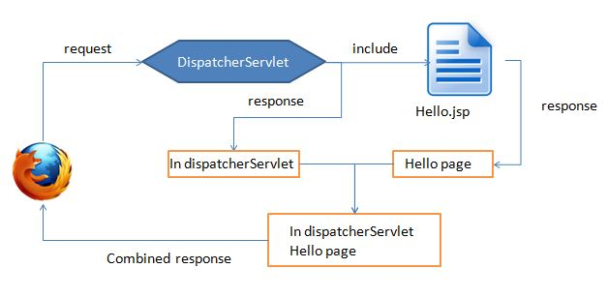
Explanation of include method
You can see that the request is for DispatcherServlet which calls include() method to include the response of Hello.jsp page, later the response of DispatcherServlet and Hello.jsp is combined and sent to the client.

Slide 5
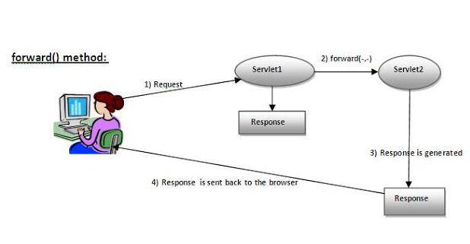
Explanation of forward method
You can see the request is for Servlet1 which forwards it to Servlet2, whose response is then sent to the client. The response of Servlet1 is not used or not sent to the client.

