Slide 1

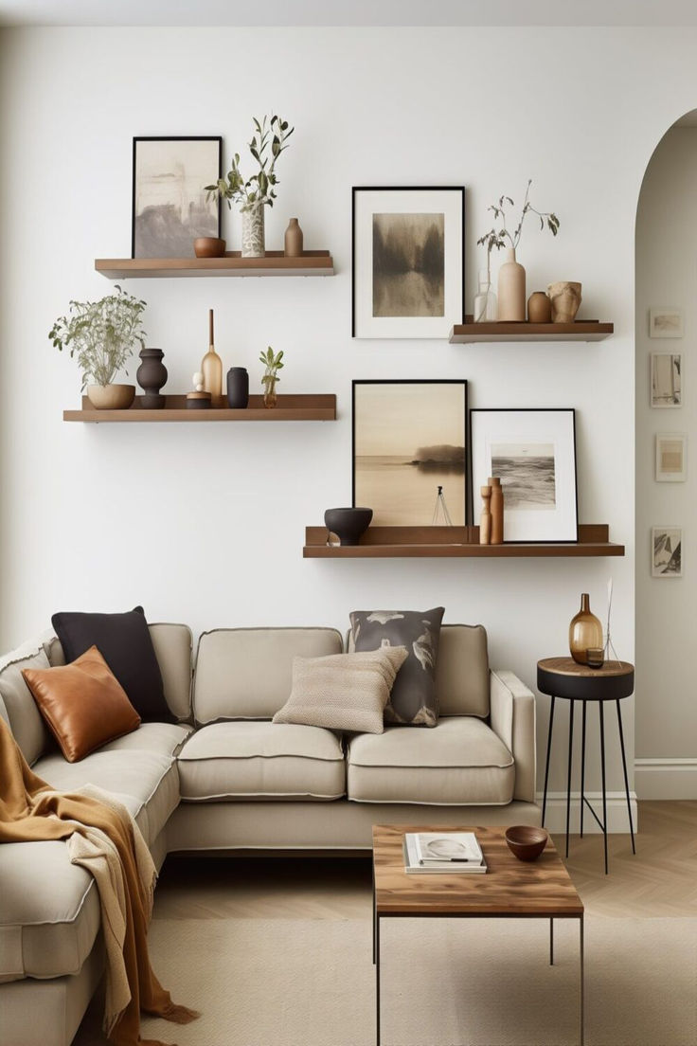
Elegant Habitat
Pixel Pioneers
Hiba Hashim – Eman Abdullah
Muzan Alhadi - Fatima Alejli

Slide 2
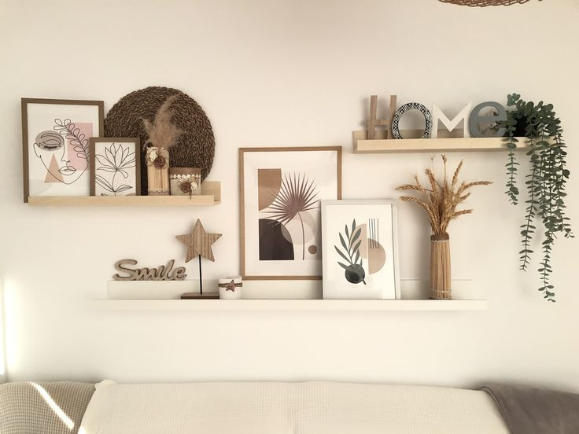
About Elegant Habitat
Hire someone to help you with decorating your house!
Very user friendly and aesthetic
Direct way to contact the team
Fully functional with pure simplicity with data collection from the user

Slide 3
The technology we used to code
CSS
HTML
CSS mainly used for designing the layout
HTML mainly used for the text

Slide 4
Perks of the website
User friendly
Responsive
Easy and clear way to contact the team
Clear information

