Slide 1

Tsitsiklis-Van Roy vs. Tilley
Anna Łazarska
Piotr Mikler
Katarzyna Rymar
www.agh.edu.pl

Slide 2
Tilley algorithm
The main idea is to devise a method based on the Monte Carlo simulation to decide the early exercise boundary .
Once the early exercise boundary is determined, an American option can be viewed as a knocked-and-exercised option.

Slide 3
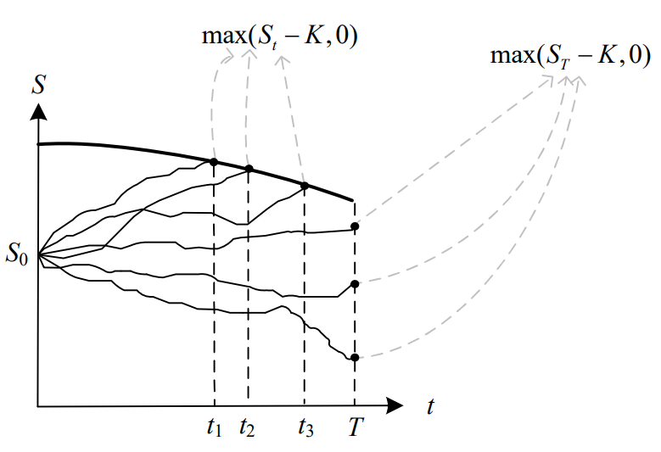
Tilley algorithm

Slide 4
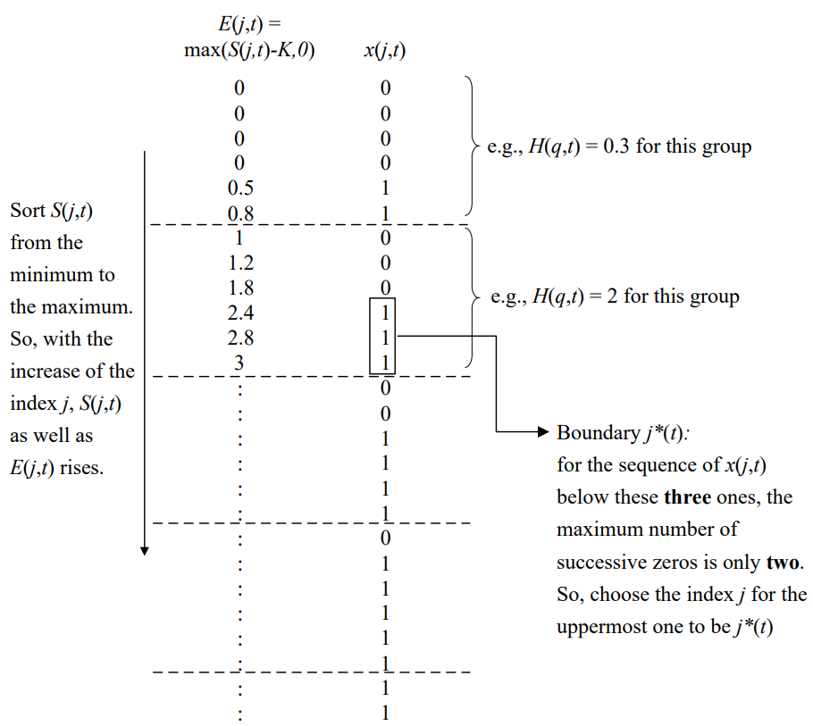
Tilley algorithm

Slide 5
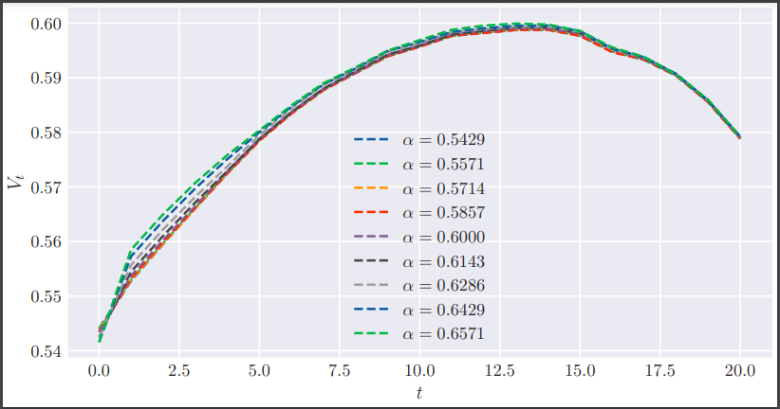
American Option
Tilley - alpha
www.agh.edu.pl

Slide 6
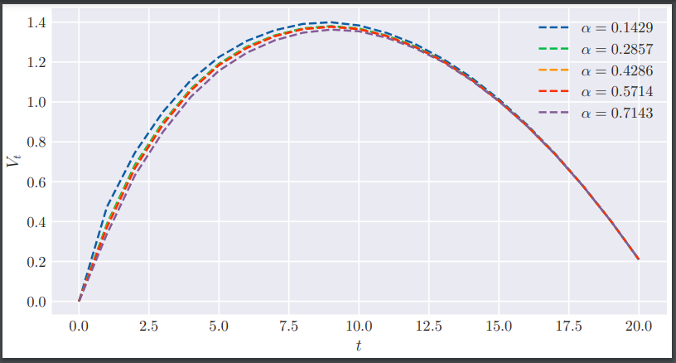
Interest Rate Swap
Tilley - alpha
www.agh.edu.pl

Slide 7


Tsitsiklis-Van Roy algorithm
We use the regression technique to approximate the conditional expectation function at each exercising date:
We are calculating value of an asset by using:
Difference between Longstaff -Schwartz and Tsitsiklis -Van Roy algorithms:
Tsitsiklis - Van Roy:
Longstaff –Schwartz:

Slide 8
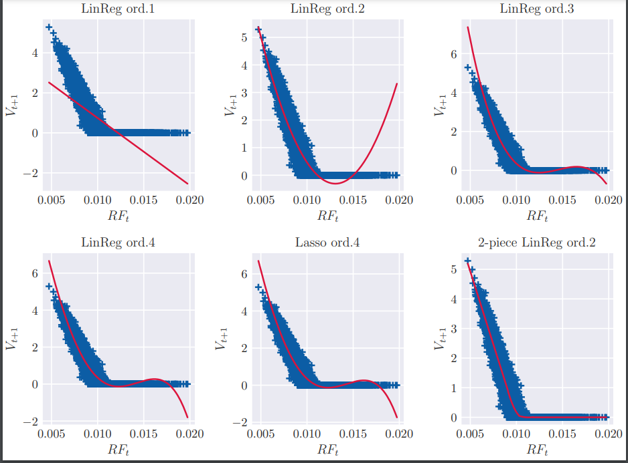
American Option
Tsitsiklis - regression
www.agh.edu.pl

Slide 9
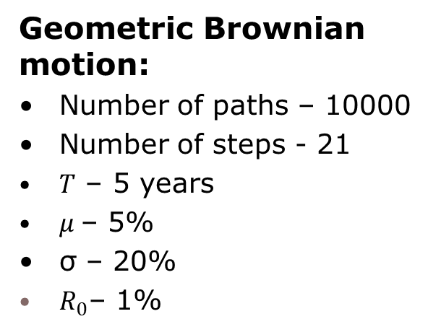
Dane
Receiver Swap:
Fixed rate – 1,5 %
Maturity – 5 years
Payment frequency – 3 months
Notional – 1000 USD
American Option:
Notional – 1000 USD
Strike - 1%
Expiry – 5 years
Time steps – 21
option_type – „put”

Slide 10
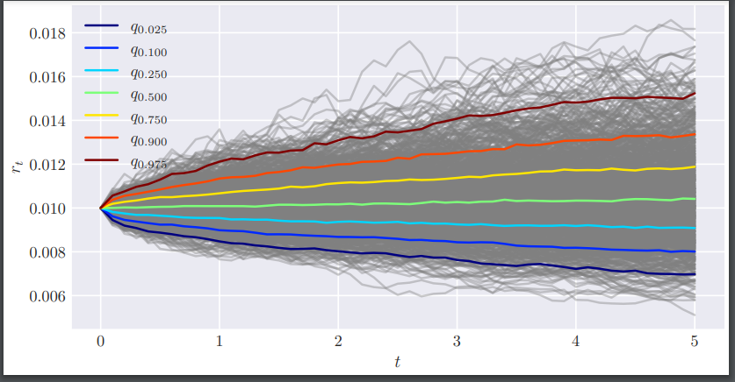
Interest rate distribution quantiles
www.agh.edu.pl

Slide 11
American Option

Slide 12
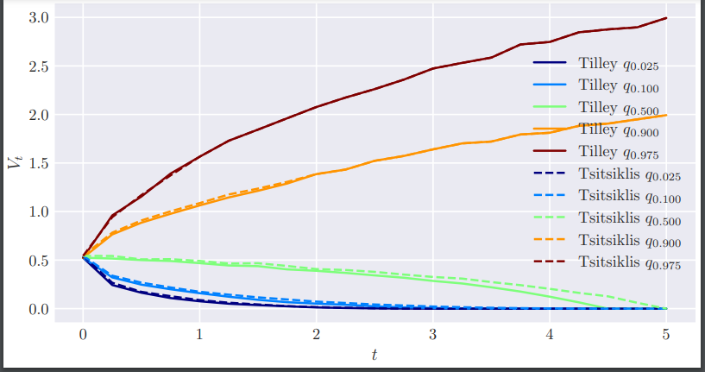
American Option
Tsitsiklis vs Tilley – exposure profile
www.agh.edu.pl

Slide 13
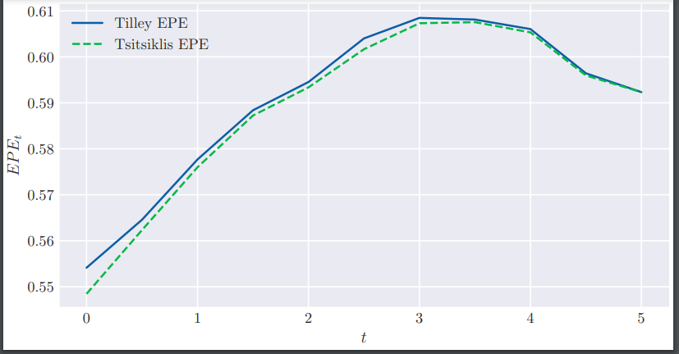
American Option
Tsitsiklis vs Tilley – Expected positive exposure
www.agh.edu.pl

Slide 14
Interest Rate Swap

Slide 15
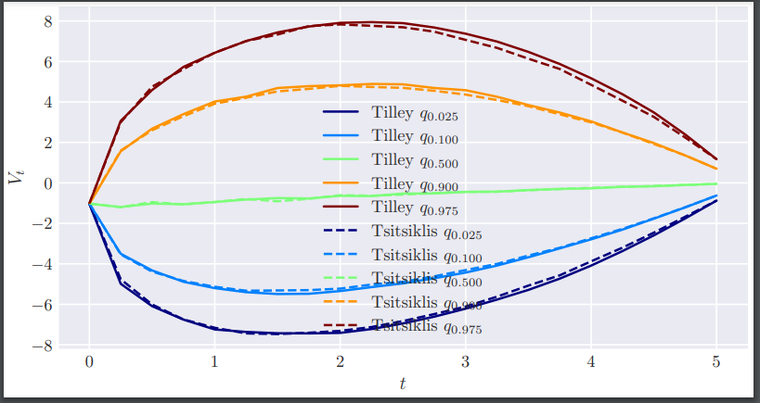
Interest Rate Swap
Tsitsiklis vs Tilley – exposure profile
www.agh.edu.pl

Slide 16
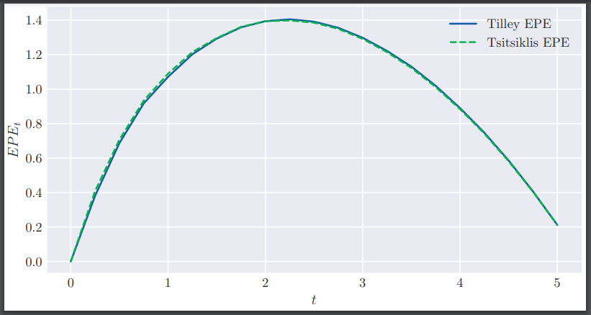
Interest Rate Swap
Tsitsiklis vs Tilley – Expected positive exposure
www.agh.edu.pl

Slide 17


Thank you for your attention!
www.agh.edu.pl

