Slide 1
Project
Piotr Mikler, Anna Łazarska, Katarzyna Rymar

Slide 2
Assignment
Our goal is to compare the two valuation algorithms (Tsitsiklis – Van Roy vs Tilley) on the example of the following portfolio:
The five-year american option on the USD interest rate (Black-Scholes model for modeling the rate)
The five-year interest rate swap in USD
and show Expected Positive Exposure profiles and quantile profiles 2.5%, 97.5%

Slide 3
Tilley (1993)
The main idea is to devise a method based on the Monte Carlo simulation to decide the early exercise boundary .
Once the early exercise boundary is determined, an American option can be viewed as a knocked-and-exercised option.

Slide 4
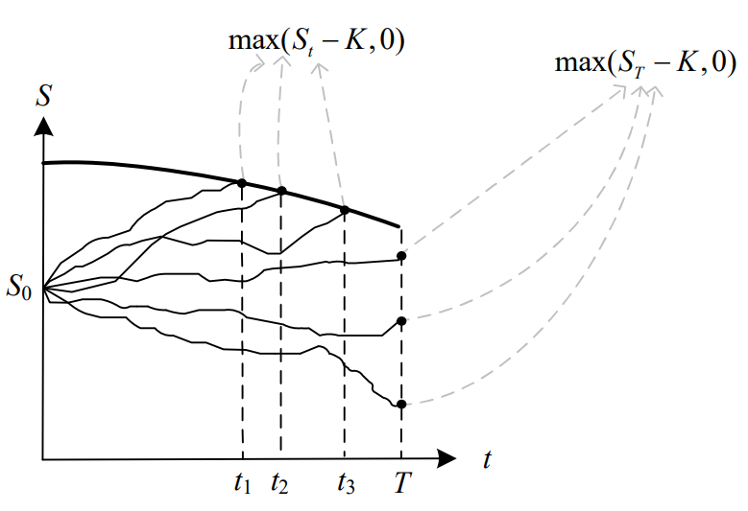

Slide 5
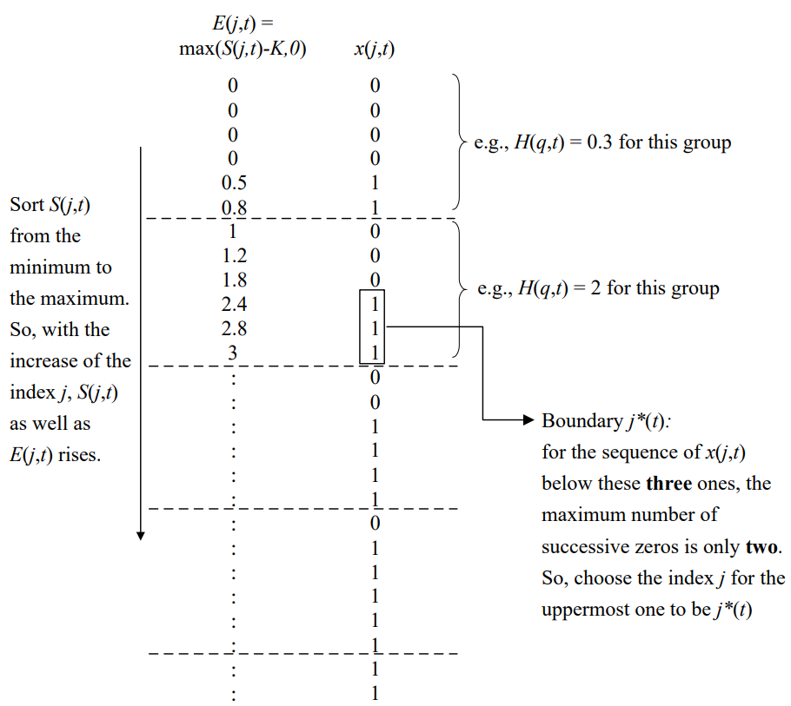

Slide 6
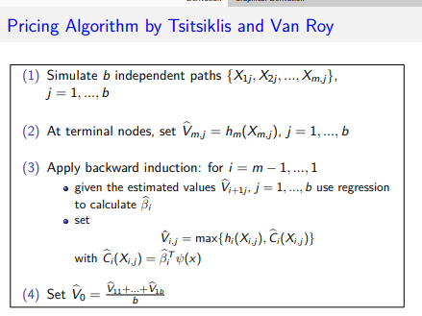
Tsitsiklis – Van Roy

Slide 7
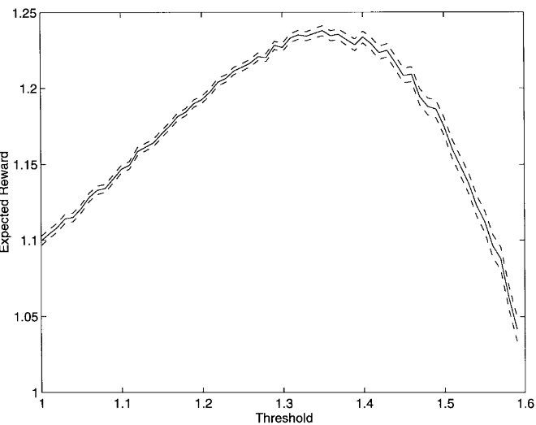

Slide 8
