Slide 1
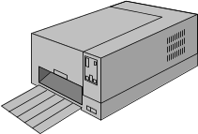



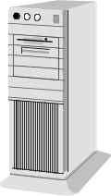

IT Infrastructure of AMIC HQ’s office in Warsaw
Printers
Other servers in Hyper-V:
File Server
MS Exchange server
Backup Server
Archive Server
DC Servers
Etc.
Laptops
Ms Office 365
RDC (Impuls)
RCM client
5 Servers in Hyper-V
RCM (MS SQL 2016) Server
Test RCM (MS SQL 2016) Server
II S FTP Server
File Zilla FTP
Magic/info (postgre SQL) Server
Environment managed by Piotr
Desktops
Ms Office 365
RDC (Impuls)
RCM client
Notes:
1

Slide 2



Connections of AMIC HQ’s with outside world
Komputronik (in Poznań)
Impuls EVO (ERP/ Warehouse)
Warsaw office
FTP server
RCM server/ MS SQL 2016
MS IIS ftp server
FileZilla FTP server
Firewall
+
Equipment from ISP provider
for Intranet and internet
AMIC’s Petrol stations x115
(RSM/MsSQL Express server)
Comarch’s FTP server
Internet
Suppliers active in EDI
Other parties (banks, LPG Polonia, fleet card etc.)

