Slide 1

ASP.NET Core <3 Docker
From 0 to Azure in one meetup
Marco De Sanctis
Visual Studio and Development Technologies MVP
info@marcodesanctis.it | @crad77

Slide 2
Agenda
What’s Docker and why should I care
ASP.NET Core & Docker
Let’s port a non-trivial project to Docker and AKS

Slide 3
Disclaimer
We are going to use some command line, but cmon, it’s not that scary, is it? ☺
Anyway, don’t worry: it’s just a few commands, and I’ll provide you a reference of everything we are going to use

Slide 4
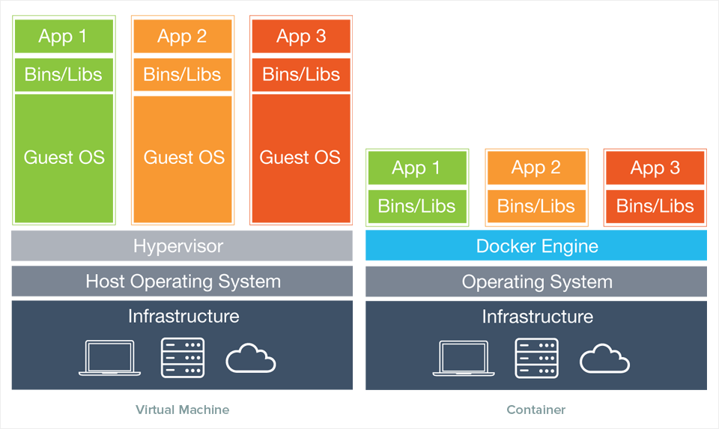
How did we get here
Service density++ ☺

Slide 5
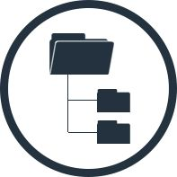
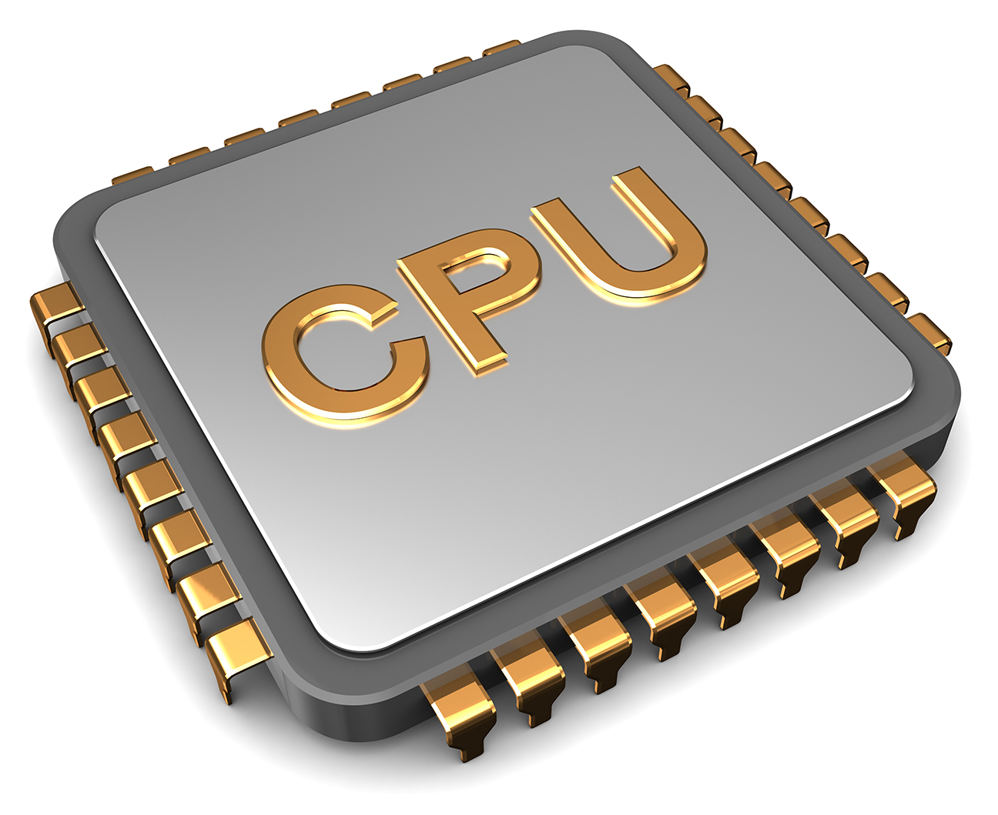
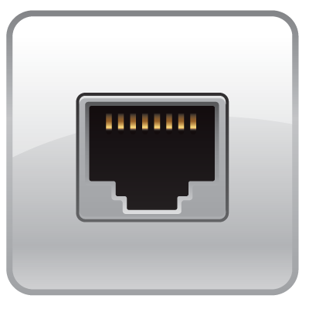
Containers == Virtualized Operating System
Kernel namespaces (Linux e Windows)
Virtual File System
Virtual Process Tree
Virtual Network

Slide 6
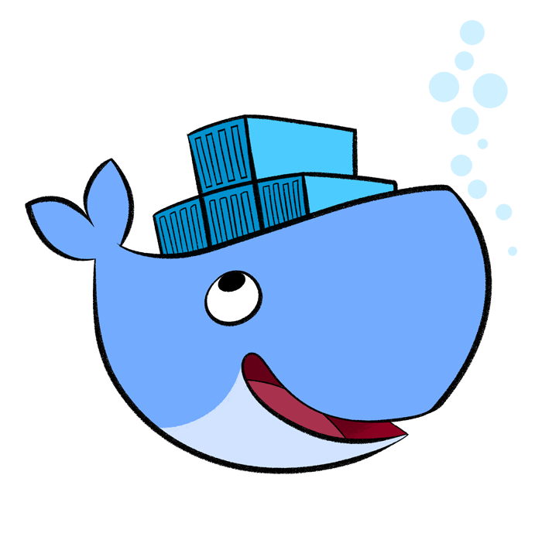
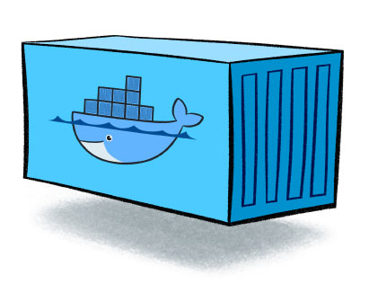
Docker is a (the) container engine
Image
Docker (aka Moby project) is free and open source, no limitations
There’s an enterprise edition (hosting, support, certification...)
It’s the de-facto standard for container-based applications

Slide 7
Demo

Slide 8

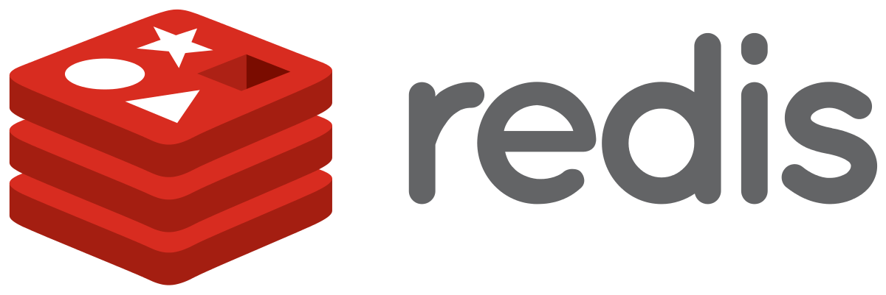


What we are going to build
Front end
ASP.NET Core MVC
Back end
ASP.NET Core MVC

Slide 9
Dockerfile explained
Host machine
base
aspnetcore:2.0
80
/app
FROM microsoft/aspnetcore:2.0 AS base
WORKDIR /app
EXPOSE 80
FROM microsoft/aspnetcore-build:2.0 AS build
WORKDIR /src
COPY *.sln ./
COPY backend/backend.csproj backend/
RUN dotnet restore
COPY . .
WORKDIR /src/backend
RUN dotnet build -c Release -o /app
FROM build AS publish
RUN dotnet publish -c Release -o /app
FROM base AS final
WORKDIR /app
COPY --from=publish /app .
ENTRYPOINT ["dotnet", "backend.dll"]
build
aspnetcore-build:2.0
/src
Demo.sln
Backend.csproj
Demo.sln
Backend.csproj
Packages
program.cs
start.cs, …
program.cs
start.cs, …
/app
backend.dll
publish
aspnetcore-build:2.0
/src
*.sln, *.csproj, *.cs…
Pkgs
/app
.dll
Pkgs
/views
final
aspnetcore:2.0
/app
/app
.dll
Pkgs
/views
80
$: dotnet backend.dll

Slide 10

Dockerfile explained
Host machine
base
aspnetcore:2.0
80
/app
FROM microsoft/aspnetcore:2.0 AS base
WORKDIR /app
EXPOSE 80
FROM microsoft/aspnetcore-build:2.0 AS build
WORKDIR /src
COPY *.sln ./
COPY backend/backend.csproj backend/
RUN dotnet restore
COPY . .
WORKDIR /src/backend
RUN dotnet build -c Release -o /app
FROM build AS publish
RUN dotnet publish -c Release -o /app
FROM base AS final
WORKDIR /app
COPY --from=publish /app .
ENTRYPOINT ["dotnet", "backend.dll"]
build
aspnetcore-build:2.0
/src
Demo.sln
Backend.csproj
Demo.sln
Backend.csproj
Packages
program.cs
start.cs, …
program.cs
start.cs, …
/app
backend.dll
publish
aspnetcore-build:2.0
/src
*.sln, *.csproj, *.cs…
Pkgs
/app
.dll
Pkgs
/views
final
aspnetcore:2.0
/app
/app
.dll
Pkgs
/views
80
$: dotnet backend.dll

Slide 11
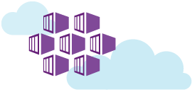
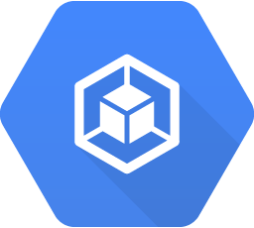
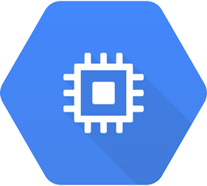
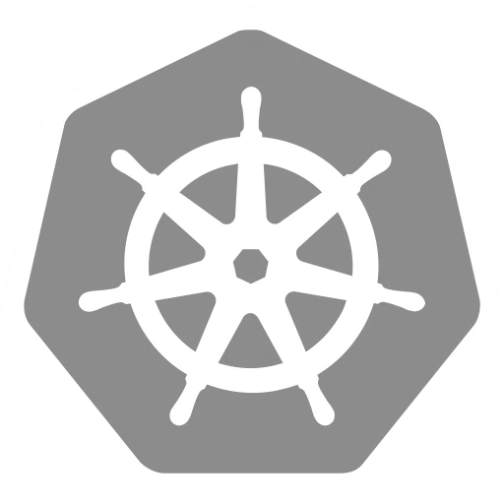
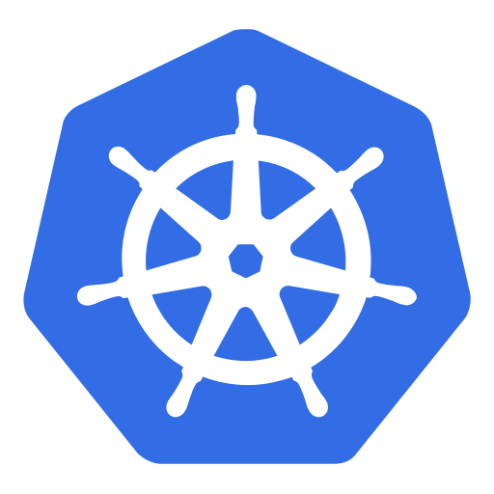
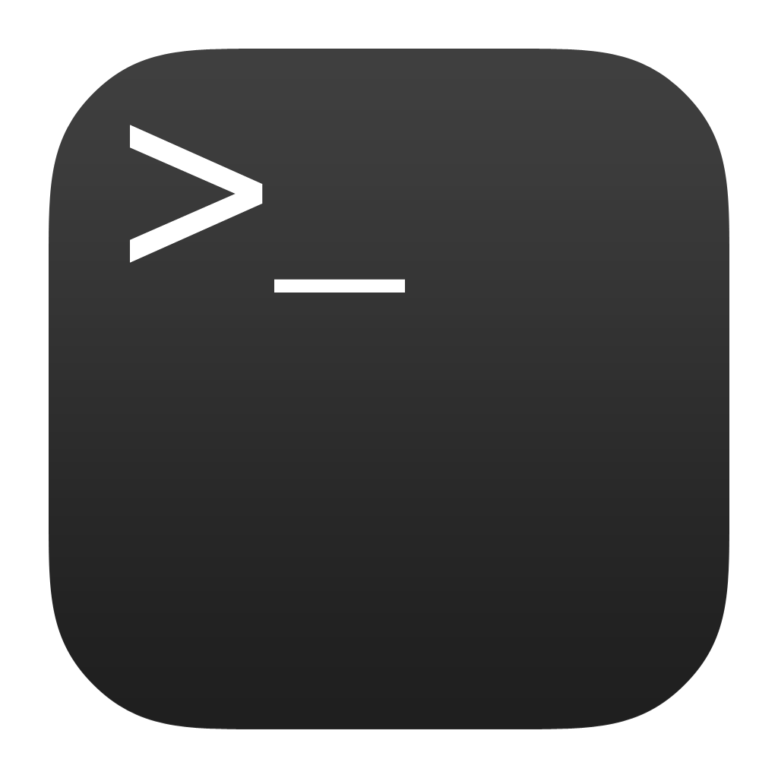
We need an orchestrator: enter Kubernetes and AKS
Running Pods
(~containers)
Agent
nodes
Master
nodes
Kubectl
CLI

Slide 12
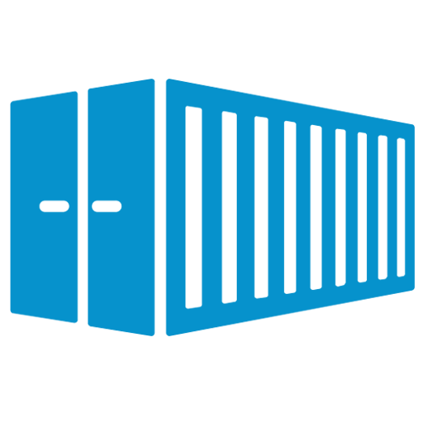
Ok... What’s a “Pod” now?!
Atomic unit of deployment in Kubernetes
It has its own IP Address
It’s short lived and replaceable
Don’t get too attached to it ☺
It runs one or more containers
All the containers share storage and network
We almost never manage pods directly
There are higher level objects
frontend
10.1.0.11
frontend
Log spooler
/var/logs
10.1.0.11

Slide 13
Kubernetes objects are created through its REST API
Service
apiVersion: v1
kind: Service
metadata:
name: frontend-svc
spec:
ports:
- port: 80
selector:
app: frontend
Deployment
HOST: frontend-svc
apiVersion: apps/v1beta1
kind: Deployment
metadata:
name: frontend-dpy
spec:
replicas: 3
template:
metadata:
labels:
app: frontend
spec:
containers:
- name: frontend
image: myreg/frontend:latest
ports:
- containerPort: 80
app: frontend
ReplicaSet
Upgrade policy
Pod
frontend
frontend
frontend
10.1.0.11:80
10.1.0.19:80
10.1.0.47:80
app: frontend
app: frontend
app: frontend

Slide 14
Recap
Run Mongo & Redis as Docker containers
Dockerised frontend and backend
Added nginx
Described the whole system on docker-compose
Run all of it on our laptop
Saved the images on Azure Container Registry
Configured a CI/CD pipeline for them
Deployed on a Kubernetes cluster in Azure Container Service (AKS)
Set up a dashboard and an alert in Log Analytics

Slide 15
Recap - Commands
docker run –p 8080:80 wordpress | Starts a container from an image, exponing it on 8080
docker ps | Lists of all running containers (-a includes stopped ones)
docker start containerName | Starts (and stops) a container
docker rm -f $(docker ps -q) | Removes all running containers
docker images | Lists all images
docker rmi imageName | Removes an image
docker login myregistry.azurecr.io | Logs in Azure Container Registry
docker tag frontend myregistry.azurecr.io/frontend | Tags an image for Azure Container Registry
docker push myregistry.azurecr.io/frontend | Pushes an image to Azure Container Registry
kubectl apply -f filename | Creates the kubectl objects specified in the file
kubectl get deployments/services/pods | Lists all the deployments/services/pods in the cluster
kubectl proxy --address="0.0.0.0" | Tunnels the cluster’s dashboard to localhost

Slide 16
Recap – On Azure
Azure Container Registry
Our private repository where we can store Docker images
docker login myregistry.azurecr.io
Azure Web App for Containers
They can run only one container at a time
Sort of CD supported via Azure Container Registry and web hooks
Azure Container Service (AKS)
Fully managed orchestrator
Based on Kubernetes
https://docs.microsoft.com/en-us/azure/aks/
Container monitoring solution
Based on Azure LogAnalytics
Uses a DaemonSet to track cluster events
https://docs.microsoft.com/en-us/azure/log-analytics/log-analytics-containers

Slide 17
Thank you!
@crad77
info@marcodesanctis.it
Get the code at https://github.com/cradle77/DockerGettingStarted

