Slide 1
Screenshots
ANIXE example test data

Slide 2
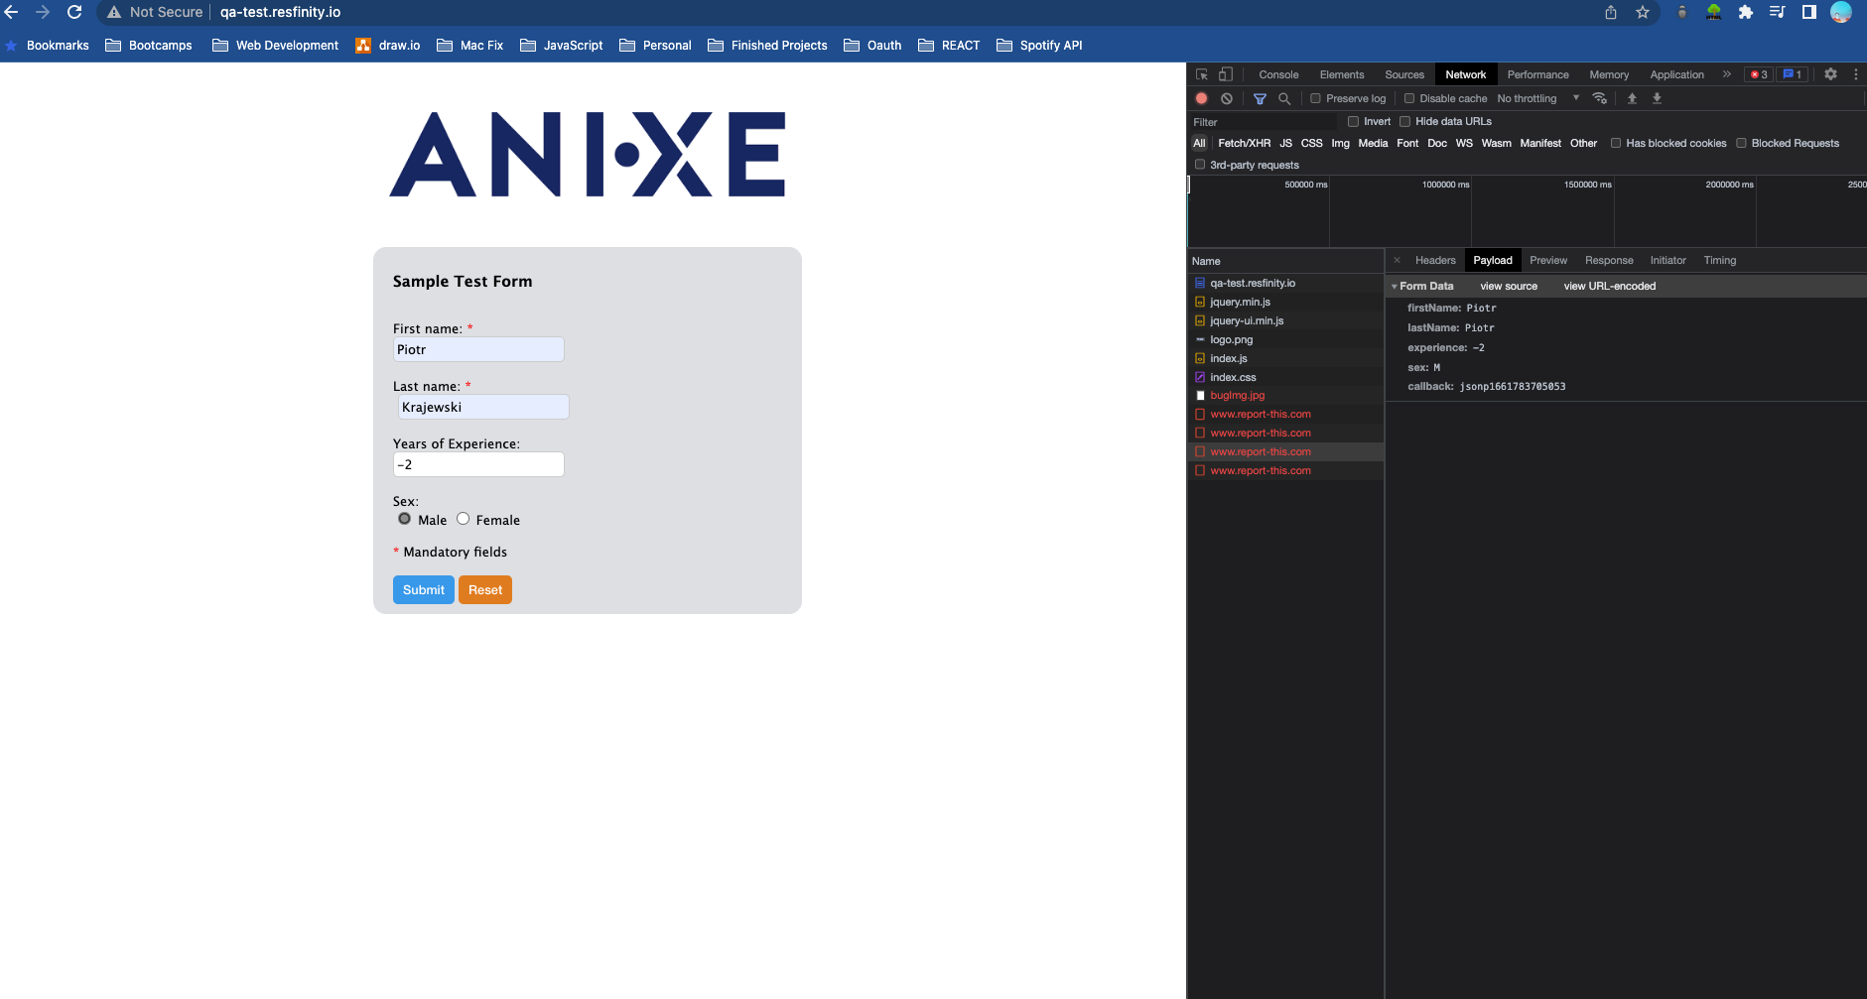

Slide 3
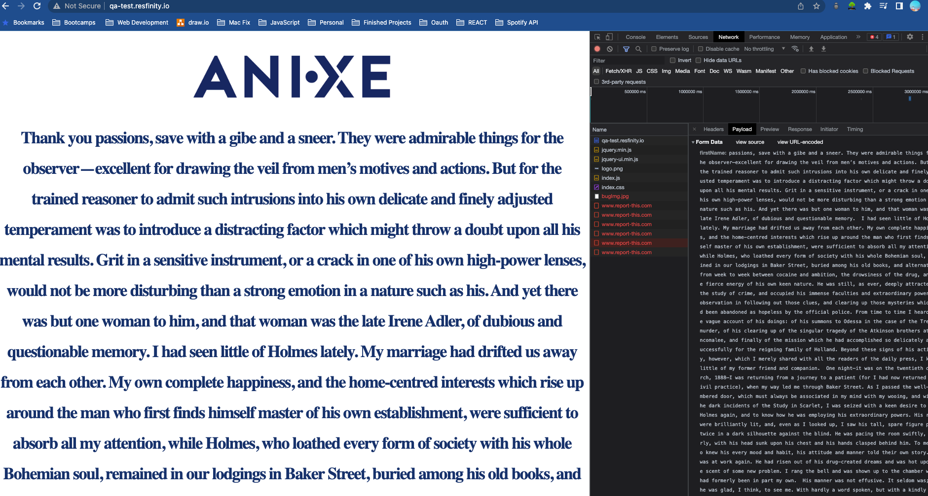

Slide 4
