Slide 1
Ferreted Away
A Revolution in Student Sales
Lab 2 Team C

Slide 2
Overview
The objective of this website is to enable students of University of Glasgow to sell and swap items from various categories. Sellers will be able to post images of the item for sale, along with a description and tentative price. Buyers can message sellers directly to arrange purchase of items listed on the site. Sellers can then respond and remove the item from sale.

Slide 3
Requirements
-User must be able to create/edit/delete their account
-User must be able to upload images of the item they have for sale
-User must be able to upload a description for each item they have to sell
-User must be able to state a tentative price for the item they have to sell
-Users must be able to message other users to arrange purchase of items
-Users must be able to search items by category and price
-Users must be able to remove items once they’ve been sold

Slide 4
User Persona 1- The Seller
Jim is a mature student at University of Glasgow and is trying to sell his fruit salad. He has previously tried selling his salad on Student Voice, but since this platform was not designed for the purpose of selling goods, he has had little success. He needs to be able to create and sign into a user account. He also needs to be able to list an item under a specific category, providing a description and price for the item, as well as upload a picture of the item for sale. He also needs the ability to message potential buyers to arrange the sale of items, as well as the ability to remove an item once it has been sold.

Slide 5
User Persona 2- The Buyer
John is a first year student and attempted to utilize the Student Voice webapp on the MyGlasgow site to purchase a bike. John saw multiple advertisements on that site selling bikes. He tried to get in contact with the sellers but was disappointed as the items had been sold weeks before. John was very disheartened by this fact. John decided to go onto the Ferreted Away site. John was then able to search by category and price and find a seller. He could view pictures uploaded by sellers, so was able to see the condition of the bikes. John could then message the seller to arrange purchase of his bike. After John bought the bike, the seller removed it from the site. John was very happy. John told his friends about this very revolutionary website.

Slide 6
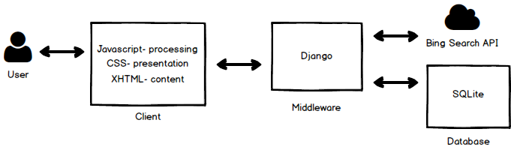
System Architecture Diagram

Slide 7
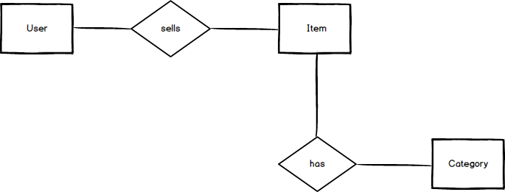
ER Diagram
Category | Type
cat_name | Char(128)
Item | Type
category | Char(128), foreign key
seller | Char(128), foreign key
item_name | Char(128)
price | integer
description | Char(350)
picture | picture
views | integer
date_added | datefield
User | Type
username | Char(128)
email | Char(128), formatted
password | Char(128)
profile_picture | picture

Slide 8
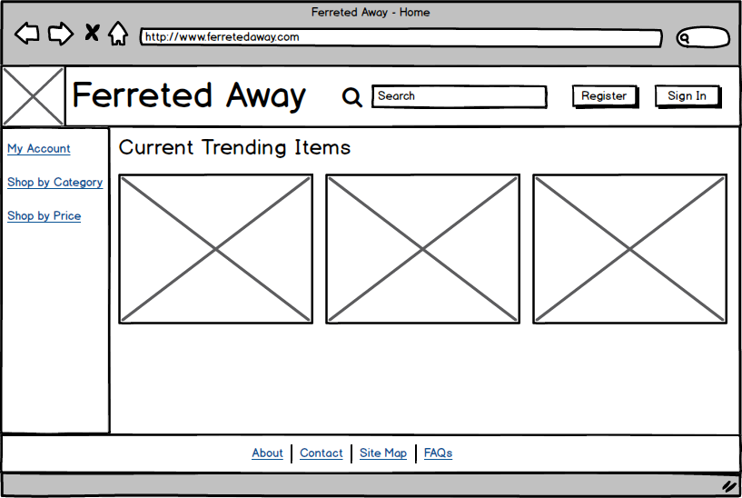
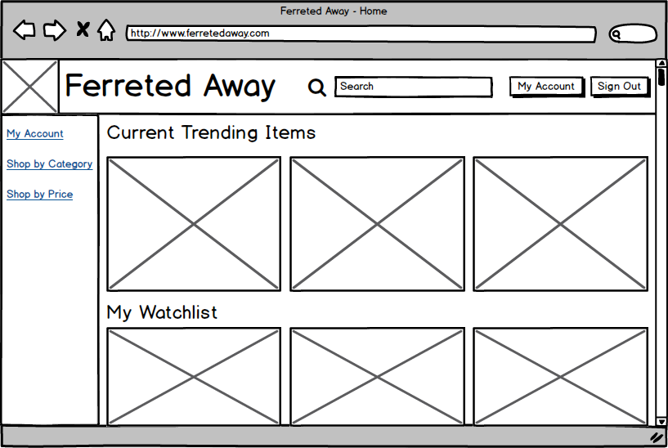
Wireframes
Home Page- User not Signed In
Shows the current 3 most viewed items on the site, with links to log in, create an account, or have a browse of the site.
Home Page- User Signed In
In addition to the 3 most viewed items, it shows the 3 items which they most recently added to their watchlist, a list of items they are considering buying.

Slide 9
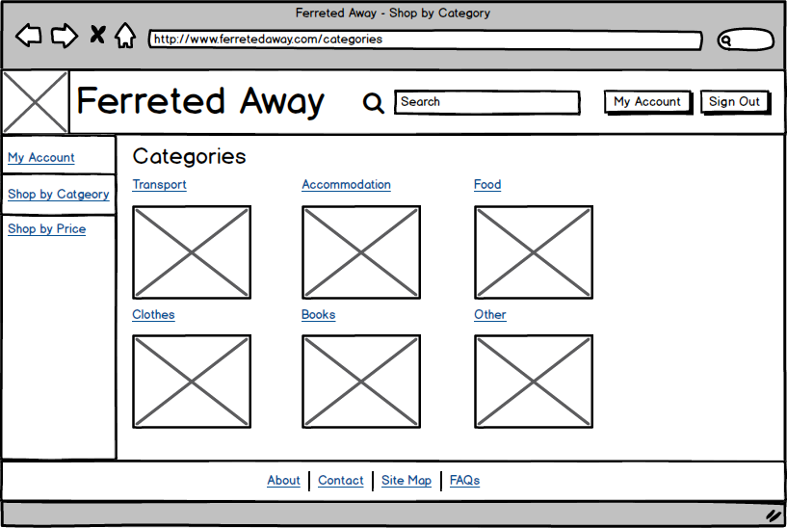
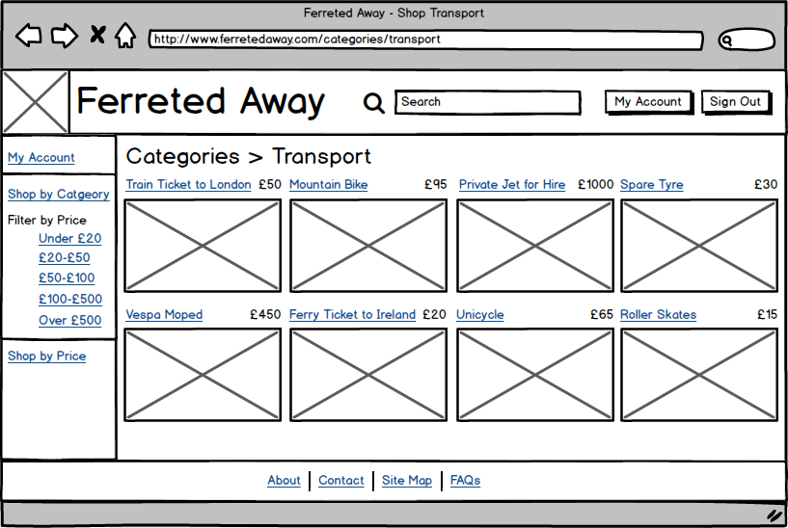
Wireframes
Browsing by Category
Allows users to search for items under a specific category.
Browsing a Specific Category
Allows a user to see items listed under a specific category.

Slide 10
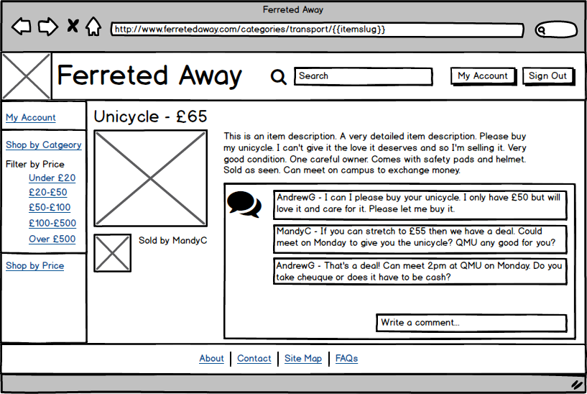
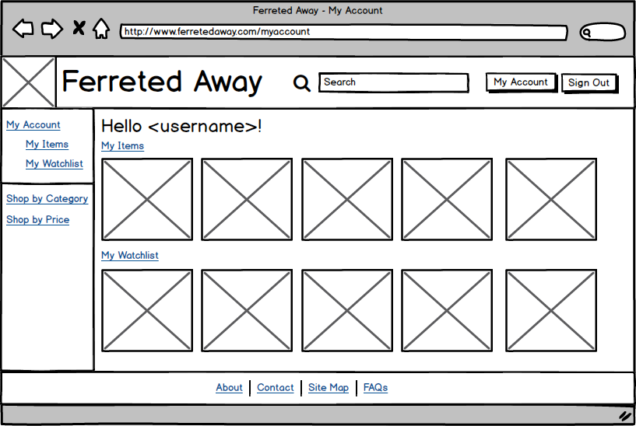
Wireframes
Shop Item
Provides a detailed item view, allows user to comment to arrange sale of the item.
My Account
Shows user attributes related to their account. Shows the 5 items they most recently added for sale, and the 5 items most recently added to their watchlist.

Slide 11
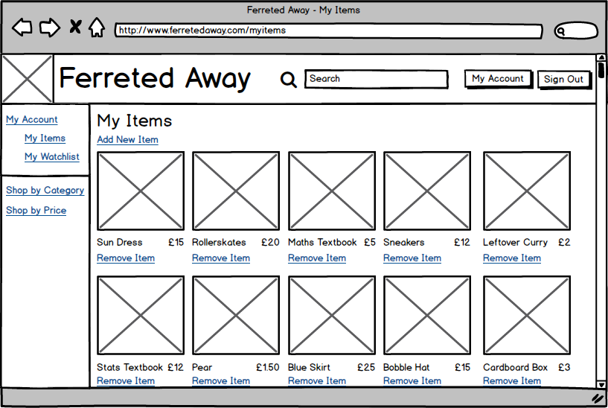
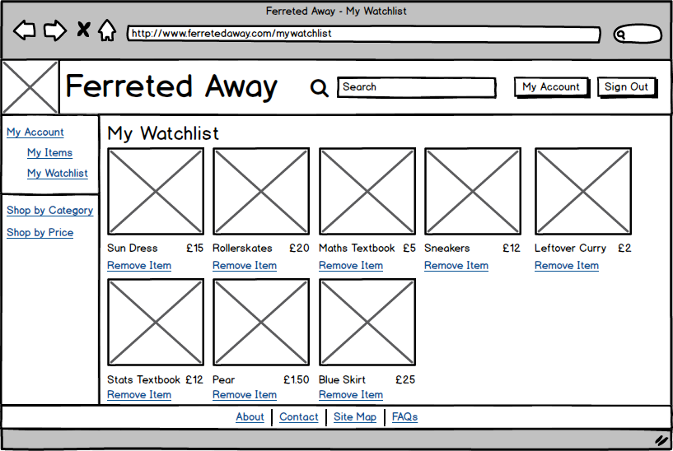
Wireframes
My Items
Lists all items the user has for sale, and gives the user the abiltiy to add and remove
My Watchlist
Lists all items in users watchlist, a list of items they are interested in buying, and gives the option to remove the item.

Slide 12
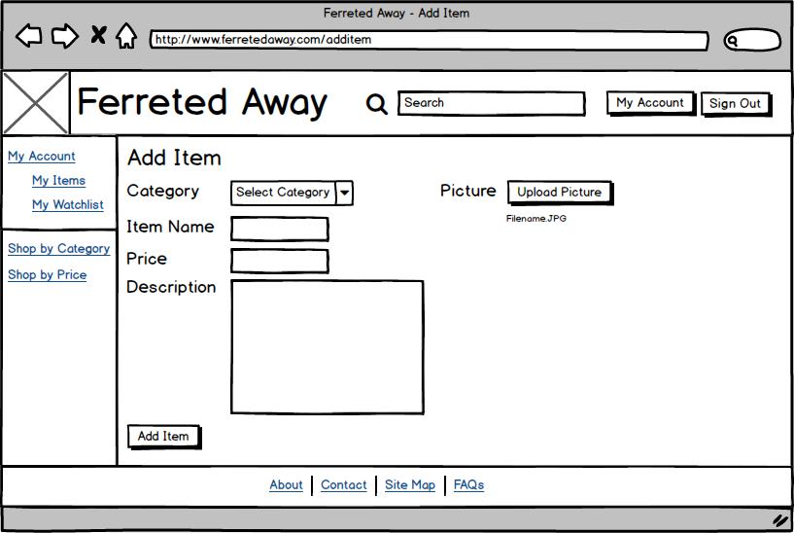
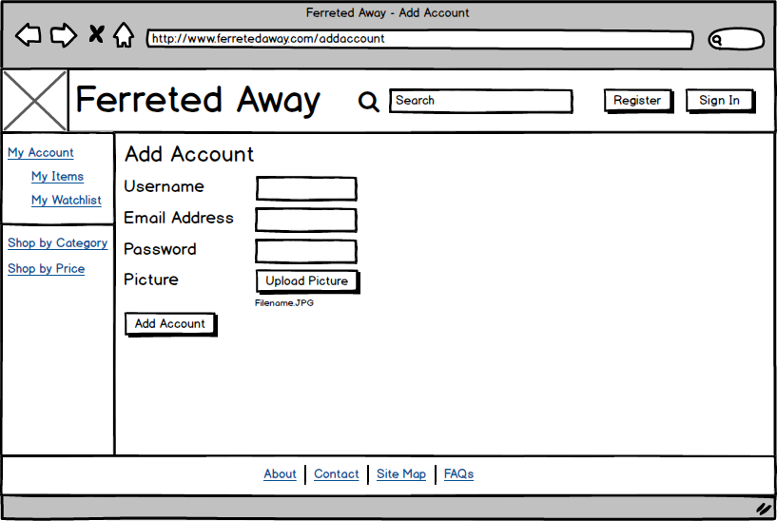
Wireframes
Add Item
Allows user to list an item for sale, and add a description, price and picture of the item.
Add Account
Allows a new user to create their account, and upload a profile picture to display next to items they sell.

Slide 13
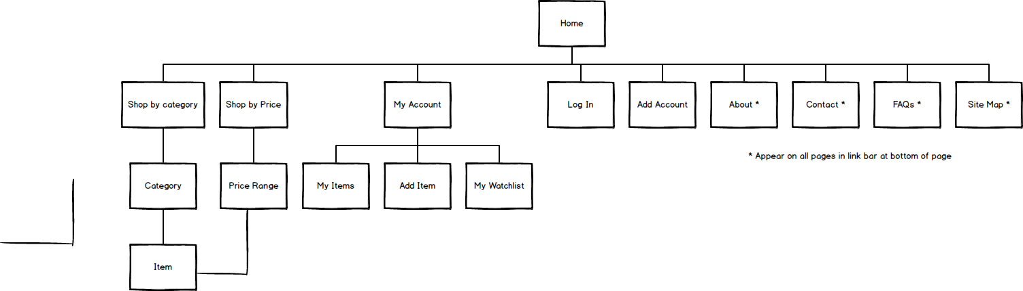
Site Map

Slide 14
Site URLS
/home
/about
/faq
/contact
/sitemap
/login
/addaccount
/myaccount
/myaccount/myitems
/myaccount/additem
/myaccount/mywatchlist
/categories
/categories/{{category_slug}}
/categories/{{category_slug}}/{{item_slug}}

