Slide 1
Data Analysis for Interactive Environments
ICA - Analysis of… Jane J. Jones

Slide 2
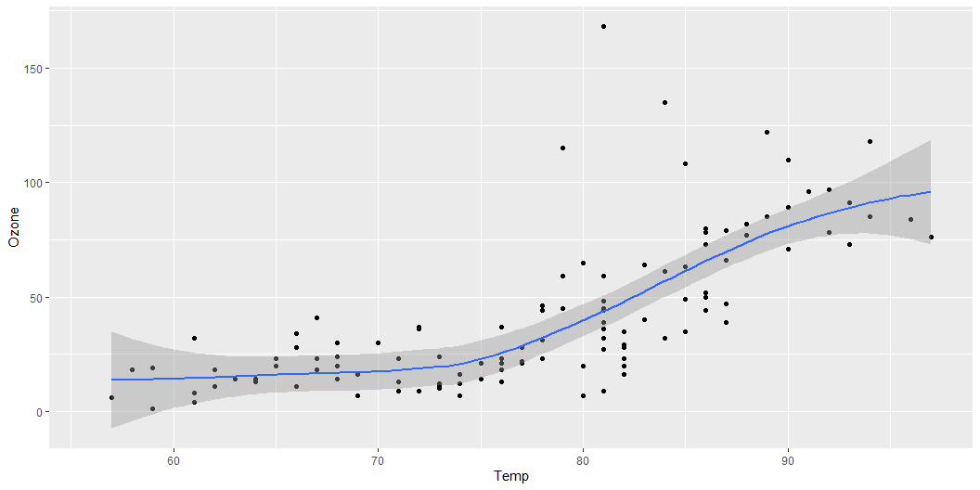
Quarto Document Overview
This example illustrates some useful functionality within Quarto including the following:
OPML Header Options
OPML Header Options header
Pandoc Syntax Highlighting Examples
Code Formatting
Cross References
Cross-references make it easier for readers to navigate your document by providing numbered references and hyperlinks to various entities like figures and tables.
Some Examples
Figure 1 explores the impact of CO2 on…
ggplot(airquality, aes(Temp, Ozone)) + geom_point() + geom_smooth(method = "loess")
Figure 1: Temperature and ozone level.

Slide 3
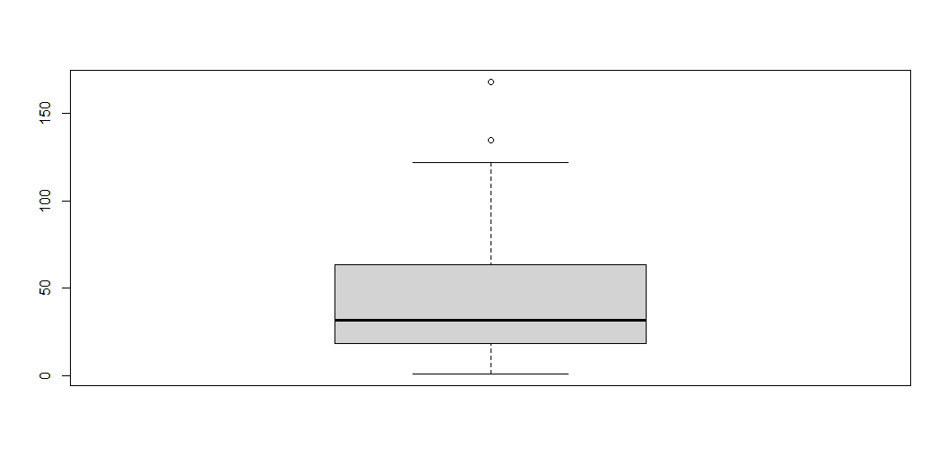
Notice that we can add annotations in the R chunk (i.e. the grey sections that contains R code) to do things like set caption, width, dpi, label, etc.
Figure 2 shows the key statistics measures and an outline of central tendency, spread, and skewness of ozone level.
boxplot(airquality$Ozone)
Figure 2: Ozone level.

Slide 4
Notice also how the table and figure numbers are automatically set by Quarto. If we re-arrange these elements then the numbers will update automatically.
Table 1 presents….
knitr::kable(head(airquality))
We can also do override the settings in the OPML header above and turn source code off with echo set to false, turn off warnings, and disable caching for a specific chunk of code.
Table 2 presents….
knitr::kable(tail(airquality))
Footnotes
Quarto will use Pandoc to automatically generate footnotes in a number of styles.
Some Examples
When considering the impact of Sea surface temperature¹ on Ozone² level…
Citations & Bibliography
Quarto will use Pandoc to automatically generate citations and a bibliography in a number of styles.
Some Examples
According to @smith2023 we may consider….and is proven [@smith2023; @doe2021]. A number of online sources [@quartoofficial] report…
To add a bibliography all we need to do is the following:
Create a references.bib file in the folder as this document.
Add a reference to this bib file in the OPML header above.
Populate the bib file with BibTeX compatible citations which you can easily generate using free online tools

Slide 5
Notes
1. Sea surface temperature (SST), or ocean surface temperature, is the ocean temperature close to the surface.
2. Ozone is a molecule composed of three oxygen atoms.

