Slide 1
Writing a software renderer in Javascript
Ryan Bissett
D00147056
Notes:
For my research project I wanted to write a software renderer. That means a program capable of drawing a 3D model on a screen. The “software” part means I wrote it without hardware acceleration, so it doesn’t use a graphics card. Everything is rendered the old fashioned way on the CPU. I now have the unenviable task of presenting the entire rendering pipeline in 5 minutes.

Slide 2

https://pipding.github.io/3dage_renderer/renderer
Notes:
The renderer I’ve written is fairly basic. It only supports triangulated meshes for reasons I’ll go into in a bit and it only has a basic form of Phong shading.
If you want to play with the renderer while I talk, there’s a link to it on my blog at this URL

Slide 3
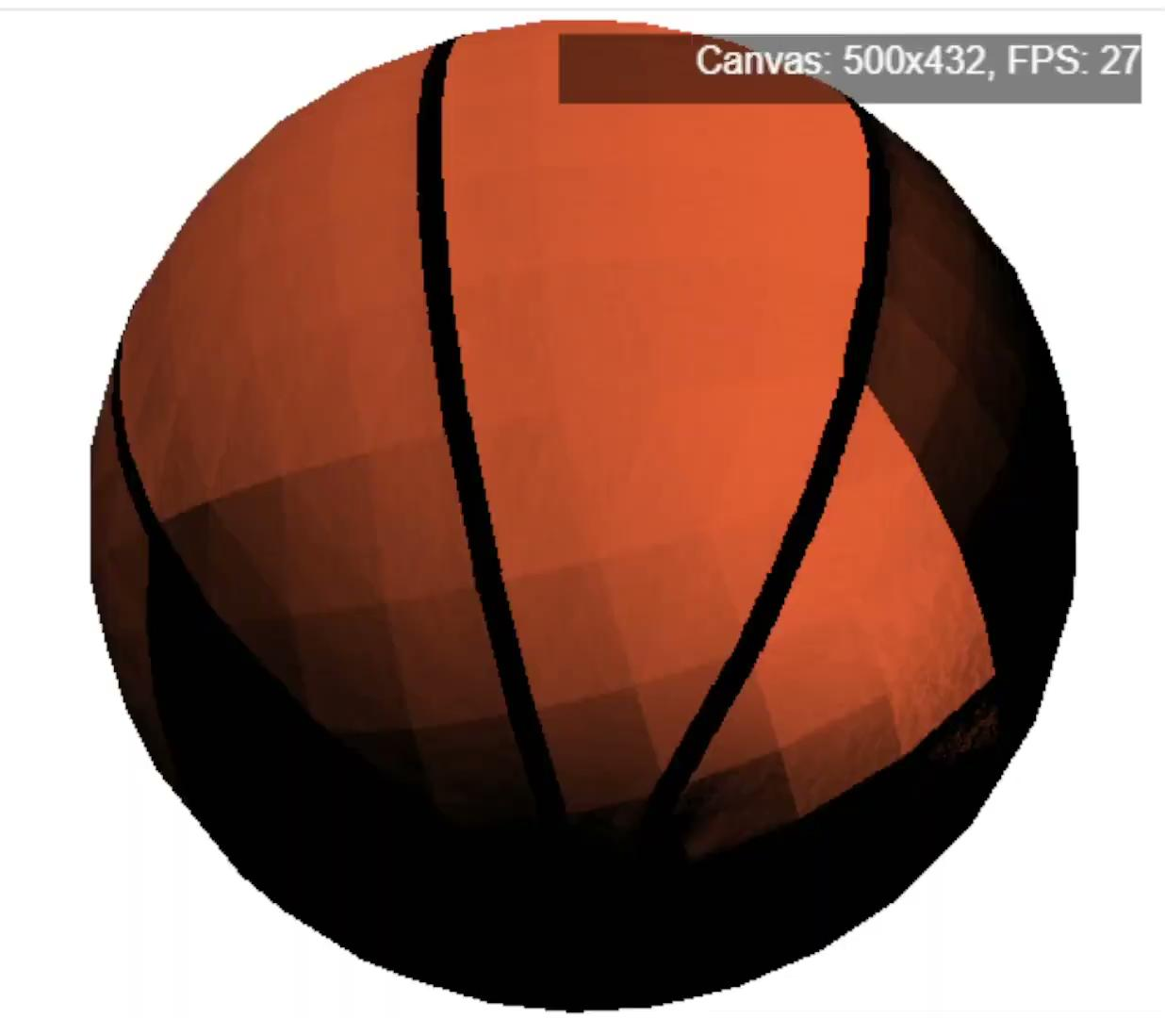
https://pipding.github.io/3dage_renderer/renderer
Notes:
I attempted to implement normal mapping at one point but wasn’t able to get it looking or performing well, so that feature is missing from the final artefact

Slide 4
https://pipding.github.io/3dage_renderer/renderer
Notes:
Now, rendering is a complicated process so I don’t expect everyone to be able to follow everything in this talk, but I’m hoping to at least provide a glimpse into the process and maybe point you in some interesting directions.
There’s no better place to start than the beginning, so let’s look inside a .obj file

Slide 5
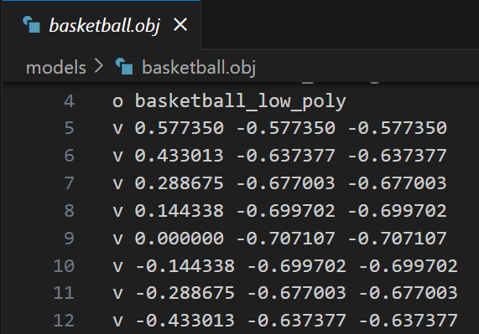
Inside an .obj file
Notes:
Inside an .obj file you’ll find this, a list of numbers.

Slide 6
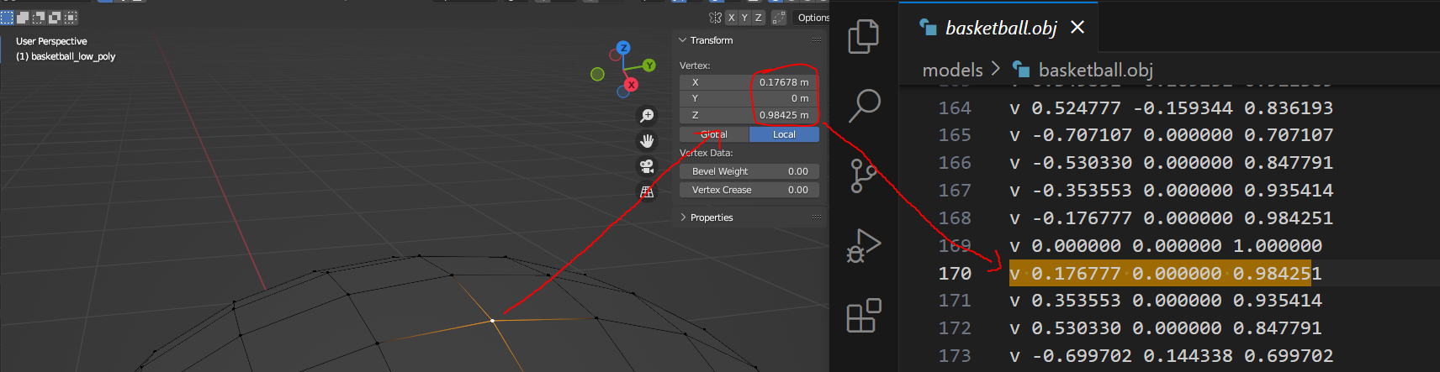
Inside an .obj file
Notes:
These numbers correspond directly to the coordinates of vertices in our mesh, as you’d see in Blender. Ultimately, any file format - be it FBX, GLTF, OBJ, will all contain a list of numbers like this in some way shape or form.

Slide 7
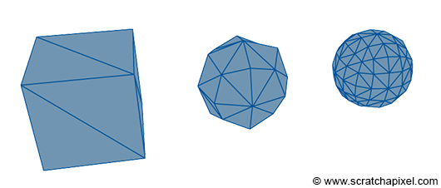
Triangles all the way down
(Bean, 2020)
Bean, N. (2020). It Starts with Triangles :: K-State CIS 580 Textbook. [online] K-State CIS 580 Textbook. Available at: https://textbooks.cs.ksu.edu/cis580/13-basic-3d-rendering/02-it-starts-with-triangles/
Notes:
Those numbers represent the vertices of the polygons which make up your mesh. One of the first important things to know about rendering is that it’s all based on triangles. No matter what kind of NGon you have in your mesh, any renderer is going to break it up into triangles.

Slide 8
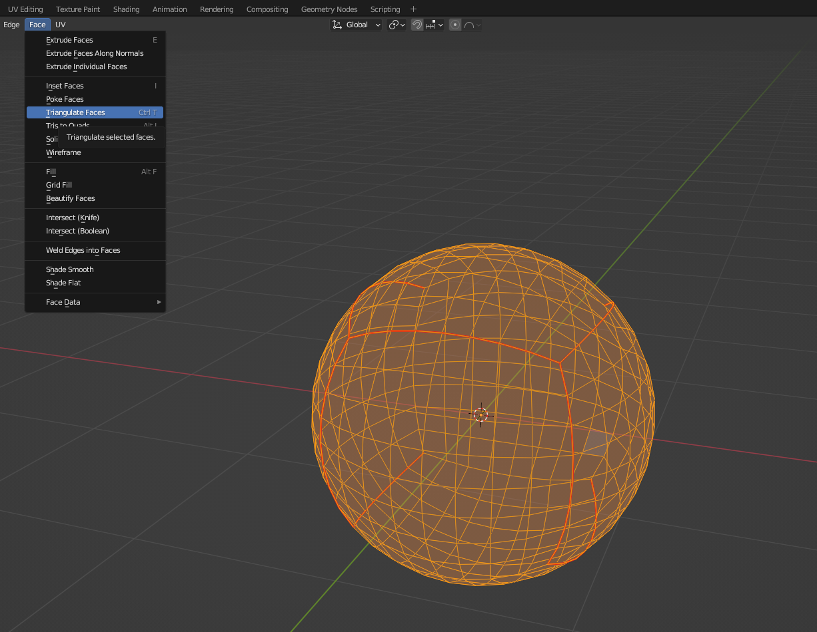
Triangles all the way down
Notes:
This is why my renderer only supports triangulated meshes - I didn’t implement a triangulation function myself. Instead I rely on the triangulation functions implemented in other programs like blender.

Slide 9
Why triangles?
Triangles are always flat
Triangles are always convex
Triangles can be used to draw any other 2D shape
Notes:
There are 3 important qualities of triangles for rendering. They’re always flat, which greatly simplifies shading calculations. They’re always convex, which allows fast rendering techniques like scanline rendering. And they can be used to construct any other 2D shape

Slide 10
Ok, triangles. Now what?
Notes:
We can talk about triangles later but for now let’s take for granted that we’ve split our mesh up into triangles. Now what? Well, we need to start turning these triangles into something we can draw on the screen. We do this in 2 phases.

Slide 11
Ok, triangles. Now what?
Phase 1: Per-triangle operations
Notes:
First there are the things we can do to the entire triangle - things like rotating it, scaling it, projecting it onto the screen

Slide 12
Ok, triangles. Now what?
Phase 1: Per-triangle operations
Phase 2: Per-pixel operations
Notes:
Then, there are things we can do with each pixel in the triangle. This includes determining its colour based on the texture map and performing shading calculations

Slide 13
Per-triangle operations - applying rotation matrix
1, 2, 3, 4
5, 6, 7, 8
9, 8, 7, 6
Notes:
There are basically 2 things my renderer does with each triangle. First, it rotates the triangle into the correct orientation using something called a rotation matrix. A matrix is a mathematical object which can be used to transform vectors. They’re represented as a grid of numbers inside a set of brackets, like this.

Slide 14
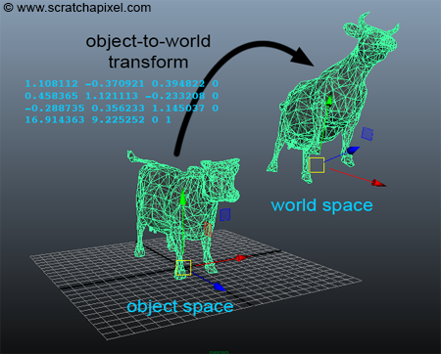
Per-triangle operations - applying rotation matrix
(Scratchapixel.com, 2024)
Scratchapixel.com. (2024). Transforming Objects using Matrices. [online] Available at: https://www.scratchapixel.com/lessons/3d-basic-rendering/transforming-objects-using-matrices/using-4x4-matrices-transform-objects-3D.html [Accessed 30 Nov. 2024]
Notes:
Different matrices can be used to scale, rotate or morph vectors and since our vertices are vectors, we can use matrices to transform our triangles. The nice thing here is that we can apply a single matrix to every vertex in the mesh and it will apply the same rotation to the entire thing, so we simply iterate through all the vertices in the mesh and apply our rotation matrix

Slide 15
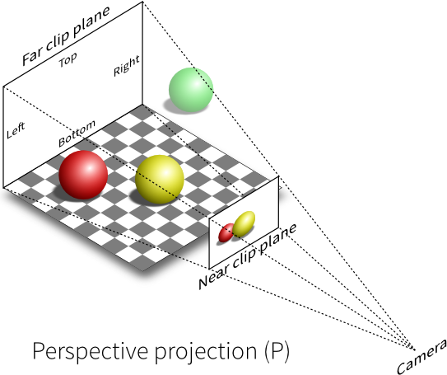
Per-triangle operations - Screen-space projection
(Szauer.com, 2016)
Szauer, G. (2016). Understanding Coordinate Transformations · LegacyOpenGL. [online] Gitbooks.io. Available at: https://gdbooks.gitbooks.io/legacyopengl/content/Chapter4/CoordinateTransforms.html [Accessed 30 Nov. 2024]
Notes:
The second thing my renderer does with the triangles is project them onto a 2D plane, i.e. the screen. 3D graphics are an illusion. We’re tricking our eyes into believing that a 2D screen has depth. This involves more maths which I won’t go into here, but if you’re interested I’ll include a link to a video where it’s explained in detail at the end of the presentation.

Slide 16
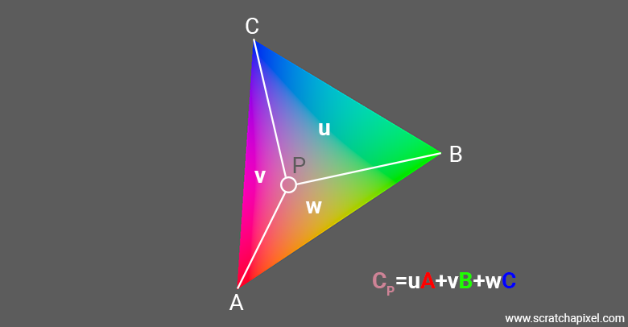
Per-pixel operations - Barycentric coordinates
(Scratchapixel.com, 2024)
www.scratchapixel.com. (2024). Ray-Tracing: Rendering a Triangle. [online] Available at: https://www.scratchapixel.com/lessons/3d-basic-rendering/ray-tracing-rendering-a-triangle/barycentric-coordinates.html [Accessed 30 Nov. 2024]
Notes:
Now that the triangle has been projected into 2D space, we need to start figuring out what colour each pixel will be. To do this we first need to calculate something called the barycentric coordinate of each pixel in the triangle. All you need to know about barycentric coordinates is that they are a way of representing any point in a triangle relative to its vertices. The barycentric coordinate of a pixel can be used to interpolate several things.

Slide 17
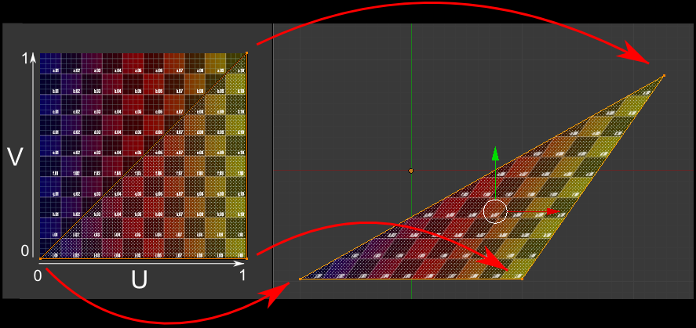
Per-pixel operations - Texture lookup
(geofftnz , 2011)
geofftnz (2011). About OpenGL texture coordinates. [online] Stack Overflow. Available at: https://stackoverflow.com/questions/5532595/about-opengl-texture-coordinates [Accessed 30 Nov. 2024]
Notes:
Because each vertex in our mesh is directly mapped to a point in our texture maps, we can use the barycentric coordinate to interpolate between the UV coordinates associated with the verts of the triangle. This allows us to pick the correct colour for each pixel from the diffuse map

Slide 18
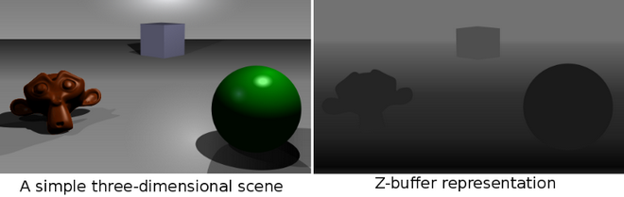
Per-pixel operations - Depth buffer
(-Zeus-, 2009)
-Zeus- (2009). Graphical representation of what a Z buffer looks like. [online] Wikimedia Commons. Available at: https://commons.wikimedia.org/wiki/File:Z_buffer.svg [Accessed 30 Nov. 2024]
Notes:
We also use it to calculate how “deep” into the screen the pixel is, which allows us to determine how close the pixel is to the camera. This is important because it’s how we avoid drawing parts of the model which are occluded by other parts of the model closer to the camera.We use something called a depth buffer, also called a z-buffer, to keep track of how “deep” into the screen each pixel is. Then, if we try to draw over that pixel again as part of a different triangle, we’ll be able to tell which one is closer to the camera by checking the depth buffer.

Slide 19

Per-pixel operations - Depth buffer
Notes:
Here’s an example of the rendering errors we can get if we don’t have a depth buffer

Slide 20
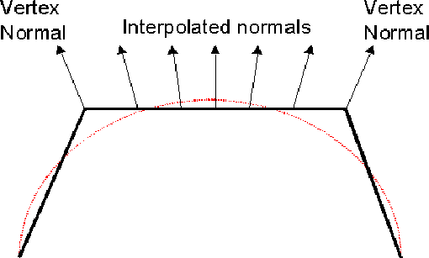
Per-pixel operations - Normal interpolation
(Power, 2016)
Power, K. (2016). Shading Models. [online] itcarlow.ie. Available at: https://glasnost.itcarlow.ie/~powerk/GeneralGraphicsNotes/LightingShadingandColour/shading.html [Accessed 30 Nov. 2024]
Notes:
The final thing we do with the barycentric coordinate is use it to interpolate the normal vectors of each vertex in the triangle. This allows us to figure out which direction each pixel is facing in 3D space, which in turn allows us to change its colour based on lighting information.

Slide 21

Per-pixel operations - Normal interpolation
Notes:
Without the barycentric coordinate and the accompanying interpolation, we’d only be able to do flat shading like this

Slide 22
Notes:
By combining all of these operations and running them on every pixel of every triangle, we’re able to render a 3D model in any orientation we like with somewhat-realistic shading

Slide 23
Limitations & improvements
Only supports a single light source
Does not support normal mapping
Has room for performance optimisation
Only supports triangulated meshes
https://pipding.github.io/3dage_renderer/renderer
Notes:
My renderer has some limitations and there’s definitely room for improvement
It only supports a single light source and as I said earlier it doesn’t support normal maps. It’s optimised, but not as optimised as it could be and of course it only supports triangulated meshes

Slide 24
References
Bean, N. (2020). It Starts with Triangles :: K-State CIS 580 Textbook. [online] K-State CIS 580 Textbook. Available at: https://textbooks.cs.ksu.edu/cis580/13-basic-3d-rendering/02-it-starts-with-triangles/
Scratchapixel.com. (2024). Transforming Objects using Matrices. [online] Available at: https://www.scratchapixel.com/lessons/3d-basic-rendering/transforming-objects-using-matrices/using-4x4-matrices-transform-objects-3D.html [Accessed 30 Nov. 2024]
Szauer, G. (2016). Understanding Coordinate Transformations · LegacyOpenGL. [online] Gitbooks.io. Available at: https://gdbooks.gitbooks.io/legacyopengl/content/Chapter4/CoordinateTransforms.html [Accessed 30 Nov. 2024]
www.scratchapixel.com. (2024). Ray-Tracing: Rendering a Triangle. [online] Available at: https://www.scratchapixel.com/lessons/3d-basic-rendering/ray-tracing-rendering-a-triangle/barycentric-coordinates.html [Accessed 30 Nov. 2024]
geofftnz (2011). About OpenGL texture coordinates. [online] Stack Overflow. Available at: https://stackoverflow.com/questions/5532595/about-opengl-texture-coordinates [Accessed 30 Nov. 2024]
-Zeus- (2009). Graphical representation of what a Z buffer looks like. [online] Wikimedia Commons. Available at: https://commons.wikimedia.org/wiki/File:Z_buffer.svg [Accessed 30 Nov. 2024]
Notes:
Here are the references used throughout this presentation

Slide 25
Further reading
My research blog: https://pipding.github.io/3dage_renderer/
My renderer: https://pipding.github.io/3dage_renderer/renderer/
Scratchapixel.com (good for beginners): https://www.scratchapixel.com/lessons/3d-basic-rendering/introduction-to-shading/what-is-shading-light-matter-interaction.html
How we trick our eyes into perceiving depth: https://www.youtube.com/watch?v=D3IhkRulkFE
thebennybox (Youtube channel with a good guide to software rendering): https://www.youtube.com/watch?v=Y_vvC2G7vRo&list=PLEETnX-uPtBUbVOok816vTl1K9vV1GgH5
Notes:
And here are some links to resources you might enjoy if you found this topic interesting. I’ve m

