Slide 1
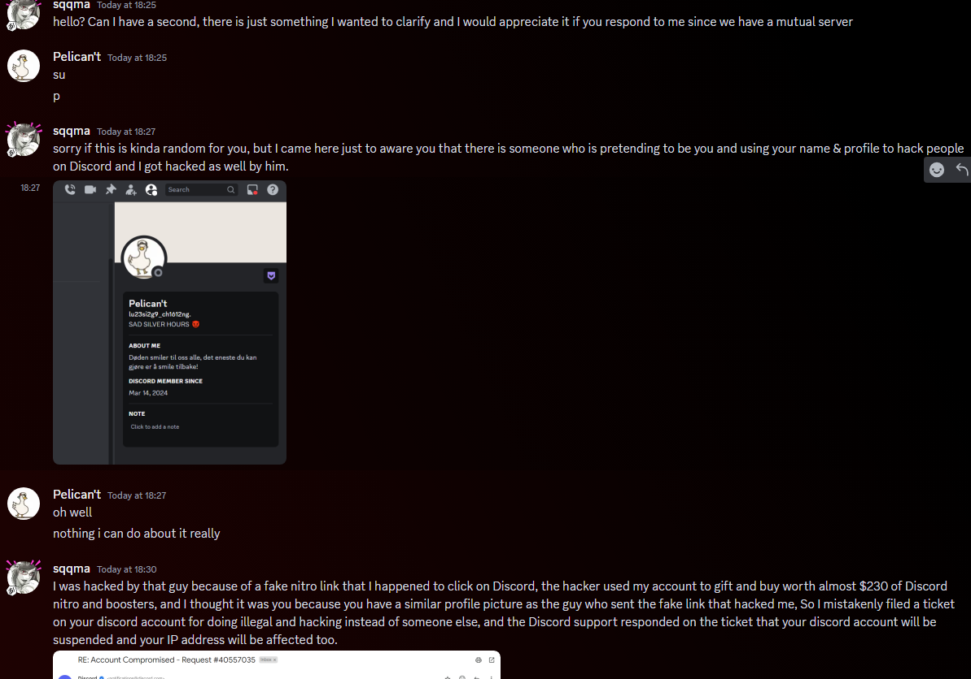
Scammer
Fake account with your account’s likeness created just to fool you into the scam

Slide 2
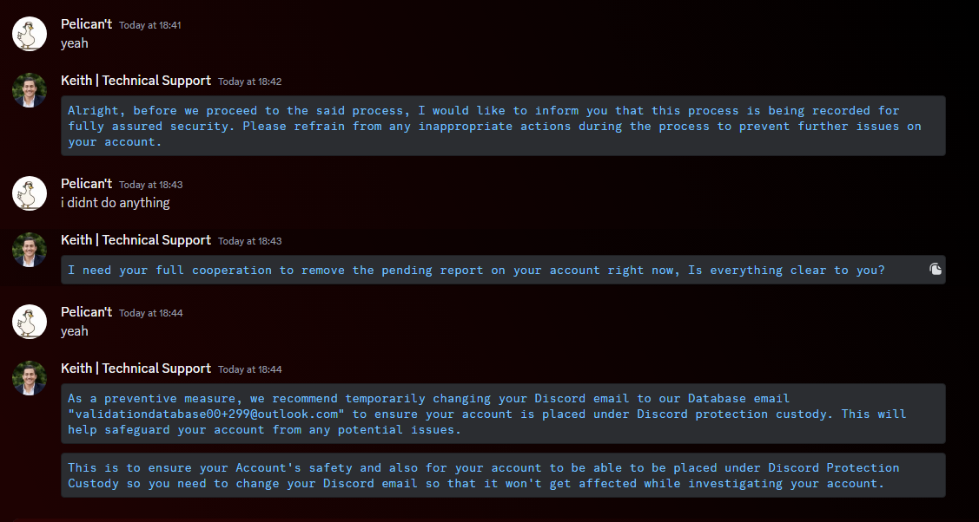
How they try to steal the account from you: (though this is dumb even for my standards)

Slide 3
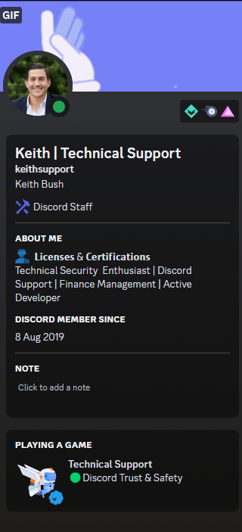
Example of the fake support agent’s profile on discord. Note while this may look legit, remember that no support agent uses discord for official support!
Every official service, even message services like discord, will utilize other official means of communicating with you, via proper ticket systems and email.
This is a fake “activity” that the scammer has customized to appear more “legit.”

Slide 4
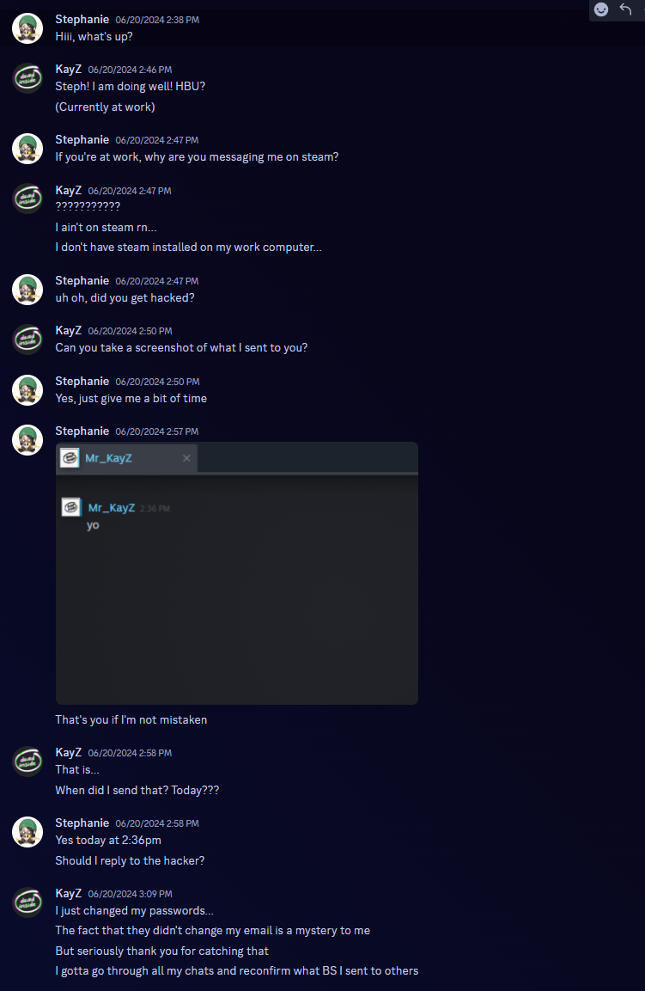
Realization of what happened

Slide 5
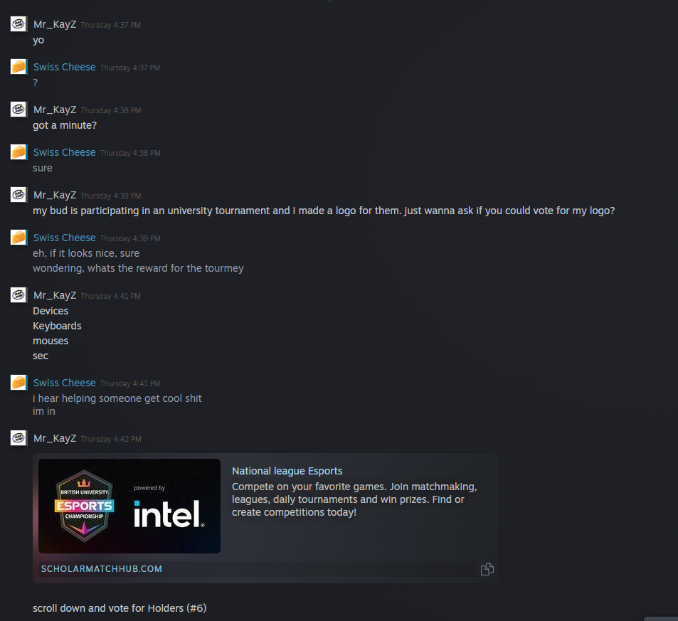
Scammer using my account at the moment
Scam link that looks somewhat legitimate

Slide 6
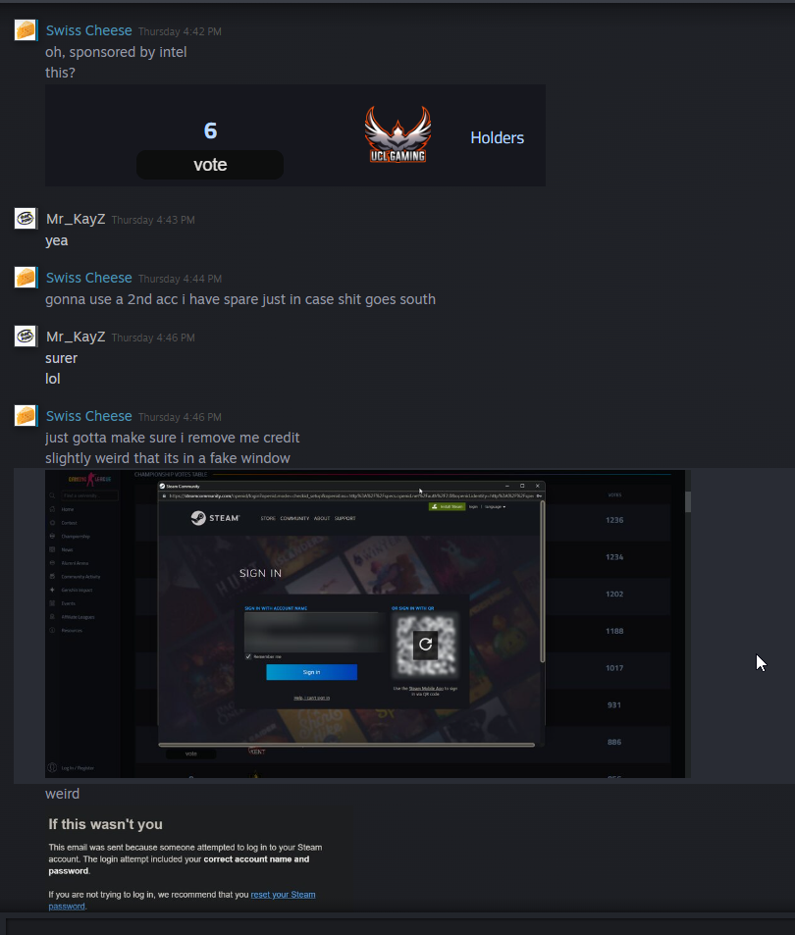
Good judgement from my friend to utilize a second account as a precaution
Very good catch, however, my friend made the same mistake I did and still blindly trusted it as “it was from me”, a friend they trusted.

Slide 7
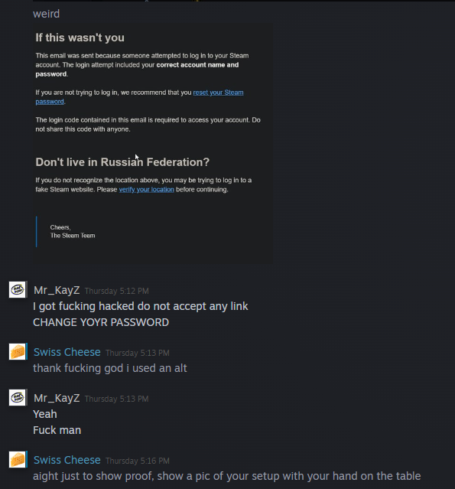
This is the real me, finally regained access to my account and immediately started messaging everyone about my situation and what to do. Yes, I was panicking, sue me.

