Slide 1

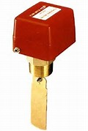

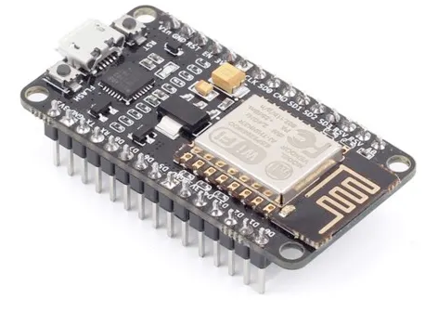

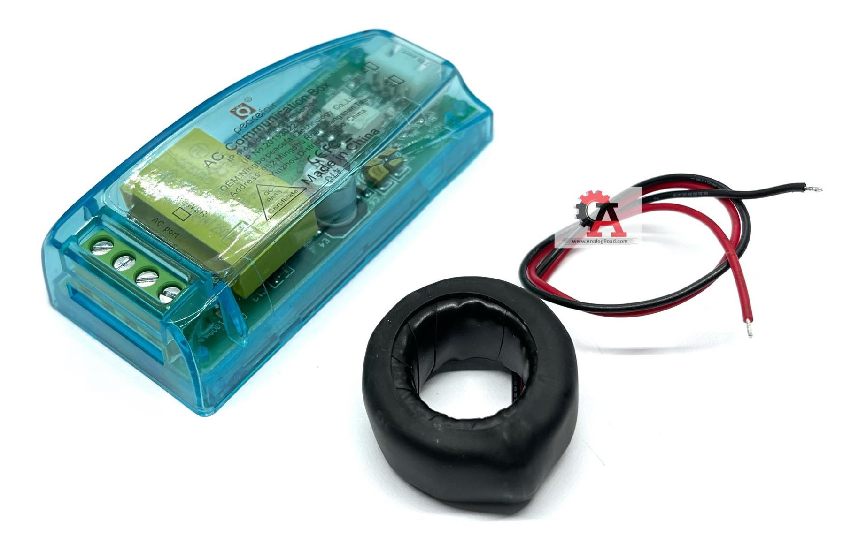
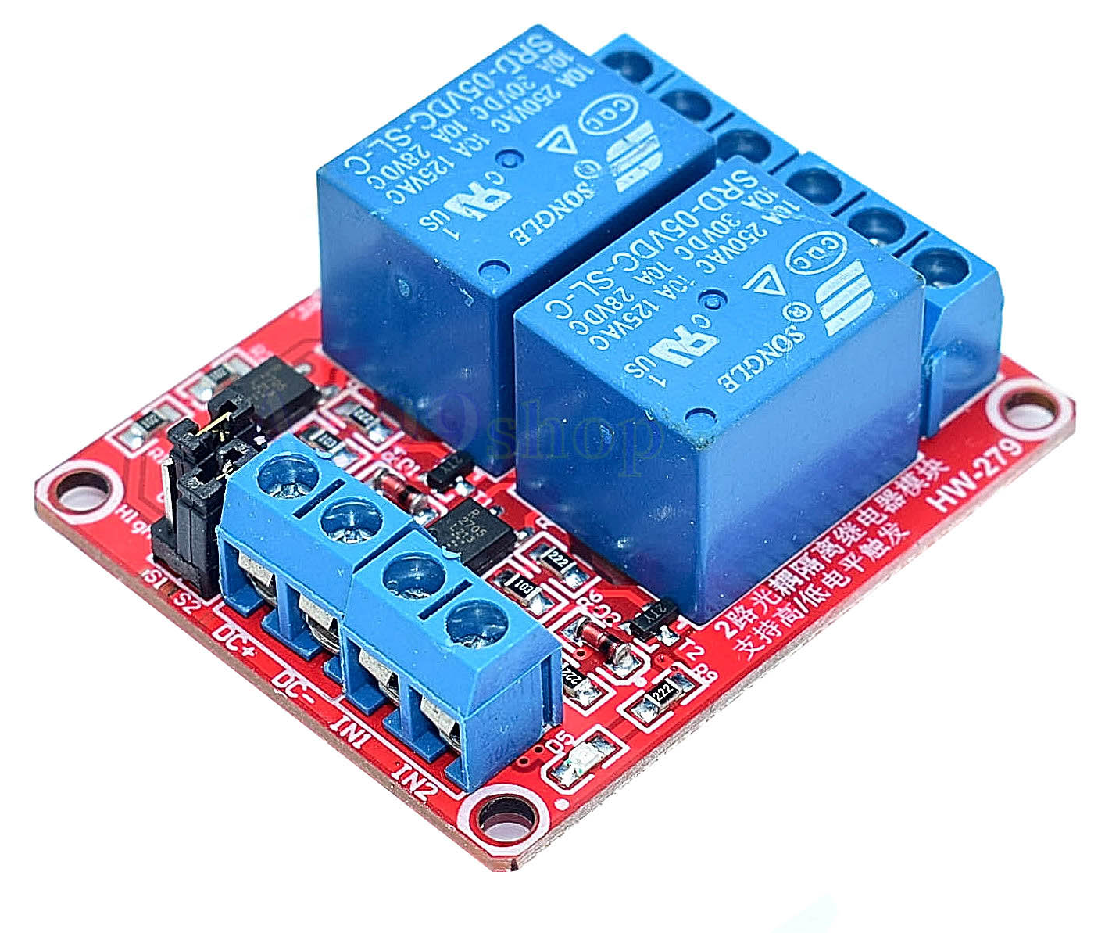
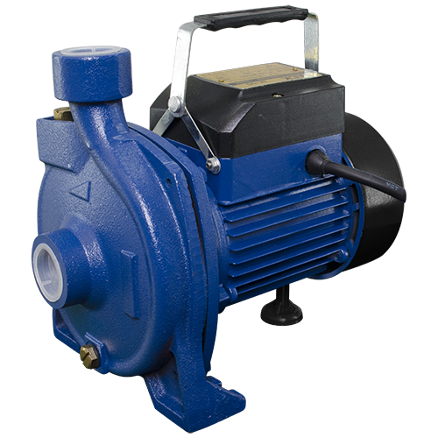
Telegram Bot Notify
1-bit Digital Input
Flow Switch
User
1 Analog Input
1-bit Digital Output
Node MCU ESP8266
AC Meter Module
2 Channels Relay
Centrifugal Pump

