Slide 1



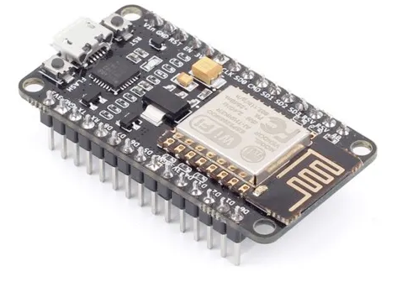

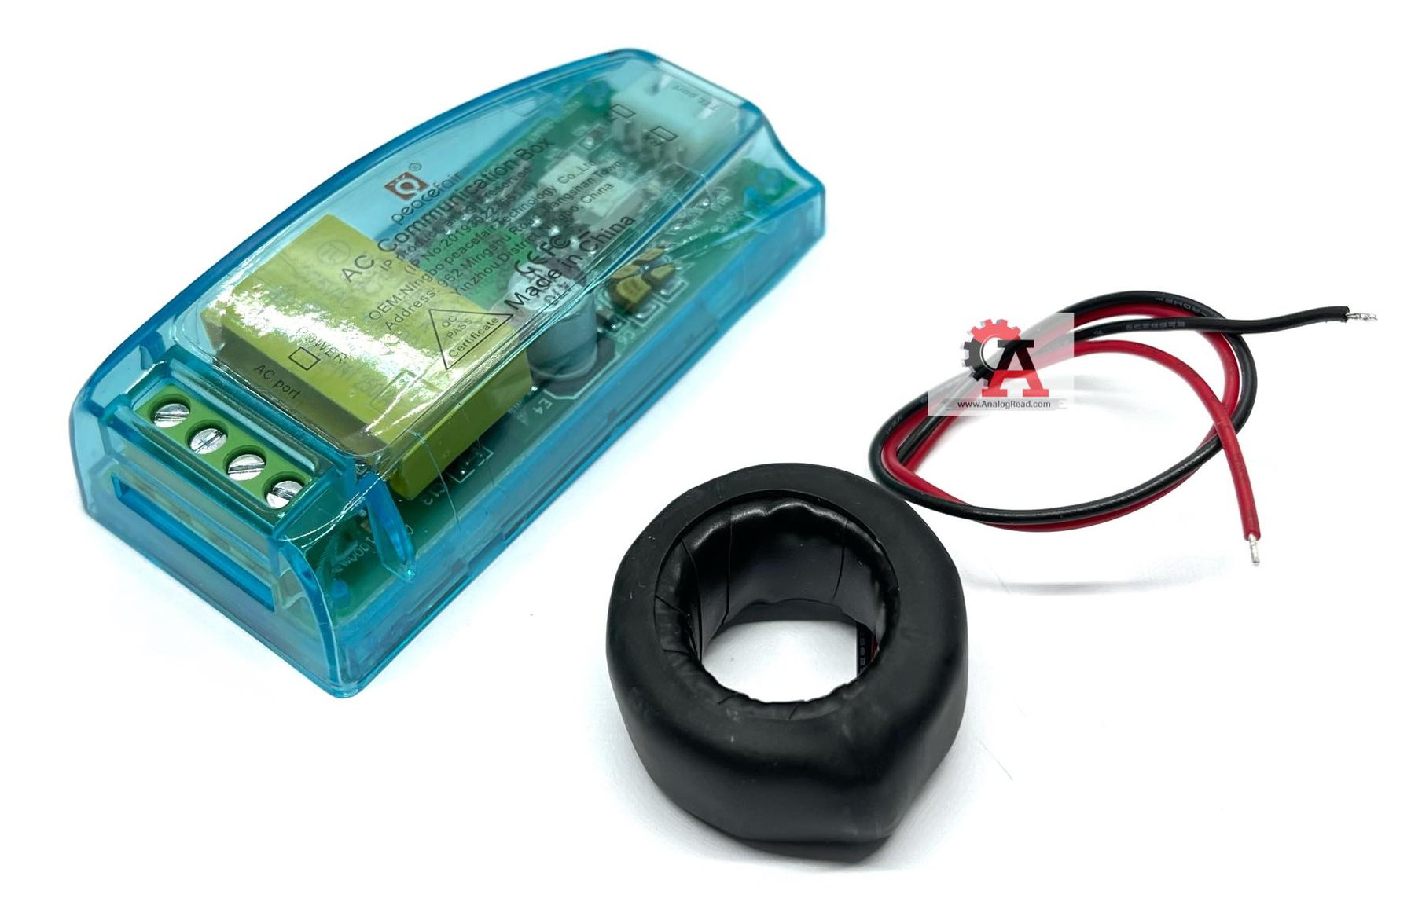
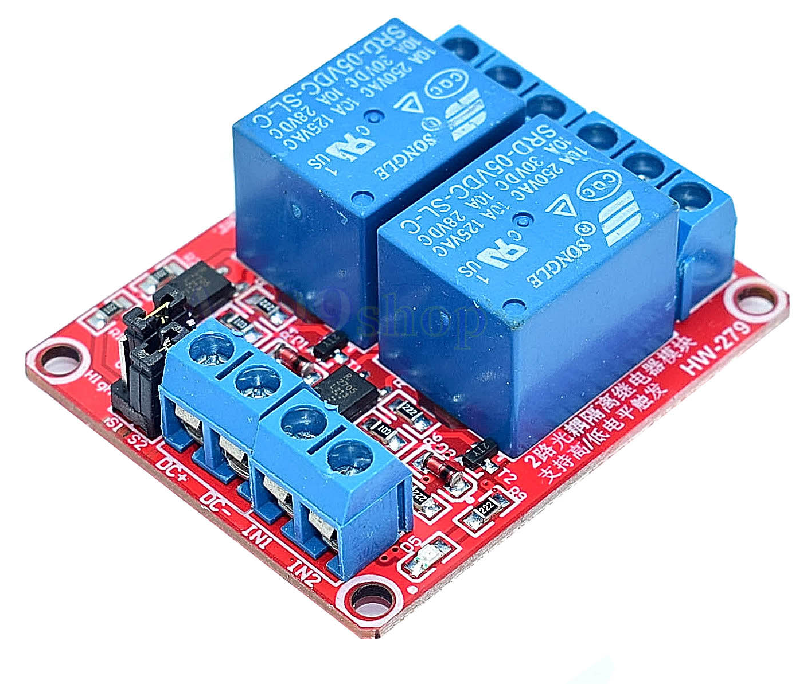
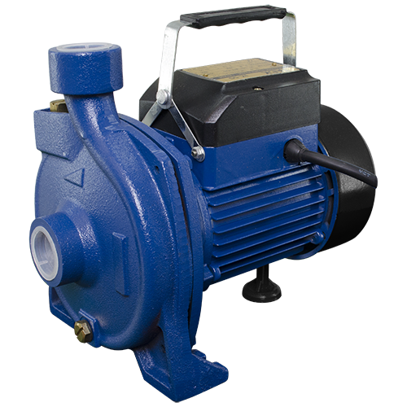
Telegram Bot Notify
1-bit Digital Input
Water Flow Switch
User
1 Analog Input
Node MCU ESP8266
1-bit Digital Output
AC Meter Module
2 Channels Relay
Water Pump

