Slide 1
try / except

Slide 2
Sintaxis de try / except
try = tratar – intentar
except = excepción
try:
Instrucciones
except:
Ejecutar en caso de error

Slide 3




Slide 4
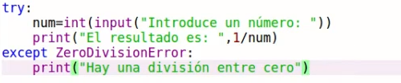


Slide 5
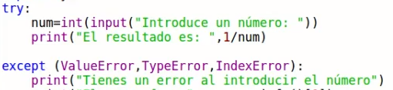


Slide 6
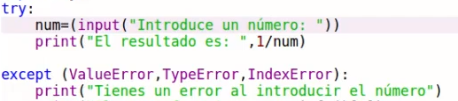


Slide 7
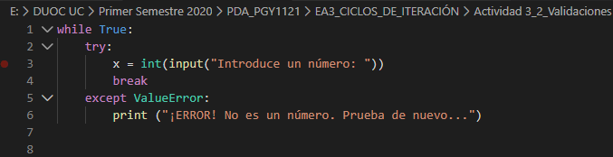
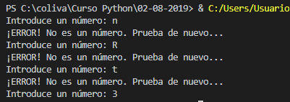

Slide 8
Excepciones de Python
https://docs.python.org/3/library/exceptions.html

