Slide 1
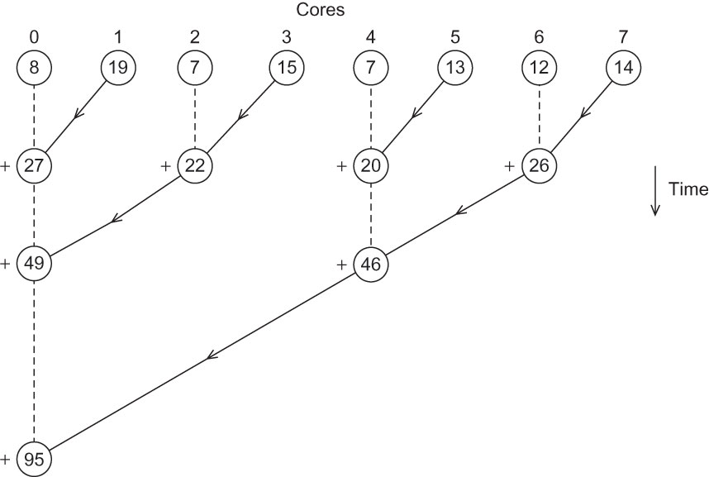
Fig 1.1
Chapter 1
Copyright © 2010, Elsevier Inc. All rights Reserved
Notes:
The University of Adelaide, School of Computer Science
Chapter 2 — Instructions: Language of the Computer

Slide 2
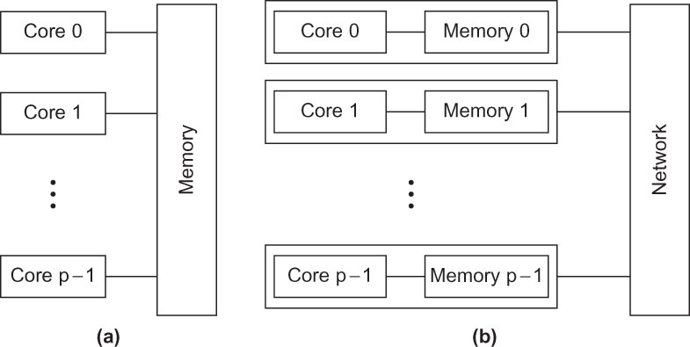
Fig 1.2
Chapter 1
Copyright © 2010, Elsevier Inc. All rights Reserved
Notes:
The University of Adelaide, School of Computer Science
Chapter 2 — Instructions: Language of the Computer

