Slide 1
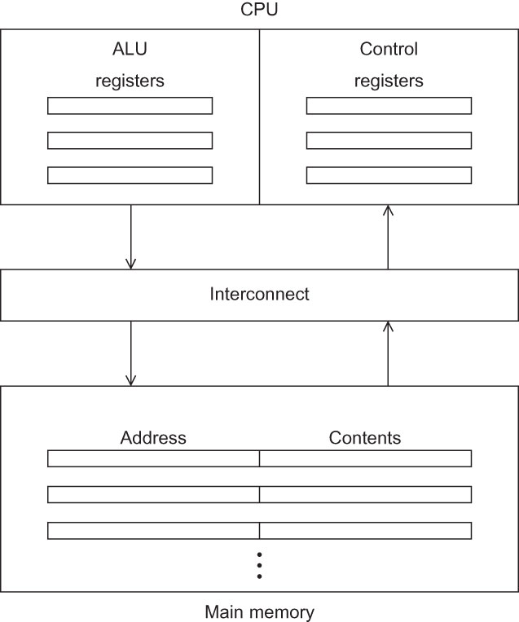
Fig 2.1
Chapter 2
Copyright © 2010, Elsevier Inc. All rights Reserved
Notes:
The University of Adelaide, School of Computer Science
Chapter 2 — Instructions: Language of the Computer

Slide 2
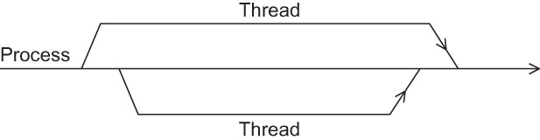
Fig 2.2
Chapter 2
Copyright © 2010, Elsevier Inc. All rights Reserved
Notes:
The University of Adelaide, School of Computer Science
Chapter 2 — Instructions: Language of the Computer

Slide 3
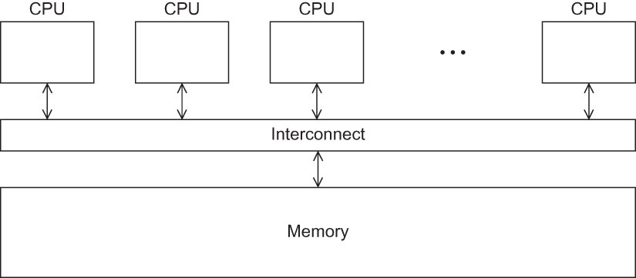
Fig 2.3
Chapter 2
Copyright © 2010, Elsevier Inc. All rights Reserved
Notes:
The University of Adelaide, School of Computer Science
Chapter 2 — Instructions: Language of the Computer

Slide 4
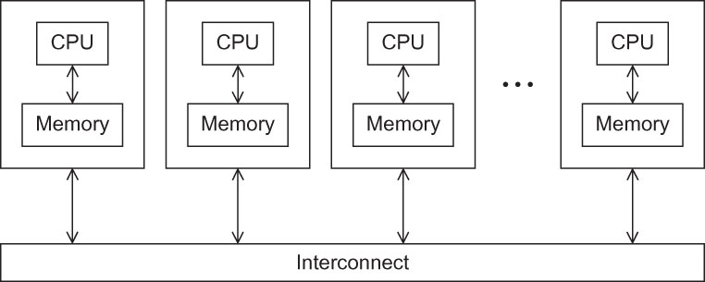
Fig 2.4
Chapter 2
Copyright © 2010, Elsevier Inc. All rights Reserved
Notes:
The University of Adelaide, School of Computer Science
Chapter 2 — Instructions: Language of the Computer

Slide 5
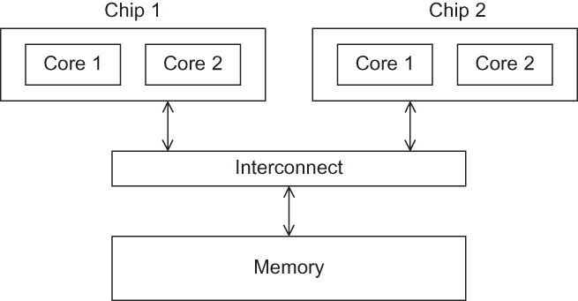
Fig 2.5
Chapter 2
Copyright © 2010, Elsevier Inc. All rights Reserved
Notes:
The University of Adelaide, School of Computer Science
Chapter 2 — Instructions: Language of the Computer

Slide 6
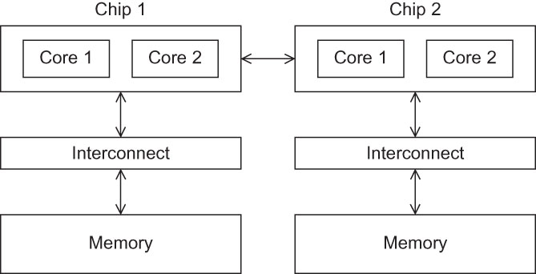
Fig 2.6
Chapter 2
Copyright © 2010, Elsevier Inc. All rights Reserved
Notes:
The University of Adelaide, School of Computer Science
Chapter 2 — Instructions: Language of the Computer

Slide 7
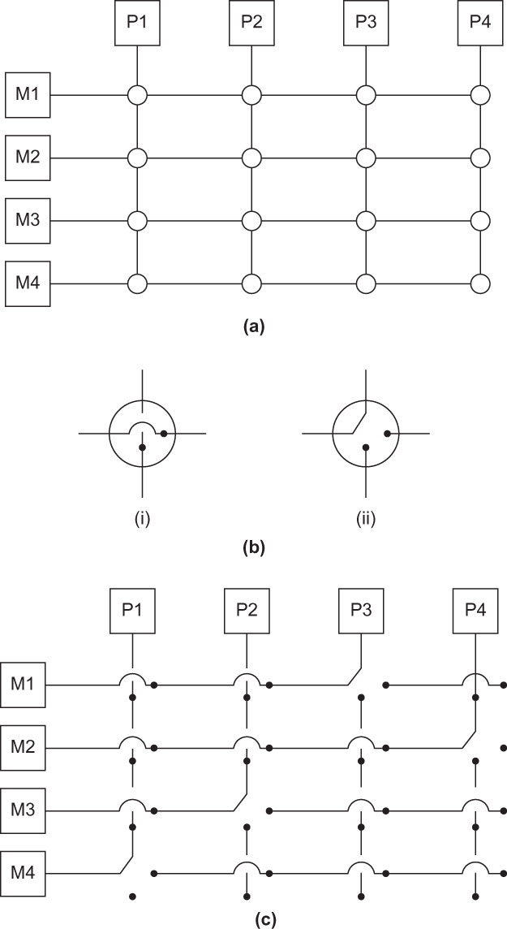
Fig 2.7
Chapter 2
Copyright © 2010, Elsevier Inc. All rights Reserved
Notes:
The University of Adelaide, School of Computer Science
Chapter 2 — Instructions: Language of the Computer

Slide 8
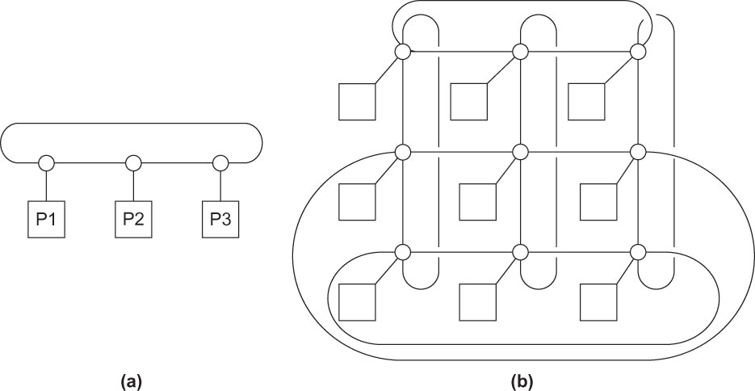
Fig 2.8
Chapter 2
Copyright © 2010, Elsevier Inc. All rights Reserved
Notes:
The University of Adelaide, School of Computer Science
Chapter 2 — Instructions: Language of the Computer

Slide 9
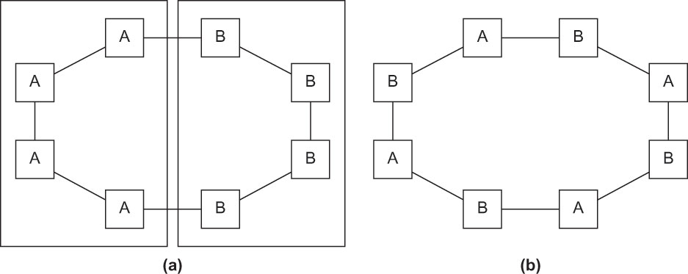
Fig 2.9
Chapter 2
Copyright © 2010, Elsevier Inc. All rights Reserved
Notes:
The University of Adelaide, School of Computer Science
Chapter 2 — Instructions: Language of the Computer

Slide 10
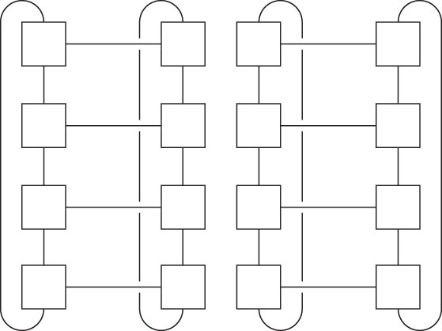
Fig 2.10
Chapter 2
Copyright © 2010, Elsevier Inc. All rights Reserved
Notes:
The University of Adelaide, School of Computer Science
Chapter 2 — Instructions: Language of the Computer

Slide 11
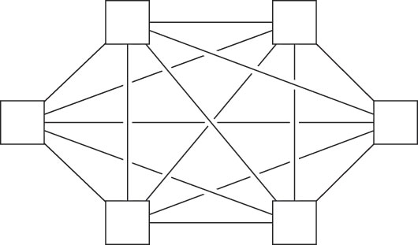
Fig 2.11
Chapter 2
Copyright © 2010, Elsevier Inc. All rights Reserved
Notes:
The University of Adelaide, School of Computer Science
Chapter 2 — Instructions: Language of the Computer

Slide 12
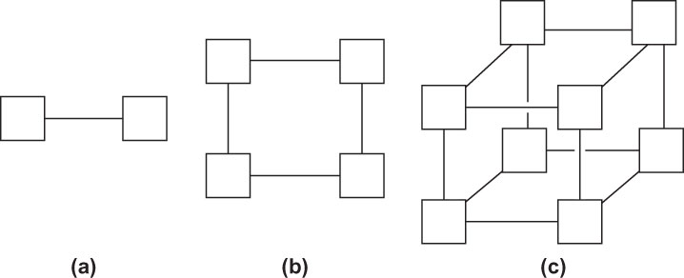
Fig 2.12
Chapter 2
Copyright © 2010, Elsevier Inc. All rights Reserved
Notes:
The University of Adelaide, School of Computer Science
Chapter 2 — Instructions: Language of the Computer

Slide 13
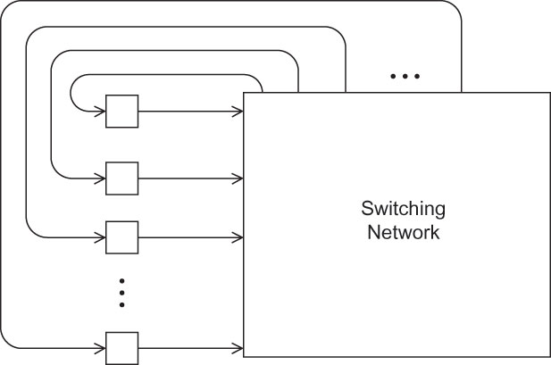
Fig 2.13
Chapter 2
Copyright © 2010, Elsevier Inc. All rights Reserved
Notes:
The University of Adelaide, School of Computer Science
Chapter 2 — Instructions: Language of the Computer

Slide 14
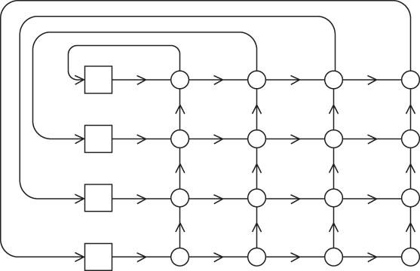
Fig 2.14
Chapter 2
Copyright © 2010, Elsevier Inc. All rights Reserved
Notes:
The University of Adelaide, School of Computer Science
Chapter 2 — Instructions: Language of the Computer

Slide 15
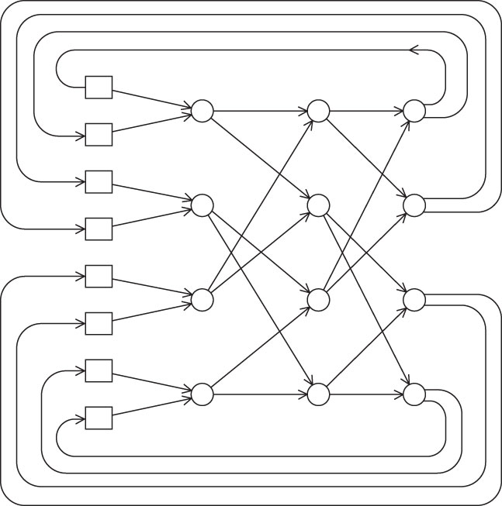
Fig 2.15
Chapter 2
Copyright © 2010, Elsevier Inc. All rights Reserved
Notes:
The University of Adelaide, School of Computer Science
Chapter 2 — Instructions: Language of the Computer

Slide 16
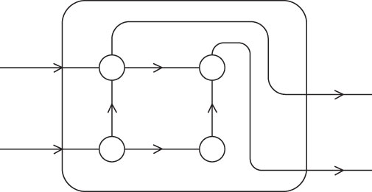
Fig 2.16
Chapter 2
Copyright © 2010, Elsevier Inc. All rights Reserved
Notes:
The University of Adelaide, School of Computer Science
Chapter 2 — Instructions: Language of the Computer

Slide 17
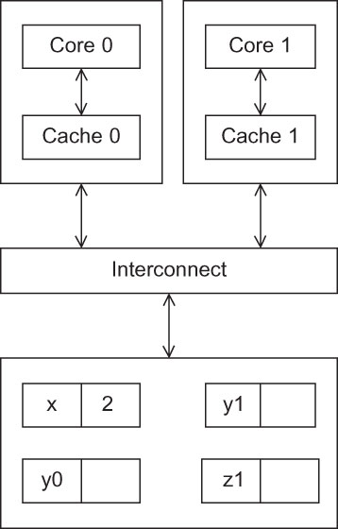
Fig 2.17
Chapter 2
Copyright © 2010, Elsevier Inc. All rights Reserved
Notes:
The University of Adelaide, School of Computer Science
Chapter 2 — Instructions: Language of the Computer

Slide 18
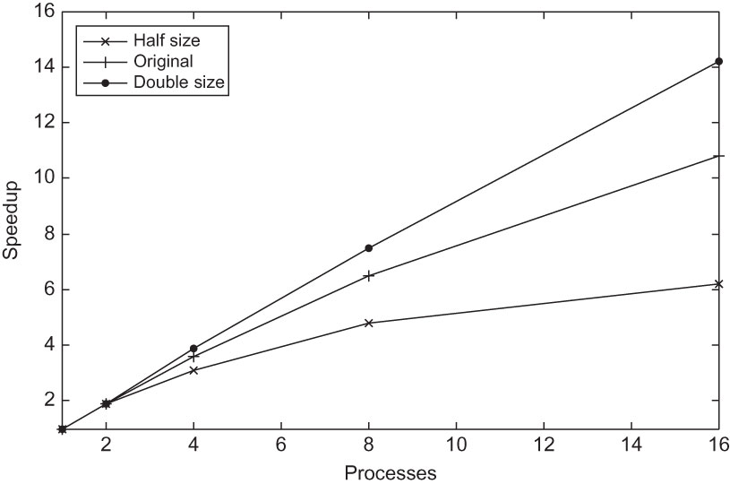
Fig 2.18
Chapter 2
Copyright © 2010, Elsevier Inc. All rights Reserved
Notes:
The University of Adelaide, School of Computer Science
Chapter 2 — Instructions: Language of the Computer

Slide 19
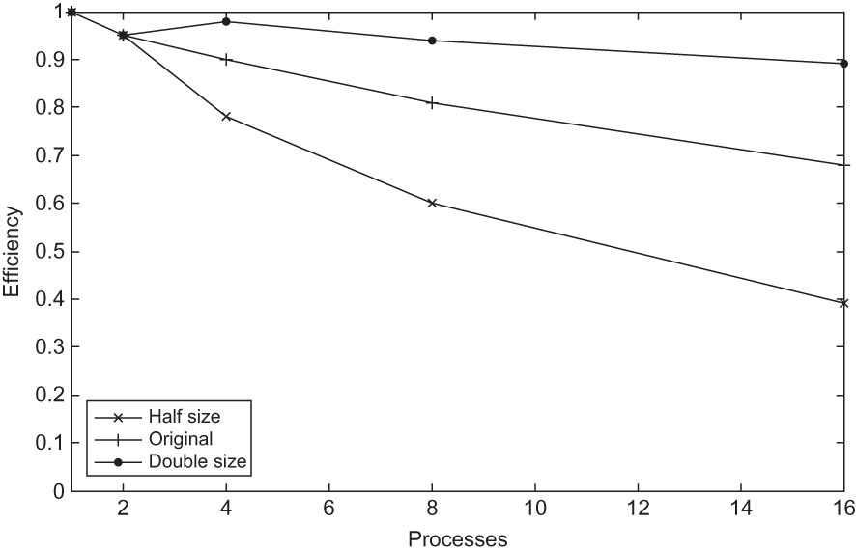
Fig 2.19
Chapter 2
Copyright © 2010, Elsevier Inc. All rights Reserved
Notes:
The University of Adelaide, School of Computer Science
Chapter 2 — Instructions: Language of the Computer

Slide 20
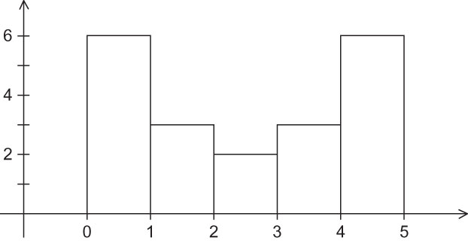
Fig 2.20
Chapter 2
Copyright © 2010, Elsevier Inc. All rights Reserved
Notes:
The University of Adelaide, School of Computer Science
Chapter 2 — Instructions: Language of the Computer

Slide 21
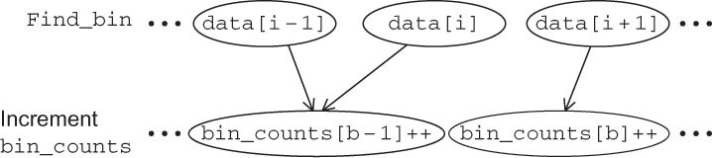
Fig 2.21
Chapter 2
Copyright © 2010, Elsevier Inc. All rights Reserved
Notes:
The University of Adelaide, School of Computer Science
Chapter 2 — Instructions: Language of the Computer

Slide 22
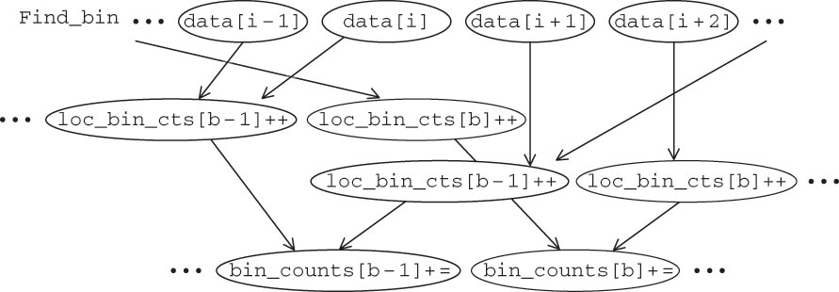
Fig 2.22
Chapter 2
Copyright © 2010, Elsevier Inc. All rights Reserved
Notes:
The University of Adelaide, School of Computer Science
Chapter 2 — Instructions: Language of the Computer

Slide 23
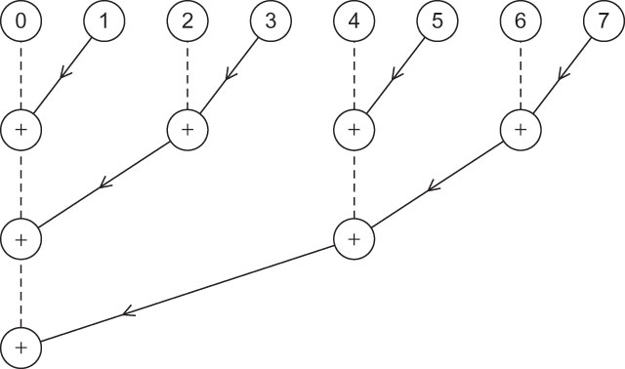
Fig 2.23
Chapter 2
Copyright © 2010, Elsevier Inc. All rights Reserved
Notes:
The University of Adelaide, School of Computer Science
Chapter 2 — Instructions: Language of the Computer

