Slide 1
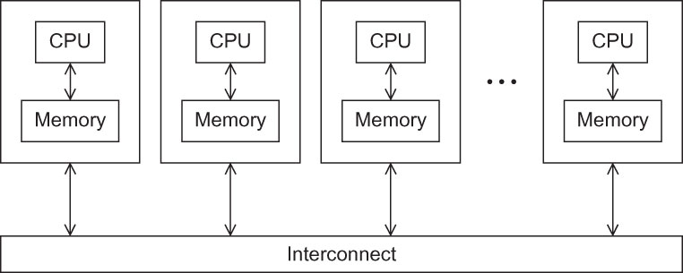
Fig 3.1
Chapter 3
Copyright © 2010, Elsevier Inc. All rights Reserved
Notes:
The University of Adelaide, School of Computer Science
Chapter 2 — Instructions: Language of the Computer

Slide 2
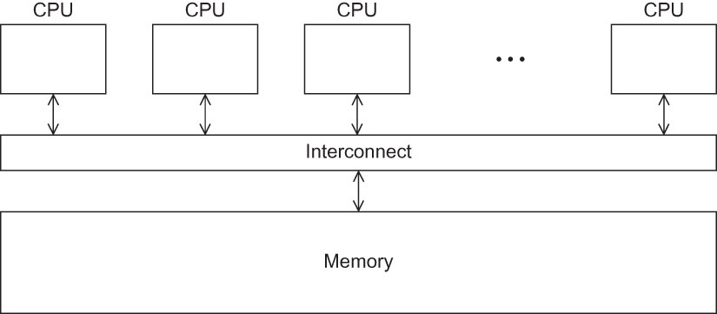
Fig 3.2
Chapter 3
Copyright © 2010, Elsevier Inc. All rights Reserved
Notes:
The University of Adelaide, School of Computer Science
Chapter 2 — Instructions: Language of the Computer

Slide 3
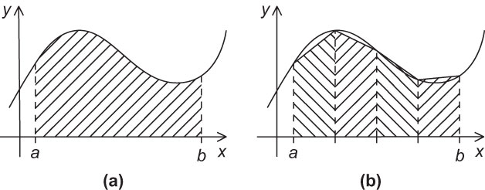
Fig 3.3
Chapter 3
Copyright © 2010, Elsevier Inc. All rights Reserved
Notes:
The University of Adelaide, School of Computer Science
Chapter 2 — Instructions: Language of the Computer

Slide 4
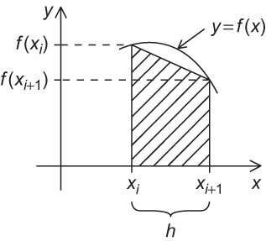
Fig 3.4
Chapter 3
Copyright © 2010, Elsevier Inc. All rights Reserved
Notes:
The University of Adelaide, School of Computer Science
Chapter 2 — Instructions: Language of the Computer

Slide 5
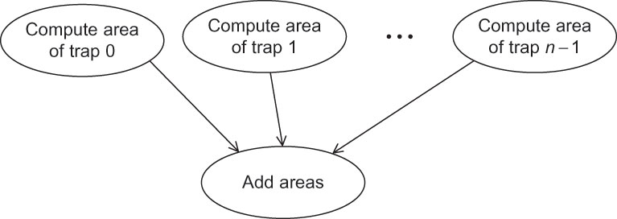
Fig 3.5
Chapter 3
Copyright © 2010, Elsevier Inc. All rights Reserved
Notes:
The University of Adelaide, School of Computer Science
Chapter 2 — Instructions: Language of the Computer

Slide 6
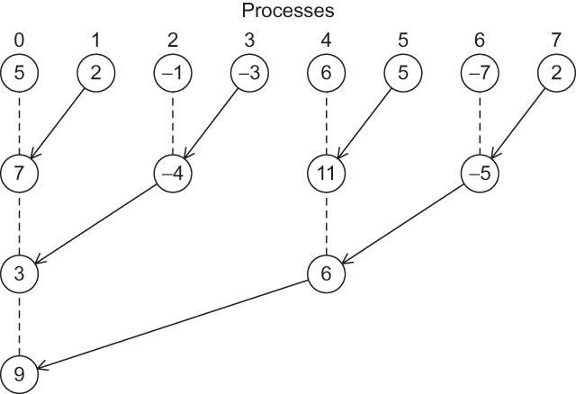
Fig 3.6
Chapter 3
Copyright © 2010, Elsevier Inc. All rights Reserved
Notes:
The University of Adelaide, School of Computer Science
Chapter 2 — Instructions: Language of the Computer

Slide 7
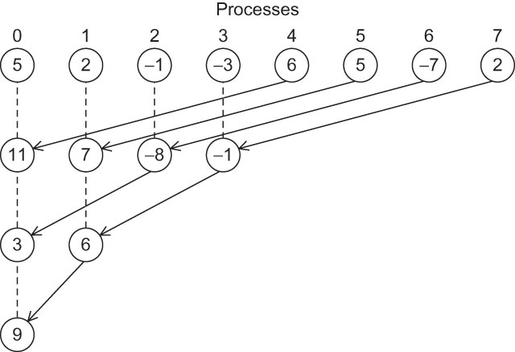
Fig 3.7
Chapter 3
Copyright © 2010, Elsevier Inc. All rights Reserved
Notes:
The University of Adelaide, School of Computer Science
Chapter 2 — Instructions: Language of the Computer

Slide 8
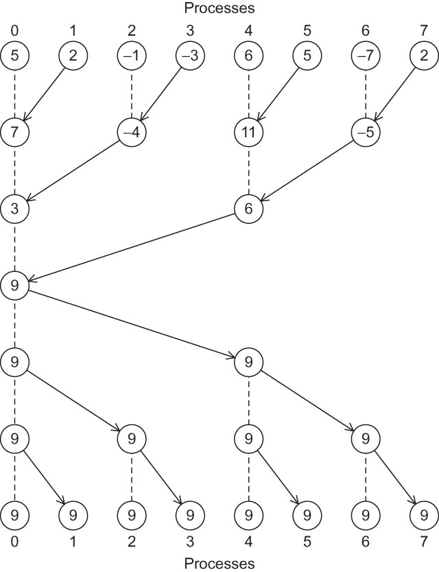
Fig 3.8
Chapter 3
Copyright © 2010, Elsevier Inc. All rights Reserved
Notes:
The University of Adelaide, School of Computer Science
Chapter 2 — Instructions: Language of the Computer

Slide 9
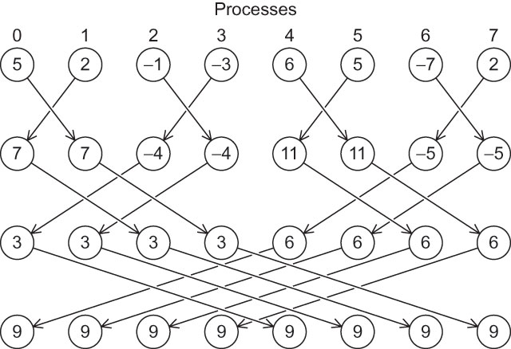
Fig 3.9
Chapter 3
Copyright © 2010, Elsevier Inc. All rights Reserved
Notes:
The University of Adelaide, School of Computer Science
Chapter 2 — Instructions: Language of the Computer

Slide 10
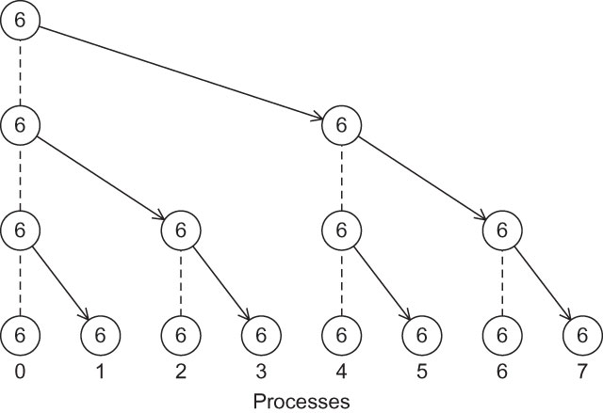
Fig 3.10
Chapter 3
Copyright © 2010, Elsevier Inc. All rights Reserved
Notes:
The University of Adelaide, School of Computer Science
Chapter 2 — Instructions: Language of the Computer

Slide 11
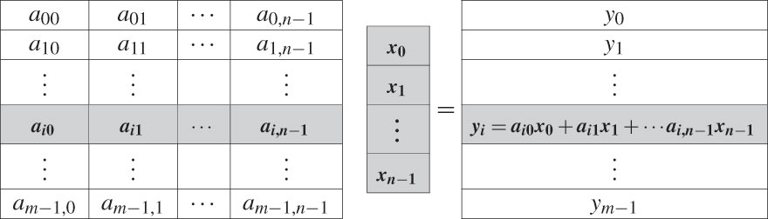
Fig 3.11
Chapter 3
Copyright © 2010, Elsevier Inc. All rights Reserved
Notes:
The University of Adelaide, School of Computer Science
Chapter 2 — Instructions: Language of the Computer

Slide 12
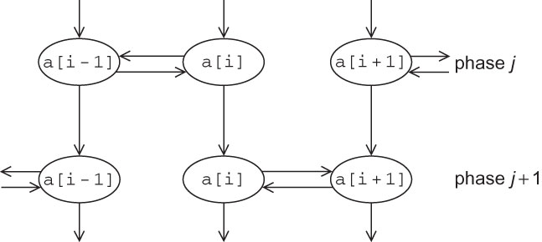
Fig 3.12
Chapter 3
Copyright © 2010, Elsevier Inc. All rights Reserved
Notes:
The University of Adelaide, School of Computer Science
Chapter 2 — Instructions: Language of the Computer

Slide 13
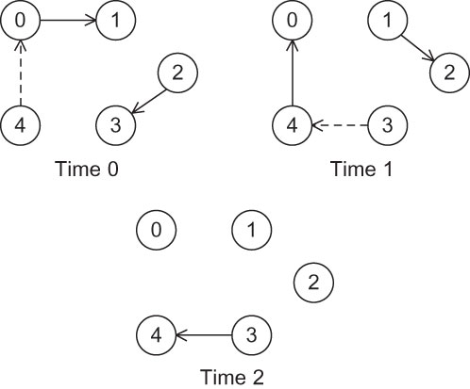
Fig 3.13
Chapter 3
Copyright © 2010, Elsevier Inc. All rights Reserved
Notes:
The University of Adelaide, School of Computer Science
Chapter 2 — Instructions: Language of the Computer

Slide 14
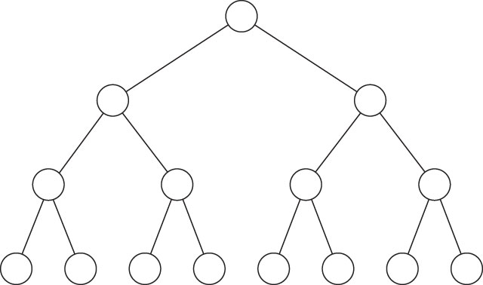
Fig 3.14
Chapter 3
Copyright © 2010, Elsevier Inc. All rights Reserved
Notes:
The University of Adelaide, School of Computer Science
Chapter 2 — Instructions: Language of the Computer

