Slide 1
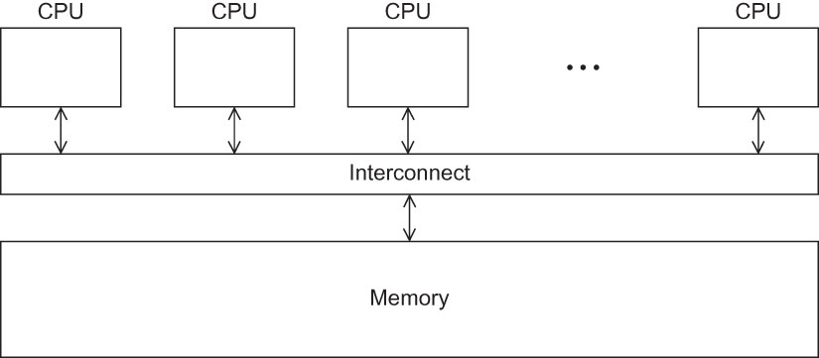
Fig 4.1
Chapter 4
Copyright © 2010, Elsevier Inc. All rights Reserved
Notes:
The University of Adelaide, School of Computer Science
Chapter 2 — Instructions: Language of the Computer

Slide 2
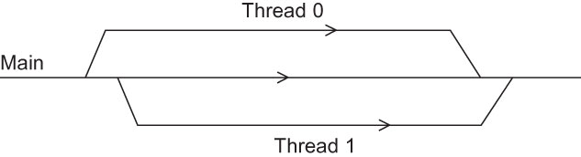
Fig 4.2
Chapter 4
Copyright © 2010, Elsevier Inc. All rights Reserved
Notes:
The University of Adelaide, School of Computer Science
Chapter 2 — Instructions: Language of the Computer

Slide 3
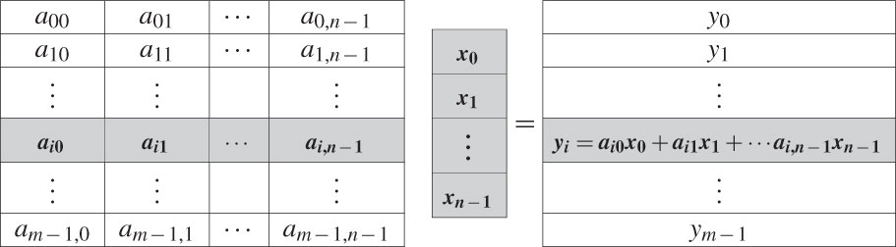
Fig 4.3
Chapter 4
Copyright © 2010, Elsevier Inc. All rights Reserved
Notes:
The University of Adelaide, School of Computer Science
Chapter 2 — Instructions: Language of the Computer

Slide 4

Fig 4.4
Chapter 4
Copyright © 2010, Elsevier Inc. All rights Reserved
Notes:
The University of Adelaide, School of Computer Science
Chapter 2 — Instructions: Language of the Computer

Slide 5
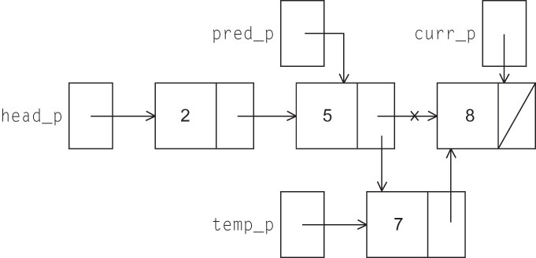
Fig 4.5
Chapter 4
Copyright © 2010, Elsevier Inc. All rights Reserved
Notes:
The University of Adelaide, School of Computer Science
Chapter 2 — Instructions: Language of the Computer

Slide 6
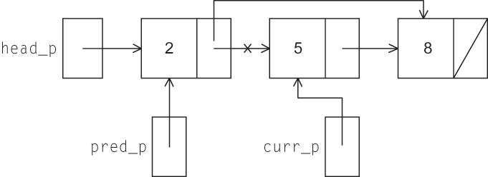
Fig 4.6
Chapter 4
Copyright © 2010, Elsevier Inc. All rights Reserved
Notes:
The University of Adelaide, School of Computer Science
Chapter 2 — Instructions: Language of the Computer

Slide 7
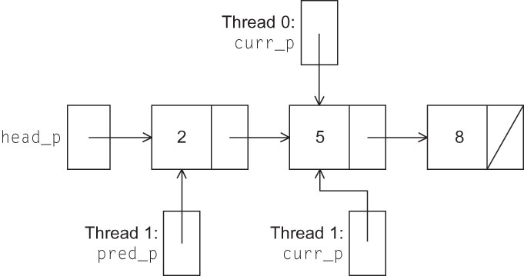
Fig 4.7
Chapter 4
Copyright © 2010, Elsevier Inc. All rights Reserved
Notes:
The University of Adelaide, School of Computer Science
Chapter 2 — Instructions: Language of the Computer

