Slide 1
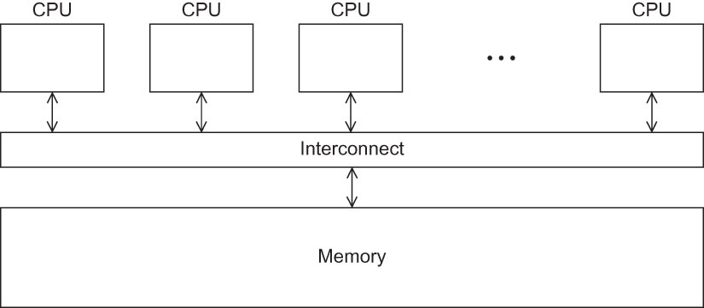
Fig 5.1
Chapter 5
Copyright © 2010, Elsevier Inc. All rights Reserved
Notes:
The University of Adelaide, School of Computer Science
Chapter 2 — Instructions: Language of the Computer

Slide 2
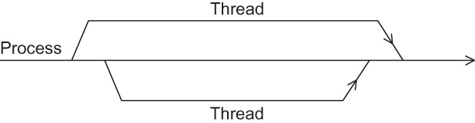
Fig 5.2
Chapter 5
Copyright © 2010, Elsevier Inc. All rights Reserved
Notes:
The University of Adelaide, School of Computer Science
Chapter 2 — Instructions: Language of the Computer

Slide 3
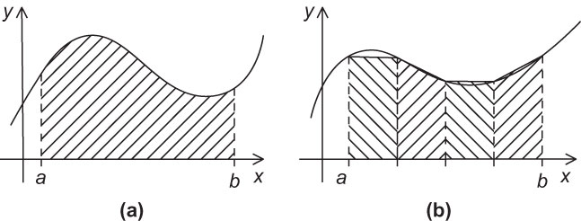
Fig 5.3
Chapter 5
Copyright © 2010, Elsevier Inc. All rights Reserved
Notes:
The University of Adelaide, School of Computer Science
Chapter 2 — Instructions: Language of the Computer

Slide 4
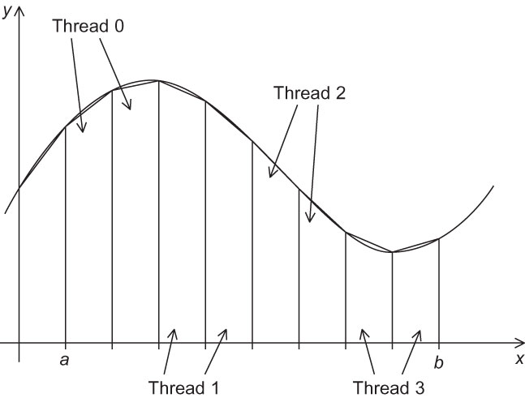
Fig 5.4
Chapter 5
Copyright © 2010, Elsevier Inc. All rights Reserved
Notes:
The University of Adelaide, School of Computer Science
Chapter 2 — Instructions: Language of the Computer

Slide 5
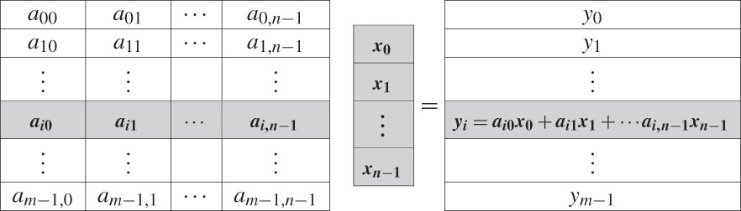
Fig 5.5
Chapter 5
Copyright © 2010, Elsevier Inc. All rights Reserved
Notes:
The University of Adelaide, School of Computer Science
Chapter 2 — Instructions: Language of the Computer

