Slide 1
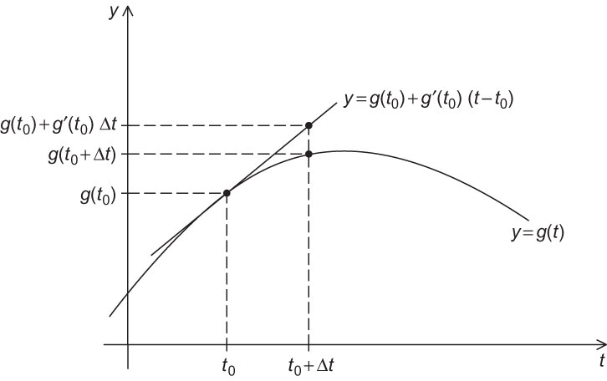
Fig 6.1
Chapter 6
Copyright © 2010, Elsevier Inc. All rights Reserved
Notes:
The University of Adelaide, School of Computer Science
Chapter 2 — Instructions: Language of the Computer

Slide 2
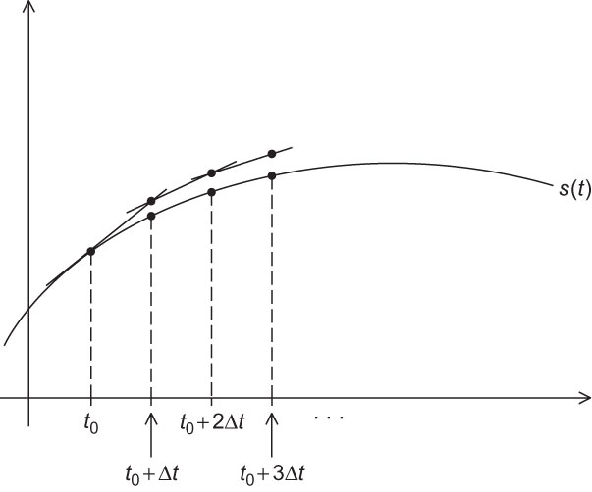
Fig 6.2
Chapter 6
Copyright © 2010, Elsevier Inc. All rights Reserved
Notes:
The University of Adelaide, School of Computer Science
Chapter 2 — Instructions: Language of the Computer

Slide 3
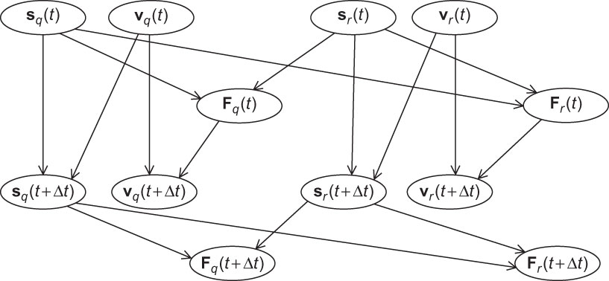
Fig 6.3
Chapter 6
Copyright © 2010, Elsevier Inc. All rights Reserved
Notes:
The University of Adelaide, School of Computer Science
Chapter 2 — Instructions: Language of the Computer

Slide 4
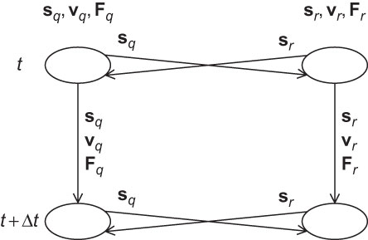
Fig 6.4
Chapter 6
Copyright © 2010, Elsevier Inc. All rights Reserved
Notes:
The University of Adelaide, School of Computer Science
Chapter 2 — Instructions: Language of the Computer

Slide 5
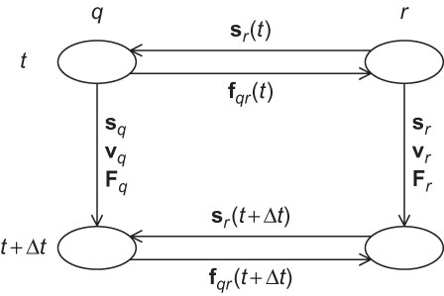
Fig 6.5
Chapter 6
Copyright © 2010, Elsevier Inc. All rights Reserved
Notes:
The University of Adelaide, School of Computer Science
Chapter 2 — Instructions: Language of the Computer

Slide 6
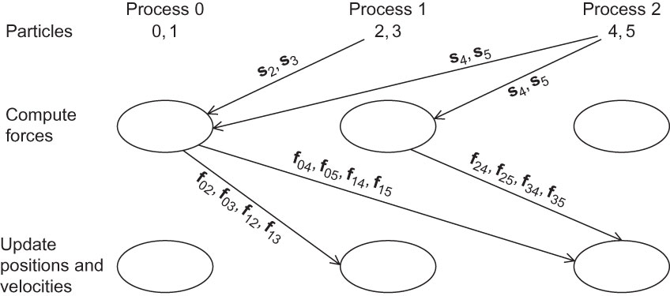
Fig 6.6
Chapter 6
Copyright © 2010, Elsevier Inc. All rights Reserved
Notes:
The University of Adelaide, School of Computer Science
Chapter 2 — Instructions: Language of the Computer

Slide 7
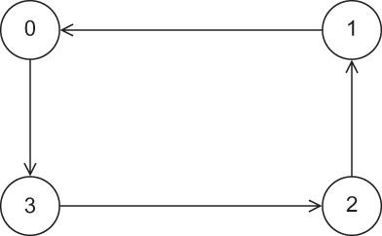
Fig 6.7
Chapter 6
Copyright © 2010, Elsevier Inc. All rights Reserved
Notes:
The University of Adelaide, School of Computer Science
Chapter 2 — Instructions: Language of the Computer

Slide 8
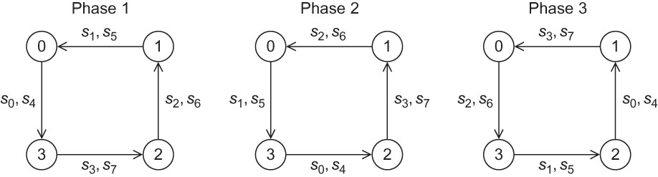
Fig 6.8
Chapter 6
Copyright © 2010, Elsevier Inc. All rights Reserved
Notes:
The University of Adelaide, School of Computer Science
Chapter 2 — Instructions: Language of the Computer

Slide 9
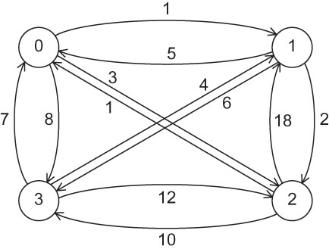
Fig 6.9
Chapter 6
Copyright © 2010, Elsevier Inc. All rights Reserved
Notes:
The University of Adelaide, School of Computer Science
Chapter 2 — Instructions: Language of the Computer

Slide 10
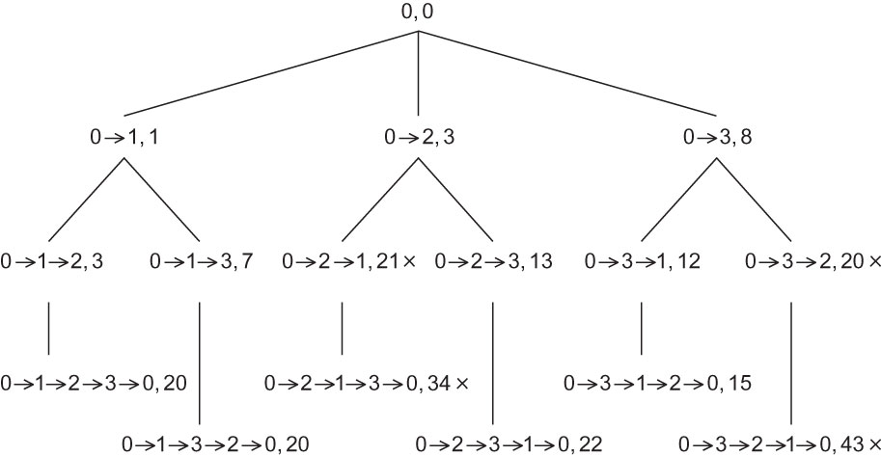
Fig 6.10
Chapter 6
Copyright © 2010, Elsevier Inc. All rights Reserved
Notes:
The University of Adelaide, School of Computer Science
Chapter 2 — Instructions: Language of the Computer

