Slide 1

HYBRID DOCUMENT SUMMERIZATION
DONE by,
Naveen P Pandurangi(1VK15CS034)
Nikhil Chandran(1VK15CS038)
Srivatsa V Jamadagni(1VK15CS054)
Mohammed Abu Talha Ahmed(1VK15CS030)
Under The Guidance Of
PROF. Chandramma R
Assoc.Professor ,Dept Of CSE,VKIT

Slide 2

Table of contents
Introduction
Existing system
Proposed system
Methodology
Expected outcomes and Results
Conclusion
References

Slide 3
INTRODUCTION :
Hybrid Document Summarization is the technique by which the huge parts of content are retrieved.
The Document Summarization plays out the summarization task by unsupervised learning system.
The significance of a sentence in info content is assessed by the assistance of 3 algorithms.
An online semantic lexicon WordNet is utilized, Word Sense Disambiguation (WSD) is a critical and testing system in the territory of characteristic dialect handling (NLP).
The Hybrid Document Summarization undertaking makes the users simpler for various Natural Language applications, like, Data Recovery, Question Answering or content decreasing etc.

Slide 4
Litearture SURVEY
Document Summarization is the technique by which the huge parts of content are retrieved.
The Document Summarization plays out the summarization task by unsupervised learning system.
The significance of a sentence in info content is assessed by the assistance of Simplified Lesk calculation.
A specific word may have distinctive significance in various setting. So, the principle task of word sense disambiguation is to decide.

Slide 5
SL No | Title | Methodology | Algorithm | Accuracy
01 | A Neural Attention Model for Abstractive Sentence Summarization | local attention-based model | Beam Search
02 | Abstractive Text Summarization using Sequence-to-sequence RNN and Beyond | RNN | -
03 | Automatic Keyword Extraction for Text Summarization : survey | - | -
04 | Summarization with Pointer-Generator Networks | Pointer generator network and CNN | -
05 | Text Summarization Techniques: A Brief Survey | Frequency Driven Approaches | -
06 | Ranking Sentences for Extractive Summarization with Reinforcement Learning | CNN/RNN | REINFORCE algorithm

Slide 6
07 | Neural Document Summarization by Jointly Learning to Score and Select Sentences | RNN | -
08 | Machine Learning Techniques for Document Summarization: A Survey | Talks about all the methods | -
09 | Ranking with Recursive Neural Networks and Its Application to Multi-Document Summarization | R2N2/RNN | -
10 | A Neural Attention Model for Sentence Summarization | local attention-based model | Beam Search
11 | A Review Paper on Text Summarization | Natural Language Processing | -
12 | Automatic Text Summarization Using Natural Language Processing | Natural Language Processing | LESK Algorithm
13 | A Novel Technique for Efficient Text Document Summarization as a Service | Natural Language Processing | LESK Algorithm

Slide 7
14 | Automatic Text Summarization and its methods : A Review | Term frequency based method/ Graph based method/ Time based method/Clustering based method | -
15 | A Review on Automatic Text Summarization Approaches | Frequency Based Approach/Term Frequency–Inverse Document Frequency/Machine Learning Approach/Discourse Based Method | -

Slide 8
Software REQUIREMENTS
FRONT END
Internet Browser
Javascript
BACK END
Anaconda 2.7.X
NLTK
WordNet 2.1
MontyLingua

Slide 9
Existing system
Usually summarization is done by hand by the editor or user.
Most of the methods currently in use do summarization for text .
Summarization of document is hardly even possible
Most methods utilize supervised learning.
This method is tedious, time consuming and very inefficient.

Slide 10
PROPOSED SYSTEM
A solitary or single input content is going to be outlined utilizing unsupervised learning.
Sentences with induced weights are composed in sliding solicitation concerning their weights.
Certain quantities of sentences are chosen as an outline.
The proposed computations, abridges solitary or single report content utilizing unsupervised learning approach.
Heaviness of every sentence in a substance is resolved using streamlined Lesk’s computation and wordnet.
Summarization procedure is performed as indicated by the given rate of synopsis.
Input document will be in the form of a .txt file.

Slide 11
The pre-processing includes the data cleaning and data abstraction.
The data will be the input to the lesk algorithm with the weights given to the words.
Wordnet acts as a dictionary for comparing the importance of the word given is the input.
Once the data is processed in the lesk algorithm it gives the output values which will be further converted into the summarized document format.

Slide 12
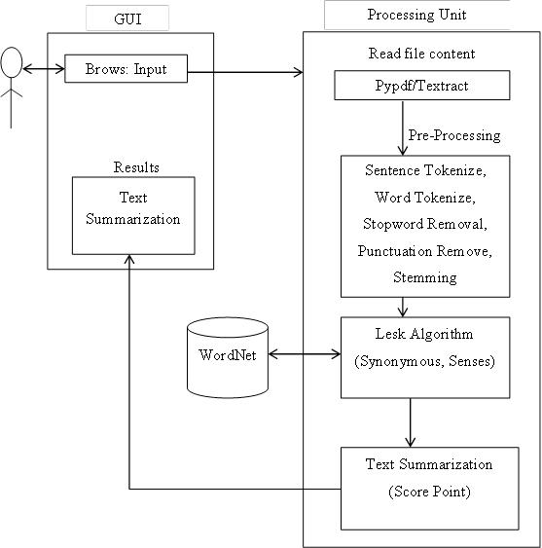
SYSTEM ARCHITECTURE OF PROPOSED SYSTEM

Slide 13
METHODOLOGY
STAGE 1: DATA PRE-PROCESSING
Programmed record outline generator is for clearing the undesirable things which exist in the substance. Henceforth it will additionally process it will be performing sentence part, tokenization, empty stop word, clear accentuation and perform stemming.
STAGE 2: EVALUATION OF WEIGHTS
This is the next phase of document summarization. After the Text data is cleaned and pre-processed, the processing techniques are applied in which the scores, frequency of words are calculated. The data is grouped on the basis of similarity, dissimilarity so that the summary generation can be made efficiently. For this different clustering techniques are used.
STAGE 3: SUMMARIZATION
After the data is processed, the summary is to be generated based on the requirement. Extraction of sentences is done from the processed data and the summary is processed. The words to added to sentences, reducing the sentences based on score etc. is done in this step to produce summary. The representation of the summary can be in the form of words sentences, paragraphs, graphs etc. for the summary to be generated different summarizers are used.

Slide 14
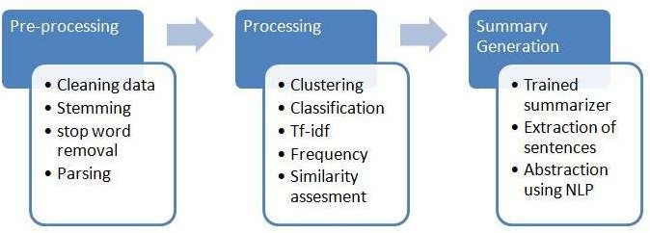
MODEL PROCESSING

Slide 15
Algorithms
AUTOMATIC SUMMARIZATION BASED ON USER QUERY
The algorithm of this approach is as follows:
Generate a Document Graph (DG) for each sentence in the input documents,
Generate a DG for the query (topic),
Measure the similarity between each sentence and the query (topic),
Search for and add the best sentence to the summary,
If the summary’s length restriction is met or there are no more sentences to add then finish and report the target summary; otherwise add the DG for the chosen sentence to the query graph,
Repeat from step 3 until no more sentences can be added to the summary.

Slide 16
2. AUTOMATIC SUMMARIZATION BASED ON WEIGHTING
This calculation compresses multiple report content utilizing unsupervised learning approach. In This approach, the heaviness of each sentence in a content is determined utilizing Improved Lesk calculation and WordNet.
Info: Multiple-report input content.
Yield: Summarized content.
Step 1: The list of distinct sentences of the content is prepared.
Step 2: Repeat steps 3 to 7 for each of the sentences.
Step 3: A sentence is gotten from the list.
Step 4: Stop words are expelled from the sentence as they don't take an interest straightforwardly in sense assessment system.
Step 5: Glosses (dictionary definitions) of all the important words are extricated utilizing the WordNet.
Step 6: Intersection is performed between the sparkles and the information content itself.
Step 7: Summation of all the crossing point comes about speaks to the heaviness of the sentence.
Step 8: Weight appointed sentences are arranged in descending request concerning their weights.
Step 9: Desired number of sentences are chosen by the level of summarization.
Step 10: Selected sentences are re-orchestrated by their real sequence in the info content.
Step 11: Stop.

Slide 17
3. INFORMATION EXTRACTION ALGORITHM
Introduce a method to extract the merited keyphrases from the source document. For example, you can use part-of-speech tagging, words sequences, or other linguistic patterns to identify the keyphrases.
Gather text documents with positively labeled keyphrases. The keyphrases should be compatible to the stipulated extraction technique. To increase accuracy, you can also create negatively-labeled keyphrases.
Train a binary machine learning classifier to make the text summarization. Some of the features you can use include:
Length of the keyphrase
Frequency of the keyphrase
The most recurring word in the keyphrase
Number of characters in the keyphrase
4. Finally, in the test phrase, create all the keyphrase words and sentences and carry out classification for them.

Slide 18
WORDNET
WordNet is a lexical database for the English language.
It groups English words into sets of synonyms called synsets.
WordNet can is a combination of dictionary, and thesaurus.
Primarily used in automatic text analysis and artificial intelligence applications.
The database and software tools are freely available for download from the WordNet website.
Both the lexicographic data (lexicographer files) and the compiler (called grind) for producing the distributed database are available.

Slide 19
NATURAL LANGUAGE TOOL KIT
The Natural Language Toolkit is a suite of libraries and programs for symbolic and statistical natural language processing (NLP).
It was developed by Steven Bird and Edward Loper in the Department of Computer and Information Science at the University of Pennsylvania.
NLTK includes graphical demonstrations and sample data.
It is accompanied by a book that explains the underlying concepts behind the language processing tasks supported by the toolkit.

Slide 20
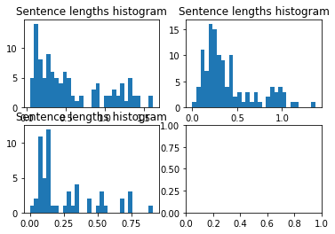
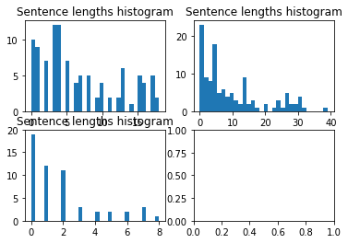
Output: Processed query: [u'friend'] [("She was ransacking the stores for Jim's present.", 1.324313323278029), ('Jim stepped inside the door, as immovable as a setter at the scent of quail.', 1.3260330166909116), ('"Give it to me quick" said Della.', 1.337516806722689), ('Jim had not yet seen his beautiful present.', 1.3436049382716049), ('"You needn\'t look for it," said Della.', 1.3593439153439153), ('And then Della leaped up like a little singed cat and cried, "Oh, oh!"', 1.3629012660542072), ('Only $1.87 to buy a present for Jim.', 1.4183846153846156), ('It surely had been made for Jim and no one else.', 1.444810744810745), ('"Jim, darling," she cried, "don\'t look at me that way.', 1.5813651999874911), ("One was Jim's gold watch that had been his father's and his grandfather's.", 1.6168950552674828)]
Summarization using query-based algorithm
Automatic summarization based on weighting
Input:
Please enter a query: friend
[('Jim drew a package from his overcoat pocket and threw it upon the table.', 16.0), ('"You needn\'t look for it," said Della.', 16.0), ('The door opened and Jim stepped in and closed it.', 16.0), ('It surely had been made for Jim and no one else.', 17.0), ('Jim had not yet seen his beautiful present.', 17.0), ('And then Della leaped up like a little singed cat and cried, "Oh, oh!"', 17.0), ('Only $1.87 to buy a present for Jim.', 17.0), ('Jim looked about the room curiously.', 17.0), ('"Jim, darling," she cried, "don\'t look at me that way.', 18.0), ("One was Jim's gold watch that had been his father's and his grandfather's.", 18.0)]
Sentence length histogram for query-based output
Sentence length histogram for Weight-based output

Slide 21
Summarization Information Extraction
Output: Separation between Subject verb Object
(NX ONE/CD DOLLAR/NN AND/CC EIGHTY-SEVEN/NNP CENTS/NNP NX) ./.
(NX THAT/WDT NX) (VX WAS/VBD VX) ALL/PDT ./.
(NX AND/CC SIXTY/CD CENTS/NNP NX) of/IN (NX it/PRP NX) (VX was/VBD VX) in/IN (NX pennies/NNS NX) ./.
(NX Pennies/NNP NX) (VX saved/VBD VX) (NX one/CD and/CC two/CD NX) at/IN (NX a/DT time/NN NX) by/IN (VX bulldozing/VBG VX) (NX the/DT grocer/NN NX) and/CC (NX the/DT vegetable/NN man/NN NX) and/CC (NX the/DT butcher/NN NX) until/IN (NX one/CD 's/POS cheeks/NNS NX) (VX burned/VBN VX) with/IN (NX the/DT silent/JJ imputation/NN NX) of/IN (NX parsimony/NN NX) (NX that/WDT such/JJ close/NN NX) (VX dealing/VBG implied/VBN VX) ./.
(NX Three/CD times/NNS Della/NNP NX) (VX counted/VBD VX) (NX it/PRP NX) ./.
(NX One/CD dollar/NN and/CC eighty-seven/JJ cents/NNS NX) ./.
And/CC (NX the/DT next/JJ day/NN NX) (VX would/MD be/VB VX) (NX Christmas/NNP NX)

Slide 22
CONCLUSION
We have worked on three algorithms and by comparing those algorithms, query-based algorithm gives the least accurate summary.
The weight-based algorithm gives the summery according to the score of the sentence but it is not accurate in the formation of the sentences.
Sometimes the sentences might not a right meaning. The information extraction algorithm uses parts of speech tagging which gives the summary having proper meaning for the sentences.
Hence, we like to conclude that information extraction algorithm is more accurate than query and weight-based algorithms.

Slide 23
REferences
[1] Alexander M., Rush Sumit Chopra, Jason Weston- A Neural Attention Model for Abstractive Sentence Summarization arXiv:1509.00685v2 [cs.CL] 3 Sep 2015
[2] Çaglar˘Gulçehre˙ Bing Xiang, Ramesh Nallapati, Bowen Zhou, Cicerodos Santos - Abstractive Text Summarization using Sequence-to-sequence RNNs and Beyond, arXiv:1602.06023v5 [cs.CL] 26 Aug 2016
[3] Santosh Kumar Bharti, Korra Sathya Babu, Sanjay Kumar Jena - Automatic Keyword Extraction for Text Summarization: A Survey, National Institute of Technology, Rourkela, Odisha 769008 India e-mail@nitrkl.ac.in 08-February-2017
[4] Abigail See, Peter J. Liu, Christopher D. Manning - Get To The Point: Summarization with Pointer-Generator NetworksarXiv:1704.04368v2 [cs.CL] 25 Apr 2017
[5] Mehdi Allahyari, Seyedamin Pouriyeh, Mehdi Assefi, Saeid Safaei, Elizabeth D. Trippe, Juan B. Gutierrez, Krys Kochut - Text Summarization Techniques: A Brief Survey, arXiv:1707.02268v3 [cs.CL] 28 Jul 2017

Slide 24

Thank You!

