Slide 1
VIVEKANANDA INSTITUTE OF TECHNOLOGY
CG MINI PROJECT USING OPENGL
Project Associates:
Naveen P Pandurangi 1VK15CS034
Saujanya P Umarji 1VK15CS049
Project Guides:
Mr. S. Suresh Kumar , BE M.Tech (P.hD)
asst. Prof, Dept. of C S E, V.K.I.T

Slide 2
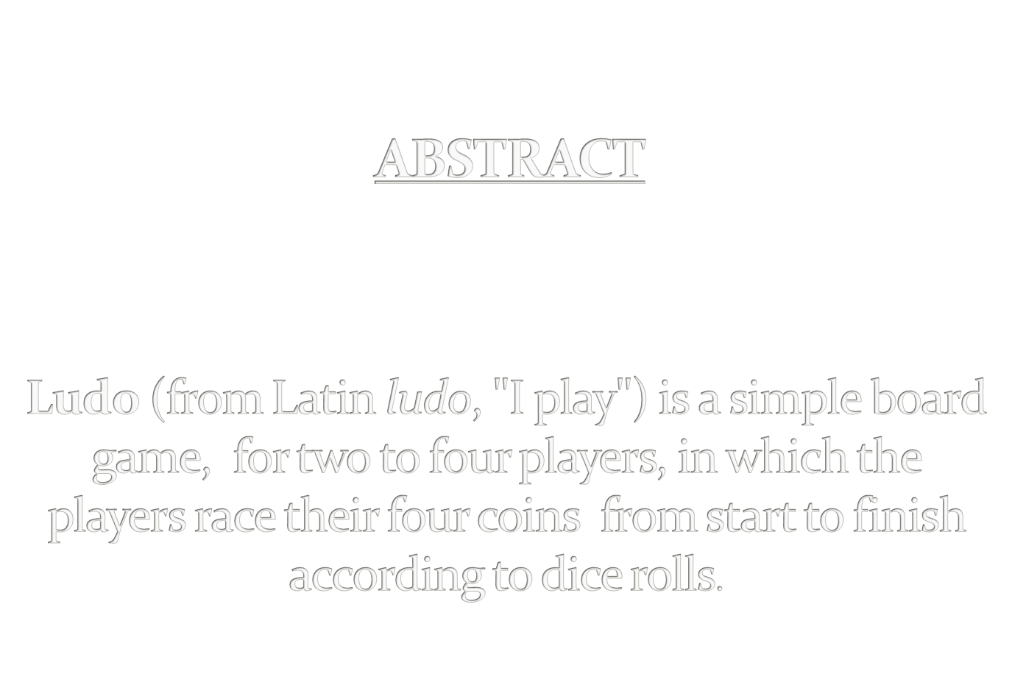

Slide 3

Introduction to open GL
About Ludo Game
Design & Implementation
Conclusion & Future Scope
Bibliography

Slide 4

OpenGL is an application program interface whose structure is similar to that of most modern API’s.
It supports the simple two- and three- dimensional programs. It also supports the advanced rendering techniques.
GL library
OpenGL Utility Library (GLU)
OpenGL Utility Toolkit (GLUT)

Slide 5
About Ludo Game
Game Rules
Four pieces are placed in the start area of their colour.
Throw a single die.
First throw a six or one to move.
Player moves a piece forward 1 to 6 squares.
Six results in another turn.
Player can’t move, pass to next player.
Captured and returns to the starting area.
No doubling rules.
Advance to home square.
Winner .

Slide 6
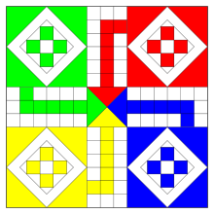
How to Play
Ludo player path.
Ludo Home.
Start area.
Move from starting square, clockwise around the perimeter.
No resting squares.
Player Identification color.

Slide 7

Design and Implementation
Start
Mouse func or key func
==LEFT
If( btn or key)
Roll the dice & Move coin
A
==RIGHT
Show menu options
==‘q’||’Q’
Exit(0);

Slide 8

A
Dice value is 6 0r 1
B
Move coin outside or change its pos
If its pos = opponent pos
Dice=6
yes
Roll the dice
no
Hit opponent
Return opponent to initial & play again
yes
goal
Change player
B
Enter Home
Fig: Flowchart of Playing Game

Slide 9
glBegin(glEnum mode);
glColor3f[i f d](TYPE r,TYPE g,TYPE b);
glVertex3f(int xcor,int ycor,int zcor);
glEnd();
glFlush();
glClearColor(GLclampf r, GLclampf g, GLclampf b, GLclampf a);
glClear
glutInitDisplayMode(unsigned int mode);
glutInitWindowPosition(int x, int y);
glutInitWindowSize(int width, int height);

Slide 10
glutCreateWindow(char *title);
glutMainLoop();
glutReshapeFunc(void (*func) (void));
glutDisplayFunc(void (*func) (void));
glutMouseFunc(myMouse);
gluOrtho2D(GLdouble left, GLdouble right, GLdouble bottom, GLdouble top);
glutPostRedisplay();
glTranslatef[fd](TYPE x,TYPE y,TYPE z);
glutBitmapCharacter(void *font, int char);
glRasterpos3f(int xcor,int ycor,int zcor);
glutCreateMenu (void (*func) (void));
glutAddMenuEntry(char *name,int index);

Slide 11

Draw();
Ply1win ();
Ply2win ();
Call ();
Arrow ();
Check_cond ();
Circle ();
Dice ();
Display ();
Display_about ();
Display1 ();

Slide 12
Display2 ();
Display_abt_game ();
Display_enter ();
Display_guide ();
Init ();
Key ();
Main ();
myMouse ();
myReshape ();
Player1 ();
Player2();
Pl1_pl2 ();
Wait ();

Slide 13

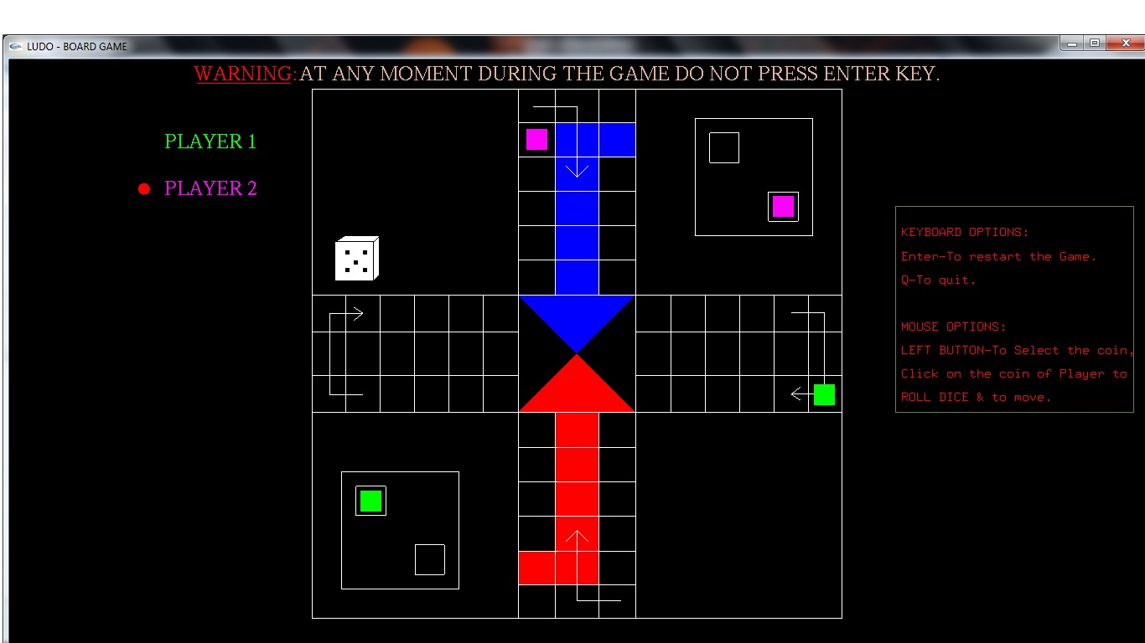

Slide 14
CONCLUSION
The LUDO game has been improvised with graphical approach.
The demo is made more iterative with a mouse interaction module in the program .
FUTURE SCOPE
Even though demo designed is enriched with many options, it is a two dimensional demo, in future it can be re designed with 3D animation and sound effects.
By using this demo further for four coins & four players can be implemented.

Slide 15
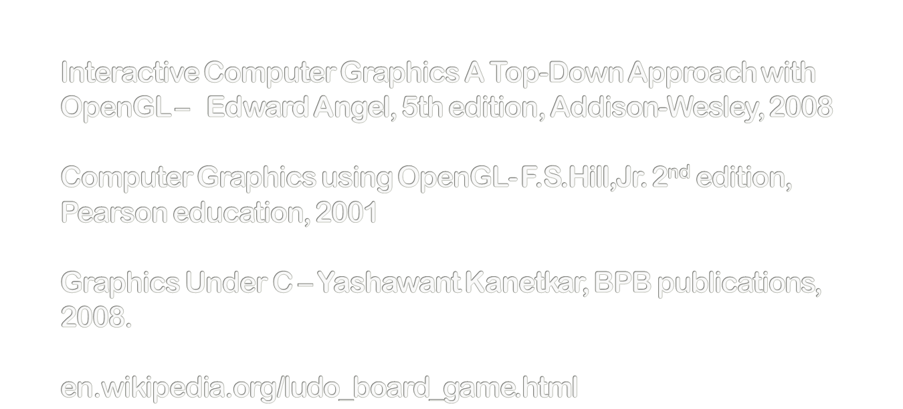
Bibliography

Slide 16
THANK YOU

