Slide 1
Association Rule
Lecturer: Dr. Bo Yuan
E-mail: yuanb@sz.tsinghua.edu.cn

Slide 2
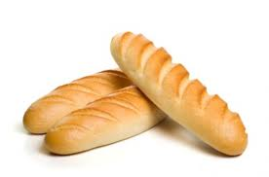

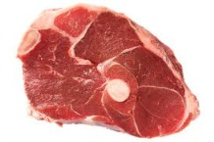
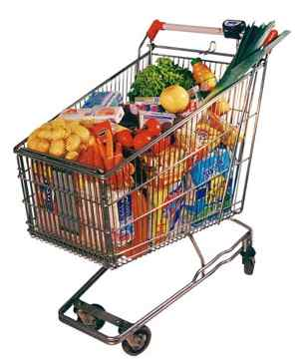

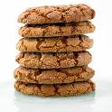


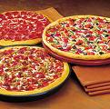

Overview
Frequent Itemsets
Association Rules
Sequential Patterns

Slide 3
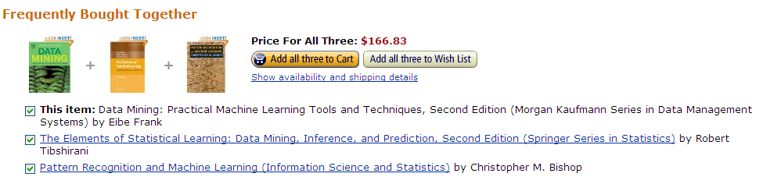
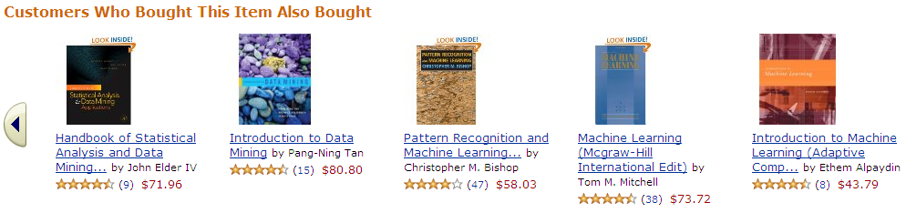
A Real Example

Slide 4

Market-Based Problems
Finding associations among items in a transactional database.
Items
  Bread, Milk, Chocolate, Butter …
Transaction (Basket)
  A non-empty subset of all items
Cross Selling
  Selling additional products or services to an existing customer.
Bundle Discount
Shop Layout Design
  Minimum Distance vs. Maximum Distance
“Baskets” & “Items”: Sentences & Words

Slide 5
Definitions
A transaction is a set of items: T={i_{a}, i_{b},…,i_{t}}
T is a subset of I where I is the set of all possible items.
The dataset D contains a set of transactions.
An association rule is in the form of
A set of items is referred to as itemset.
An itemset containing k items is called k-itemset.
An itemset can be seen as a conjunction of items.

Slide 6
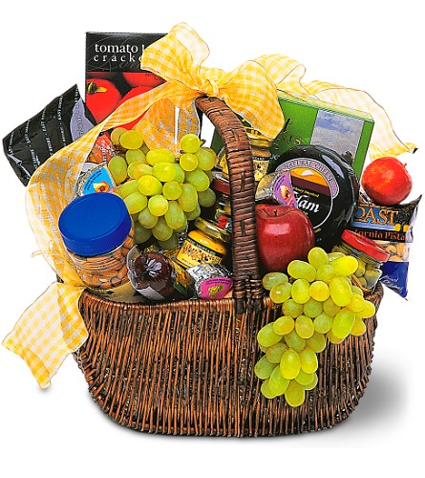
Transactions
Transactions | Items
1 | Bread, Jelly, Peanut, Butter
2 | Bread, Butter
3 | Bread, Jelly
4 | Bread, Milk, Butter
5 | Chips, Milk
6 | Bread, Chips
7 | Bread, Milk
8 | Chips, Jelly
Searching for rules in the form of: Bread → Butter

Slide 7


Slide 8
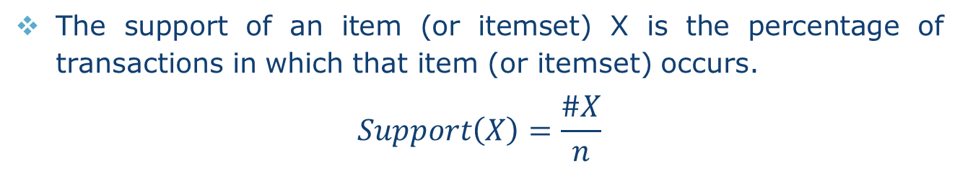
Support of an Itemset
The support of an item (or itemset) X is the percentage of transactions in which that item (or itemset) occurs.
$$Support\left(X\right)=\frac{\#X}{n}$$
Itemset | Support | Itemset | Support
Bread | 6/8 | Bread, Butter | 3/8
Butter | 3/8 | …
Chips | 2/8 | Bread, Butter, Chips | 0/8
Jelly | 3/8 | …
Milk | 3/8 | Bread, Butter, Chips, Jelly | 0/8
Peanut | 1/8 | …
 |  | Bread, Butter, Chips, Jelly, Milk | 0/8
 |  | …
 |  | Bread, Butter, Chips, Jelly, Milk, Peanut | 0/8

Slide 9
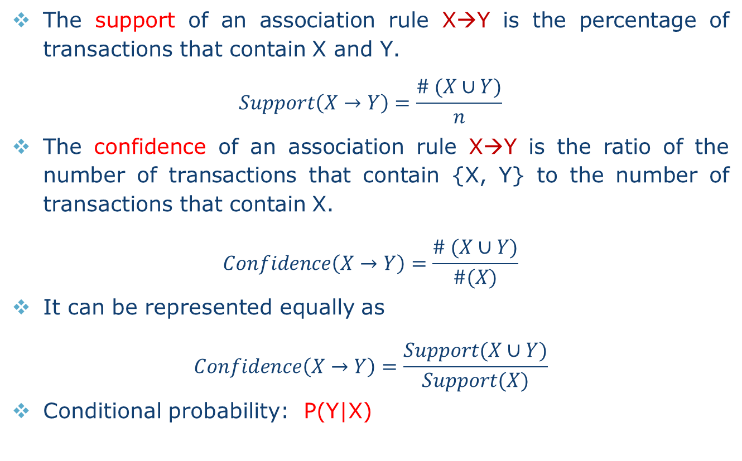
Support & Confidence of Association Rule
The support of an association rule X→Y is the percentage of transactions that contain X and Y.
$$Support\left(X→Y\right)=\frac{\# (X∪Y)}{n}$$
The confidence of an association rule X→Y is the ratio of the number of transactions that contain {X, Y} to the number of transactions that contain X.
$$Confidence\left(X→Y\right)=\frac{\# (X∪Y)}{\#(X)}$$
It can be represented equally as
$$Confidence\left(X→Y\right)=\frac{Support(X∪Y)}{Support(X)}$$
Conditional probability: P(Y|X)

Slide 10
Support & Confidence of Association Rule
Support measures how often the rule occurs in the dataset.
Confidence measures the strength of the rule.
Transactions | Items
1 | Bread, Jelly, Peanut, Butter
2 | Bread, Butter
3 | Bread, Jelly
4 | Bread, Milk, Butter
5 | Chips, Milk
6 | Bread, Chips
7 | Bread, Milk
8 | Chips, Jelly
Bread → Milk
Support: 2/8
Confidence: 1/3
Milk → Bread
Support: 2/8
Confidence: 2/3

Slide 11
Frequent Itemsets and Strong Rules
Support and Confidence are bounded by thresholds:
  Minimum support σ
  Minimum confidence Φ
  A frequent (large) itemset is an itemset with support larger than σ.
A strong rule is a rule that is frequent and its confidence is higher than Φ.
Association Rule Problem
  Given I, D, σ and Φ, to find all strong rules in the form of X→Y.
The number of all possible association rules is huge.
  Brute force strategy is infeasible.
  A smart way is to find frequent itemsets first.

Slide 12
The Big Picture
Step 1: Find all frequent itemsets.
Step 2: Use frequent itemsets to generate association rules.
  For each frequent itemset f
    Create all non-empty subsets of f.
  For each non-empty subset s of f
    Output s → (f-s) if support (f) / support (s) > Φ
a b → c
a c → b
b c → a
{a, b, c}
The key is to find frequent itemsets.
a → b c
b → a c
c → a b

Slide 13
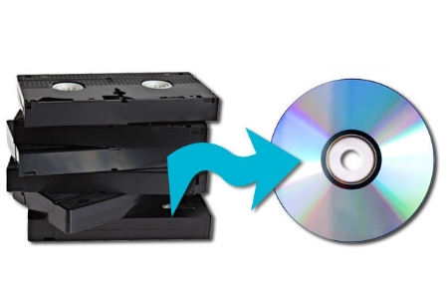

Myth No. 1
A rule with high confidence is not necessarily plausible.
For example:
  |D|=10000
  #{DVD}=7500
  #{Tape}=6000
  #{DVD, Tape}=4000
  Thresholds: σ=30%, Φ=50%
  Support(Tape → DVD)= 4000/10000=40%
  Confidence(Tape → DVD)=4000/6000=66%
Now we have a strong rule: Tape → DVD
  Seems that Tapes will help promote DVDs.
  However, P(DVD)=75% > P(DVD | Tape) !!
  Tape buyers are less likely to purchase DVDs.

Slide 14
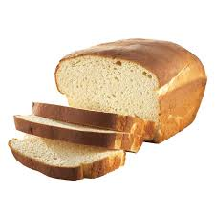
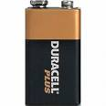

Myth No. 2
Transactions
Bread, Milk
Bread, Battery
Bread, Butter
Bread, Honey
Bread, Chips
Yogurt, Coke
Bread, Battery
Cookie, Jelly

Slide 15

Myth No. 3
Association ≠ Causality
P(Y|X) is just the conditional probability.

Slide 17

Itemset Generation
Ø
A
B
C
D
AB
AC
AD
BC
BD
CD
ABC
ABD
ACD
BCD
ABCD

Slide 18
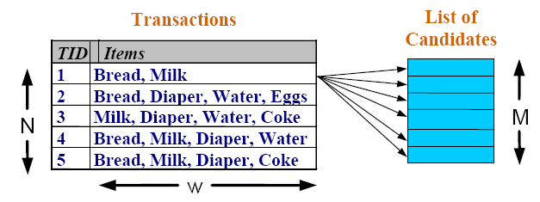

Itemset Calculation

Slide 19
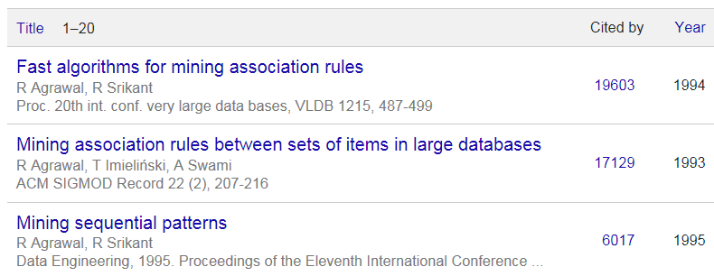
The Apriori Method
One of the best known algorithms in Data Mining
Key ideas
  A subset of a frequent itemset must be frequent.
    {Milk, Bread, Coke} is frequent → {Milk, Coke} is frequent
  The supersets of any infrequent itemset cannot be frequent.
    {Battery} is infrequent → {Milk, Battery} is infrequent

Slide 20


Candidate Pruning
Ø
A
B
C
D
AB
AC
AD
BC
BD
CD
ABC
ABD
ACD
BCD
ABCD

Slide 21
General Procedure
Generate itemsets of a particular size.
Scan the database once to see which of them are frequent.
Use frequent itemsets to generate candidate itemsets of size=size+1.
Iteratively find frequent itemsets with cardinality from 1 to k.
Avoid generating candidates that are known to be infrequent.
Require multiple scans of the database.
Efficient indexing techniques such as Hash function & Bitmap may help.

Slide 22
Apriori Algorithm
C_{k}: Candidate itemset of size k
L_{k}: Frequent itemset of size k
for (k=1; L_{k}≠∅; k++)
for each transaction t
end for
end for
return
candidates
counting
filtering

Slide 24

L_{k} → C_{k+1}

Slide 25


L_{k} → C_{k+1}
Ordered List

Slide 26

Correctness
Join

Slide 27
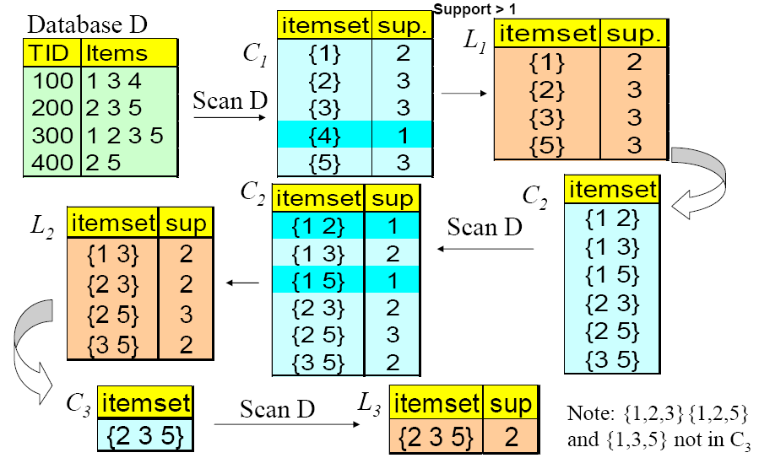
Demo

Slide 28
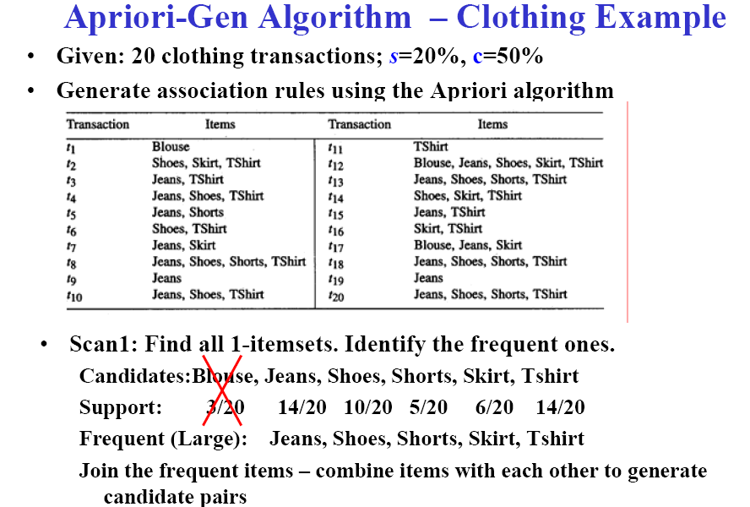
Clothing Example

Slide 29
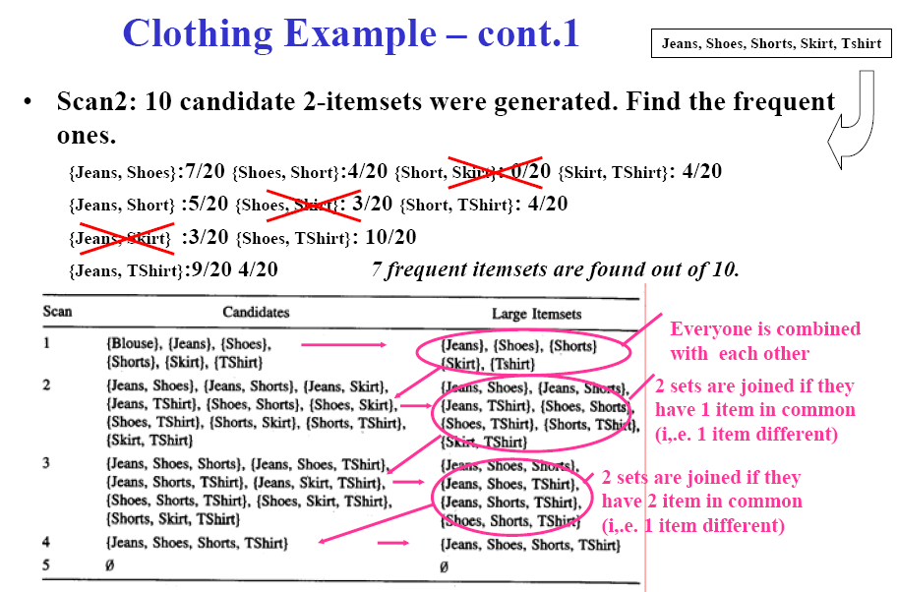
Clothing Example

Slide 30
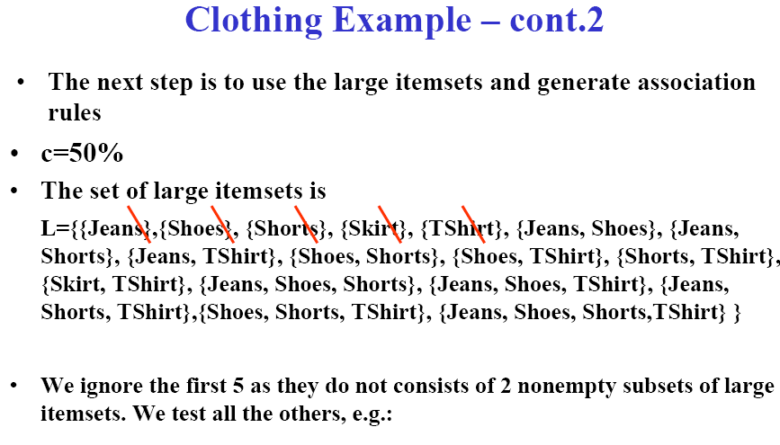
Clothing Example
$$Confidence\left(Jeans→Shoes\right)=\frac{Support(\{Jeans, Shoes\})}{Support(\left\{Jeans\right\})}=\frac{7/20}{14/20}=50\%≥c$$

Slide 31
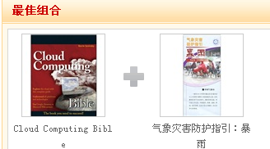
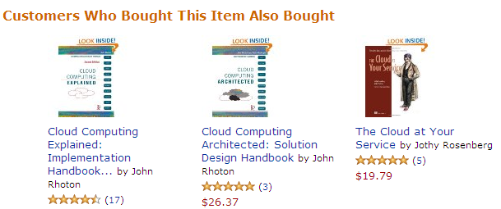
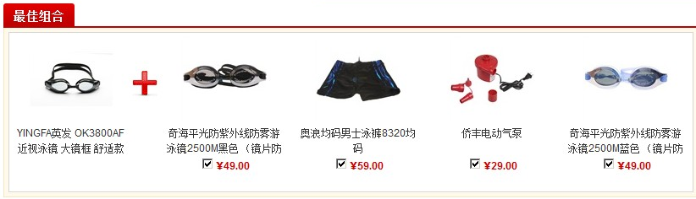
Real Examples

Slide 32


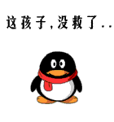
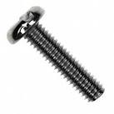
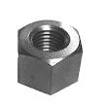

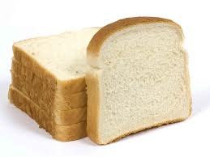
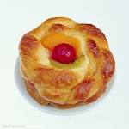

Effective Recommendation

Slide 34
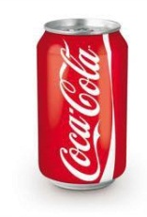
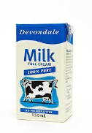
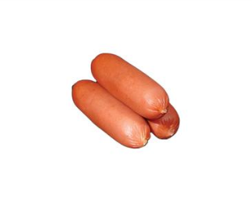
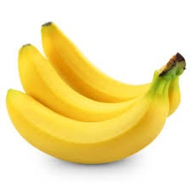
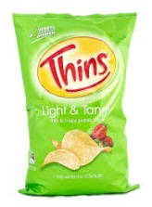
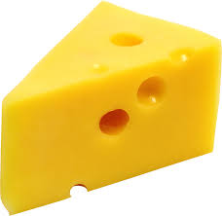
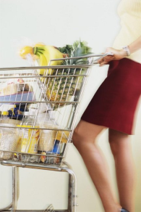

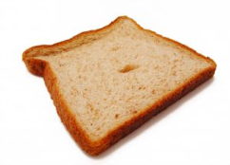
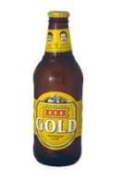
Sequential Pattern
1
2
3
4
5
6
7
8
Customer
Time

Slide 35
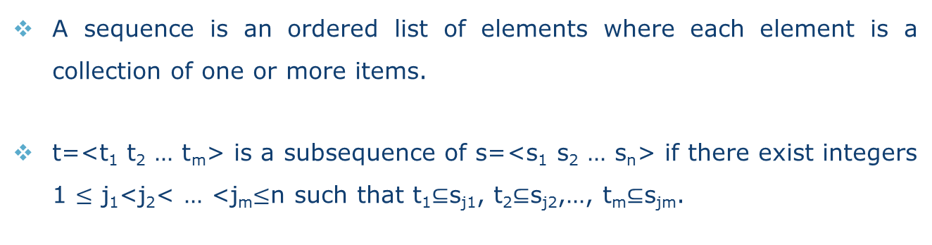
Sequence
A sequence is an ordered list of elements where each element is a collection of one or more items.
t=<t₁ t₂ … t_{m}> is a subsequence of s=<s₁ s₂ … s_{n}> if there exist integers 1 $≤$ j₁<j₂< … <j_{m}$≤$n such that t₁$⊆$s_{j1}, t₂$⊆$s_{j2},…, t_{m}$⊆$s_{jm}.
s | t | Y/N
<{2, 4} {3, 6, 5} {8}> | <{2} {3, 6} {8}> | Yes
<{2, 4} {3, 6, 5} {8}> | <{2} {8}> | Yes
<{1, 2} {3, 4}> | <{1} {2}> | No
<{2, 4} {2, 4} {2, 5}> | <{2} {4}> | Yes

Slide 36
Support of Sequence
CID | Time | Items
A | 1 | 1, 2, 4
A | 2 | 2, 3
A | 3 | 5
B | 1 | 1, 2
B | 2 | 2, 3, 4
C | 1 | 1, 2
C | 2 | 2, 3, 4
C | 3 | 2, 4, 5
D | 1 | 2
D | 2 | 3, 4
D | 3 | 4, 5
E | 1 | 1, 3
E | 2 | 2, 4, 5
Support
<{1, 2}> | 60%
<{2, 3}> | 60%
<{2, 4}> | 80%
<{3} {5}> | 80%
<{1} {2}> | 80%
<{2} {2}> | 60%
<{1} {2, 3}> | 60%
<{2} {2, 3}> | 60%
<{1, 2} {2, 3}> | 60%

Slide 37
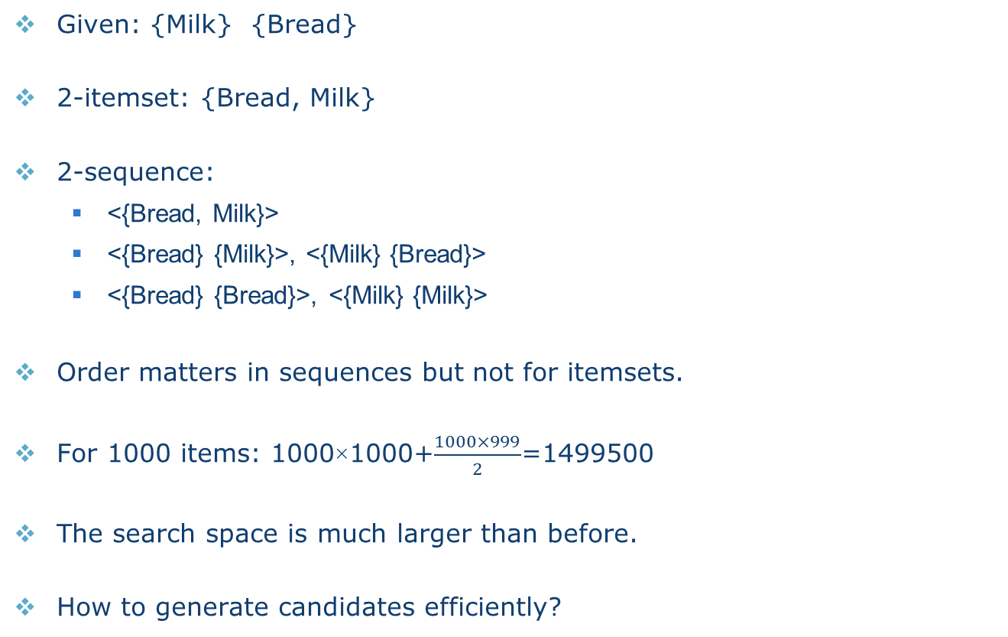
Candidate Space
Given: {Milk} {Bread}
2-itemset: {Bread, Milk}
2-sequence:
  <{Bread, Milk}>
  <{Bread} {Milk}>, <{Milk} {Bread}>
  <{Bread} {Bread}>, <{Milk} {Milk}>
Order matters in sequences but not for itemsets.
For 1000 items: 1000×1000+$\frac{1000×999}{2}$=1499500
The search space is much larger than before.
How to generate candidates efficiently?

Slide 38
Candidate Generation
A sequence s₁ is merged with another sequence s₂ if and only if the subsequence obtained by dropping the first item in s₁ is identical to the subsequence obtained by dropping the last item in s₂.
s₁
3-sequences
<{1} {2} {3}>
<{1} {2, 5}>
<{1} {5} {3}>
<{2} {3} {4}>
<{2, 5} {3}>
<{3} {4} {5}>
<{5} {3, 4}>
s₂
Candidate
<{1} {2} {3} {4}>
<{1} {2, 5} {3}>
<{1} {5} {3, 4}>
<{2} {3} {4} {5}>
<{2, 5} {3, 4}>
Pruning
<{1} {2, 5} {3}>

Slide 39
Reading Materials
Text Book
  J. Han and M. Kamber, Data Mining: Concepts and Techniques, Chapter 6, Morgan Kaufmann.
Core Papers
  J. Han, J. Pei, Y. Yin and R. Mao (2004) “Mining frequent patterns without candidate generation: A frequent-pattern tree approach”. Data Mining and Knowledge Discovery, Vol. 8(1), pp. 53-87.
  R. Agrawal and R. Srikant (1995) “Mining sequential patterns”. In Proceedings of the Eleventh International Conference on Data Engineering (ICDE), pp. 3-14.
  R. Agrawal and R. Srikant (1994) “Fast algorithms for mining association rules”. In Proceedings of the 20th International Conference on Very Large Data Bases (VLDB), pp. 487-499.
  R. Agrawal, T. Imielinski, and A. Swami (1993) “Mining association rules between sets of items in large databases”. In Proceedings of the ACM SIGMOD International Conference on Management of Data (SIGMOD), pp. 207-216.

