Slide 1
Ensemble Learning
Lecturer: Dr. Bo Yuan
E-mail: yuanb@sz.tsinghua.edu.cn

Slide 2




Real World Scenarios
VS.

Slide 3


Real World Scenarios

Slide 4
What is ensemble learning?
Many individual learning algorithms are available:
Decision Trees, Neural Networks, Support Vector Machines
The process by which multiple models are strategically generated and combined in order to better solve a particular Machine Learning problem.
Motivations
To improve the performance of a single model.
To reduce the likelihood of an unfortunate selection of a poor model.
Multiple Classifier Systems
One idea, many implementations
Bagging
Boosting

Slide 5
Algorithm Hierarchy
Machine learning
Supervised learning
Classification
Semi-supervised learning
Unsupervised learning
Clustering
Single algorithms:
SVM,DT,NN
Ensemble algorithms
Boosting
Bagging

Slide 6
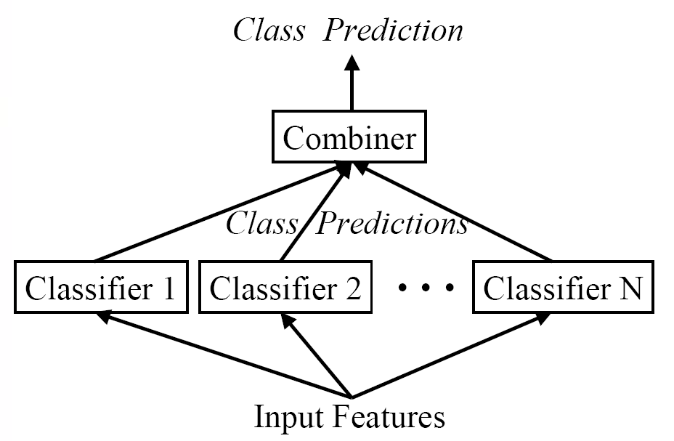
Combination of Classifiers

Slide 7
Model Selection

Slide 8
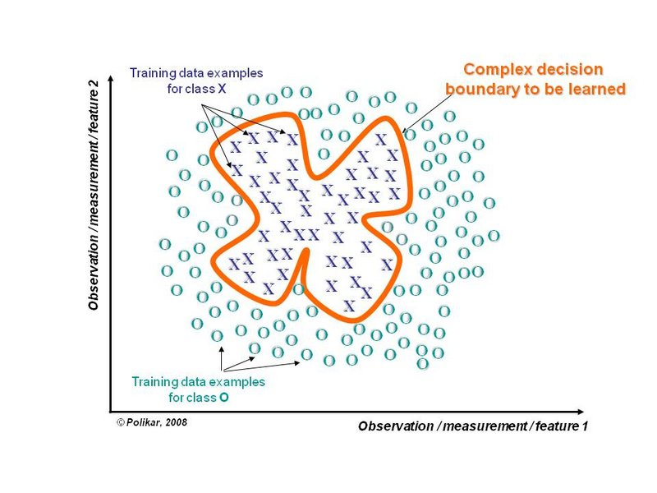
Divide and Conquer

Slide 9
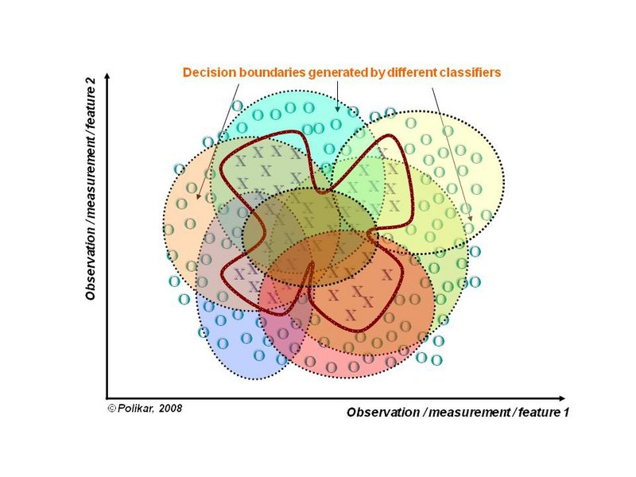
Divide and Conquer

Slide 10


Slide 11
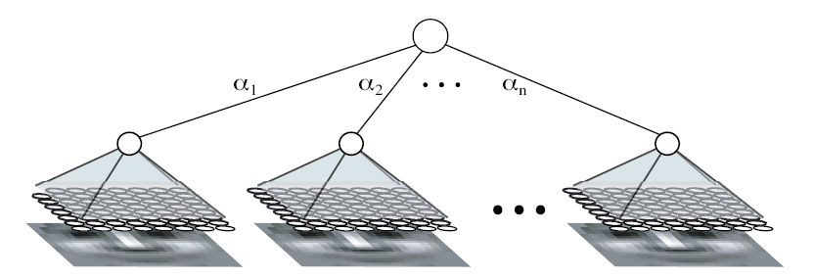
Combiners
How to combine the outputs of classifiers?
Averaging
Voting
Majority Voting
Random Forest
Weighted Majority Voting
AdaBoost
Learning Combiner
General Combiner
Stacking
Piecewise Combiner
RegionBoost
No Free Lunch

Slide 12
Diversity
The key to the success of ensemble learning
Need to correct the errors made by other classifiers.
Does not work if all models are identical.
Different Learning Algorithms
DT, SVM, NN, KNN …
Different Training Processes
Different Parameters
Different Training Sets
Different Feature Sets
Weak Learners
Easy to create different decision boundaries.
Stumps …

Slide 13
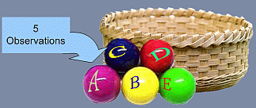
Bootstrap Samples
Sample 1
Sample 2
Sample 3

Slide 14
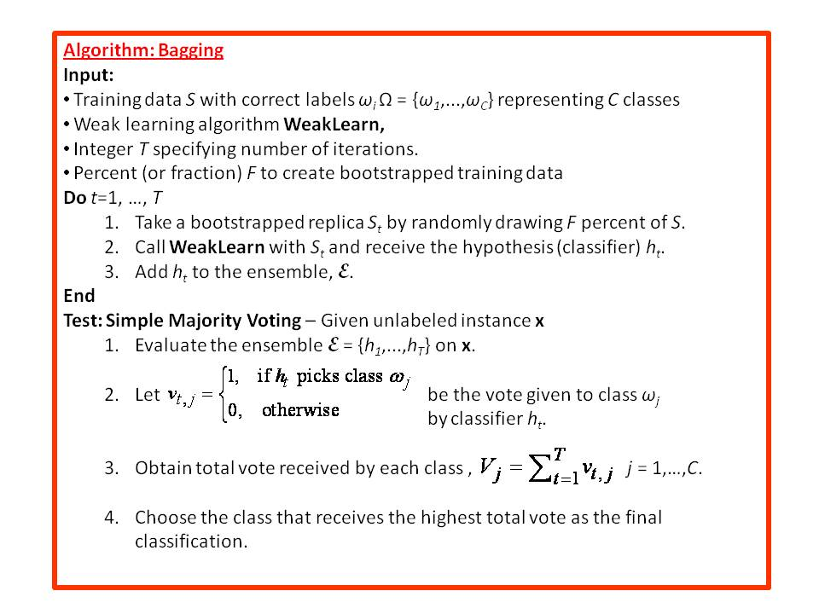
Bagging (Bootstrap Aggregating)

Slide 15
Bagging
D
Bootstrap
D₁
Train
D₂
Learner
…
D_{k}
0
1
..
1
C₁
Voting
Test
1
C₂
…
x
C_{k}

Slide 16
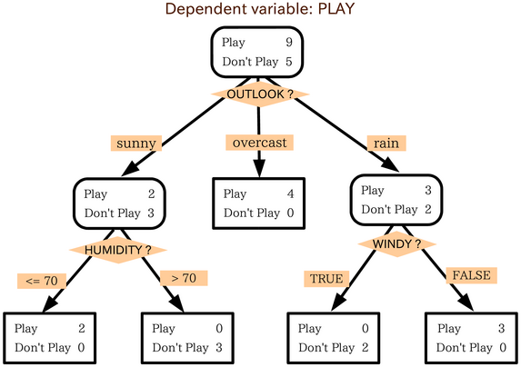
A Decision Tree

Slide 17
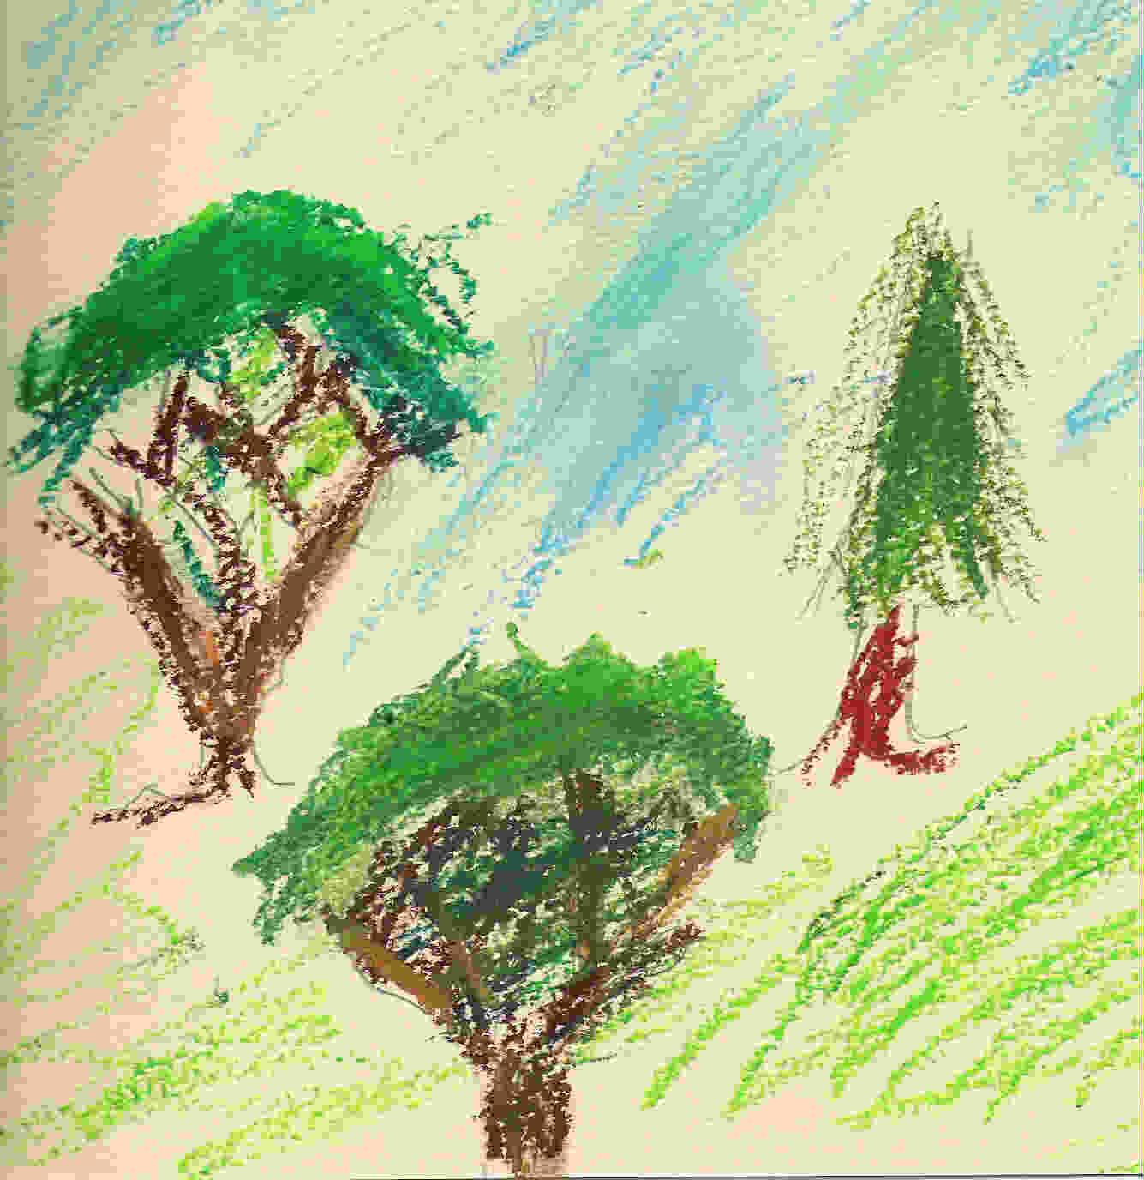
Tree vs. Forest

Slide 18

Random Forests
Developed by Prof. Leo Breiman
Inventor of CART
www.stat.berkeley.edu/users/breiman/
Breiman, L.: Random Forests. Machine Learning 45(1), 5–32, 2001
Bootstrap Aggregation (Bagging)
Resample with Replacement
Use around two third of the original data.
A Collection of CART-like Trees
Binary Partition
No Pruning
Inherent Randomness
Majority Voting
$$1−\lim_{n→∞}{{\left(1−\frac{1}{n}\right)}^{n}}$$

Slide 19
RF Main Features
Generates substantially different trees:
Use random bootstrap samples of the training data.
Use random subsets of variables for each node.
Number of Variables
Square Root (K)
K: total number of available variables
Can dramatically speed up the tree building process.
Number of Trees
500 or more
Self-Testing
Around one third of the original data are left out.
Out of Bag (OOB)
Similar to Cross-Validation

Slide 20
RF Advantages
All data can be used in the training process.
No need to leave some data for testing.
No need to do conventional cross-validation.
Data in OOB are used to evaluate the current tree.
Performance of the entire RF
Each data point is tested over a subset of trees.
Depends on whether it is in the OOB.
High levels of predictive accuracy
Only a few parameters to experiment with.
Suitable for both classification and regression.
Resistant to overtraining (overfitting).
No need for prior feature selection.

Slide 22


Stacking
Learner
Learner
h₁(x_{i})
C₁
h₂(x_{i})
C₂
C
y_{i}
…
Train
Train
h_{k}(x_{i})
C_{k}
D
Base Classifiers
Meta Classifier
$$\left\{\left(x_{1},y_{1}\right)…(x_{n},y_{n})\right\}$$
$$\left\{\left(h_{1}\left(x_{i}\right),h_{2}\left(x_{i}\right),…,h_{k}\left(x_{i}\right),y_{i}\right)\right\}$$

Slide 23
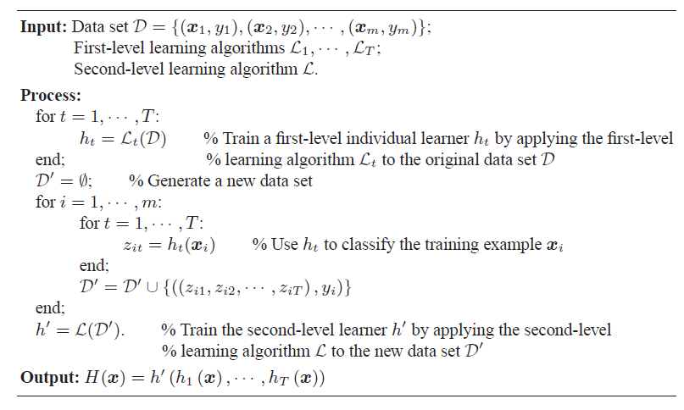
Stacking

Slide 24
Boosting
D
Select
D₁
Learner
C₁
Test
Train
√ | × | √ | √ | × | ×
D₂
Learner
C₂
Train

Slide 25
Boosting
D
Test
C₁
1/0 | 0/1 | 1/0 | 1/0 | 0/1
D₃
C₂
Learner
C₃
Train
C₁
C₂
C₃
No
O₃
O₁
O₂
O₃
Yes
x
O₁=O₂
O₁
Test

Slide 26
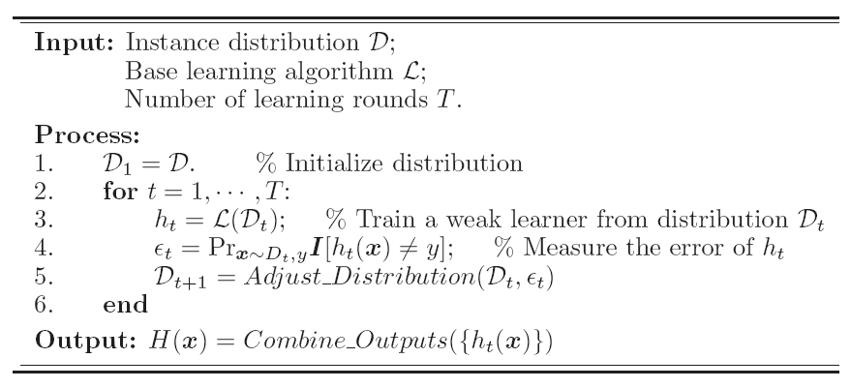
Boosting

Slide 27
Boosting
Bagging aims at reducing variance, not bias.
In Boosting, classifiers are generated sequentially.
Focuses on most informative data points.
Training samples are weighted.
Outputs are combined via weighted voting.
Can create arbitrarily strong classifiers.
The base learners can be arbitrarily weak.
As long as they are better than random guess!

Slide 28
Boosting
Base classifier h₁(x)
Base classifier
h₂(x)
Base classifier
h_{T}(x)
Training
Boosting classifier
H(x) = sign(∑α_{i}h_{i}(x))
Test
Results

Slide 29
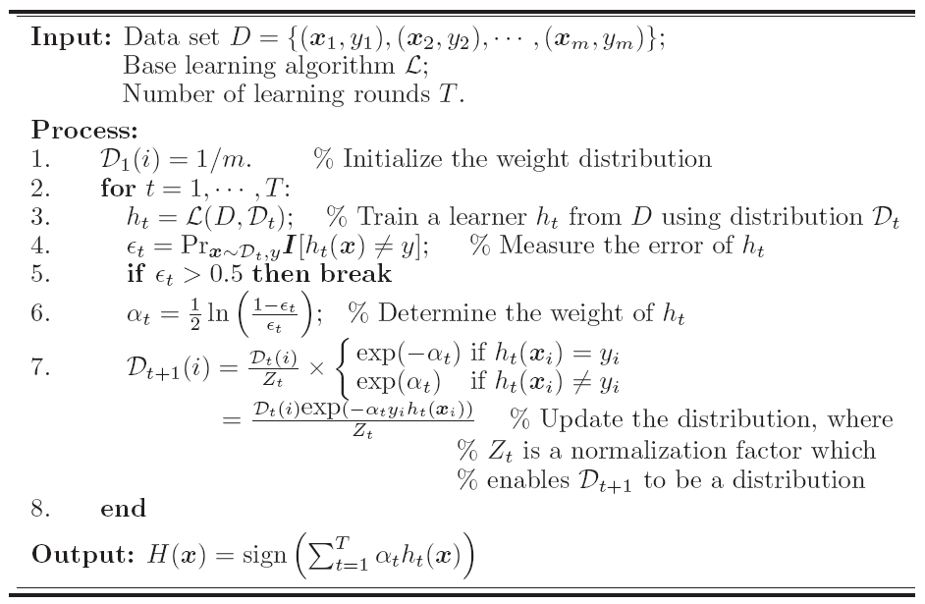
AdaBoost

Slide 30
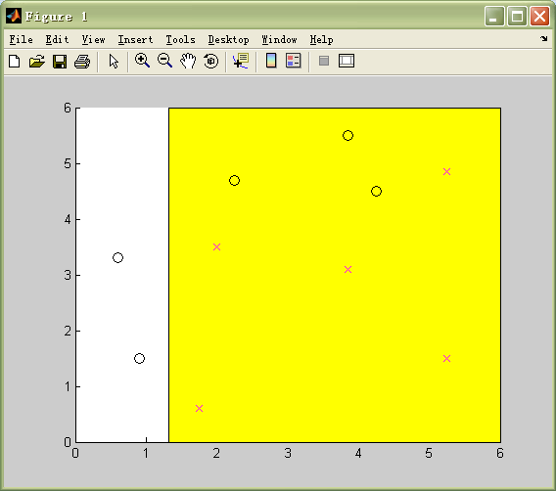
Demo: Classifier 1

Slide 31
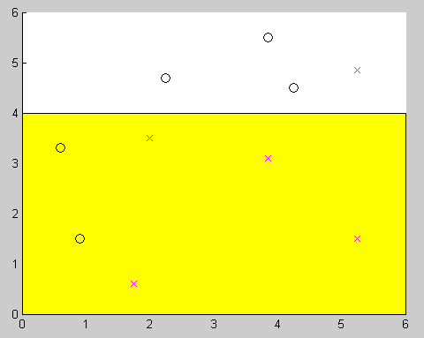
Demo: Classifier 2

Slide 32
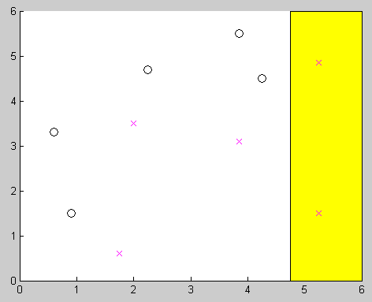
Demo: Classifier 3

Slide 33
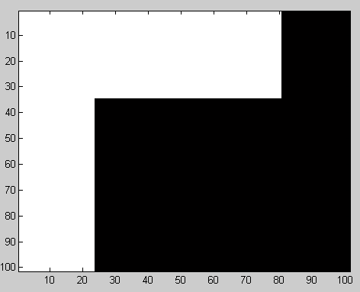
Demo: Combined Classifier

Slide 35
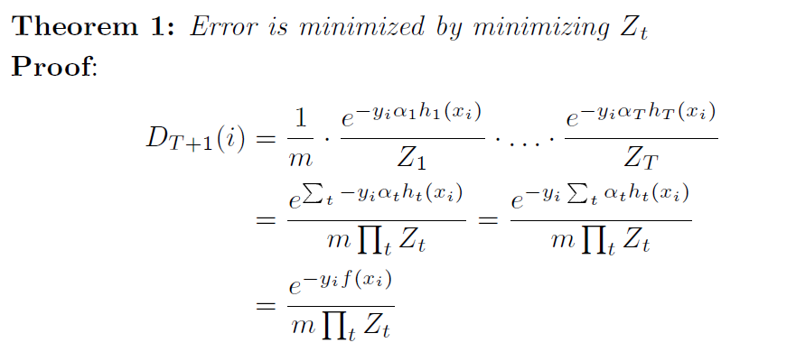

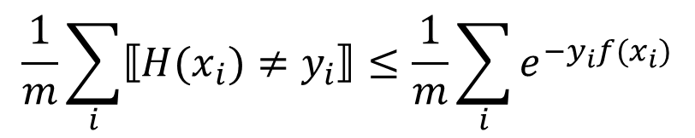

The Choice of α
$$f(x_{i})=\sum_{t}{α_{t}h_{t}}(x_{i})$$
$$H\left(x_{i}\right)≠y_{i}⇒y_{i}f\left(x_{i}\right)≤0⇒e^{−y_{i}f\left(x_{i}\right)}≥1$$
$$⟦H(x_{i})≠y_{i}⟧≤e^{−y_{i}f(x_{i})}$$
$$\frac{1}{m}\sum_{i}{⟦H(x_{i})≠y_{i}⟧≤\frac{1}{m}\sum_{i}{e^{−y_{i}f(x_{i})}}}$$
Model Error

Slide 36
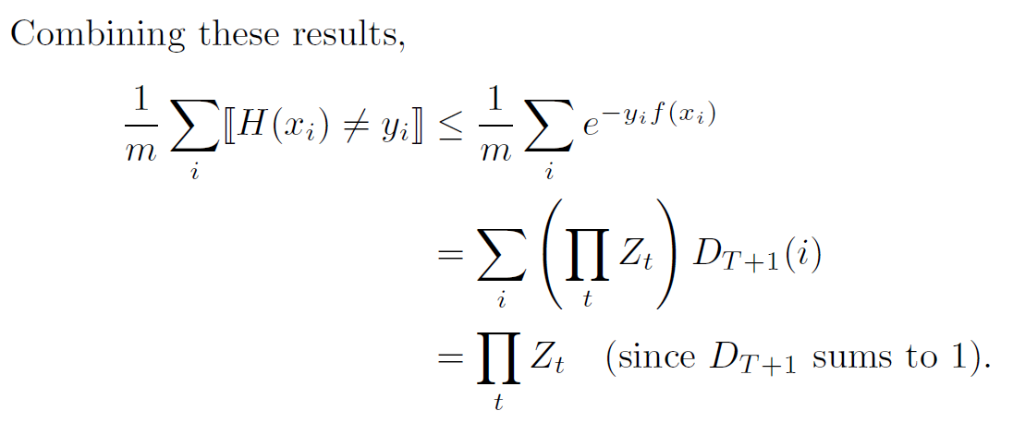
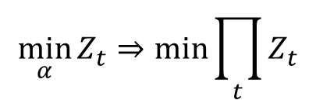
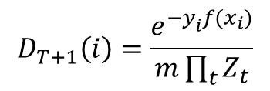
The Choice of α
$$D_{T+1}\left(i\right)=\frac{e^{−y_{i}^{}f(x_{i})}}{m\prod_{t}{Z_{t}}}$$
$$\min_{α}{Z_{t}⇒\min_{}{\prod_{t}{Z_{t}}}}$$

Slide 37

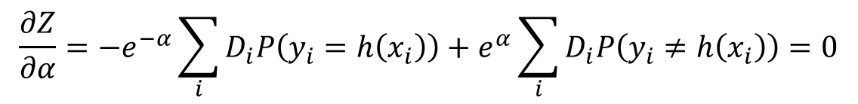
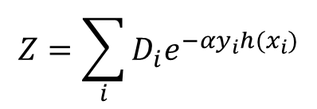
The Choice of α
$$y, h(x)∈\left\{−1,+1\right\}$$
$$Z=\sum_{i}{D_{i}e^{−αy_{i}h(x_{i})}}$$
$$\frac{∂Z}{∂α}=−e^{−α}\sum_{i}{D_{i}P\left(y_{i}=h\left(x_{i}\right)\right)+e^{α}\sum_{i}{D_{i}P\left(y_{i}≠h\left(x_{i}\right)\right)=0}}$$

Slide 38
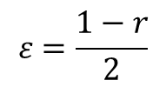
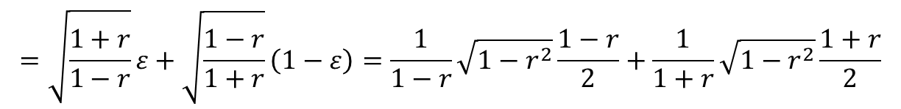
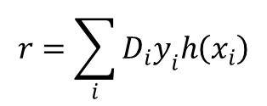
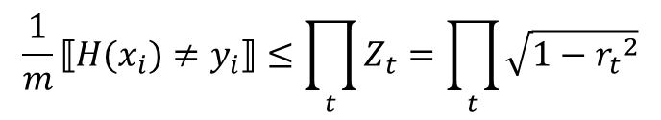
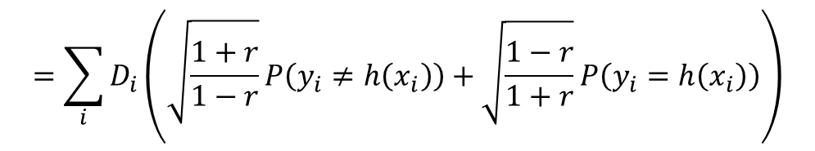
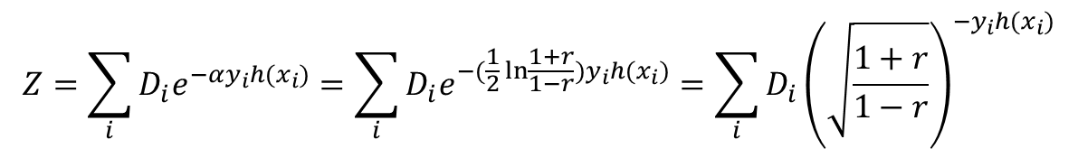

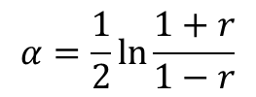
Error Bounds
$$r=\sum_{i}{D_{i}y_{i}h\left(x_{i}\right)}$$
$$ε=\frac{1−r}{2}$$
$$α=\frac{1}{2}\ln{\frac{1+r}{1−r}}$$
$$Z=\sum_{i}{D_{i}e^{−αy_{i}h(x_{i})}}=\sum_{i}{D_{i}e^{−(\frac{1}{2}\ln{\frac{1+r}{1−r}})y_{i}h(x_{i})}}=\sum_{i}{D_{i}{\left(\sqrt{\frac{1+r}{1−r}}\right)}^{−y_{i}h(x_{i})}}$$
$$=\sum_{i}{D_{i}\left(\sqrt{\frac{1+r}{1−r}}P\left(y_{i}≠h\left(x_{i}\right)\right)+\sqrt{\frac{1−r}{1+r}}P\left(y_{i}=h\left(x_{i}\right)\right)\right)}$$
$$=\sqrt{\frac{1+r}{1−r}}ε+\sqrt{\frac{1−r}{1+r}}\left(1−ε\right)=\frac{1}{1−r}\sqrt{1−r^{2}}\frac{1−r}{2}+\frac{1}{1+r}\sqrt{1−r^{2}}\frac{1+r}{2}$$
$$=\sqrt{1−r^{2}}$$
$$\frac{1}{m}⟦H(x_{i})≠y_{i}⟧≤\prod_{t}{Z_{t}}=\prod_{t}{\sqrt{1−{r_{t}}^{2}}}$$

Slide 39

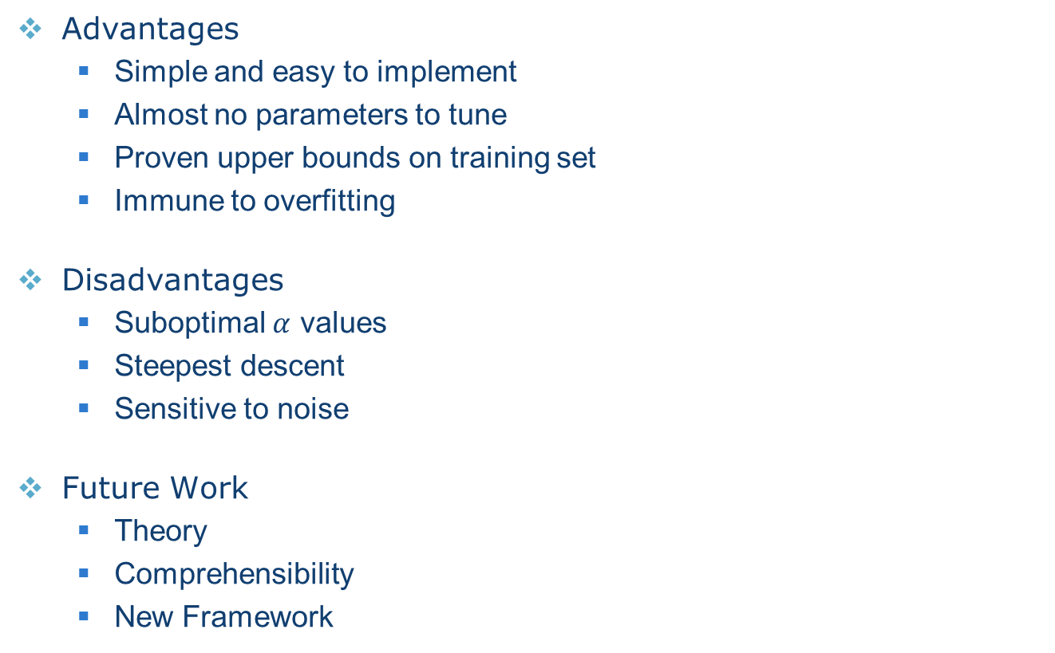
Summary of AdaBoost
Advantages
Simple and easy to implement
Almost no parameters to tune
Proven upper bounds on training set
Immune to overfitting
Disadvantages
Suboptimal $α$ values
Steepest descent
Sensitive to noise
Future Work
Theory
Comprehensibility
New Framework

Slide 41
Fixed Weighting Scheme

Slide 42
Dynamic Weighting Scheme
Base classifier h₁(x)
Base classifier
h₂(x)
Base classifier
h_{T}(x)
Training
Estimator
α₁(x)
Estimator
α₂(x)
Estimator
α_{T}(x)
Boosting classifier
H(x) = sign(∑α_{i}(x)h_{i}(x))
Test
Results

Slide 43
RegionBoost
AdaBoost assigns fixed weights to models.
However, different models emphasize different regions.
The weights of models should be input-dependent.
Given an input, only invoke appropriate models.
Train a competency predictor for each model.
Estimate whether the model is likely to make a right decision.
Use this information as the weight.
Maclin, R.: Boosting classifiers regionally. AAAI, 700-705, 1998.

Slide 44
RegionBoost
Base Classifier
Competency Predicator

Slide 45
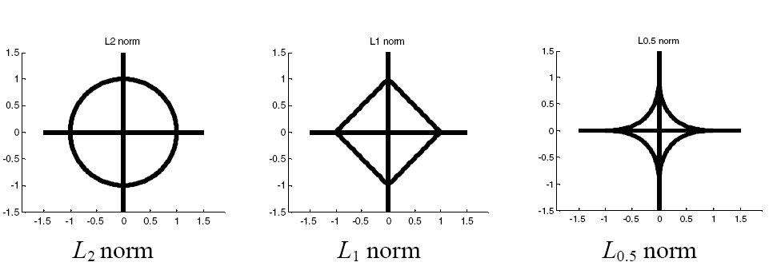
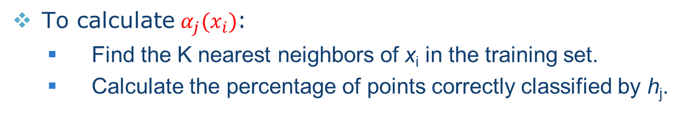
RegionBoost with KNN
To calculate${ α}_{j}(x_{i})$:
Find the K nearest neighbors of x_{i} in the training set.
Calculate the percentage of points correctly classified by h_{j}.

Slide 46
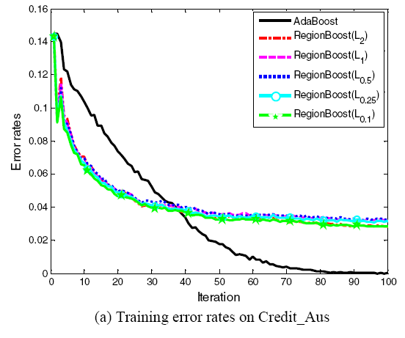
RegionBoost Results

Slide 47
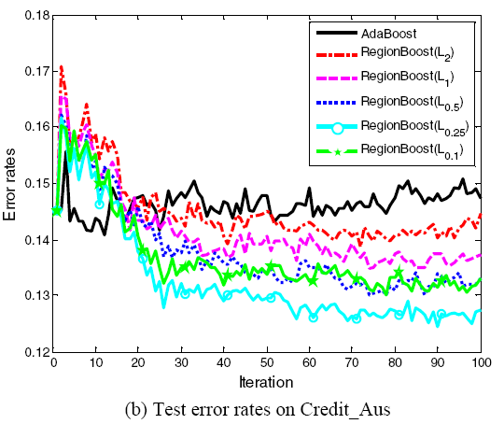
RegionBoost Results

Slide 48

Review
What is ensemble learning?
What can ensemble learning help us?
Two major types of ensemble learning:
Parallel (Bagging)
Sequential (Boosting)
Different ways to combine models:
Average
Majority Voting
Weighted Majority Voting
Some representative algorithms:
Random Forests
AdaBoost
RegionBoost

