Slide 1
Deep Reinforcement Learning for Proactive Network Traffic Congestion Control
Authors: Peter Borngreat-Mensah, Henry Asante, Blessing Listowell Issaka
MSc Computer Science, Cohort B, University of Ghana
Notes:
Welcome the audience, supervisor, and committee. Introduce the research topic: evaluating Deep Reinforcement Learning (DQN and PPO) against static ECMP for proactive load balancing across wide-area ISP networks.

Slide 2
The Problem: Static Routing & Micro-Bursts
- Wide-area networks suffer from transient micro-bursts and volatile traffic demands.
- Equal-Cost Multi-Path (ECMP, RFC 2992) relies on static packet header hashing.
- ECMP is stateless and blind to real-time link queue depths.
- Hash collisions map heavy 'elephant flows' onto the same bottleneck links, causing packet drops.
Notes:
Explain that traditional ECMP relies on static hashing of packet headers without inspecting buffer occupancy. When heavy elephant flows hash to the same link, severe queue overflows occur.

Slide 3
Research Objectives
1. Implement DRL agents (DQN and PPO) inside an SDN-controlled framework.
2. Evaluate zero-shot generalization on 5 completely unseen ISP topologies.
3. Evaluate per-step routing efficiency vs cumulative episode truncation effects.
4. Identify theoretical capacity boundaries under heavy network saturation.
Notes:
State our key objectives: evaluating DQN and PPO against ECMP, validating zero-shot transferability on held-out topologies, examining per-step dynamics, and identifying saturation limits.

Slide 4
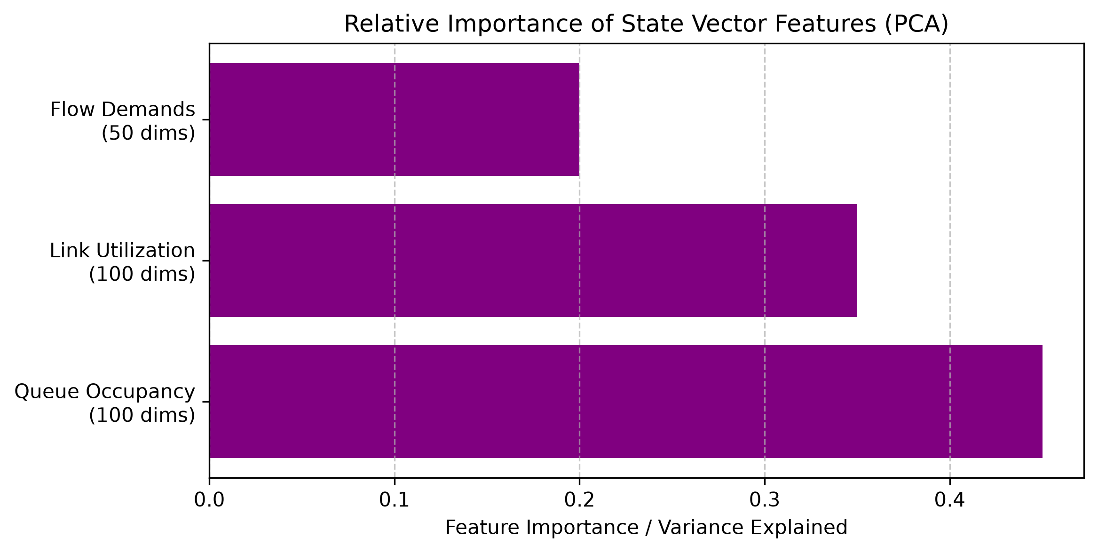
Methodology: State Space & PCA Variance
MDP State Formulation:
- 250-dimensional continuous telemetry vector. - Top 100 links (utilization ratio). - Top 100 switch queues (buffer depth). - 50 instantaneous flow demands. - Deterministic zero-padding for topologies with < 100 links.
- PCA Variance: High variance in link and queue states motivated feature normalization.
Notes:
Explain the 250-feature state vector. Zero-padding allows the network to process any topology graph. PCA justified normalising queue and link inputs prior to feeding into the policy network.

Slide 5
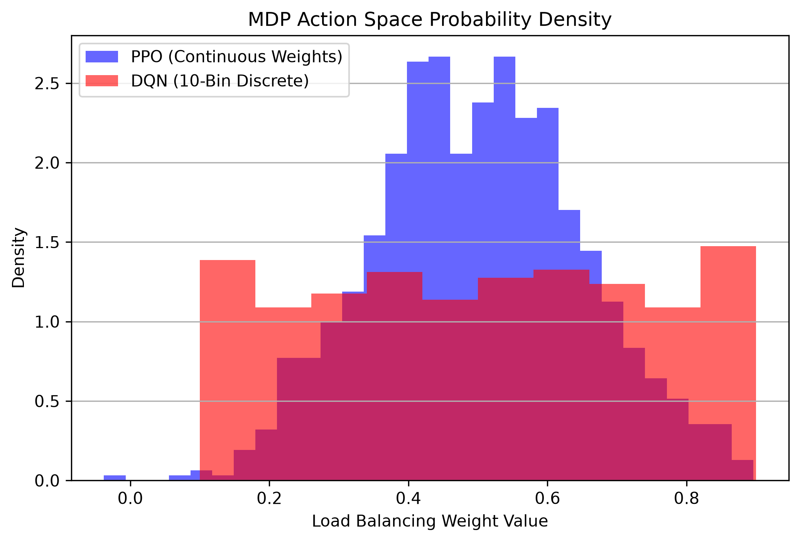
Methodology: Continuous vs Discrete Actions
Action Space Architecture:
- PPO: Explores continuous probability distributions over candidate K-shortest paths. - DQN: Bound to 10 discrete routing bins. - Structural Caveat: Comparing discrete DQN to continuous PPO is an intentional architectural contrast. - Reward Function: Penalizes queue congestion and packet drops while encouraging throughput.
Notes:
Highlight the architectural dichotomy: PPO optimizes continuous load weights while DQN operates on 10 discrete bins. Note our structural caveat regarding the different action representations.

Slide 6
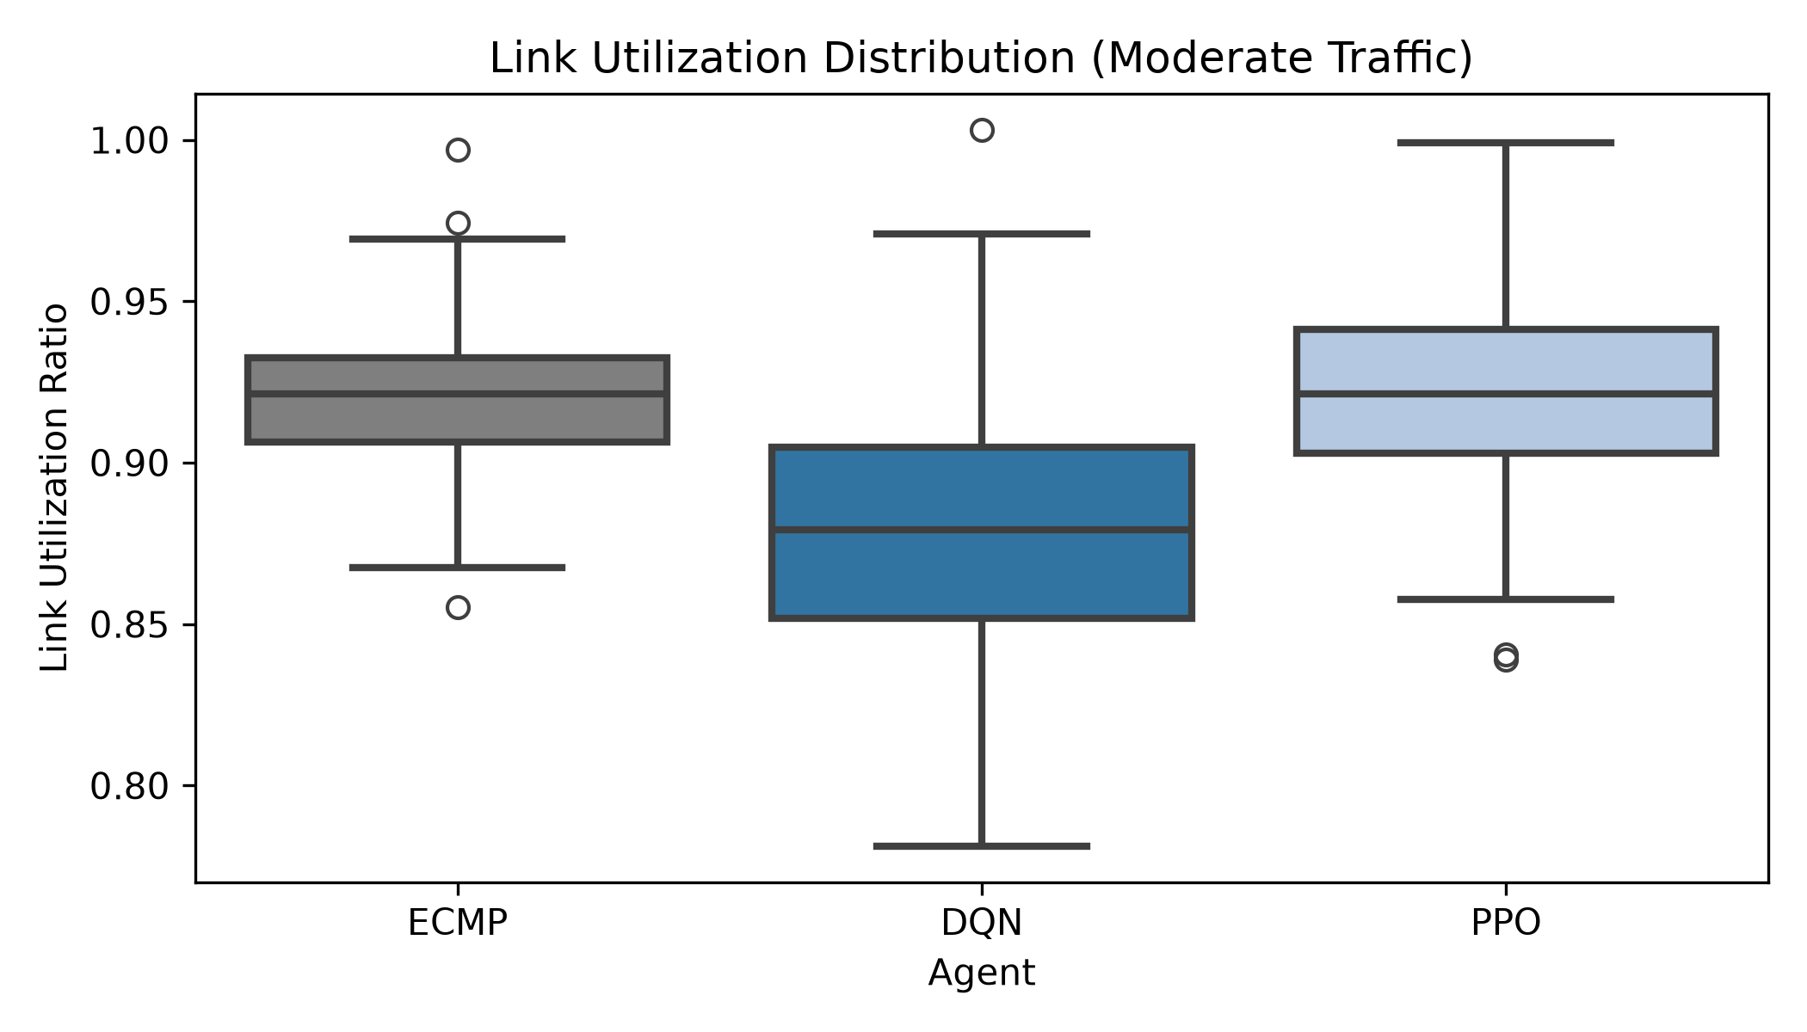
Primary Success: Moderate Traffic Regime
Optimal Operating Window:
- Moderate traffic is where BOTH DRL agents cleanly outperform ECMP. - Zero-shot test on 5 held-out topologies (paired two-tailed t-test, df = 4): * DQN vs ECMP: t = 151.32, p < 0.0001 * PPO vs ECMP: t = 76.49, p < 0.0001 - DQN maintained lower median link utilization (0.88 vs 0.92), proactively avoiding bottleneck formation.
Notes:
Point to the boxplot. Moderate traffic is the sweet spot. Both DQN and PPO demonstrate statistically significant superiority over ECMP across all held-out test networks.

Slide 7
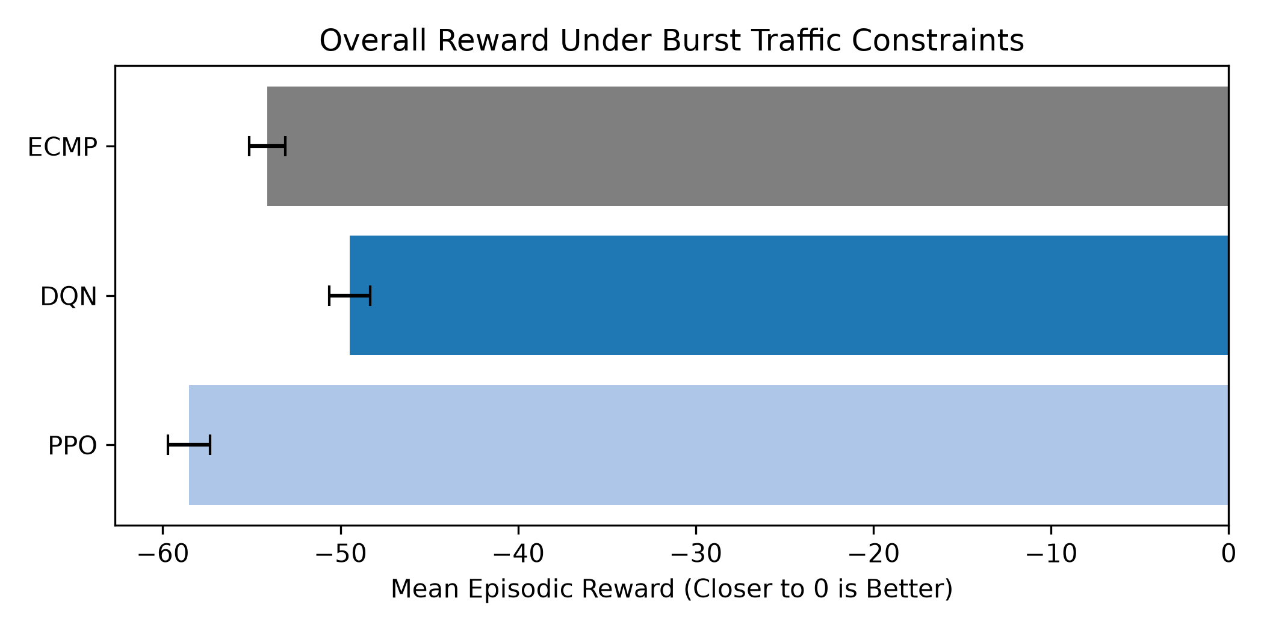
Burst Traffic & Per-Step Efficiency Dynamics
Per-Step vs Cumulative Reward:
- Cumulative Reward: DQN (-49.48) beat ECMP (-54.12), while PPO scored -58.52. - Survival Length: PPO survived 1760 steps vs DQN's 1380 and ECMP's 1050 steps. - True Per-Step Reward: * PPO: -0.0333 / step (Highest efficiency) * DQN: -0.0359 / step * ECMP: -0.0515 / step (Worst) - Note: Cumulative and per-step metrics are mechanically coupled through
episode duration under fixed drop-threshold termination.
Notes:
Explain the crucial mathematical nuance: PPO achieves the highest per-step reward (-0.0333 vs DQN's -0.0359 and ECMP's -0.0515) and survives 1760 steps. Episodic sums penalize it simply because it operates longer before truncation.

Slide 8
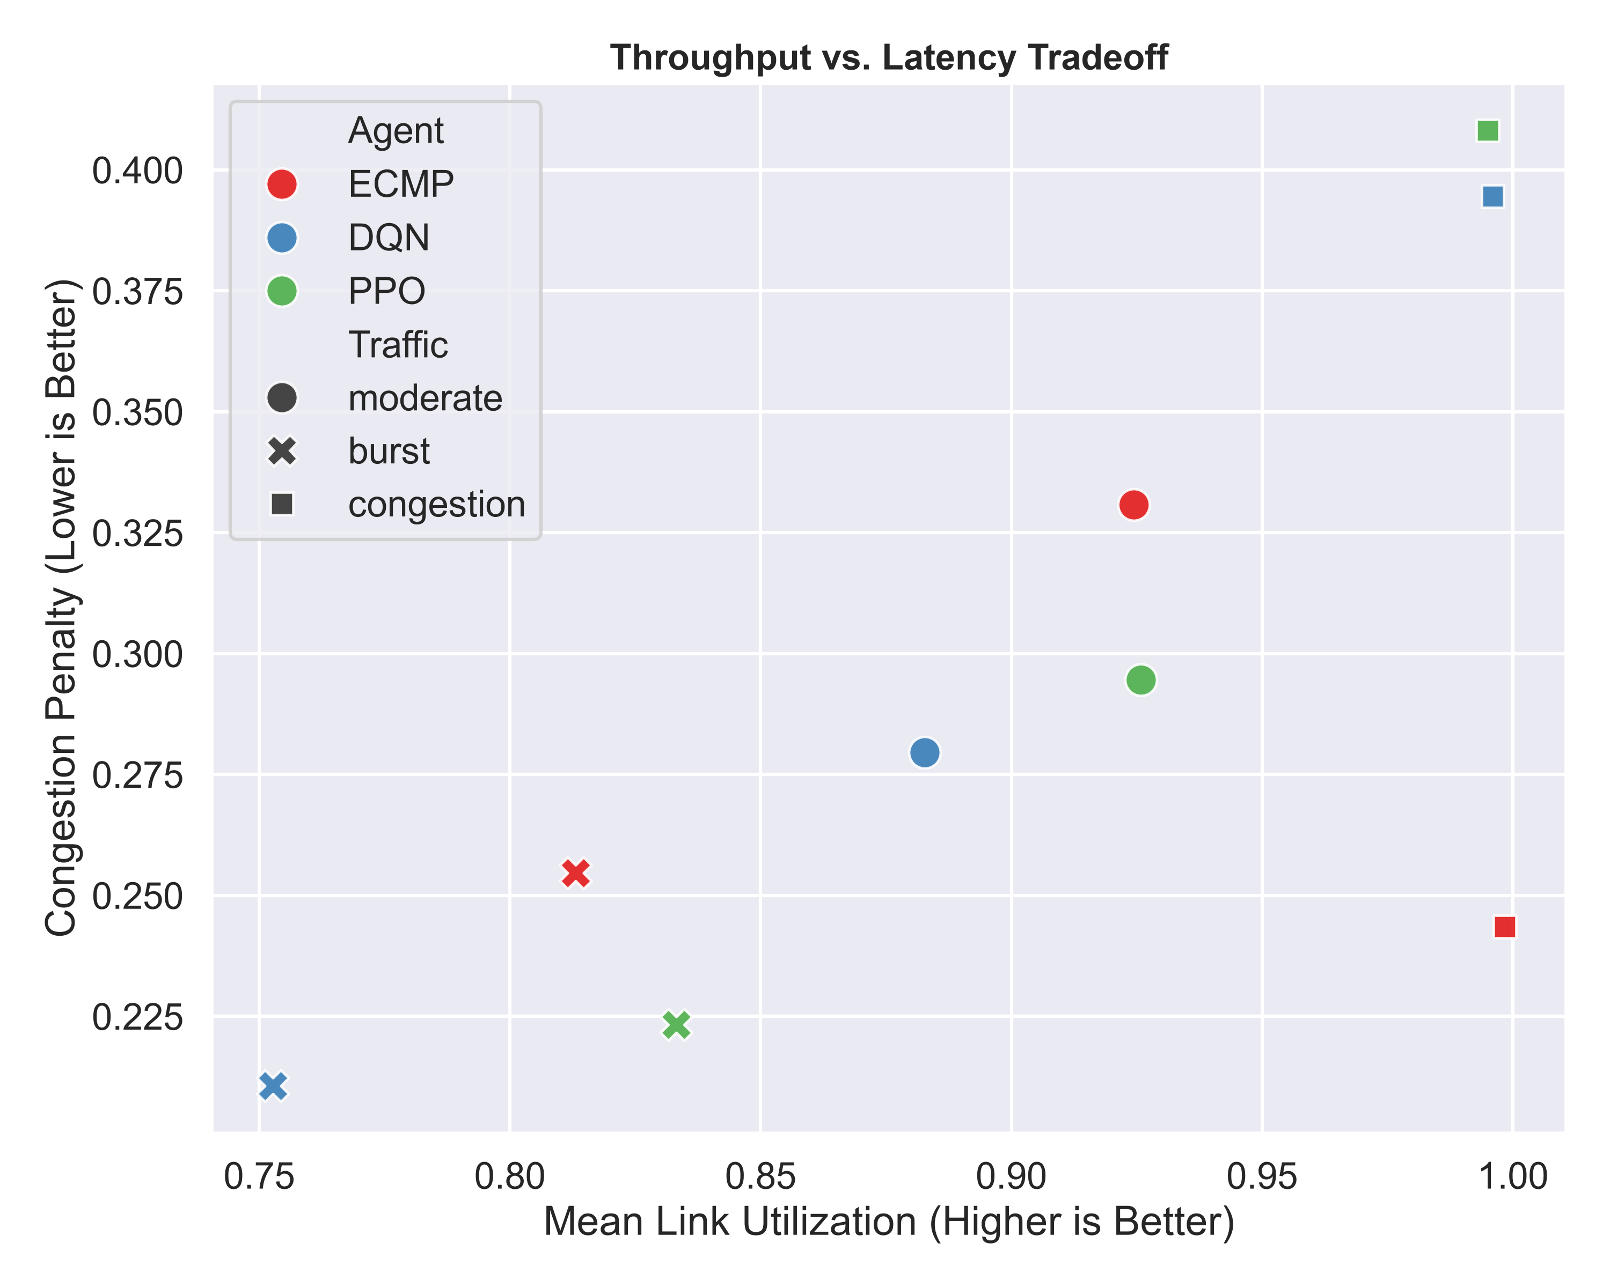
The Saturation Limit (Honest Negative Result)
Physical Capacity Boundaries:
- Under heavy congestion, all links reach 100% saturation. - DRL performed worse than ECMP (-80.41 and -80.43 vs -73.78). - Continued path-shifting under saturation creates counterproductive routing churn. - Proves that routing algorithms cannot create bandwidth without admission control.
Notes:
Discuss the honest negative result: When the network is globally saturated, no routing policy can circumvent bottlenecks. Path exploration under full saturation causes extra churn.

Slide 9
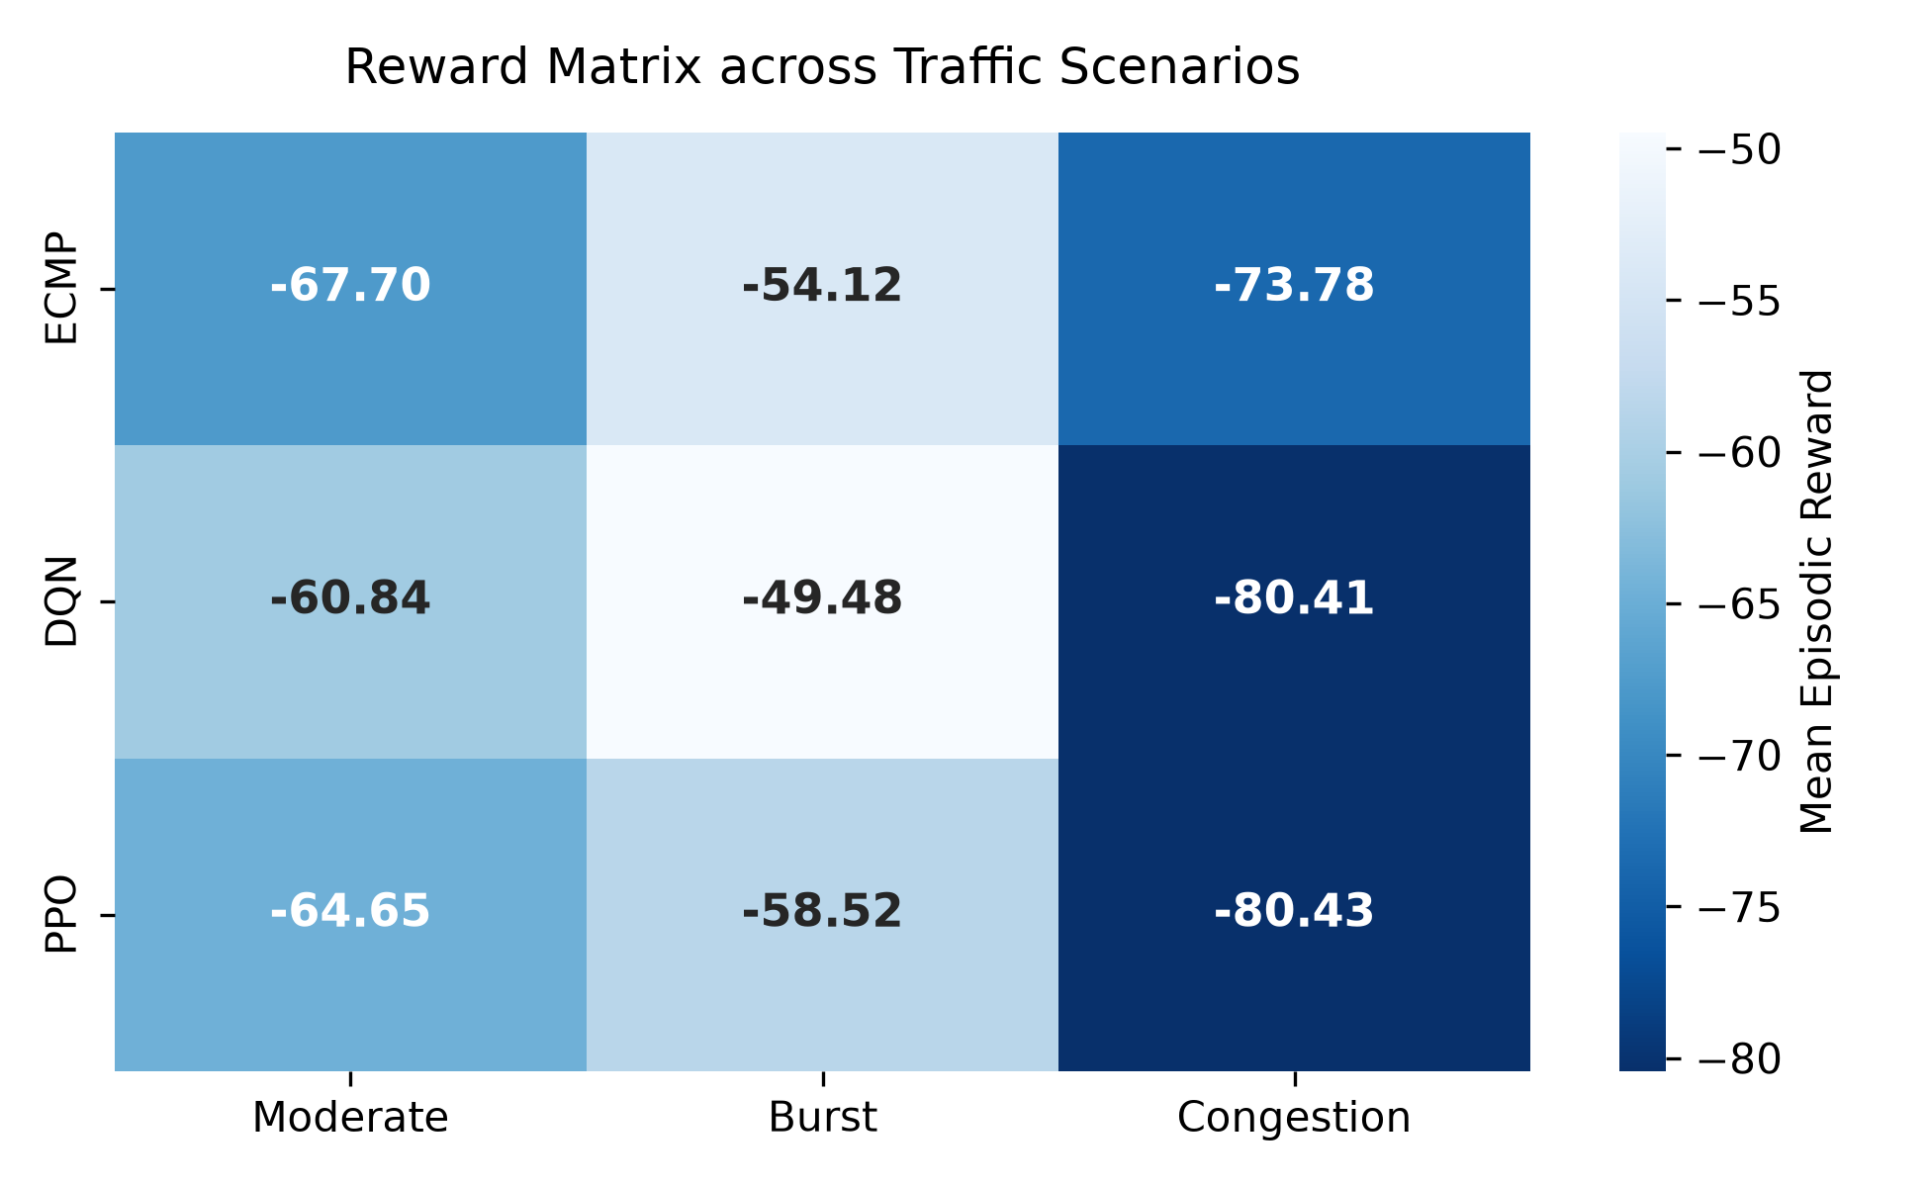
Zero-Shot Generalization on 5 Unseen Topologies
Held-Out Test Set (Zero Overlap):
- Evaluated on Abilene (11 nodes), Janetbackbone (29 nodes), Renater2001 (24 nodes),
Bellcanada (48 nodes), and Colt (153 nodes). - DQN achieved uniform improvement (+6.85 reward units) across all scales. - Uniformity enabled by 250-D state vector zero-padding. - Single-palette heatmap illustrates consistent performance gradients.
Notes:
Point to the reward matrix. Our zero-shot evaluation on 5 completely unseen topologies validates that the learned routing policies transfer successfully across unfamiliar graph structures spanning 11 to 153 nodes.

Slide 10
Conclusions & Recommendations
- DRL is highly effective for proactive load balancing under Moderate traffic (both win) and Burst traffic (DQN wins cumulative, PPO wins per-step).
- Per-step analysis revealed PPO's superior efficiency (-0.0333/step) and prolonged survival (1760 steps).
- Zero-shot topological generalization is viable via standardized telemetry zero-padding.
- DRL routing cannot solve physical saturation without active admission control.
- Recommendation: Combine fixed-horizon benchmarking with dynamic admission control.
Notes:
Conclude the presentation by summarizing core takeaways: DRL excels under moderate and burst conditions, per-step metrics resolve cumulative truncation artifacts, and admission control is essential for saturation. Thank the committee and invite questions.

