Slide 1



MATH 121E
CALCULUS II

Slide 2
Grading System
Course Outcome
Online Written Exam – 40%
Quizzes- 30%
Exercises -10%
Assignment-15%
Attendance- 5%
Satisfactory Rating -70%
Note: At least 50% of the students must get at least a grade of 70%
Mid Term Final Term
CO1 -33.33% CO1-33.33%
CO2- 33.33% CO2 -33.33%
CO3-33.33%C CO3- 33.33%
Final Grade = 50% midterm + 50% of Final Term

Slide 3
OBJECTIVES
To understand Integration Concepts and Formulas
To familiarize fundamental Integration Formulas and Applications

Slide 4
TOPIC OUTLINE
Indefinite Integral
The Power Formula
Definite Integral
Trigonometric Functions
Logarithmic Function
Exponential Function

Slide 5
TOPIC OUTLINE
Inverse Trigonometric Function
Hyperbolic Functions (sinh u and cosh u only)
General Power Formula (include Substitution Rule)
Constant of Integration
Definite Integral (include absolute, odd and even functions)

Slide 6
An integral is the reverse of a derivative, and integral calculus is the opposite of differential calculus. ... The word "integral" can also be used as an adjective meaning "related to integers".
Integral Calculus Definition

Slide 7
Indefinite Integral

Slide 8
If f(x) is a given function and F(x) is a function whose derivative is f(x), the relation between them is expressed below:
F(x) = ∫f(x) dx where the symbol ∫, called the integral sign, which indicates that we are to perform the operation of integration upon f(x) dx: that is we are to find a function whose derivative is f(x) or whose differential is f(x) dx.
Indefinite Integral

Slide 9
Evaluate ∫x² dx
In integration, we must increase the exponent by 1 and divide it by that exponent ,then with addition of the arbitrary constant C, thus;
∫x² dx = x³ +C
3
Since it contains an arbitrary additive constant, the constant of integration. For this reason, the function of ∫f(x) dx is called the indefinite integral of f(x).
Indefinite Integral

Slide 10
Note: If the integrand contains a constant factor, the factor maybe written before the integral sign . We may introduce a constant factor into the integrand, provided we place its reciprocal before the integral sign.
F(x) = 1 ∫uf(x) dx or uF(x) = ∫uf(x) dx u
Indefinite Integral

Slide 11
The Power Formula

Slide 12
Evaluate ∫u^{n} du let us replace n by n+1, then divide by n+1. Therefore;
∫u^{n} du = u^{n+1} + C , n≠ -1 n+1
Above is the general power formula of integration
The Power Formula

Slide 13
Example a:
∫(3x³ +1+ 1 ) dx = 3 ∫x³ dx + ∫dx + ½ ∫x⁻²dx
2x² = 3x⁴ + x + 1x⁻¹ + C
4 2(-1)
= 3x⁴ + x - 1 + C
4 2x
Example b:
∫(a²-x²)² dx= ∫(a⁴ - 2a²x² + x⁴)dx
= a⁴x – 2a²x³ + x⁵ + C
3 5
The Power Formula

Slide 14
Definite Integral

Slide 15
The change in the value of the integral F(x) as x changes from a to b, i.e., the quantity F(b)- F(a), is called the definite integral of f(x) between the “limits” a and b or simply the definite integral from a to b denoted by the symbol ∫^{b} f(x)dx ª
It is called indefinite integral because the value is dependent of the constant of integration.
Definite Integral

Slide 16
The numbers a and b are called the lower, limit and upper limit respectively. Thus the definite integral is the value of the indefinite integral at upper limit minus its value at lower limit. The symbol [ F(x)]^{b} ª means F(b) – F (a)
∫^{b} f(x) dx = [ f(x)]^{b} = F(b)- F(a) ª ª
Definite Integral

Slide 17
Example a: ∫¹ (x+1)² dx = [ (X+1)³ ]¹
⁰ 3 ⁰
Substitute the given values,
= 8 – 1 = 7
3 3 3
Example b: ∫ª (a²- t²)dt = [ a²t – t³ ]ª
^{-a} 3 ^{-a}
= a³ – a³ – (-a³ + a³ )
1 3 1 3
= (3a³- a³ ) - (-3a³ + a³)
3 3
= 4a³
3
Definite Integral

Slide 18
The following properties possessed by a definite integral:
(1) ∫^{b} f(x) dx = - ∫ª f(x) dx
^{a b}
(2) ∫^{b} f(x) dx = ∫^{c} f(x) dx + ∫^{b} f(x) dx
^{a a c}
(3) ∫^{b} f(x) dx = ∫^{b} f(z) dz
^{a a}
Definite Integral

Slide 19
Trigonometric Functions

Slide 20
There are six functions of an angle commonly used in trigonometry. Their names and abbreviations are sine (sin), cosine (cos), tangent (tan), cotangent (cot), secant (sec), and cosecant (csc).
Please be familiarized with some trigonometric identities
Trigonometric Functions

Slide 21
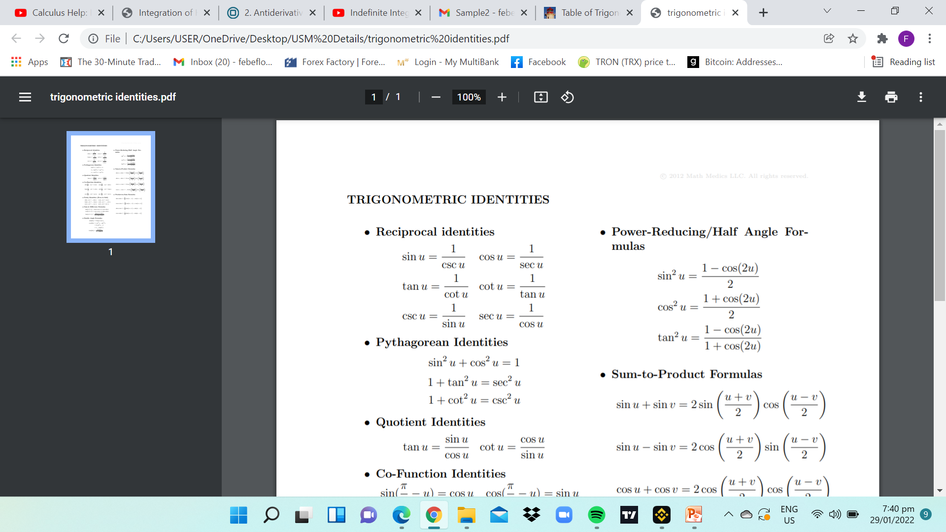
Trigonometric identities
Trigonometric Functions

Slide 22

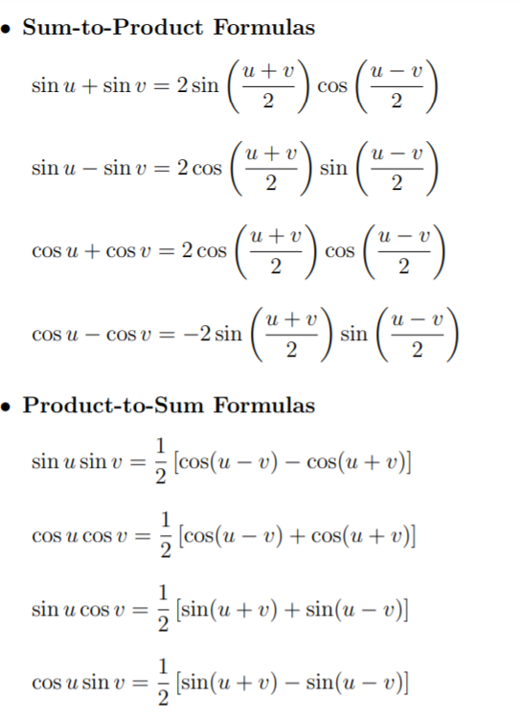
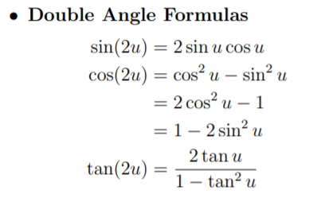
Trigonometric Functions

Slide 23
The Basic Formulas for integrations involving Trigonometric Functions
∫ cos u du = sin u + C
∫ sin u du = -cos u + C
∫ sec² u du = tan u + C
∫ csc² u du = -cot u + C
∫ sec u tan u du = sec u + C
∫ csc u cot u du = -csc u + C
Trigonometric Function

Slide 24
Examples (a):
Evaluate ∫ sin x tan x dx
= ∫ sin x sin x dx cos x
= ∫ sin² x dx cos x
= ∫ 1- cos² x dx cos x
= ∫ sec x dx - ∫ cos x dx
= ∫ sec x. (sec x + tan x) dx- ∫ cos x dx
(sec x + tan x)
= ∫ sec² x + sec x tan x dx- ∫ cos x dx
(sec x + tan x) let u = sec x + tan x du = (sec x tan x +sec² x )dx dx = du
(sec x tan x +sec² x )
Trigonometric Function
= ∫ sec² x + sec x tan x du - ∫ cos x dx
u (sec x tan x+sec² x)
= ∫ du - ∫ cos x dx
u
= ln |u | - sin x
= ln |sec x + tan x |- sin x + C

Slide 25
Examples (b):
Evaluate ∫ x sin x² dx let u = x²
^{du = 2x dx}
^{dx = du}
^{2x}
∫ x sin x² dx
= ∫ x sin u du
2x
= 1 ∫ sin u du
2
= - 1cos u + C
2
= - 1cos x² + C
2
Trigonometric Functions
Examples (c):
Evaluate ∫ tan²x dx
= ∫(sec² x-1) dx
= ∫sec²x dx - ∫ dx
= tan x – x + C

Slide 26
Evaluate below Integrals
(a) ∫ ( x³ - 4x)dx
(b) ∫ (6x³ - 4x + 1)dx
(c) ∫ (2x-x²)dx
(d) ∫ (3 -2y⁻²)dy
(e) ∫ (x²+7x+3 )dx
(f) ∫² x⁴dx
¹
(g) ∫² (x-3x²)dx
⁰
(h) ∫⁻¹ (3 + 2u) du
¹
Exercises 1

Slide 27
6. ∫ ( tan θ – 1)² dθ
7. ∫ cos² y dy
1- sin y
8. ∫ cos³ θ dθ
1 – sin θ
9. ∫ sin ² x csc² 2x dx
10. ∫ sin³ x dx
Exercises 2
Evaluate below:
1. ∫ sin 3θ dθ
2. ∫ cos 1 y dy
2
3. ∫ sec² 3x dx
1 + 4 tan 3x
4. ∫ cos lnx dx
x
5. ∫ cot² y dy

Slide 28
Logarithmic Function

Slide 29
Formulas for logarithm;
(1) ∫ du = ln u + C, u > 0 u
(2) ∫ du = ln (-u) + C₁, u < 0 u
(3) ∫ du = ln |u | + C₂, u ≠ 0 u note: the symbol "ln" refers to natural logarithms
Logarithmic Function

Slide 30
Example (a). Evaluate ∫ x dx
1- x²
= - 1 ∫ -2x dx = - 1 ln (1-x²) + C
2 1-x² 2 note: the integral of any quotient whose numerator is differential of the denominator is the logarithm of the denominator.
Or buy substitution, ∫ x dx , then let u = 1-x²
1- x² du = -2xdx dx = du
-2x
= ∫ x du = -1 ∫ du = -1 ln u + C u (-2x) 2 u 2
= - 1 ln (1-x² ) + C
2
Logarithmic Function

Slide 31
Example (b)
Evaluate ∫ x²dx x³ + 4
Solution: let u = x³ + 4 du = 3x² dx dx = du
3x²
∫ x²dx x³ + 4
= ∫ x² du = 1∫ du
(u) 3x² 3 u
= 1 ln (u) + C
3
= 1 ln (x³ + 4) + C
3
Logarithmic Function
Example (c)
Evaluate ∫ x²⁻4 dx
x
Solution:
= ∫( x2 – 4 ) dx
x x
= ∫( x – 4) dx
x
= ∫ x dx - ∫ 4 dx
x
= x² – 4 ln x + C
2
=1 x² – ln |x⁴ | +C
2

Slide 32
Exercises 3:
Evaluate below
1. ∫ 2 dy
3y-4
2. ∫ x dx x²-3
3. ∫ x³ dx x-1
4. ∫ (x+ 6 )dx
(x+2)²
5. ∫ (lnx)² dx x
Logarithmic Function
6. ∫ dx
sin 2x
7. ∫ tanx dx
8. ∫ (1-2x)² dx
x
9. ∫ (x²-3x+2) dx
x+1
10. ∫ dx
x (1 + x²)

Slide 33
Exponential Function

Slide 34
There are two basic formulas for the integration of exponential functions;
∫ e^{u} du = e^{u} + C
∫ a^{u} du = a^{u} + C , a > 0 ln a
Exponential Function

Slide 35
Example (a)
Evaluate ∫ e^{-3x} dx
= e ^{-3x} + C
-3
= -1 e ^{-3x} + C
3
Example (b)
Evaluate ∫ e^{2x} dx
= e^{2x} + C
2
= 1 e^{2x} + C
2
Exponential Function
Example (c)
Evaluate ∫ dx
3^{2x}
= 3 ^{-2x} dx
= -1 3 ^{-2x} + C
2 ln 3
Example (d)
Evaluate ∫ 2^{-x} dx
= 2 ^{-x} + C
ln 2

Slide 36
Exercises 4:
Evaluate the following
1. ∫x³e^{x4} dx
2. ∫ ln e^{2x} dx
3. ∫ e^{x} ( 1-e^{x}) dx
4. ∫( e^{x} + e^{-x} )dx e^{x} – e^{-x}
Exponential Function

Slide 37
Inverse Trigonometric Function

Slide 38
Consider below formulas:
∫ du = Arcsin u + C a² – u² a
∫ du = 1 Arctan u + C a² + u² a a
Inverse trigonometric Function
Example (a):
Evaluate
∫ dx
9 – 4x²
₌ ∫ dx
9 –(2x)²
^{let u = 2x}
^{du = 2dx}
^{dx= du}
²
∫ dx
=
3² – (2x)²
∫du
=
2 3² – (u)²
= 1 Arcsin u + C
2 3
₌ 1 Arcsin 2x + C
2 3

Slide 39
Example (b):
Evaluate ∫ dy
9y² + 6y + 5
= ∫ dy
(3y)² + 6y + 1 + 4
= ∫ dy
(3y +1)² + 4 let u = 3y + 1 du = 3dy dy= du
3
=∫ dy
(3y +1)² + 2²
= ∫ du
3 (u²) + 2²
=1 ∫du
3 (u²) + 2²
= 1.1 Arctan u + C = 1 Arctan 3y + 1 + C
3 2 2 6 2
Inverse Trigonometric Function
Example (c):
Evaluate ∫ y² + 1 dy
y² +4
= ∫ y² + 4 -3 dy
y² +4
= ∫( 1 – 3 ) dy
y² + 4
= ∫ dy – 3dy
y² + 4
= y-3 ∫ dy
y² + 2²
= y-3 1 Arctan y + C
2 2
= y- 3 Arctan y + C
2 2

Slide 40
6. ∫ x dx
9 + x²
7. ∫ (y + 4 )dy y² + 16
8. ∫ sec² θ dθ
5 – sec² θ
9. ∫ u (u² + 4) du u⁴ + 9
10. ∫ e^{6x} dx
9 + 4e^{6x}
Inverse Trigonometric Function
Exercises 5:
Evaluate below
1. ∫ dx
16+ x²
2. ∫ dy
9- y²
3. ∫ dv
9 + 4v²
4. ∫ dt
5- 16t²
5. ∫ y dy
25 – 16y²

Slide 41
Hyperbolic Functions
sinh u and cosh u only

Slide 42
Formulas :
∫ cosh x dx = sinh x + C
∫ sinh x dx = cosh x + C
Hyperbolic Functions
Example (b):
Evaluate
∫ sinh x dx
1 + cosh x
Let u = 1+ cosh x
du = sinh x dx
∫ sinh x dx
1 + cosh x
= ∫ du
u
= ln |u | + C
= ln |1 + cosh x | + c
Example (a):
Evaluate
∫ cosh x dx
2 + 3sinh x
let u = 2 + 3 sinh x
du = 3 cosh x dx;
cosh x dx = du
3
∫ cosh x dx
2 + 3sinh x
= ∫ du
3 (u)
= 1 ∫ du
3 u
= 1 ln u + C = = 1 ln | 2 + 3 sinh x| + C
3 3

Slide 43
General Power Formula
Include Substitution Rule

Slide 44
∫u^{n} du = u^{n+1} + C , n≠ -1 n+1
The General Power Formula
Example (b):
Evaluate ∫ cos x dx
sin⁴ x
= ∫ sin⁻⁴ x cos x dx
Let u = sin x
du = cos x dx
= ∫ sin⁻⁴ x cos x dx
= ∫ u⁻⁴ du
= - u⁻³ + C
3
= - sin ⁻³ x + C
3
= -1 + C
3 sin³ x
Example (a):
Evaluate ∫ (2x⁴ – 5)⁶ x³ dx
let u = (2x⁴ – 5)
du = 8x³ dx
dx = du
8x³
∫ (2x⁴ – 5)⁶ x³ dx
= ∫ u⁶ x³ du
8x³
= 1 ∫ u⁶du
8
= 1 u⁷ + C
8 7
= u⁷ + C = (2x⁴-5)⁷ + C
56 56

Slide 45
Exercises 6:
Evaluate the following
1. ∫ sin 4x cos 4x dx
2. ∫ (x² - 1)³ x dx
3. ∫( 3x² + 5x – 3)⁶ (6x + 5) dx
4. ∫ (7x+ 5)³ dx
5. ∫(√3x + 2) dx
The General Power Formula

Slide 46
Constant of Integration

Slide 47
Constant of Integration is added to the answer of the integration. This is written to represent the constant term of the original function, which could not be obtained through this anti-derivative process. The constant of integration can have arbitrary values and is written as +C.
Constant of Integration

Slide 48
Properties of Constant of Integration
The following properties of constant of integration are helpful for a better understanding of constant of integration.
1. The constant of integration is an arbitrary constant and it can have any value.
2. The sum or difference of two constants of integration is written as a single constant of integration.
3. For logarithmic or trigonometric functions, the constant of integration even if it involves a logarithmic or a trigonometric function is always written as only C.
4. The constant of integration is only used for indefinite integrals and is not used for definite integrals.
5. Multiplying and dividing the integral also multiplies or divides the constant of integration by the same number, which is presented as a constant C.
6. Even with different methods of integration, and for different assumed values of constant of integration, we use the same alphabet C to represent the constant of integration.
Constant of Integration

Slide 49
Definite Integral
Include absolute, odd and even functions

Slide 50
A function f is even if the graph of f is symmetric with respect to the y-axis.
Algebraically, f is even if and only if f(-x) = f(x) for all x in the domain of f. A function f is odd if the graph of f is symmetric with respect to the origin.
If (fx) is an even function of x, ∫ª (fx)dx = 2 ∫ª (fx)dx
^{-a} ^{-a}
If (fx) is an odd function of x, ∫ª (fx)dx =0
^{-a}
Definite Integrals -Odd and Even Functions

Slide 51
Example (a)
∫ª (a² – t²) dt
^{-a}
= 2 ∫ª (a² – t²) dt
^{-a}
= 2 [a²t – t³ ]ª
3 ^{-a} by substitution:
= 4a³
3
Definite Integrals -Odd and Even Functions
Example (b)
∫³ (y – 2)² d
¹
= [ ( y-2)³ ]³
3 ¹
By substitution;
= 1 – ( - 1)
3 3
= 2
3

Slide 52


End of Topic
Thank you
Engr. Febe F. Murillo
College of Engineering and Information Technology

