Slide 1

CFG: Python Course
Spreadsheet Project
Individual Submission: Pippa Ward

Slide 2
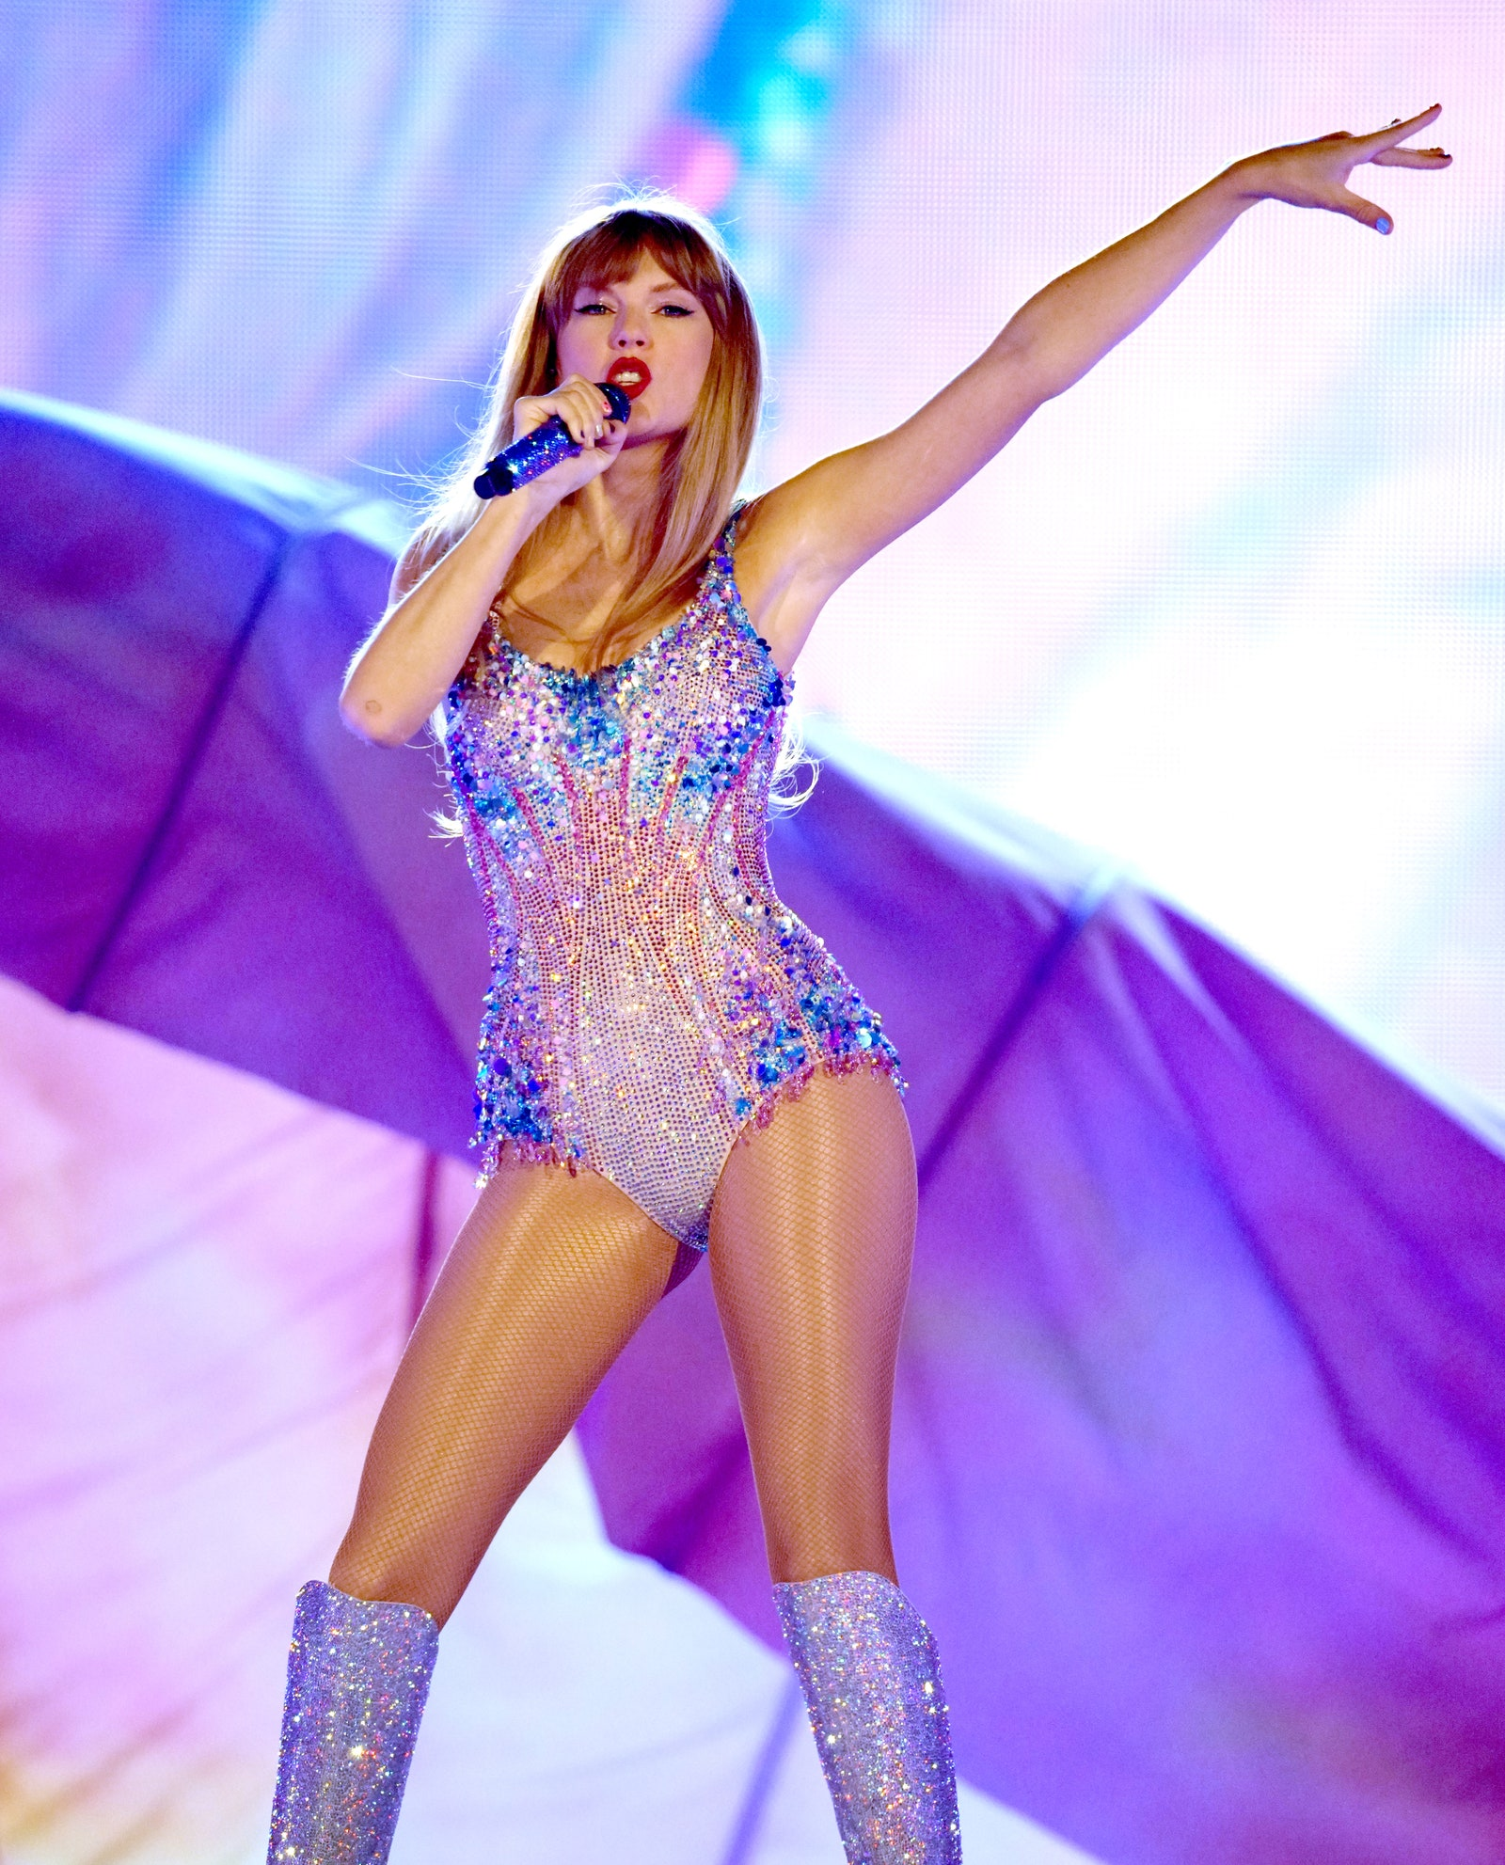
RunFit
(Taylor’s Version)
Her training regimen included running on the treadmill every day while singing the entire Eras setlist aloud—”Fast for fast songs, and a jog or a fast walk for slow songs”
- TIME MAGAZINE

Slide 3

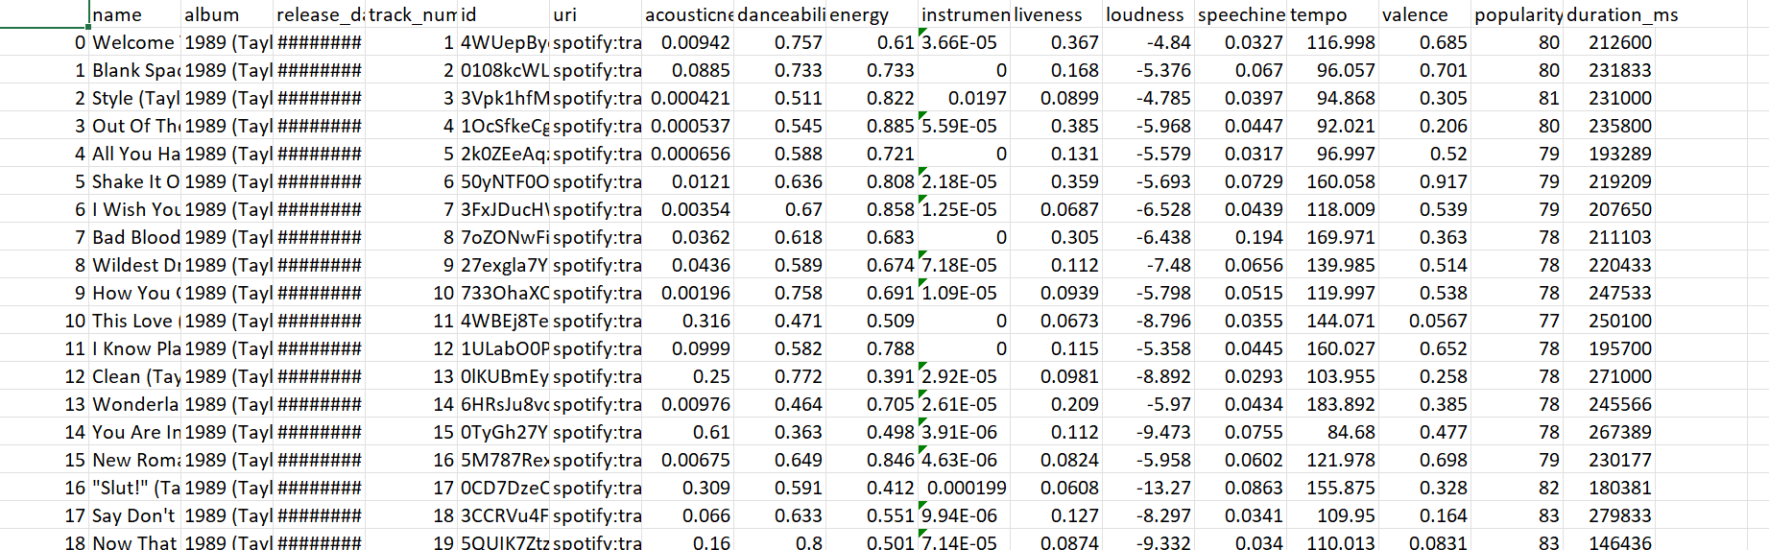
https://www.kaggle.com/datasets/jarredpriester/taylor-swift-spotify-dataset

Slide 4
Aims
MUST
Read the CSV file
Collect and output data
SHOULD
Allow user input
COULD
Have a menu to aid functionality and aesthetic
WON’T
Return song recommendations for chosen workout speed
Have a fancy user interface – will just run in Python terminal

Slide 5

DEMO

Slide 6
Celebrating Success
It works!
I’ve learned how to convert seconds into a more useable time format
I have demonstrated reading data, manipulating data, lists, dictionaries, for loops, if statements, defining and calling functions and user input
Relatively user friendly

Slide 7
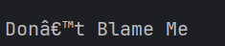
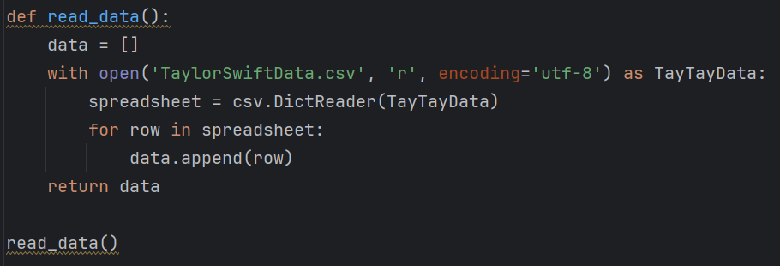
Stumbling block 1

Slide 8
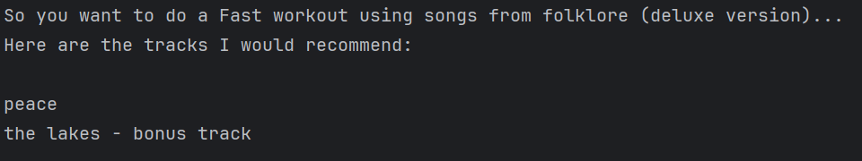

Stumbling block 2

Slide 9
Next steps…
Organise my project into separate files – creating a “run” file and a “functions” file
User input error breaks the code – find a fix
Store recommended tracks in a list which the user can add to and export when finished
Return the Spotify URIs from the .CSV to open the recommended tracks

