Slide 1
MODELING & CONTROL OF ELETRIC DRIVES POSITION CONTROL OF A DC SERVO MOTOR
Bertin Filippo
Borlina Tommaso
Gottardo Filippo
Pegoraro Giulia

Slide 2
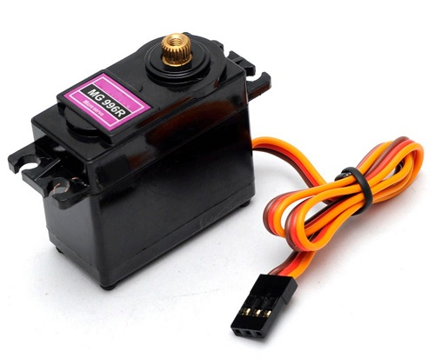
design a controller board for the common MG996R hobby servo motor to improve its accuracy
Goal

Slide 3
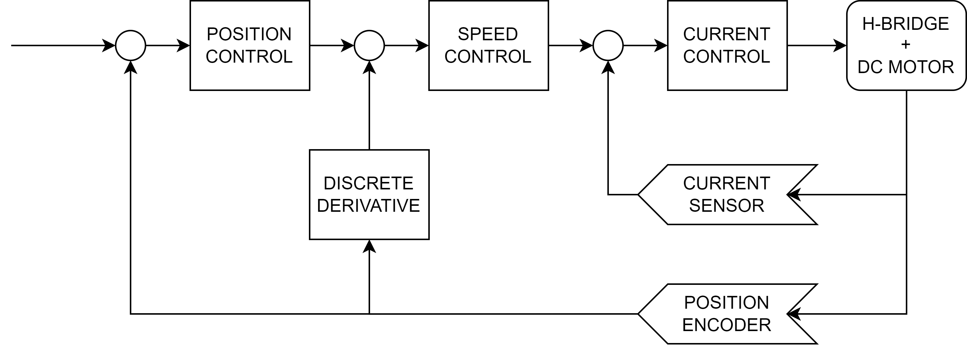
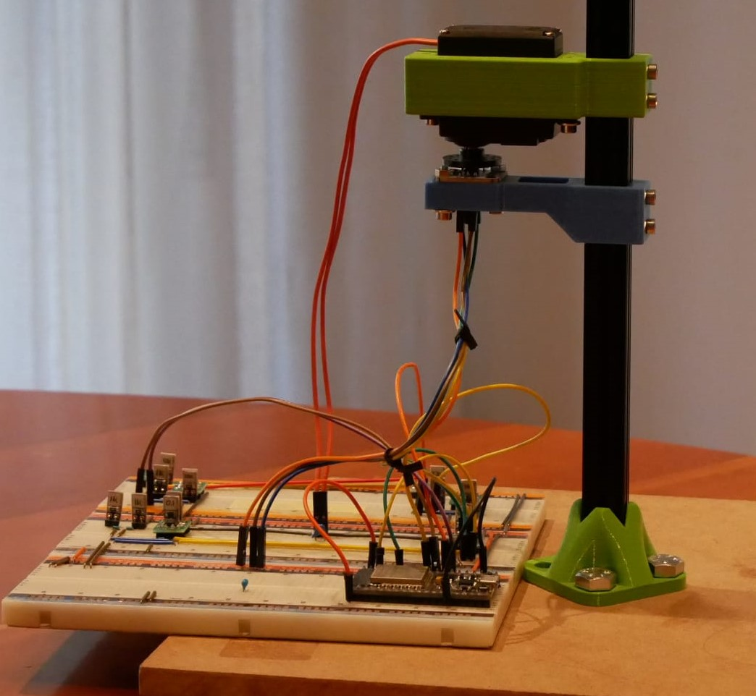
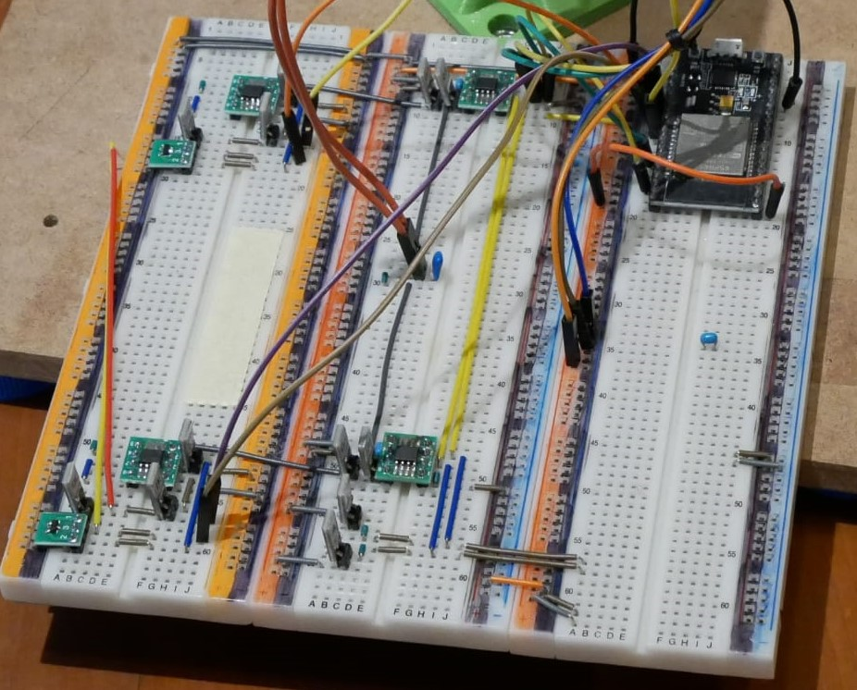
How to achieve position control ?
Hardware components:
H-bridge circuit
Magnetic encoder
Current & Voltage sensor

Slide 4
A few problems along the way
Problem #1
Interface problem between Simulink and Arduino board due to memory issues.
Solution
Adopted the ESP32 board which has more memory and computation power.
Problem #2
Knowledge of system parameters is required for proper controller tuning.
Solution
Systems parameters estimated through experiments on real hardware.

Slide 5
Unexpected behaviour of the real system

Slide 6
A quick demo

