Slide 1
Robotics and Control 2
Cristian Lorenzi, Filippo Gottardo, Giulia Pegoraro, Edoardo Di Pietrantonio

Slide 2
THE PROBLEM
3 mobile robots have to agree on a randez vous point and when they are in proximity of the point they start a tracking task on a circular trajectory
SCENARIO SPECIFICS
Mobile robots are unicycles
Mobile robots are independent
ADDITIONAL CONSTRAINTS
The robots world is a 2d grid 12x12
Initial conditions of the robots can be randomly chosen, both position and orientation
The final trajecotry is a circle of radius 1
The proximity circle is 4

Slide 3
SOLUTION APPROACH
THREE STEPS PROCEDURE:
Consensus - before moving
Regulation – until proximity to randez-vouz point
Tracking – until the end of the simulation
This algorithm is applied to each agent INDEPENDENTLY
REGULATION CONTROL will be validated before applying it to the final solution system
TRACKING CONTROL will be implemented using differente control strategies:
Linearization of state error dynamics
Non-linear controller of state error dynamics
Feedback linearization of based on a reference point on the sagittal axis
Feedback linearization based on second order derivatives
Each one will be validated with the same methodology and in the end they will be compared to draw final conclusions.

Slide 4
CONSENSUS
Consensus point is computed before starting to move.
The adopted strategy is AVERAGE CONSENSUS – e.g. we compute the mean point starting from initial positions of the agents
MISSING IMAGE
Future improvement - Consensus could be dynamically computed at every step of the iteration until every agent is in its proximity

Slide 5
REGULATION - CARTESIAN

Slide 6
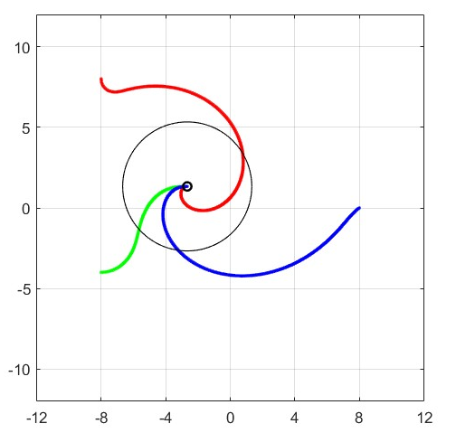
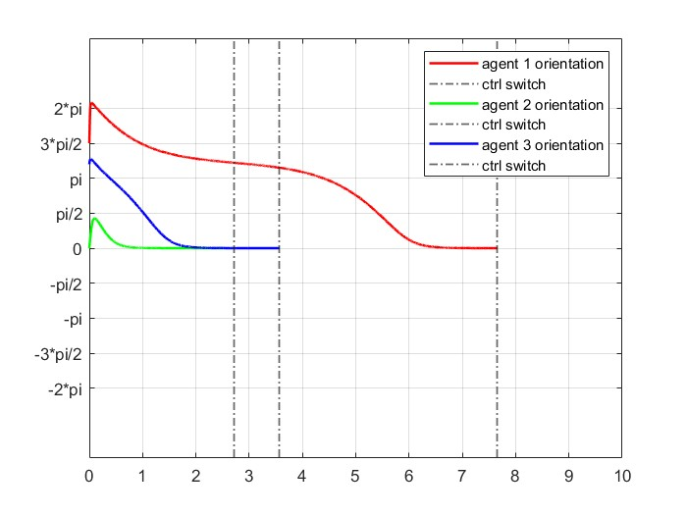
REGULATION - POSTURE
EXPLAIN THE REASONS

Slide 7
CONTROLLER SWITCH
How do we switch between posture regulation and tracking control?
A simulink block is responsible for checking if we are inside a fixed proximity radius, in that case it switches controller
Proximity radius is 4
IMPLEMENTATION PROBLEMS
Posture regulation and tracking control are two different subsystems in Simulink.
Tracking subsytem must inherit initial conditions from last iteration of Regulation subsystem.
Transition between controllers must be smooth. We should avoid sudden changes in orientation and velocity

Slide 8
TESTING PROCEDURE
CONVERGENCE TEST – to test if final result is acceptable
SMOOTHNESS TEST – to test the smoothness of agents paths
SENSITIVITY TEST – to test robustness if we slightly modify the gains
PROXIMITY TEST – to test how close the agent are to the desired trajectory
Each test except the Smoothness test is automated via MatLab livescript.
The Smoothness Test was impossible to automate since the final results could only be interpreted by a human depending on his needs (trajectory path).
Each trajectory tracking controller was tested using this procedure.

Slide 9
LINEAR CONTROLLER
CONVERGENCE TEST
94%
Smoothness image
SENSITIVITY TEST
80/100
PROXIMITY TEST (avg error)
2.58

Slide 10
NON-LINEAR CONTROLLER
CONVERGENCE TEST
94%
Smoothness image
SENSITIVITY TEST
80/100
PROXIMITY TEST (avg error)
2.58

Slide 11
FEEDBACK SAGITTAL CONTROLLER
CONVERGENCE TEST
94%
Smoothness image
SENSITIVITY TEST
80/100
PROXIMITY TEST (avg error)
2.58

Slide 12
FEEDBACK DD CONTROLLER
CONVERGENCE TEST
94%
Smoothness image
SENSITIVITY TEST
80/100
PROXIMITY TEST (avg error)
2.58

