Slide 1
Robotics & Control 2
Giulia Pegoraro
Filippo Gottardo
Cristian Lorenzi
Edoardo Di Pietrantonio

Slide 2
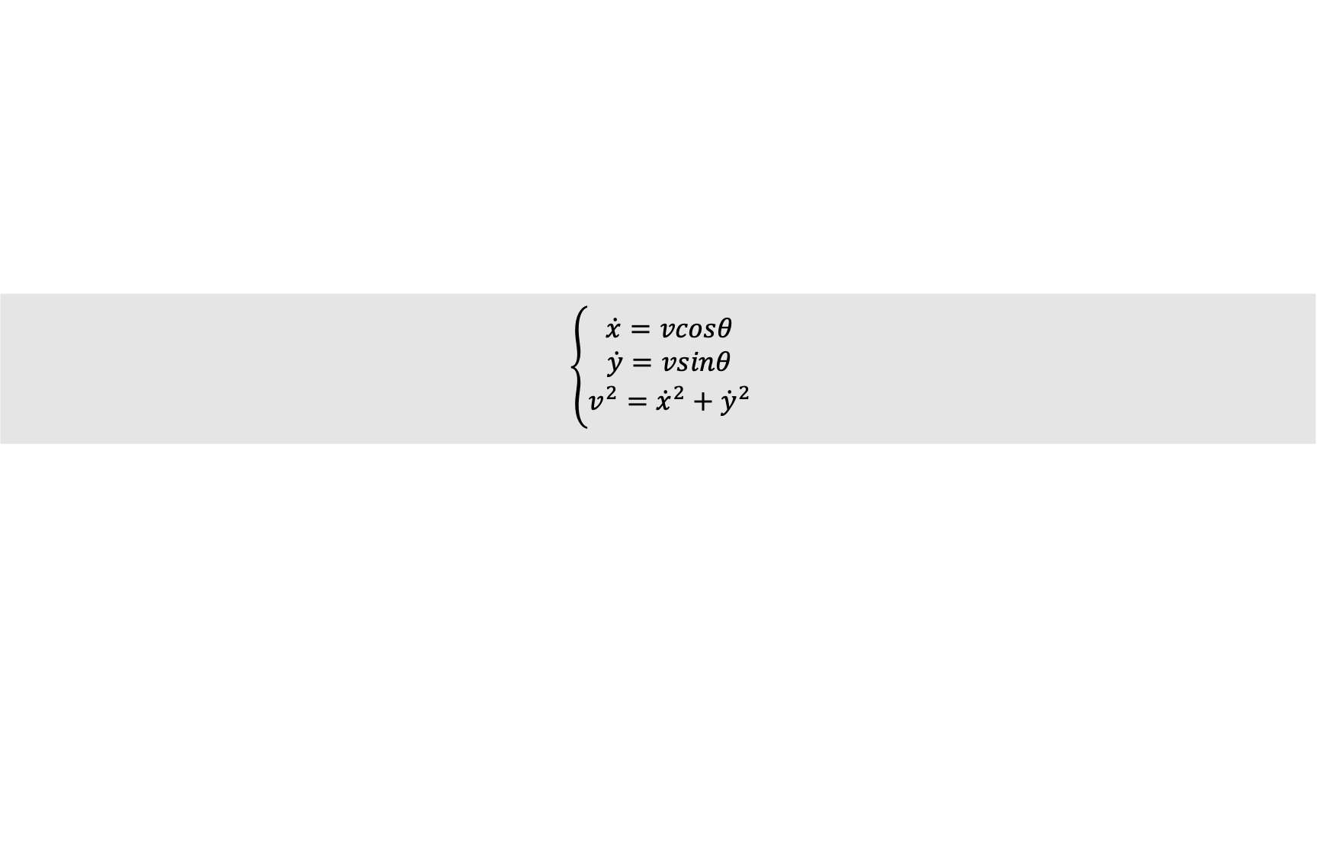
THE PROBLEM
3 mobile robotic agents should agree on a rendez-vous point and when in proximity of such point, they start a tracking task over a circular trajectory centered in the rendez-vous point.
SCENARIO SPECIFICS
All agents are unicycles;
All agents are independent from each other;
ADDITIONAL CONSTRAINTS
Agents live in a 2D grid 12x12;
Initial conditions of the agents can be randomly chosen (both position and orientation);
The final target trajectory is a circle of radius 1;
The proximity circle radius is 4;
$$\left\{\begin{aligned}\dot{x}=vcosθ \\ \dot{y}=vsinθ \\ v^{2}={\dot{x}}^{2}+{\dot{y}}^{2}\end{aligned}\right.$$
Unicycle kinematic model:

Slide 3
SOLUTION APPROACH
THREE STEPS PROCEDURE:
Consensus - before moving
Regulation – until proximity to rendez-vouz point
Tracking – until the end of the simulation
This algorithm is applied to each agent INDEPENDENTLY.
REGULATION CONTROL will be validated before applying it to the final solution system.
TRACKING CONTROL will be implemented using different control strategies:
- Linearization of state error dynamics
- Non-linear controller of state error dynamics
- Feedback linearization based on a reference point on the sagittal axis
- Feedback linearization based on second order derivatives
Each one will be validated using the same methodologies and compared in order to draw final conclusions.

Slide 4
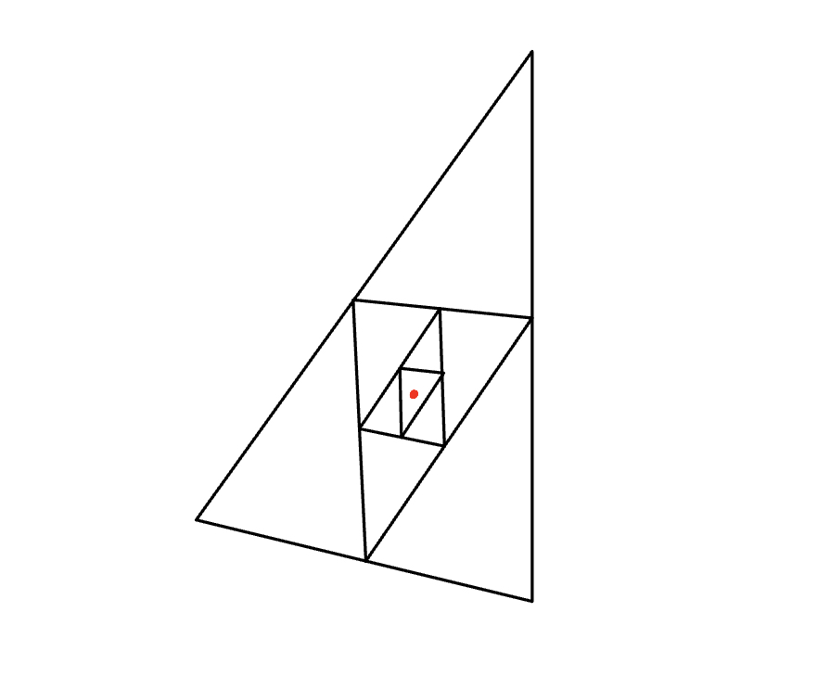
CONSENSUS
The adopted strategy is AVERAGE CONSENSUS.
Consensus is computed before starting the control action and does not change over time

Slide 5
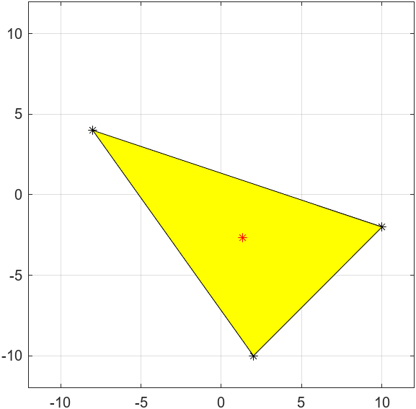
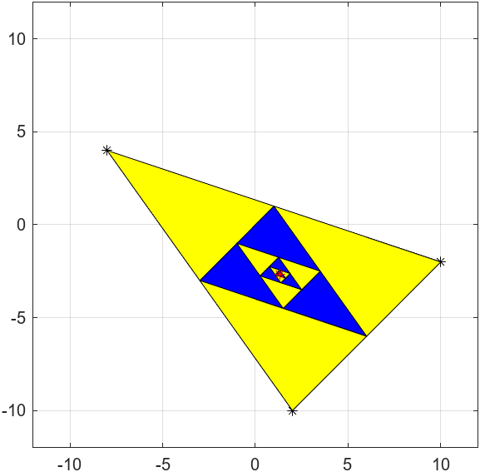


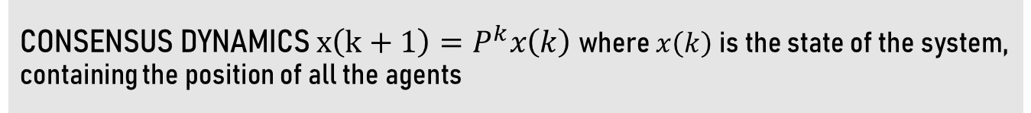
CONSENSUS
CONSENSUS DYNAMICS $x\left(k+1\right)=P^{k}x\left(k\right)$ where $x\left(k\right)$ is the state of the system, containing the position of all the agents
HOW DO WE CHOOSE THE P MATRIX ?
We need primitive and doubly stochastic P
Average consensus in one step
Average consensus
$$P=\left[\begin{matrix}1/3 & 1/3 & 1/3 \\ 1/3 & 1/3 & 1/3 \\ 1/3 & 1/3 & 1/3\end{matrix}\right]$$
$$P=\left[\begin{matrix}1/2 & 0 & 1/2 \\ 1/2 & 1/2 & 0 \\ 0 & 1/2 & 1/2\end{matrix}\right]$$

Slide 6
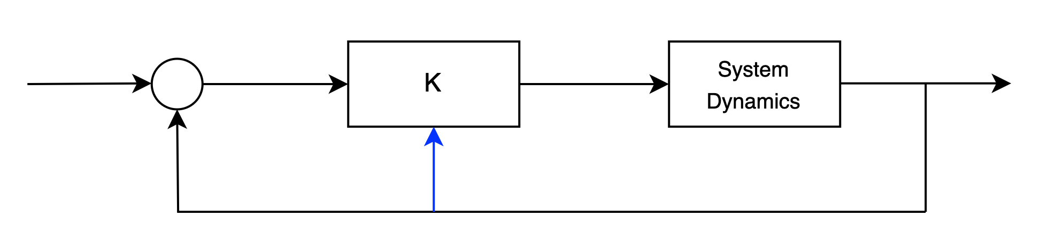





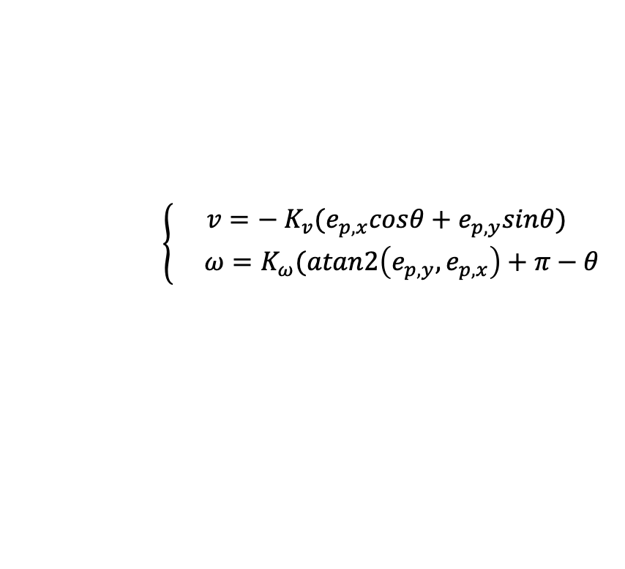


REGULATION - CARTESIAN
$$p_{d}=0$$
+
$$e_{p}$$
$$v,ω_{ }$$
$$q$$
$$−$$
$$θ$$
$$x, y$$
CONTROL LAW
$$\left\{\begin{aligned}v={− K}_{v}(e_{p,x}cosθ+e_{p,y}sinθ) \\ ω=K_{ω}(atan2\left(e_{p,y},e_{p,x}\right)+π−θ\end{aligned}\right.$$

Slide 7
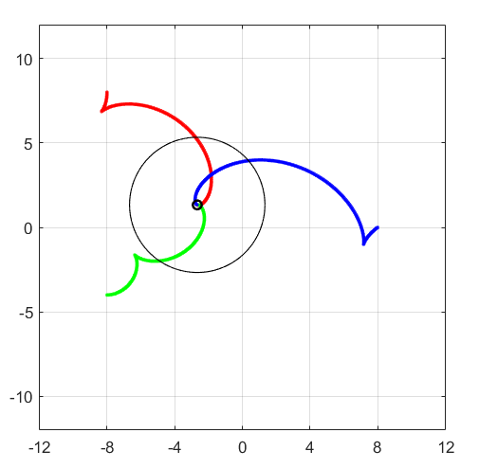
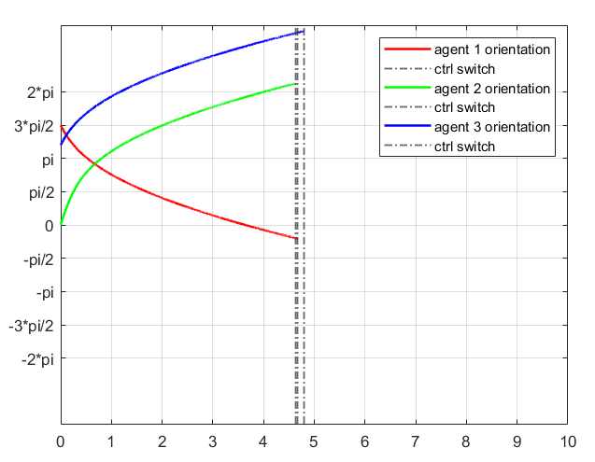
REGULATION - CARTESIAN
GOAL: reach the desired target configuration
q = [0, 0, ?]

Slide 8
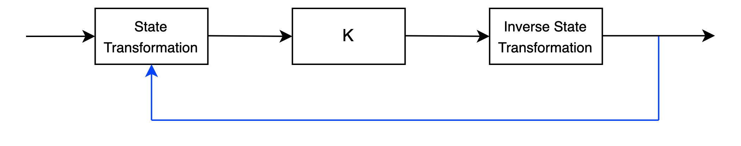
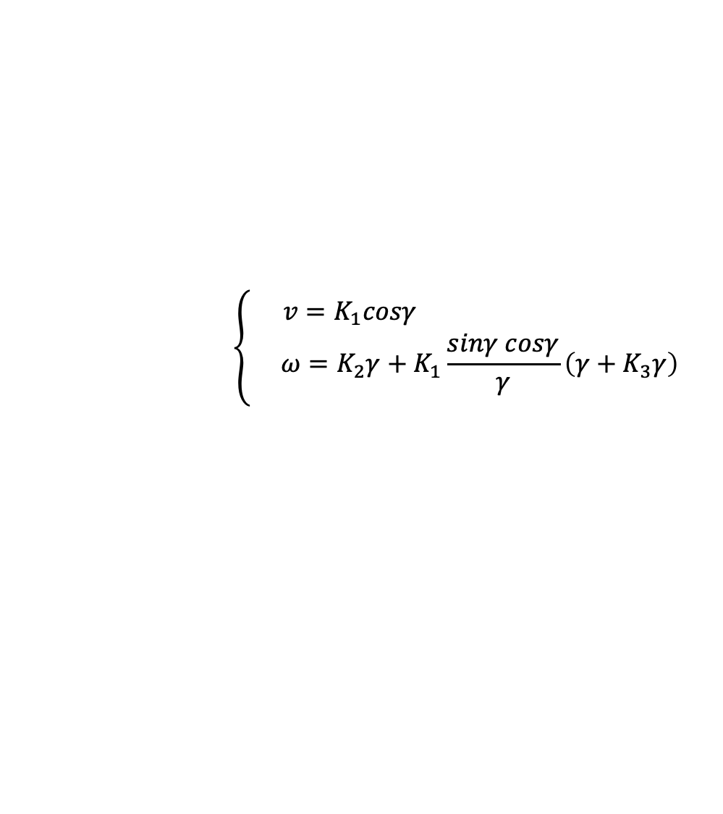






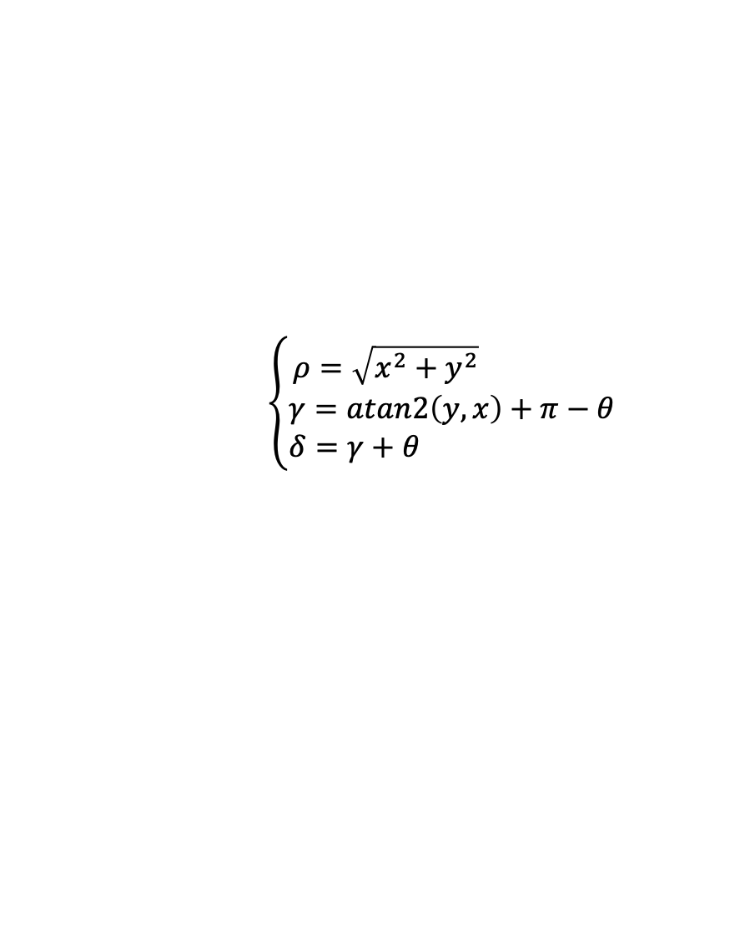
REGULATION - POSTURE
$$q_{d}=0$$
$$ρ, γ,δ$$
$$u,ω_{ }$$
$$q$$
$θ$, $x, y$
$$\left\{\begin{aligned}ρ=\sqrt{x^{2}+y^{2}} \\ γ=atan2\left(y,x\right)+π−θ \\ δ=γ+θ \end{aligned}\right.$$
STATE TRANSFORMATION
INPUT TRANSFORMATION
$$u=\frac{v}{ρ}$$
$$\left\{\begin{aligned}v=K_{1}cosγ \\ ω=K_{2}γ+K_{1}\frac{sinγ cosγ}{γ}\left(γ+K_{3}γ\right)\end{aligned}\right.$$
CONTROL LAW

Slide 9
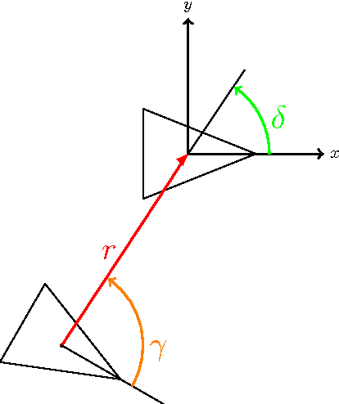
REGULATION - POSTURE
GOAL: reach the desired target configuration
q = [0, 0, 0]
TWO OPTIONS:
Control Law with singularity at the origin
Control Law without singularity at the origin
In our scenario we will implement the latter

Slide 10
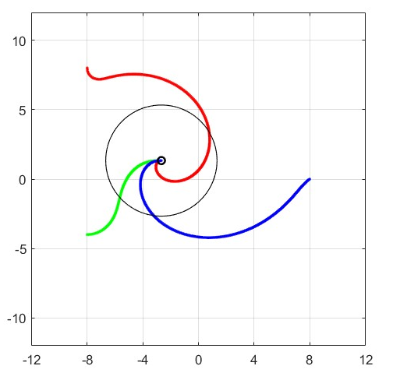
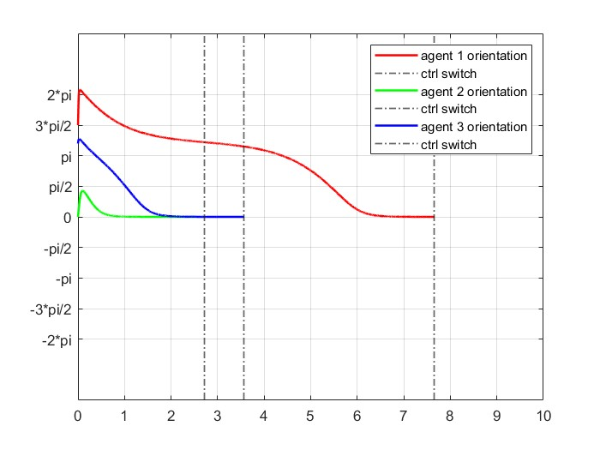
REGULATION - POSTURE
Desired behaviour is accomplished since we reach consensus point with final orientation equal to zero and at most the trajectory presents one backup manuever.

Slide 11
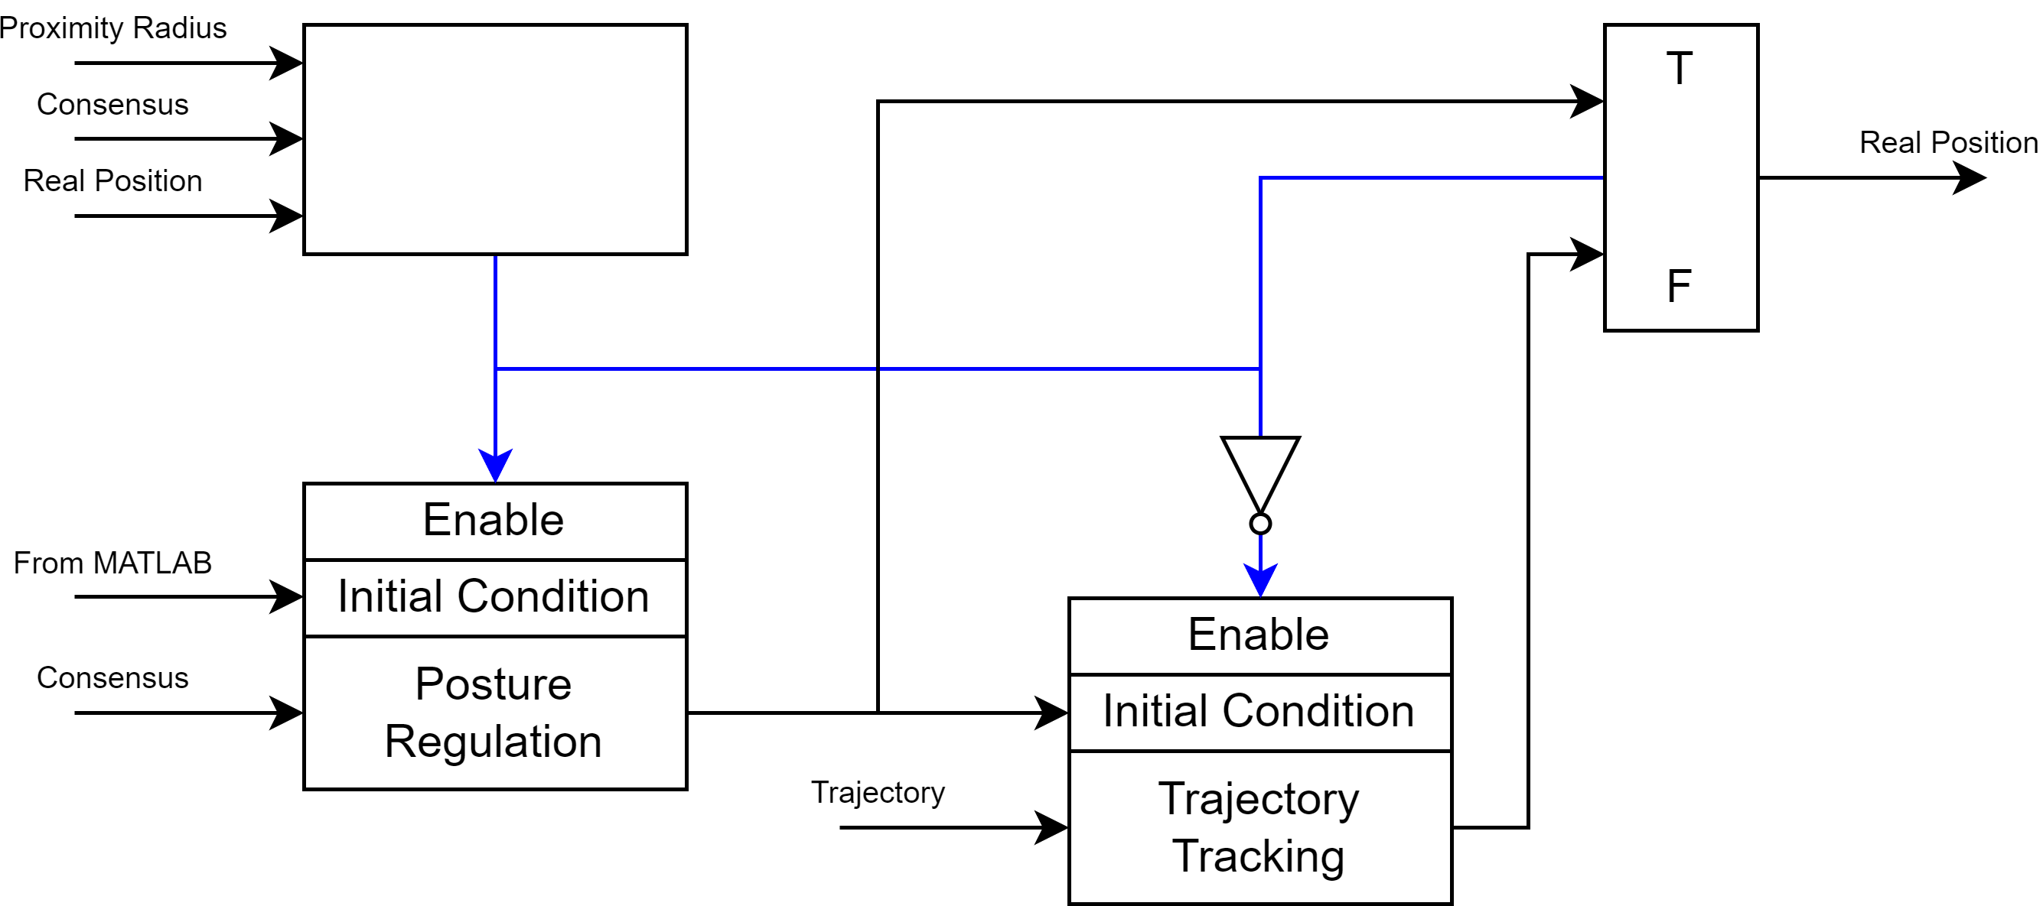



CONTROLLER SWITCH
How do we switch between posture regulation and tracking control ?
$$q$$
IMPLEMENTATION PROBLEM:
Posture regulation and tracking control are two different subsystems in Simulink !
The tracking subsytem must inherit initial conditions from the last iteration of the regulation subsystem.
Transition between controllers must be smooth. We should avoid sudden changes in orientation and velocity.
$$\left|p_{d}−p\right|≥r$$
$$q$$

Slide 12
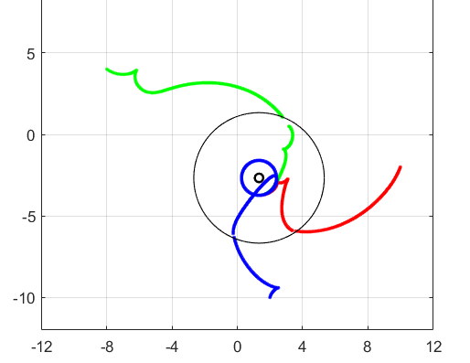
CONTROLLER SWITCH
EXAMPLE OF NON SMOOTH TRANSITION
THIS CAN BE AVOIDED WITH PROPER TUNING

Slide 13
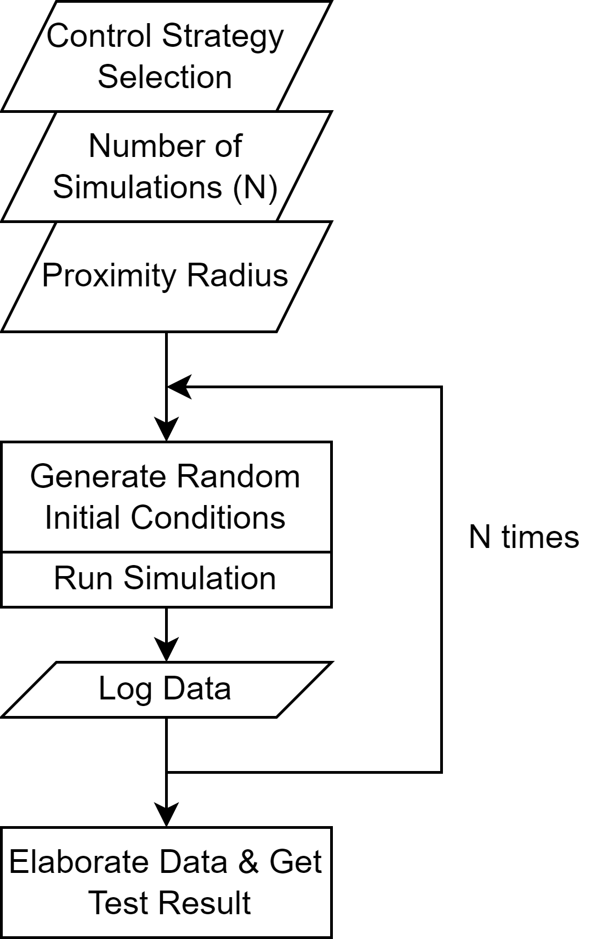
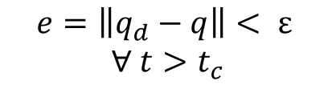
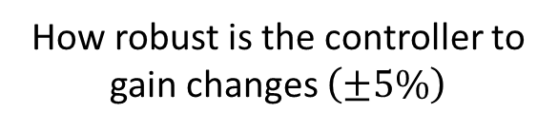
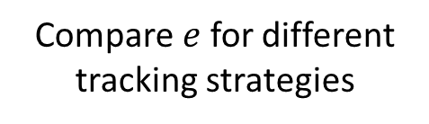
TESTS & EVALUATION PROCEDURE
CONVERGENCE TEST:
$$e=\left\|q_{d}−q\right\|< ε$$
$∀ t>t_{c}$
PROXIMITY TEST:
Compare $e$ for different tracking strategies
SMOOTHNESS TEST:
Evaluate the agents’ path smoothness
SENSITIVITY TEST:
How robust is the controller to gain changes $\left(±5\%\right)$

Slide 14
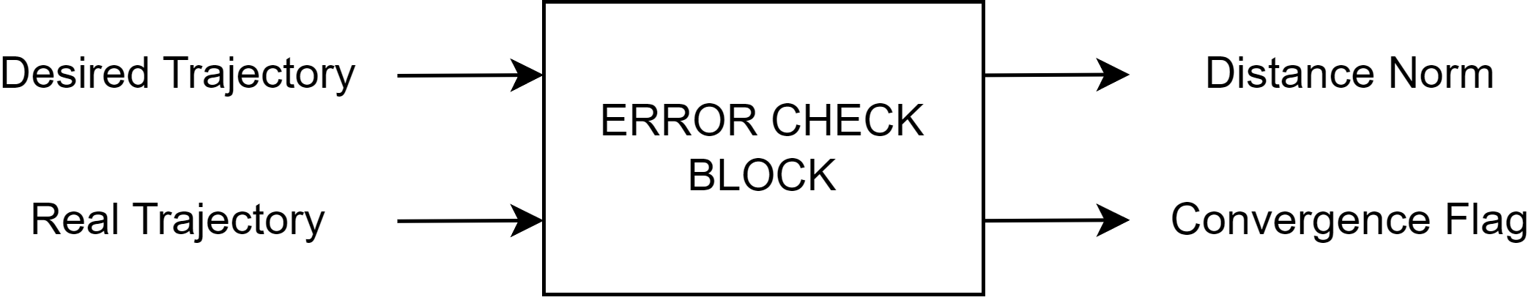
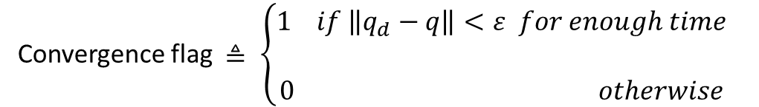

ERROR CHECK BLOCK
For easy and automatic evaluation of controller functionality a simple block is implemented:
Convergence flag $≜ \left\{\begin{aligned}1 if \left\|q_{d}−q\right\|<ε for enough time \\ \\ 0 otherwise\end{aligned}\right.$
We set $ε=1$

Slide 15

CONVERGENCE AND PROXIMITY TESTS
1
Perform N simulations starting from random initial positions and for each simulation collect the output of error check block
2
Convergence score is given by the following equation:
$$Score=\frac{Successful Runs}{N}$$
3
Compute the average time to reach proper tracking and average distance from desired trajectory at flag switch
ONLY USE SUCCESSFUL RUNS!

Slide 16

SENSITIVITY TEST
1
Perform N simulations
starting from random initial positions
slightly changing control parameters
for each simulation collect the output of
error check block
2
Convergence score is given by the following equation:
$$Score=\frac{Successful Runs}{N}$$

Slide 17
SMOOTHNESS TEST
Since the description of «smooth path» can be very generic and its definition can become cumbersome and hard to automate, the evaluation of this property is performed manually for a small number of runs.
Path characteristics considered for the evaluation:
Inversion manouvers
Sudden changes to speeds
Discontinuities (due to improper gain tuning)

Slide 18
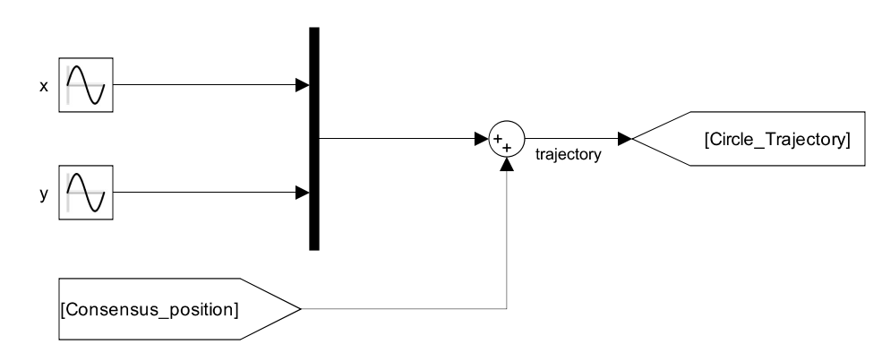





TRACKING: CIRCULAR TRAJECTORY
p_{d} = (x_{d} , y_{d})
(x_{C} , y_{C})
$Consensus position=(x_{c}$, $y_{c})$
$r=1 [m]$
CENTER
RADIUS
$$\left\{\begin{aligned}&x_{d}=x_{c}+sin⁡(t) \\ &y_{d}= y_{c}+sin⁡(t+\frac{π}{2})\end{aligned}\right.$$
$$ω=1 [\frac{rad}{s}]$$
FREQUENCY
TRAJECTORY

Slide 19
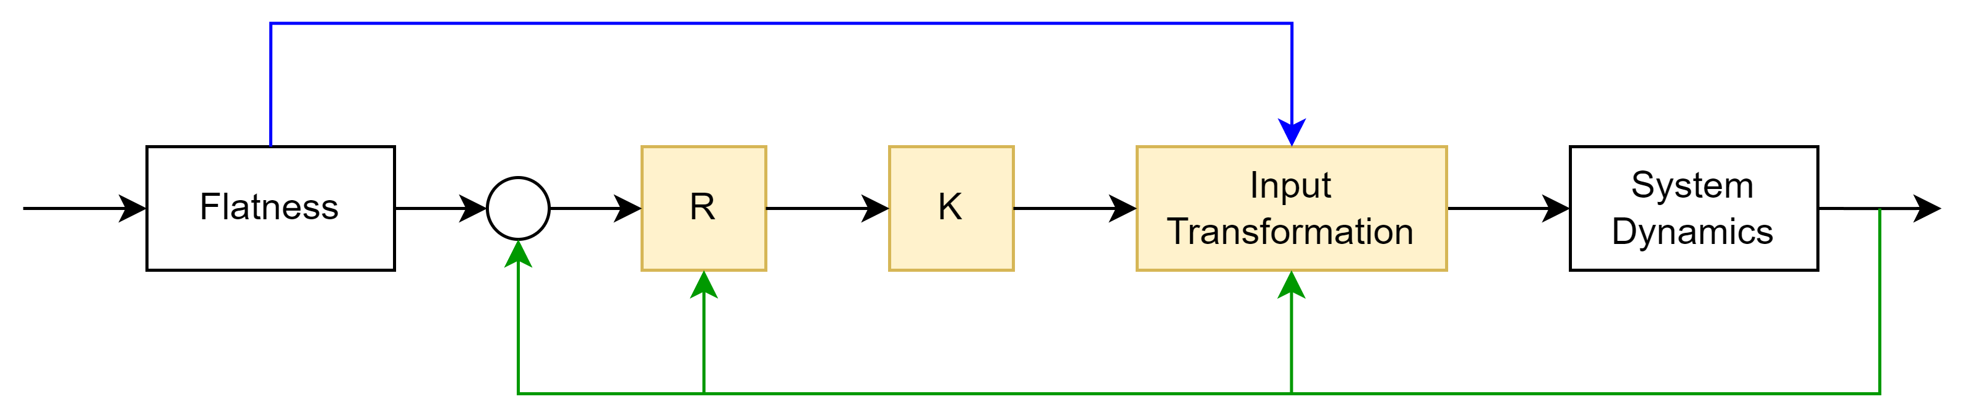



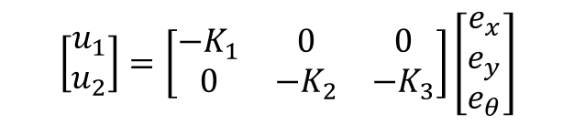





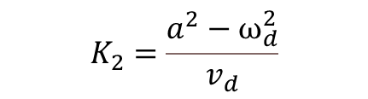





LINEAR CONTROLLER - IMPLEMENTATION
$$v_{d},ω_{d}$$
$$p_{d}$$
$$+$$
$$e$$
$$u$$
$$v,ω_{ }$$
$$q$$
$$q_{d}$$
$$−$$
$$θ$$
$$θ$$
$$\left[\begin{matrix}u_{1} \\ u_{2}\end{matrix}\right]=\left[\begin{matrix}{−K}_{1} & 0 & 0 \\ 0 & −K_{2} & {−K}_{3}\end{matrix}\right]\left[\begin{matrix}e_{x} \\ e_{y} \\ e_{θ}\end{matrix}\right]$$
CONTROL LAW
We expect asymptotically stable control law since we have a circular trajectory to follow
$$K_{1}=K_{3}=2ξa$$
CONTROL GAINS
$$K_{2}=\frac{a^{2}−ω_{d}^{2}}{v_{d}}$$
$$\left\{\begin{aligned}&v=v_{d}cose_{θ}−u_{1} \\ &ω= ω_{d}−u_{2}\end{aligned}\right.$$
INPUT TRANSFORMATION

Slide 20
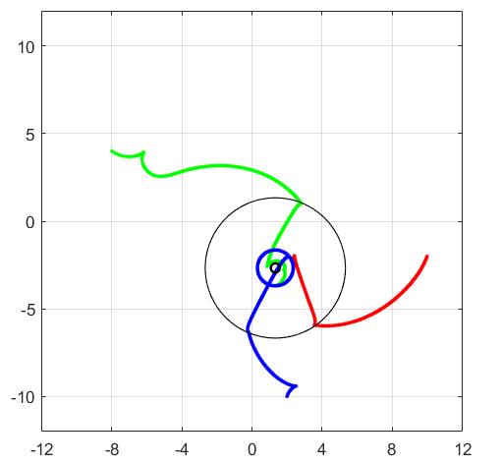
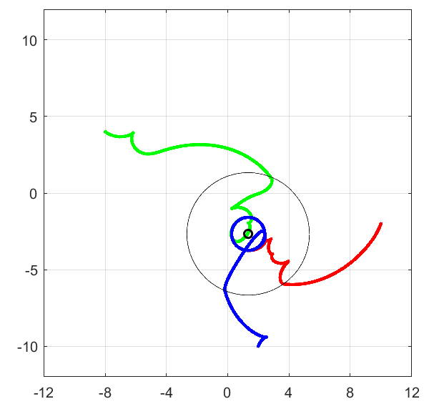
LINEAR CONTROLLER - RESULTS
CONVERGENCE TEST
90%
SENSITIVITY TEST
86.67%
PROXIMITY TEST (avg error)
0.240

Slide 21
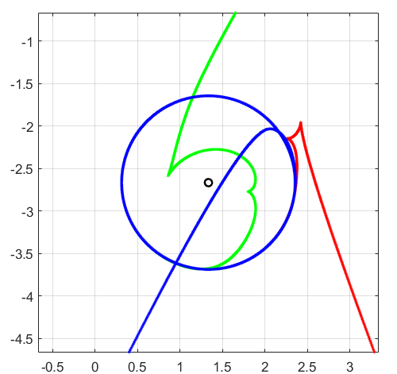
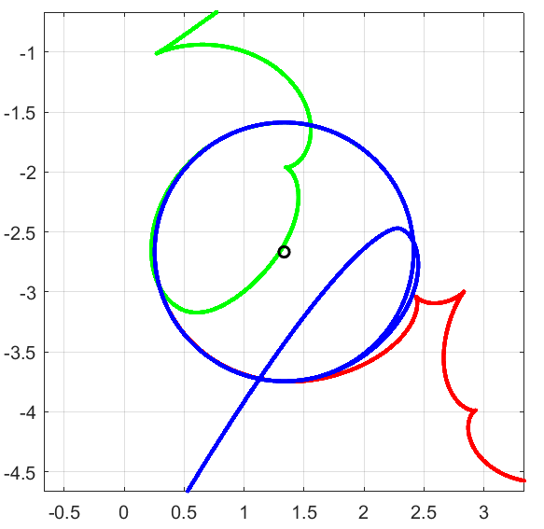
LINEAR CONTROLLER - RESULTS

Slide 22
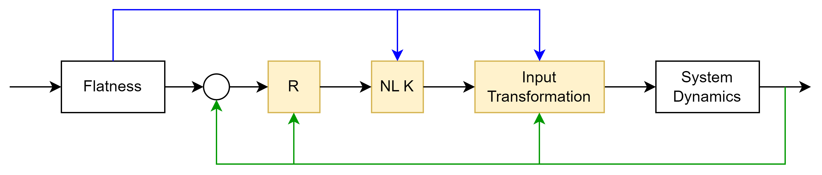







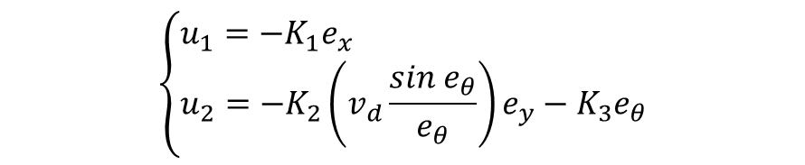




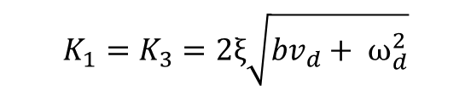


NON-LINEAR CONTROLLER - IMPLEMENTATION
$$v_{d},ω_{d}$$
$$p_{d}$$
$$+$$
$$e$$
$$u$$
$$v,ω_{ }$$
$$q$$
$$q_{d}$$
$$−$$
$$θ$$
$$θ$$
$$\left\{\begin{aligned}&u_{1}={−K}_{1}e_{x} \\ &u_{2}={−K}_{2}\left(v_{d}\frac{sin e_{θ}}{e_{θ}}\right)e_{y}−K_{3}e_{θ}\end{aligned}\right.$$
CONTROL LAW
We expect asymptotically stable control law from application of Barbalat’s Lemma
$$K_{1}=K_{3}=2ξ\sqrt{bv_{d}+ ω_{d}^{2}}$$
CONTROL GAINS
$$K_{2}=b$$
$$\left\{\begin{aligned}&v=v_{d}cose_{θ}−u_{1} \\ &ω= ω_{d}−u_{2}\end{aligned}\right.$$
INPUT TRANSFORMATION

Slide 23
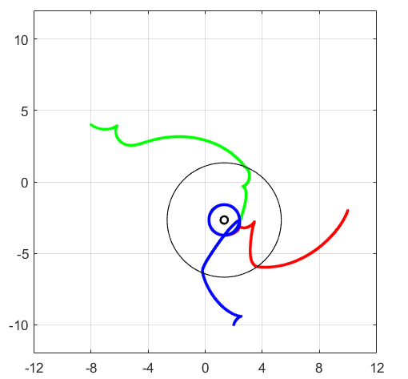
NON-LINEAR CONTROLLER - RESULTS
CONVERGENCE TEST
100%
SENSITIVITY TEST
100%
PROXIMITY TEST (avg error)
0.235

Slide 24
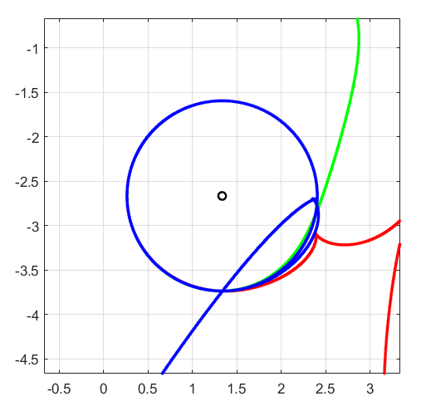
NON-LINEAR CONTROLLER - RESULTS

Slide 25
STATE-ERROR CONTROLLERS – IMPLEMENTATION ISSUES
UNWRAP in differential flatness block for angle theta computation
DERIVATIVES computation in differential flatness block
PARAMETERS tuning via trial and error method

Slide 26
THIS IS THE EXPLANATION – HIDDEN SLIDE
Unwrap: used to avid discontinuity in angle computation. Discontinuities lead to unexpected behaviour of the system.
First order high pass filter.
Large alphas increase the control action. Excessive control action leads to slow convergence time to the desired trajectory and more backup manuevers.

Slide 27
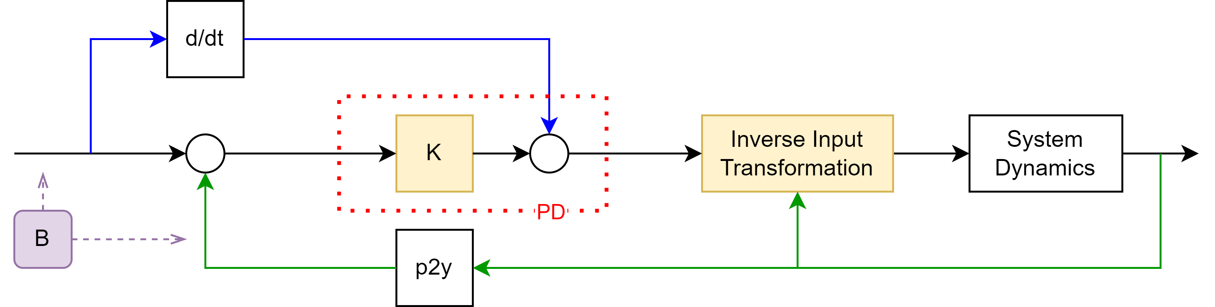





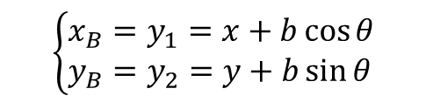
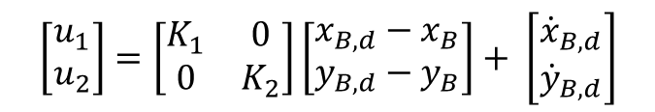





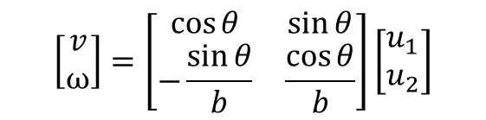


SAGITTAL CONTROLLER - IMPLEMENTATION
$$\dot{y_{d}}$$
$$y_{d}$$
$$+$$
$$e_{y}$$
$$u_{ }$$
$$v,ω_{ }$$
$$q$$
$$+$$
$$−$$
$$y$$
$$θ$$
$$\left\{\begin{aligned}&x_{B}=y_{1}=x+b\cos{θ} \\ &y_{B}=y_{2}=y+b\sin{θ}\end{aligned}\right.$$
P2Y TRANSFORMATION
$$\left\{\begin{aligned}&{\dot{x}}_{B}=u_{1} \\ &{\dot{y}}_{B}=u_{2}\end{aligned}\right.$$
We expect smooth trajectory and tuning flexibility, since we have decoupled dynamics and feedforward action
NEW DYNAMICS
$$\left[\begin{matrix}u_{1} \\ u_{2}\end{matrix}\right]=\left[\begin{matrix}K_{1} & 0 \\ 0 & K_{2}\end{matrix}\right]\left[\begin{matrix}x_{B,d}−x_{B} \\ y_{B,d}−y_{B}\end{matrix}\right]+ \left[\begin{matrix}{\dot{x}}_{B,d} \\ {\dot{y}}_{B,d}\end{matrix}\right]$$
CONTROL LAW
$$\left[\begin{matrix}v \\ ω\end{matrix}\right]=\left[\begin{matrix}\cos{θ} & \sin{θ} \\ −\frac{\sin{θ}}{b} & \frac{\cos{θ}}{b}\end{matrix}\right]\left[\begin{matrix}u_{1} \\ u_{2}\end{matrix}\right]$$
INPUT TRANSFORMATION

Slide 28

SAGITTAL CONTROLLER - RESULTS
CONVERGENCE TEST
100%
SENSITIVITY TEST
99.33%
PROXIMITY TEST (avg error)
0.300

Slide 29
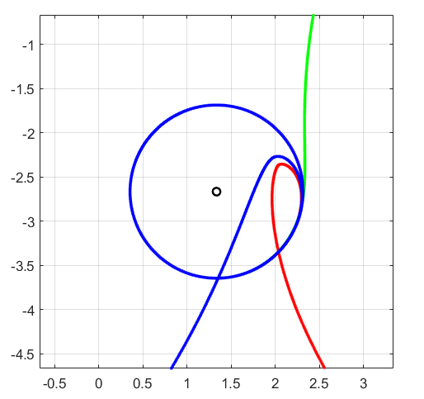
SAGITTAL CONTROLLER - RESULTS

Slide 30















D. DERIVATIVE CONTROLLER - IMPLEMENTATION
$$\dot{z_{d}}$$
$$z_{d}$$
$$+$$
$$e_{z}$$
$$u_{ }$$
$$v,ω_{ }$$
$$q$$
$$+$$
$$−$$
$$z$$
$$θ,v$$
$$\left\{\begin{aligned}&z_{1}=x \\ &z_{2}=y \\ &z_{3}=\dot{x} \\ &z_{4}=\dot{y}\end{aligned}\right.$$
P2Z TRANSFORMATION
We expect smooth trajectory and even more control flexibility
$$\left[\begin{matrix}u_{1} \\ u_{2}\end{matrix}\right]=\left[\begin{matrix}K_{1} & 0 & K_{3} & 0 \\ 0 & K_{2} & 0 & K_{4}\end{matrix}\right]\left[\begin{matrix}x_{d}−x \\ y_{d}−y \\ {\dot{x}}_{d}−\dot{x} \\ {\dot{y}}_{d}−\dot{y}\end{matrix}\right]+ \left[\begin{matrix}{\ddot{x}}_{d} \\ {\ddot{y}}_{d}\end{matrix}\right]$$
CONTROL LAW
$$\left[\begin{matrix}a \\ ω\end{matrix}\right]=\left[\begin{matrix}\cos{θ} & \sin{θ} \\ −\frac{\sin{θ}}{v} & \frac{\cos{θ}}{v}\end{matrix}\right]\left[\begin{matrix}u_{1} \\ u_{2}\end{matrix}\right]$$
INPUT TRANSFORMATION

Slide 31
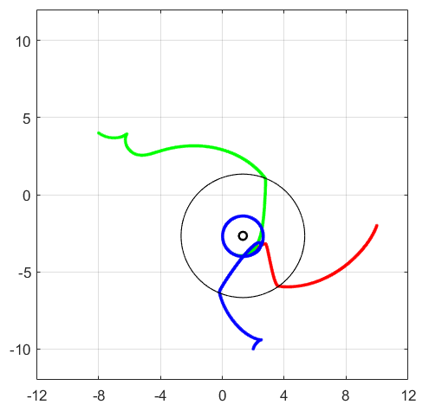
D. DERIVATIVE CONTROLLER - RESULTS
CONVERGENCE TEST
94%
SENSITIVITY TEST
78%
PROXIMITY TEST (avg error)
0.262

Slide 32
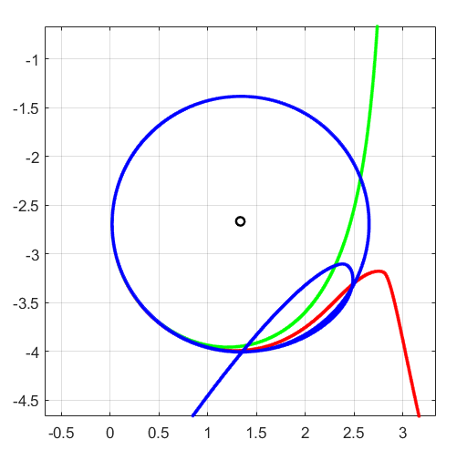
D. DERIVATIVE CONTROLLER - RESULTS

Slide 33
D. DERIVATIVE CONTROLLER - ISSUES
DERIVATIVE of STATE
Continuous time block:
Instability issues, exploding values of derivative
First order high pass filter:
Filtering high frequency components and thus avoiding too sudden variations

Slide 34

D. DERIVATIVE CONTROLLER - ISSUES
LINEAR VELOCITY
Linear velocity must be different from zero to ensure non singularity of the matrix
$$T^{−1}=\left[\begin{matrix}\cos{θ} & \sin{θ} \\ −\frac{\sin{θ}}{v} & \frac{\cos{θ}}{v}\end{matrix}\right]$$
Solution: Set the minimum linear velocity to 1e-4

Slide 35
CONTROLLER COMPARISON
 | LINEAR | NON-LINEAR | SAGITTAL | D.DERIVATIVE
TUNING | EASY | HARD | EASY | HARD
SMOOTHNESS | POOR | POOR | GOOD | GOOD
IMPL. ISSUES | FEW | FEW | FEW | MANY
CONV. TIME | 3.915 | 2.876 | 2.268 | 3.319
SENSITIVITY | MEDIUM | LOW | LOW | HIGH

Slide 36
FINAL CONSIDERATIONS
 | PRO | CONS
LINEAR | Linear dynamics Poles allocation rule | Approximation around equilibrium Differential Flatness needed Stability only for specific conditions
NON-LINEAR | No approximation needed Robustness | Non-linear dynamics Differential Flatness needed
SAGITTAL | Decoupled dynamics No differential flatness Linear control law Feedforward action | Smooth desired trajectory Theta is not controllable Choice of parameter b
DOUBLE DERIVATIVES | Decoupled dynamics No differential flatness Linear control law Feedforward action | Relies on second order derivatives Constraint on linear velocity v Sensitivity

