Slide 1
Robotics and Control 2
Cristian Lorenzi – IL GOAT
Filippo Gottardo – THE DUNGEON MASTER
Giulia Pegoraro – THE C1 ENGLISH TEACHER
Edoardo Di Pietrantonio

Slide 2
THE PROBLEM
3 mobile robotic agents should agree on a rendez-vous point, then, when in proximity of such point, they start a tracking task over a circular trajectory.
SCENARIO SPECIFICS
All agents are unicycles;
All agents are independent from each other;
ADDITIONAL CONSTRAINTS
Agents live in a 2D grid 12x12;
Initial conditions of the agents can be randomly chosen (both position and orientation);
The final target trajectory is a circle of radius 1;
The proximity circle radius is 4 or 0.5;

Slide 3
SOLUTION APPROACH
THREE STEPS PROCEDURE:
Consensus - before moving
Regulation – until proximity to rendez-vouz point
Tracking – until the end of the simulation
This algorithm is applied to each agent INDEPENDENTLY.
REGULATION CONTROL will be validated before applying it to the final solution system.
TRACKING CONTROL will be implemented using different control strategies:
Linearization of state error dynamics
Non-linear controller of state error dynamics
Feedback linearization based on a reference point on the sagittal axis
Feedback linearization based on second order derivatives
Each one will be validated using the same methodologies and compared in order to draw final conclusions.

Slide 4
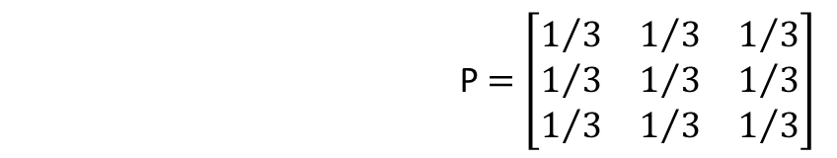
CONSENSUS
The consensus point is computed before any movement, based on the initial position of each agent.
The adopted strategy is AVERAGE CONSENSUS, meaning we compute the center of mass of the agents as rendez-vous point.
MISSING IMAGE
P $=\left[\begin{matrix}1/3 & 1/3 & 1/3 \\ 1/3 & 1/3 & 1/3 \\ 1/3 & 1/3 & 1/3\end{matrix}\right]$

Slide 5
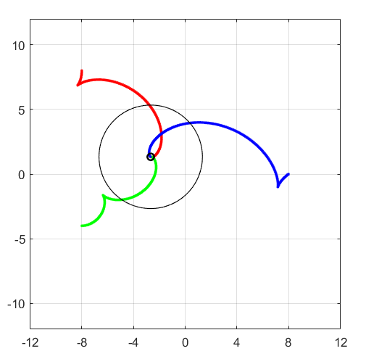
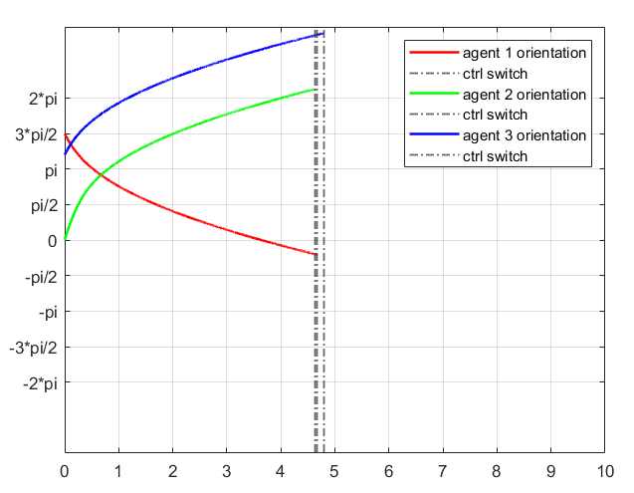
REGULATION - CARTESIAN
GOAL: reach the desired target configuration
q = [0, 0, ?]

Slide 6
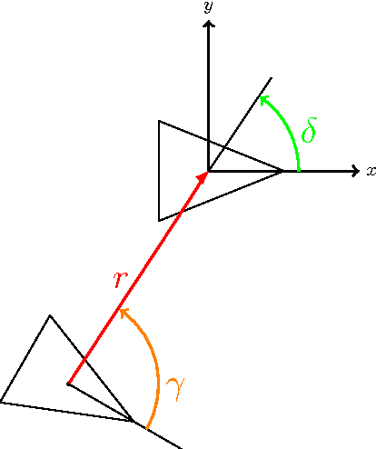
REGULATION - POSTURE
GOAL: reach the desired target configuration
q = [0, 0, 0]
TWO OPTIONS:
Control Law with singularity at the origin
Control Law without singularity at the origin
In our scenario we will implement the latter

Slide 7
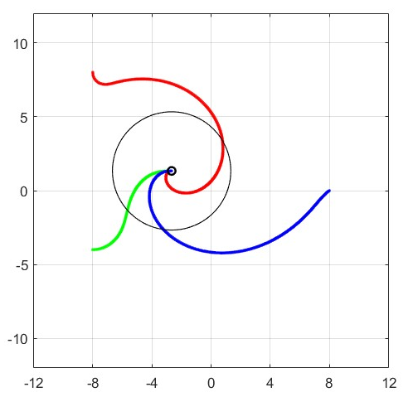
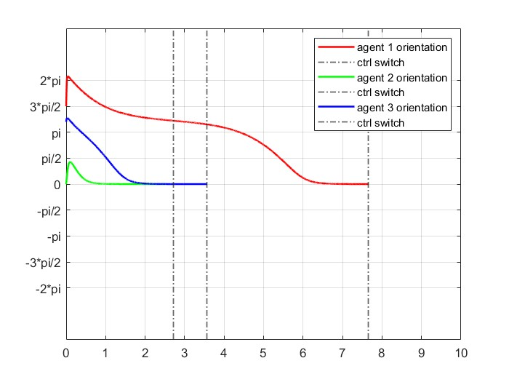
REGULATION - POSTURE
Desired behaviour is accomplished since we reach consensus point with final orientation equal to zero and at most the trajectory presents one backup manuever.

Slide 8
CONTROLLER SWITCH
How do we switch between posture regulation and tracking control?
A simulink block is responsible for checking if we are inside a fixed proximity radius, in which case it switches controller
Proximity radius is set to 4
IMPLEMENTATION PROBLEMS
Posture regulation and tracking control are two different subsystems in Simulink.
The tracking subsytem must inherit initial conditions from the last iteration of the regulation subsystem.
Transition between controllers must be smooth. We should avoid sudden changes in orientation and velocity.

Slide 9
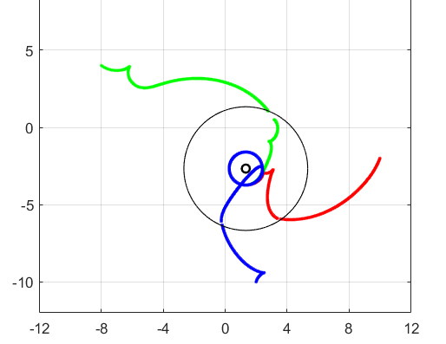
CONTROLLER SWITCH
EXAMPLE OF NON SMOOTH TRANSITION – CAN BE AVOIDED WITH PROPER TUNING

Slide 10
TESTING PROCEDURE
CONVERGENCE TEST – tests if the controller strategy works and how quickly the agents move to the desired position/trajectory
SMOOTHNESS TEST – tests the smoothness of the agents paths
SENSITIVITY TEST – tests the robustness of the controllers to small changes of gain values
PROXIMITY TEST – tests how close the agents are to the desired trajectory
Each test (except for the smoothness test) is automated via MatLab livescript.
The smoothness test was impossible to automate since the final results could only be interpreted by a human depending on his needs (trajectory path).
Each trajectory tracking controller was tested using this procedure.

Slide 11
CONVERGENCE AND PROXIMITY TESTS
A Simulink Block named «Error Check> is responsible for:
Collecting the distance of the agent from the desired trajectory
Checking if the distance is below a given threshold, in that case we say that proper tracking is achieved.
The test is divided in steps:
Perform N simulations with random initial conditions and collect data from «Error Check» block
To compute the convergence score just verify how many times proper tracking is achieved over N simulations
If proper tracking is achieved proximity test returns the distance from desired trajectory and the time needed to reach proper tracking

Slide 12
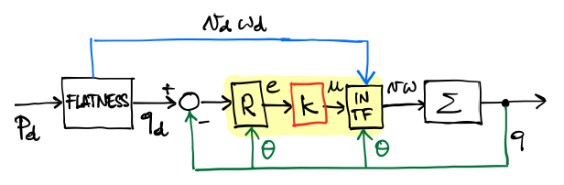
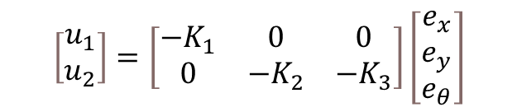

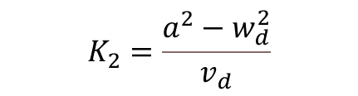

LINEAR CONTROLLER - IMPLEMENTATION
$$\left[\begin{matrix}u_{1} \\ u_{2}\end{matrix}\right]=\left[\begin{matrix}{−K}_{1} & 0 & 0 \\ 0 & −K_{2} & {−K}_{3}\end{matrix}\right]\left[\begin{matrix}e_{x} \\ e_{y} \\ e_{θ}\end{matrix}\right]$$
CONTROL LAW
We expect asympatotically stable control law since the desired trajectory is circular
$$K_{1}=K_{3}=2εa$$
CONTROL GAINS
$$K_{2}=\frac{a^{2}−w_{d}^{2}}{v_{d}}$$
$$\left\{\begin{aligned}&v=v_{d}cose_{θ}−u_{1} \\ &w= w_{d}−u_{2}\end{aligned}\right.$$
INPUT TRANSFORMATION

Slide 13
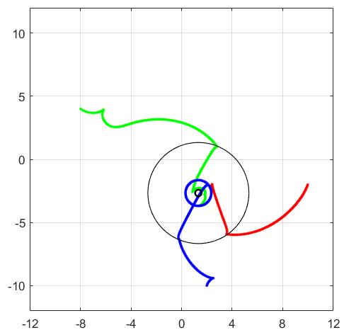
LINEAR CONTROLLER - RESULTS
CONVERGENCE TEST
00
SENSITIVITY TEST
000
PROXIMITY TEST (avg error)
000

Slide 14
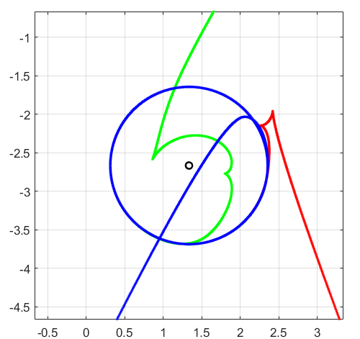
LINEAR CONTROLLER - RESULTS

Slide 15
LINEAR CONTROLLER – IMPLEMENTATION ISSUES
UNWRAP in differential flatness block for angle theta computation
DERIVATIVES computation in differential flatness block
ALPHA tuning via trial and error method

Slide 16
THIS IS THE EXPLANATION – HIDDEN SLIDE
Unwrap: used to avid discontinuity in angle computation. Discontinuities lead to unexpected behaviour of the system.
First order high pass filter
Large alphas increase the control action. Excessive control action leads to slow convergence time to desired trajectory and more backup manuevers

Slide 17
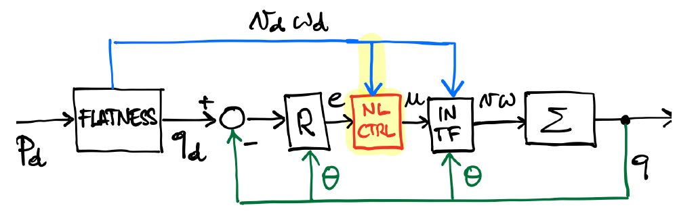


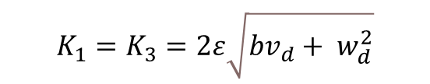

NON-LINEAR CONTROLLER - IMPLEMENTATION
$$\left\{\begin{aligned}&u_{1}={−K}_{1}e_{x} \\ &u_{2}={−K}_{2}\left(v_{d}\frac{sin e_{θ}}{e_{θ}}\right)e_{y}−K_{3}e_{θ}\end{aligned}\right.$$
CONTROL LAW
We expect asympatotically stable control law since desired linear velocity and angular velocity are nevere convergin to zero together
$$K_{1}=K_{3}=2ε\sqrt{bv_{d}+ w_{d}^{2}}$$
CONTROL GAINS
$$K_{2}=b$$
$$\left\{\begin{aligned}&v=v_{d}cose_{θ}−u_{1} \\ &w= w_{d}−u_{2}\end{aligned}\right.$$
INPUT TRANSFORMATION

Slide 18
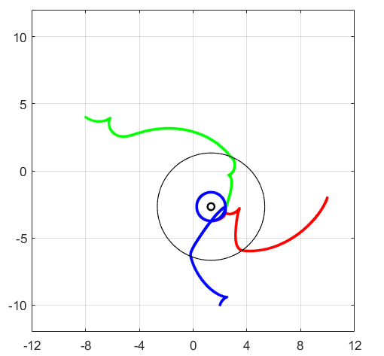
NON-LINEAR CONTROLLER - RESULTS
CONVERGENCE TEST
000
SENSITIVITY TEST
00
PROXIMITY TEST (avg error)
000

Slide 19
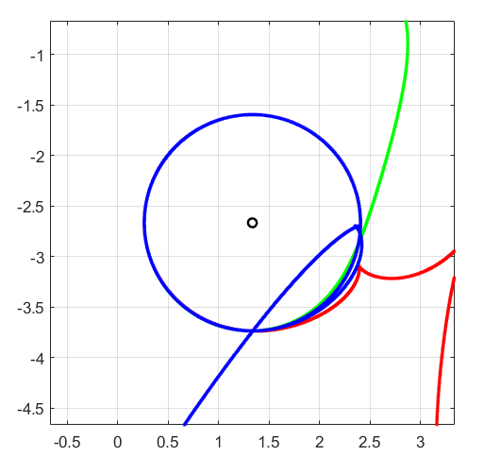
NON-LINEAR CONTROLLER - RESULTS

Slide 20
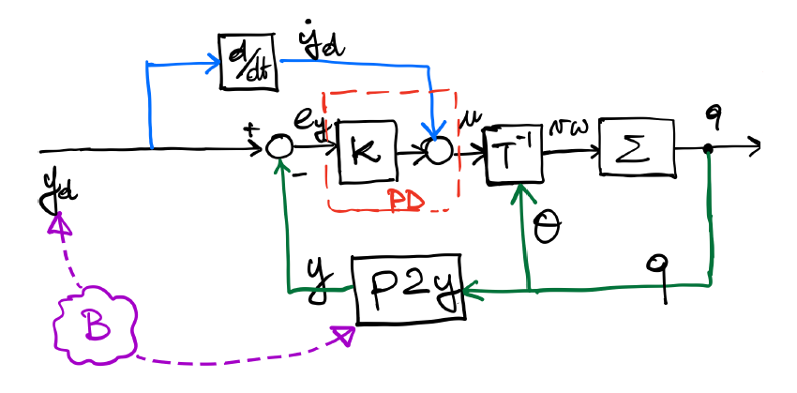
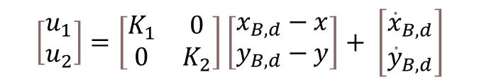
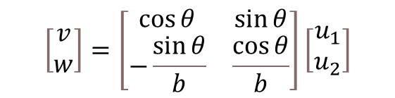

SAGITTAL CONTROLLER - IMPLEMENTATION
$$\left\{\begin{aligned}&x_{B}=x+b\cos{θ} \\ &y_{B}= y+b\sin{θ}\end{aligned}\right.$$
P2B TRANSFORMATION
We expect asympatotically stable control law
$$\left[\begin{matrix}u_{1} \\ u_{2}\end{matrix}\right]=\left[\begin{matrix}K_{1} & 0 \\ 0 & K_{2}\end{matrix}\right]\left[\begin{matrix}x_{B,d}−x \\ y_{B,d}−y\end{matrix}\right]+ \left[\begin{matrix}{\dot{x}}_{B,d} \\ {\dot{y}}_{B,d}\end{matrix}\right]$$
CONTROL LAW
$$\left[\begin{matrix}v \\ w\end{matrix}\right]=\left[\begin{matrix}\cos{θ} & \sin{θ} \\ −\frac{\sin{θ}}{b} & \frac{\cos{θ}}{b}\end{matrix}\right]\left[\begin{matrix}u_{1} \\ u_{2}\end{matrix}\right]$$
INPUT TRANSFORMATION

Slide 21

SAGITTAL CONTROLLER - RESULTS
CONVERGENCE TEST
00
SENSITIVITY TEST
000
PROXIMITY TEST (avg error)
0.00

Slide 22
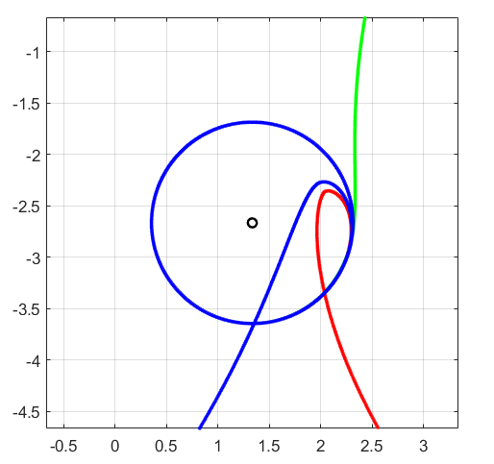
SAGITTAL CONTROLLER - RESULTS

Slide 23
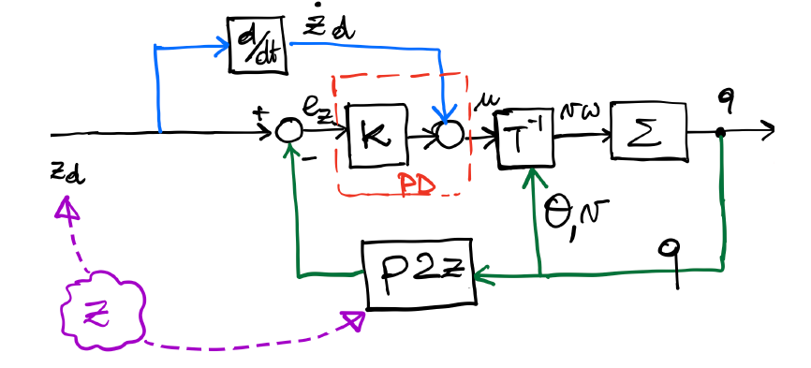



DOUBLE DERIVATIVE CONTROLLER - IMPLEMENTATION
$$\left\{\begin{aligned}&z_{1}=x \\ &z_{2}=y \\ &z_{3}=\dot{x} \\ &z_{4}=\dot{y}\end{aligned}\right.$$
P2Z TRANSFORMATION
We expect:
Asympatotically stable control law
Few Backup manuevers and smooth trajectory
$$\left[\begin{matrix}u_{1} \\ u_{2}\end{matrix}\right]=\left[\begin{matrix}K_{1} & 0 & K_{3} & 0 \\ 0 & K_{2} & 0 & K_{4}\end{matrix}\right]\left[\begin{matrix}x_{d}−x \\ y_{d}−y \\ {\dot{x}}_{d}−\dot{x} \\ {\dot{y}}_{d}−\dot{y}\end{matrix}\right]+ \left[\begin{matrix}{\dot{x}}_{d} \\ {\dot{y}}_{d}\end{matrix}\right]$$
CONTROL LAW
$$\left[\begin{matrix}a \\ w\end{matrix}\right]=\left[\begin{matrix}\cos{θ} & \sin{θ} \\ −\frac{\sin{θ}}{v} & \frac{\cos{θ}}{v}\end{matrix}\right]\left[\begin{matrix}u_{1} \\ u_{2}\end{matrix}\right]$$
INPUT TRANSFORMATION

Slide 24
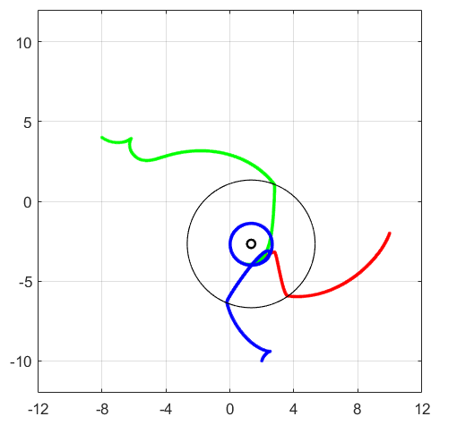
DOUBLE DERIVATIVE CONTROLLER - RESULTS
CONVERGENCE TEST
000
SENSITIVITY TEST
000
PROXIMITY TEST (avg error)
0.00

Slide 25
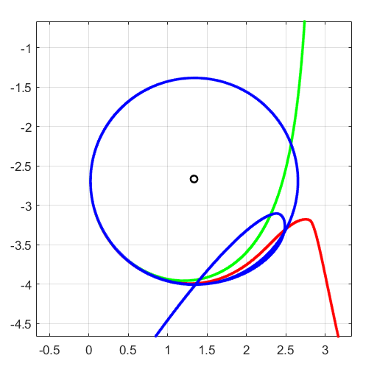
D. DERIVATIVE CONTROLLER - RESULTS

Slide 26
D. DERIVATIVE CONTROLLER - ISSUES
DERIVATIVE of STATE
Continuous time block:
Instability issues, exploding values of derivative
First order high pass filter:
Filters high frequency components thus avoiding too sudden variations

Slide 27
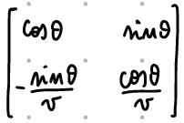
D. DERIVATIVE CONTROLLER - ISSUES
LINEAR VELOCITY
Linear velocity must be different from zero to ensure non singularity of the matrix
Solution: Set the minimum linear velocity to 1e-4

Slide 28
CONTROLLER COMPARISON
 | LINEAR | NON-LINEAR | SAGITTAL | D.DERIVATIVE
TUNING | EASY | EASY | HARD | HARD
SMOOTHNESS | POOR | POOR | GOOD | GOOD
IMPL. ISSUES | FEW | FEW | FEW | MANY
CONV. SPEED

Slide 29
FINAL CONSIDERATIONS
 | PRO | CONS
LINEAR | Linear dynamics Poles allocation rule | Sensitivity Approximation around equilibrium Differential Flatness needed Stability only for specific conditions
NON-LINEAR | No approximation needed Non linear control law | Non-linear dynamics Differential Flatness needed
SAGITTAL | Decoupled dynamics No differential flatness Linear control law | Smooth desired trajectory Theta is not controllable Constraint on b
DOUBLE DERIVATIVES | Decoupled dynamics No differential flatness Linear control law | Relies on second order derivatives Constraint on linear velocity v

